Slide 1
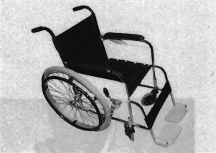

Slide 2
(A) This is a picture of a motorcycle.
(B) This is a picture of a chair.
(C) This is a picture of a wheelchair.
(D) This is a picture of a bicycle.

Slide 3
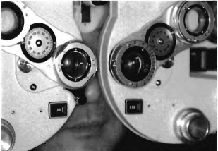

Slide 4
(A) This man is wearing glasses.
(B) He is looking into a movie camera.
(C) He is using a computer.
(D) The man is checking his eyesight.

Slide 5
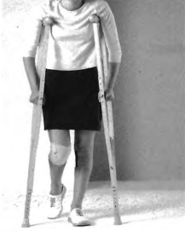

Slide 6
(A) The woman has an injured arm.
(B) She has an injured knee.
(C) The woman has an injured foot.
(D) She injured her wrist.

Slide 7
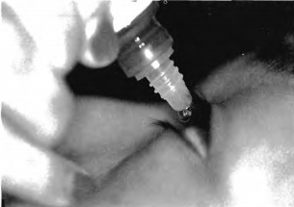

Slide 8
(A) The woman is looking in a bottle.
(B) The woman is crying.
(C) She is looking into a telescope.
(D) She is putting medicine in her eye.

Slide 9
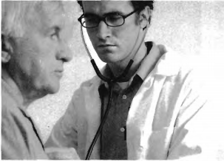

Slide 10
(A) The man in white is a doctor.
(B) The man in white is a businessman.
(C) The man in white is a cook.
(D) The man in white is a teacher.

