Slide 1
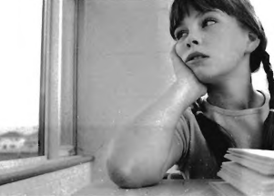

Slide 2
(A) The girl looks happy.
(B) The girl is sleepy.
(C) The girl is angry.
(D) The girl is looking out the window.

Slide 3
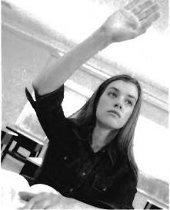

Slide 4
(A) The girl is telling a joke.
(B) She has an injured arm.
(C) She is asking a question.
(D) The girl is reading a book.

Slide 5
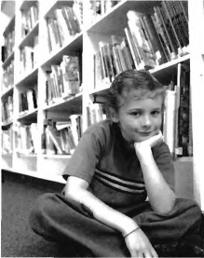

Slide 6
(A)The boy is in the kitchen.
(B) He is in the library.
(C) He is in a classroom.
(D) He is at the hospital.

Slide 7
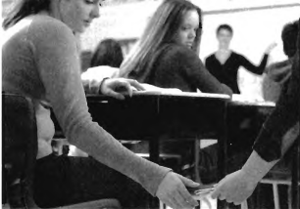

Slide 8
(A) The students are passing notes.
(B) The boy and girl are holding hands.
(C) They are studying.
(D) The students are eating lunch.

Slide 9
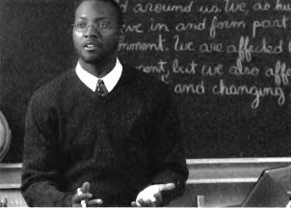

Slide 10
(A) The man is at his desk.
(B) He is in his office.
(C) The man is by the entrance.
(D) The man is near the board.

