Slide 1
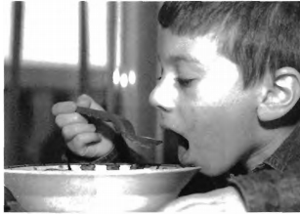

Slide 2
(A) The boy is watching television.
(B) The boy is doing homework.
(C) The boy is eating.
(D) The boy is making lunch.

Slide 3
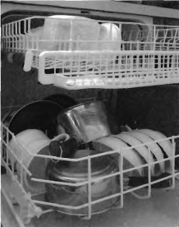

Slide 4
(A) The box is full of toys.
(B) The bowls and plates are broken.
(C) The dishwasher is almost full.
(D) The dishes are in the refrigerator.

Slide 5
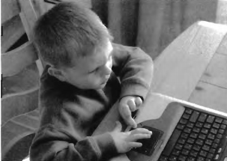

Slide 6
(A) The boy is in front of the computer.
(B) The boy is looking behind the computer.
(C) The computer is next to a desk.
(D) The boy is fixing the computer.

Slide 7
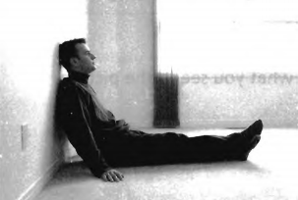

Slide 8
(A) The man is sitting by the bed.
(B) The curtains are closed.
(C) There is no furniture in the room.
(D) The man is watching television.

Slide 9
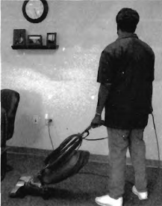

Slide 10
(A) The man is cleaning the room.
(B) They are having a party.
(C) The man is in the garden.
(D) The man has a car.

