Slide 1
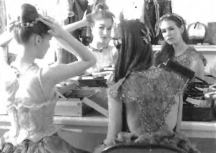

Slide 2
(A) The actresses are making a movie.
(B) They are leaving the theater.
(C) The two women are watching a show.
(D) The actresses are in costume.

Slide 3
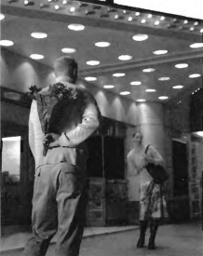

Slide 4
(A) The man is holding flowers.
(B) The man gave the woman flowers.
(C) The movie theater is closed.
(D) There are many people waiting in line.

Slide 5
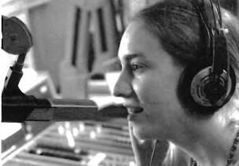

Slide 6
(A) The woman is wearing headphones.
(B) The woman is singing on stage.
(C) She is speaking to a small audience.
(D) She is turning on the machine.

Slide 7
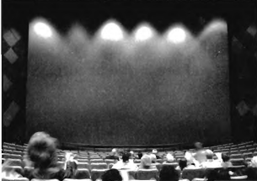

Slide 8
(A) The people are watching a movie.
(B) The people are making a sign.
(C) The people are in a theater.
(D) The people are buying tickets.

Slide 9
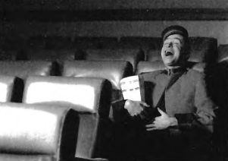

Slide 10
(A) The man is selling tickets.
(B) The man is watching a sad movie.
(C) The man is laughing.
(D) The man is sitting at home.

