Slide 1
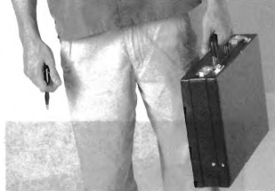

Slide 2
(A) The man is holding a backpack.
(B) He is carrying a suitcase.
(C) He is holding a box.
(D) The man is carrying a briefcase.

Slide 3
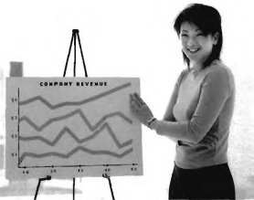

Slide 4
(A) The woman is giving a presentation.
(B) The woman is drawing a picture.
(C) She is changing clothes.
(D) She is serving food.

Slide 5
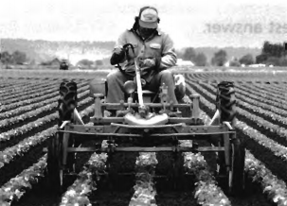

Slide 6
(A) The man is in a sports stadium.
(B) He is near an office building.
(C) He is on a farm.
(D) He is in a city.

Slide 7
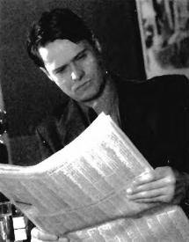

Slide 8
(A) The man is reading the paper.
(B) He is reading a book.
(C) The man is exercising.
(D) He is eating lunch.

Slide 9
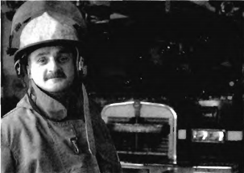

Slide 10
(A) He is a police officer.
(B) He is a doctor.
(C) He is a firefighter.
(D) He is a teacher

