Slide 1
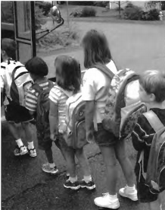

Slide 2
(A) The children are waiting to get on the bus.
(B) The kids are eating lunch.
(C) A girl is getting off the bus.
(D) The bus is stuck in traffic.

Slide 3
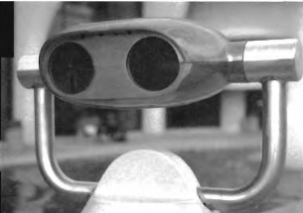

Slide 4
(A) The telescope is being used.
(B) The weather is not good.
(C) The view looks out on a park.
(D) This is used to see things far away.

Slide 5
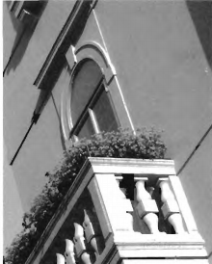

Slide 6
(A) There are two people on the balcony.
(B) The flowers are around the room.
(C) There are flowers on the balcony.
(D) The hotel has few guests.

Slide 7
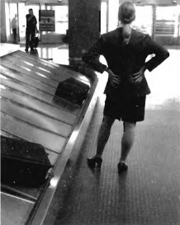

Slide 8
(A) The woman is waiting for her luggage.
(B) The woman is checking in her luggage.
(C) The woman is walking with her luggage.
(D) The luggage is next to the door.

Slide 9
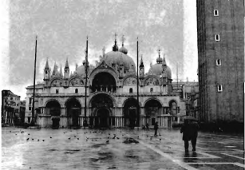

Slide 10
(A) There are many tourists in front of the building.
(B) There are very few people in front of the building
(C) The weather is hot and sunny.
(D) The people are dancing.

