Slide 1
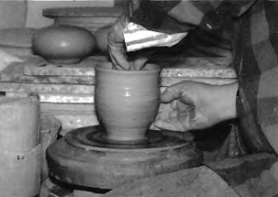

Slide 2
(A) The person is cooking food.
(B) The person is planting a flower.
(C) The person is working with clay.
(D) The person is playing a musical instrument.

Slide 3
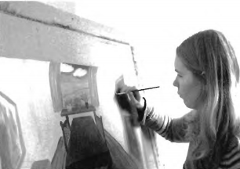

Slide 4
(A) The girl is looking in a mirror.
(B) She is reading a book.
(C) She is painting a picture.
(D) The girl is using a computer.

Slide 5
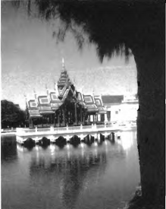

Slide 6
(A) The building is on the lake.
(B) The building is in the mountains.
(C) The building is in the field.
(D) The building is in the forest.

Slide 7
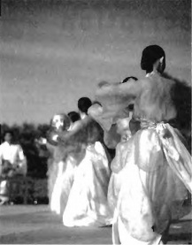

Slide 8
(A) These women are dancing.
(B) They are playing sports.
(C) These women are walking to school.
(D) They are swimming.

Slide 9
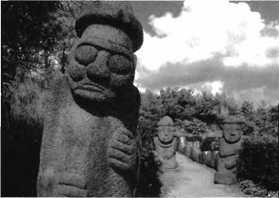

Slide 10
(A) This is a picture of some trees.
(B) These are a few statues.
(C) These are tourists on holiday.
(D) These are actors in a movie

