Slide 1
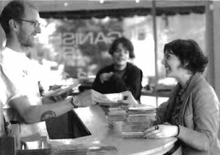

Slide 2
(A) The woman is listening to music.
(B) The woman is buying some CDs.
(C) The woman is holding a CD.
(D) The woman is recording a CD.

Slide 3
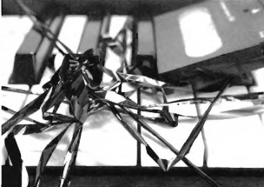

Slide 4
(A) The cassette tape is damaged.
(B) The cassette tape is brand-new.
(C) The cassette tape is on sale.
(D) There are many cassette tapes on the keyboard.

Slide 5
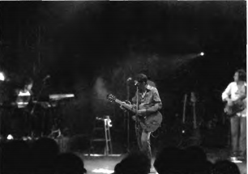

Slide 6
(A) There are many fans on the stage.
(B) There is no one on the stage.
(C) There are some musicians on the stage.
(D) There are several bands on the stage.

Slide 7
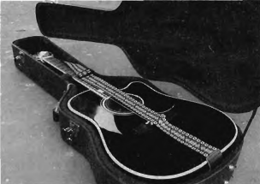

Slide 8
(A) The guitar is in its case.
(B) The guitar is under the table.
(C) The guitar is against the wall.
(D) The guitar is broken.

Slide 9
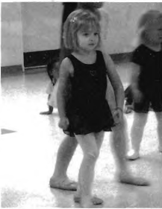

Slide 10
(A) The children are studying.
(B) The children are fighting.
(C) The children are playing music.
(D) The children are learning to dance

