Slide 1
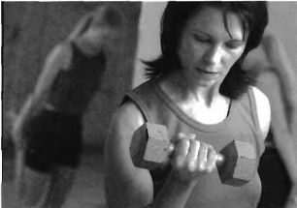

Slide 2
(A) The woman is dancing.
(B) She is playing guitar.
(C) She is rock climbing.
(D) The woman is weight-lifting.

Slide 3
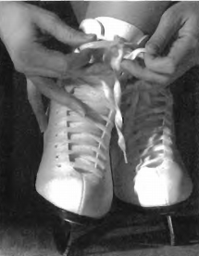

Slide 4
(A) The person is putting on ice-skates.
(B) The person is putting on shoes.
(C) The person is taking off her running shoes.
(D) The person is taking off her socks.

Slide 5
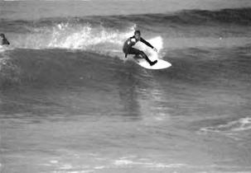

Slide 6
(A) The surfer is beside his board.
(B) The surfer is in the water.
(C) The surfer is on his board.
(D) The surfer is on the beach.

Slide 7
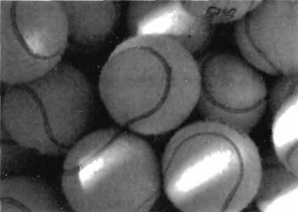

Slide 8
(A) These are basketballs.
(B) They are bowling balls.
(C) They are tennis balls.
(D) These are golf balls.

Slide 9
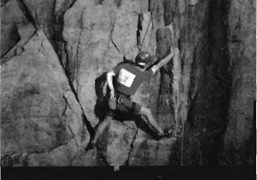

Slide 10
(A) The man is falling down.
(B) The man is going to work.
(C) He is climbing the rocks.
(D) He is jumping in the air

