Slide 1
Pneumonia Detection Using CNN
Motivation:
Pneumonia detection from X-rays requires medical review
AI can support faster screening, save time and resources
Main Idea:
Use CNN to classify X-ray images
Output: NORMAL or PNEUMONIA
Result:
78.82% accuracy

Slide 2
Project Overview
Problem:
Manual X-ray review take time, even days to receive results
Goal:
Build an AI image classifier using deep learning
Flow:
Chest X-Ray → CNN → Diagnosis Prediction

Slide 3
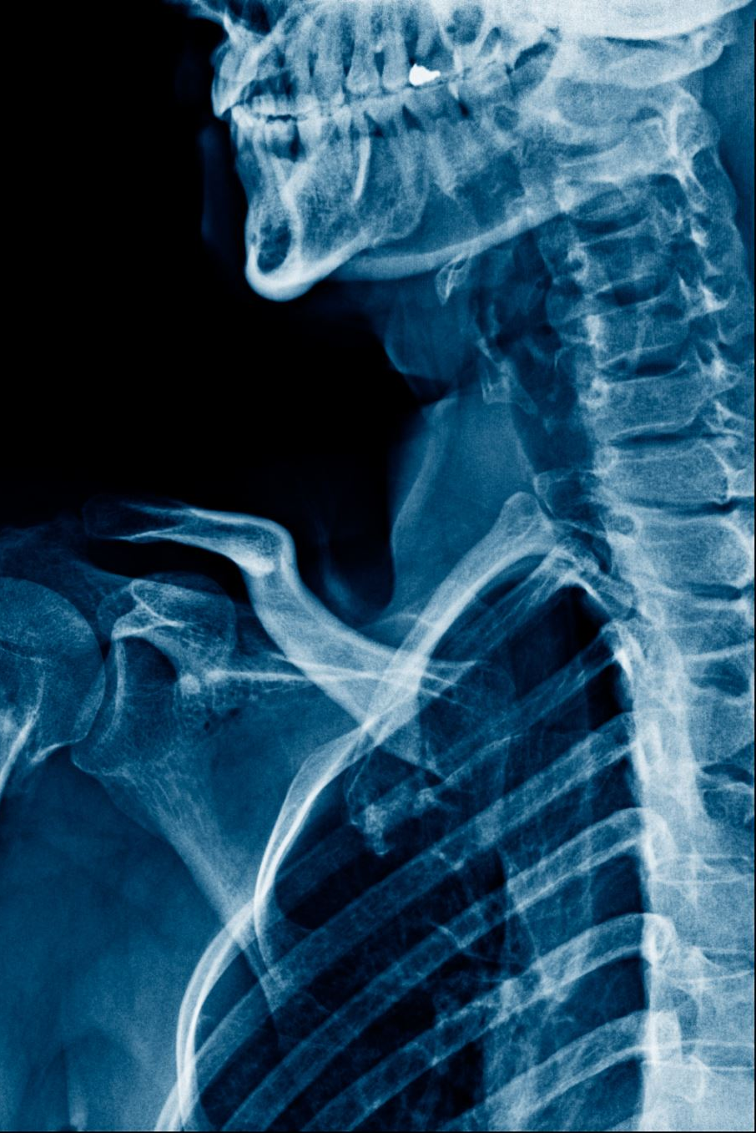
Dataset
Chest X-Ray Images (Pneumonia)
Dataset Type:
Image dataset from Kaggle
Supervised learning
Binary classification
Classes:
NORMAL
PNEUMONIA

Slide 4
Literature Review - CNN
Convolutional Neural Networks (CNN)
CNNs: strong performance in image classification tasks.
Reference: LeCun et al. (1998) Gradient-Based Learning Applied to Document Recognition
CNN for Medical Image Diagnosis
CNN: help identify pneumonia patterns from X-ray images.
Reference: Kermany et al. (2018) Identifying Medical Diagnoses and Treatable Diseases by Image-Based Deep Learning

Slide 5
Approach Used
Input chest X-ray image: https://www.kaggle.com/datasets/paultimothymooney/chest-xray-pneumonia
Resize image (64 × 64)
Apply CNN convolution layer
Use ReLU activation
Apply max pooling
Flatten extracted features
Classify image as Normal or Pneumonia
Tools:
Python: https://www.python.org/
PyTorch: https://pytorch.org/
TorchVision: https://docs.pytorch.org/vision/stable/index.html
Matplotlib: https://matplotlib.org/
Training: Cross Entropy Loss/ Adam Optimizer

Slide 6
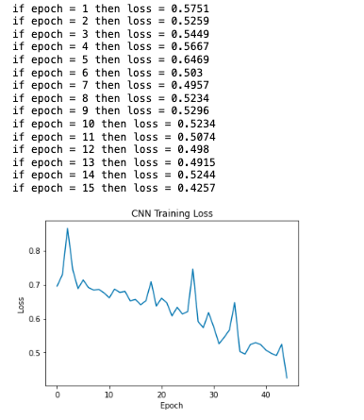
Results

Slide 7
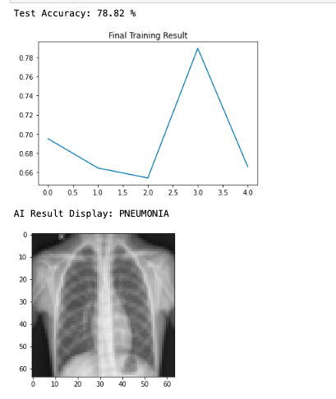
Results

Slide 8
Demo
Load dataset
Train CNN model
Show training result
Test X-ray image
Display prediction

Slide 9
Links and References
GitHub:
(add link)
YouTube Demo:
(add link)

