Slide 1
Pneumonia Detection Using CNN
Problem: Pneumonia detection from X-rays requires medical review which takes time, based on my experience
AI can support faster screening, save time and resources
Project Goal: Use CNN to classify X-ray images
Output: NORMAL or PNEUMONIA
Result: 78.82% accuracy

Slide 2
Motivation
Pneumonia is a serious lung infection that requires fast and accurate diagnosis.
Traditional diagnosis relies on doctors manually reviewing chest X-ray images, which can be time-consuming and affected by human error.
Artificial Intelligence, especially Computer Vision (CV) and Deep Learning, can help automatically analyze medical images.
Why CNN?
CNNs are designed for image recognition tasks.
They automatically learn important image features such as patterns, edges, and abnormalities.
A CNN-based model can support faster and more consistent pneumonia detection.
Expected Benefits
Faster screening process
Support doctors’ decision-making
Reduce manual workload
Improve accessibility of medical image analysis

Slide 3
Literature Review - CNN
CNN
CNNs: good performance in image classification tasks.
LeCun et al. (1998) Gradient-Based Learning Applied to Document Recognition
Medical Image Diagnosis
CNN: help identify pneumonia patterns from X-ray images.
Kermany et al. (2018) Identifying Medical Diagnoses and Treatable Diseases by Image-Based Deep Learning

Slide 4
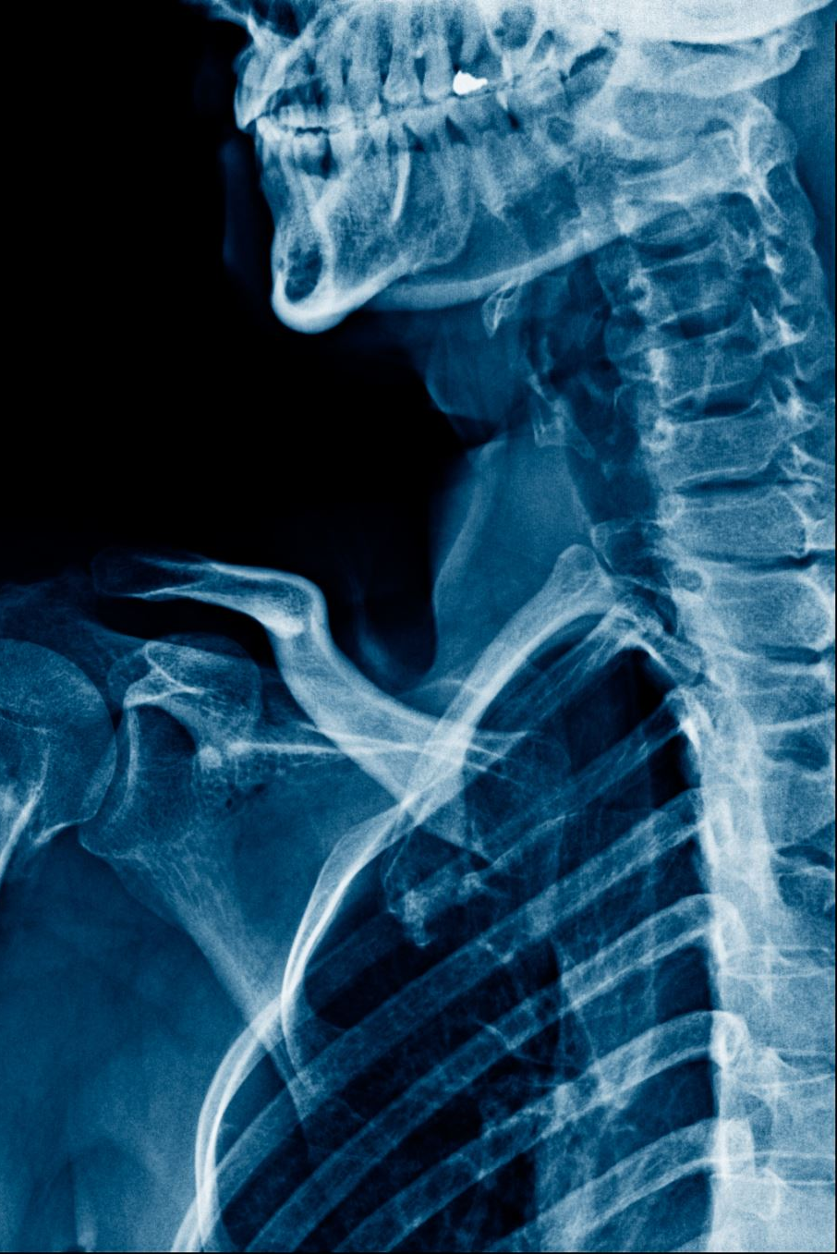
Dataset
Chest X-Ray Images (Pneumonia)
Dataset Type:
Image dataset from Kaggle
Supervised learning
Binary classification
Classes:
NORMAL
PNEUMONIA

Slide 5
Approach Used
Input chest X-ray image: https://www.kaggle.com/datasets/paultimothymooney/chest-xray-pneumonia
Resize image (64 × 64)
Apply CNN convolution layer: 1st extracts low-level image features, 2nd learns more complex patterns before classification.
Use ReLU activation: reduces vanishing gradients and makes deep networks train faster.
Apply max pooling
Flatten extracted features
Classify image as Normal or Pneumonia
Tools: PyTorch: https://pytorch.org/, TorchVision: https://docs.pytorch.org/vision/stable/index.html, Matplotlib: https://matplotlib.org/
Training:
Cross Entropy Loss: for binary classification task. It compares the predicted class probabilities with the true labels and guides the CNN to reduce classification errors
Adam Optimizer: automatically adjusts the learning rate for each parameter, which is very helpful when the training data is noisy or the architecture is simple

Slide 6
Results
Results & Evaluation
The CNN model was trained for 15 epochs using chest X-ray images to classify Normal vs Pneumonia cases.
During training, the model accuracy increased gradually, showing that the CNN successfully learned important image patterns such as lung texture differences.
CNN model was evaluated on unseen test images and achieved a final test accuracy of 78.82%. This shows that the model successfully learned meaningful visual patterns from chest X-ray images to classify Normal vs Pneumonia cases.
However, the accuracy fluctuated across epochs, which suggests that the training process was not fully stable. This may be caused by limited data, small batch size, or untuned hyperparameters.
Performance could be improved by using more training data, adding data augmentation, training for more epochs, and tuning the learning rate or batch size.

Slide 7
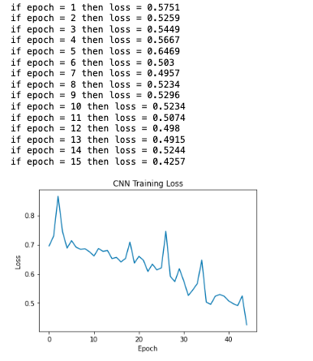
Results

Slide 8
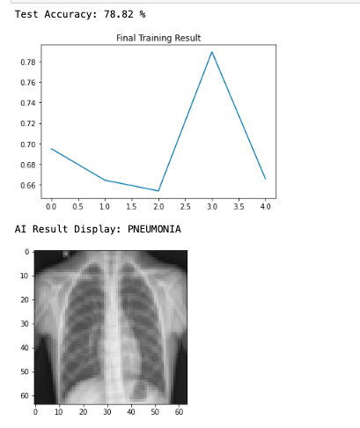
Results

Slide 9
Demo
Load dataset
Train CNN model
Show training result
Test X-ray image
Display prediction

Slide 10
Links and References
GitHub:
https://github.com/thucanh305/mrp_final
YouTube Demo:
https://youtu.be/hoMQMG_n_yI
Future Plan:
Implement Transfer Learning
Take a model pre-trained on a massive dataset (like ImageNet) and 'fine-tune' it for X-ray detection.
Give the model a 'head start' by letting it use pre-learned knowledge of complex shapes, which is much more effective than training from scratch on a small dataset.

