Slide 1

Text Mining
&
Natural Language Processing
Anh Thu DOAN - PIB3

Slide 2

Table of Contents
Text Mining & doctoral dissertations
Associated metrics (TF-IDF)
Cosine similarity
POS-tagging and exercise generation
Part-of-Speech Tagging
Exercise generation

Slide 3
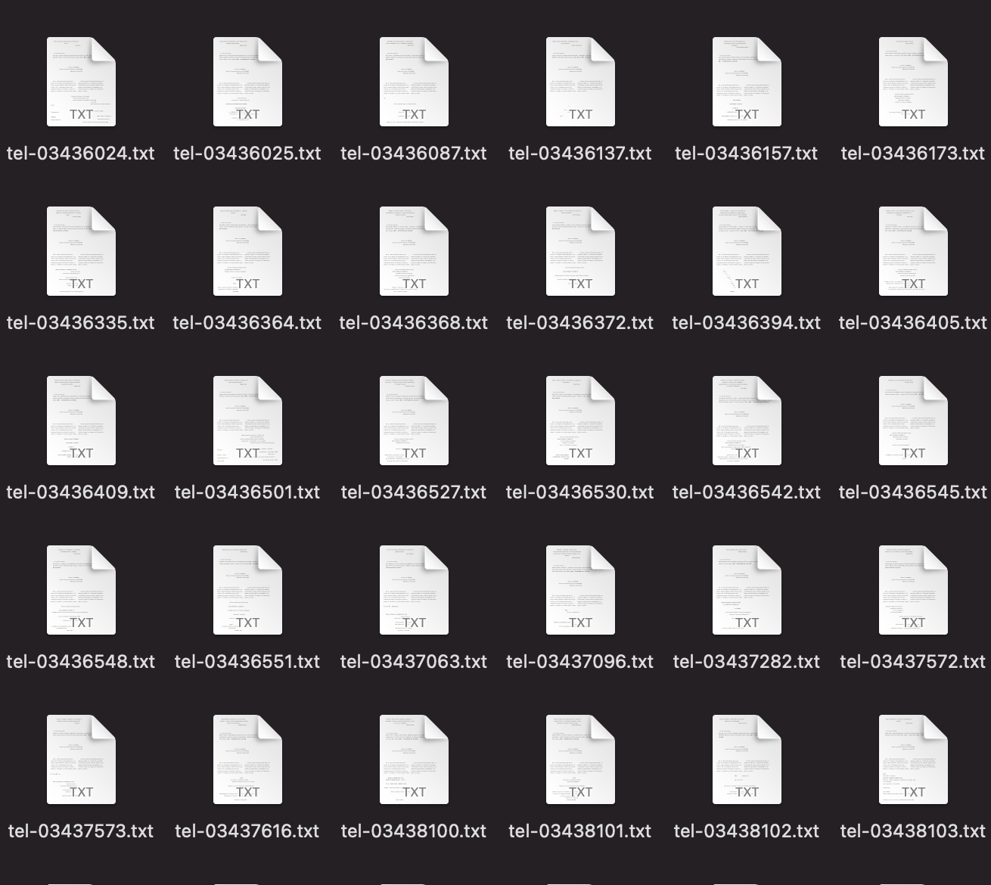
Text Mining & Doctoral dissertations
Data used: A folder with 50 txt files of doctoral dissertations

Slide 4
Associated metrics (TF-IDF)
Tf-idf is a method for identifying the most frequently occurring or noteworthy terms in a document.
Tf-idf = term_frequency * inverse_document_frequency
term_frequency = number of times a given term appears in document
inverse_document_frequency = log(total number of documents / number of documents with term) + 1*****

Slide 5

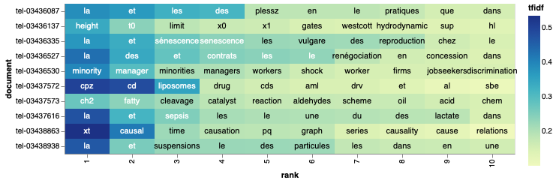
Visualize TF-IDF
The highest TF-IDF scoring words of the first ten txt files

Slide 6
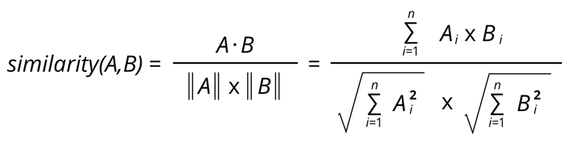
Cosine similarity
The cosine similarity method calculates the cosine angle between two vector lists to determine how similar they are.
In NLP, Cosine similarity is a metric for comparing the text similarity of two documents, regardless of their size.

Slide 7
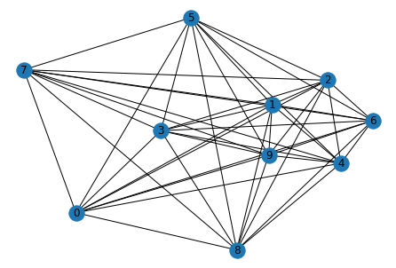
Cosine similarity visualize for the first ten text file

Slide 8
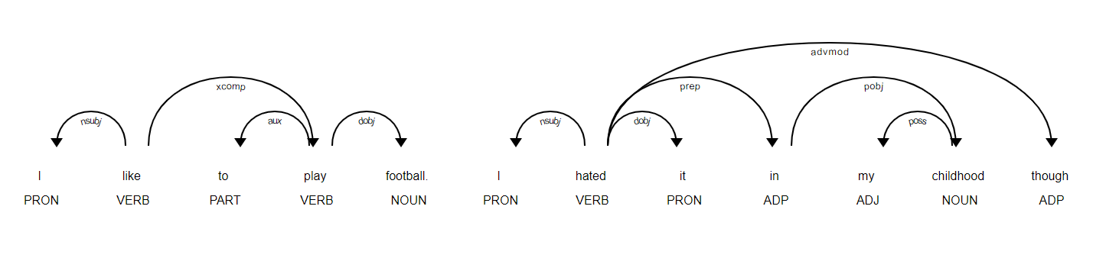
POS-tagging &
Exercise generation

Slide 9
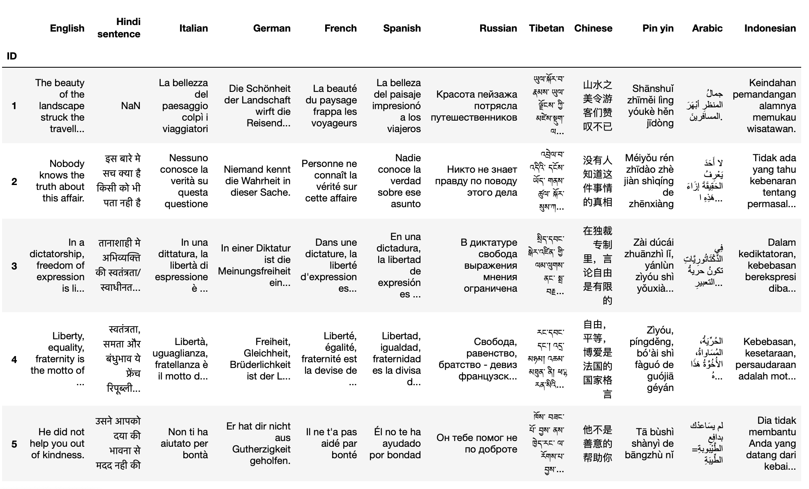
Overview
Dataset: A csv file contains 3000 sentences in different languages.

Slide 10
Methodology
Two python library were used: spaCy, stanza
To process a particular language, we need to have Stanza language model as basic
In this part, we used some of feature of spaCy library such as: Lemmatization, Part-of-speech(POS) Tagging

Slide 11
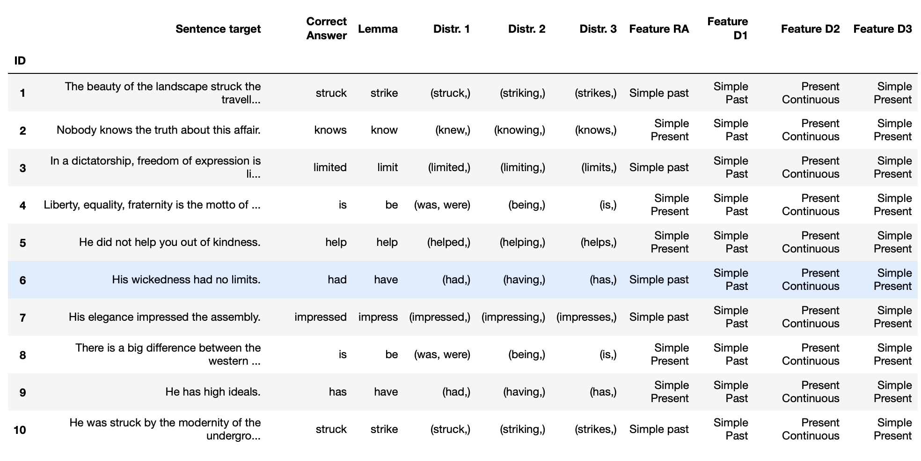
Results

Slide 12

Exercise generation
Q: The beauty of the landscape ___ the travellers.
Struck
Striking
Strikes
-> Correct Answer: A

