Slide 1
ITERATION TECHNIQUE
Introduction to programming – Nhập môn lập trình
Advisor: Trương Toàn Thịnh

Slide 2
CONTENTS
Some basic iteration algorithms
Stop condition
Prime number verification
Fast exponentiation
Number factorization
Iteration techniques
Loop techniques in array
Recursion

Slide 3
SOME BASIC ITERATION ALGORTHMS
Sum/Product
  Var ‘sum’ is initialize with 0
  Var ‘product’ is initialize with 1
  Scan all elements in a collection (array)
  Accumulate into var sum/product
Sum | Product
S ← 0 | P ← 1
Scan collection | Scan collection
S ← S + x | P ← P × x
End scan | End scan

Slide 4
SOME BASIC ITERATION ALGORTHMS
Given an array of numbers 1, 2, … n, compute sum & product
Lines | Method 01
1 | void TinhTongTich(long n, long& s, long& p){
2 | s = 0, p = 1;
3 | for(int i = 1; i < n; i++){
4 | s+=i;
5 | p*=i;
6 | }
7 | }
Method 02
void TinhTongTich(long n, long& s, long& p){
s = 0, p = 1;
for(; n > 0; n--){
s+=n;
p*=n;
}
}

Slide 5
SOME BASIC ITERATION ALGORTHMS
Given n ∈ ℤ⁺, let’s compute:
  Sum ‘s’ of all numbers with the form of m/(1 + m²), where m % 4 = 1 & m < n
  Product ‘p’ of all odd m, where m % 3 = 1 & m < n
Lines | Description
1 | void main(){
2 | long m, n; double s = 0, p = 1;
3 | scanf(“%d”, &n); m = n;
4 | for(; m > 0; m--){
5 | if(m % 4 == 1) s+=m/(1.0+m*m);
6 | if(m % 2 == 1 && m% 3 == 1) p*=m;
7 | }
8 | printf(“%lf\n”, s); printf(“%lf\n”, p);
9 | }

Slide 6
SOME BASIC ITERATION ALGORTHMS
Compute
  Note: x² = x × x, x³ = x × x², …, x^{n} = x × x^{n – 1}
Lines | Description
1 | double TinhTong(double x, int n){
2 | double s = 0, p = 1;
3 | for(int i = 1; i <= n; i++){
4 | p*=x;
5 | s+=(p/i);
6 | }
7 | return s;
8 | }
void main(){
double x, s = 0; int n;
scanf(“%lf”, &x); scanf(“%d”, &n);
s = TinhTong(x, n);
printf(“%lf”, s);
}

Slide 7
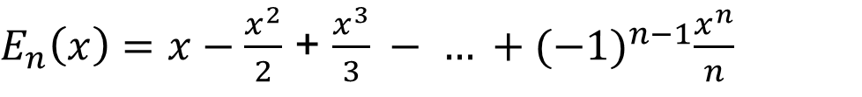
SOME BASIC ITERATION ALGORTHMS
Compute
  Method 1: Change line 2 (p = -1) & transmit –x in main function
$E_{n}\left(x\right)=x−\frac{x^{2}}{2}$ + $\frac{x^{3}}{3} − … +{(−1)}^{n−1}\frac{x^{n}}{n}$
Lines | Description
1 | double TinhTong(double x, int n){
2 | double s = 0, p = -1;
3 | for(int i = 1; i <= n; i++){
4 | p*=x;
5 | s+=(p/i);
6 | }
7 | return s;
8 | }
void main(){
double x, s = 0; int n;
scanf(“%lf”, &x); scanf(“%d”, &n);
s = TinhTong(-x, n);
printf(“%lf”, s);
}

Slide 8
SOME BASIC ITERATION ALGORTHMS
Compute
  Method 2: Change the way of calling function in main
$E_{n}\left(x\right)=x−\frac{x^{2}}{2}$ + $\frac{x^{3}}{3} − … +{(−1)}^{n−1}\frac{x^{n}}{n}$
Lines | Description
1 | double TinhTong(double x, int n){
2 | double s = 0, p = 1;
3 | for(int i = 1; i <= n; i++){
4 | p*=x;
5 | s+=(p/i);
6 | }
7 | return s;
8 | }
void main(){
double x, s = 0; int n;
scanf(“%lf”, &x); scanf(“%d”, &n);
s = -TinhTong(-x, n);
printf(“%lf”, s);
}

Slide 9
SOME BASIC ITERATION ALGORTHMS
Compute
  Rewrite K_{n}(x) as follows
  So, we replace x with (–x) to simplify sign (+/-) problem
  We see
  So as to compute i^{th} component, we take previous result ×

Slide 10
SOME BASIC ITERATION ALGORTHMS
Compute
Lines | Description
1 | double TinhK(double x, int n){
2 | double s = 0, p = 1;
3 | for(int i = 1; i <= n; i++){
4 | p*=(x/i); s+=p;
5 | }
6 | return s;}
7 | void main(){
8 | double x, s, n;
9 | scanf(“%f”, &x); scanf(“%d”, &n);
10 | s = TinhK(-x, n);
11 | }

Slide 11
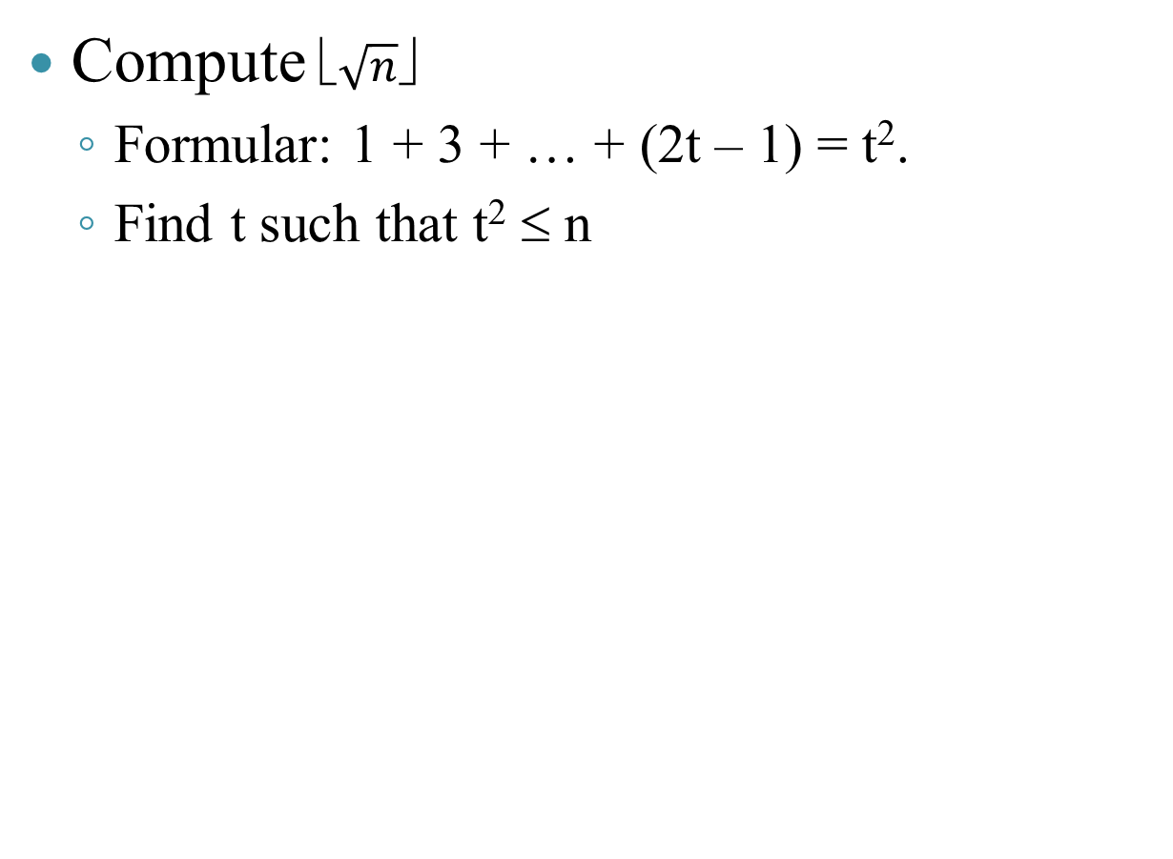
SOME BASIC ITERATION ALGORTHMS
s
Compute $\sqrt{n}✗$
  Formular: 1 + 3 + … + (2t – 1) = t².
  Find t such that t² ≤ n
k
Lines | Description
1 | double sqrtInt(long n){
2 | long s = 1, k = 1;
3 | while(s < n){
4 | k += 2; s += k;
5 | }
6 | if(s > n) k = k – 2;
7 | return (k + 1)/2;
8 | }

Slide 12
SOME BASIC ITERATION ALGORTHMS
Find all perfect numbers less than given m
  Example: 6 is a perfect number: 6 = 1 + 2 + 3, where {1, 2, 3} are all divisors of 6
  Example: 28 is a perfect number: 28 = 1 + 2 + 4 + 7 + 14, where {1, 2, 4, 14} are all divisors of 28
Notes:
  6 = 2 × 3 = 2¹ × (2² – 1)
  28 = 4 × 7 = 2² × (2³ – 1)
  All perfect numbers have the form of 2^{k – 1} × (2^{k} – 1)

Slide 13
SOME BASIC ITERATION ALGORTHMS
Find all perfect numbers less than given m
Lines | Description
1 | long sumDivisors(long n){
2 | long s = 0, k = n;
3 | while(--k){
4 | if(n % k) s+=k;
5 | }
6 | return s;
7 | }
8 | int isPerfect(long n){
9 | if(n == sumDivisors(n)) return 1;
10 | return 0;
11 | }
12 | void main(){
13 | long m;
14 | scanf(“%ld”, &m)
15 | while(m--){
16 | if(isPerfect(m))
17 | printf(“%ld\n”, m)
18 | }
19 | }

Slide 14
SOME BASIC ITERATION ALGORTHMS
Count algorithm
  Var ‘dem’ is initialize with 0
  Scan all elements in an array
  If element satisfies the condition, we increase ‘dem’ by one
Count algorithm
Count ← 0
Scan collection
Take current member
If x satisfy condition then
Count ← Count + 1

Slide 15
SOME BASIC ITERATION ALGORTHMS
Count divisors of whole number n > 0
Can use this function to verify if a number n is a prime number?
Lines | Description
1 | int DemUocSo(long n){
2 | long count = 0;
3 | for(int i = 1; i <= n; i++){
4 | if(n % i == 0)
5 | count++;
6 | }
7 | }

Slide 16
SOME BASIC ITERATION ALGORTHMS
Counting a number of symbol (digit/character) in the given string
Lines | Description
1 | void DemKiSoKiTu(char* s, int& c, int& n){
2 | c = n = 0;
3 | for(int i = 0; i < strlen(s); i++){
4 | if(‘a’ <= s[i] && s[i] <= ‘z’)
5 | c++;
6 | else if(‘A’ <= s[i] && s[i] <= ‘Z’)
7 | c++;
8 | else n++;
9 | }
10 | }
void main(){
char s[] = “Hello world”;
int n, c;
DemKiSoKiTu(s, c, n);
printf(“%d %d”, n, c);
}
H
e
l
l
o
w
o
r
l
d
0
<10>
<???>
<10>
s

Slide 17
SOME BASIC ITERATION ALGORTHMS
Count a number of negative/positive/zero numbers in float array
Lines | Description
1 | void DemSo(float a[], int n, int* nd, int* na, int* no){
2 | *nd = *na = *no = 0;
3 | for(int i = 0; i < n; i++){
4 | if(a[i] > 0)
5 | (*nd)++;
6 | else if(a[i] < 0)
7 | (*na)++;
8 | else (*no)++;
9 | }
10 | }
void main(){
float b[] = {-2, 1, 4, -9, 0};
int nn = 5, dn, an, on;
DemSo(s, c, n);
printf(“%d %d %d”, dn, an, on);
}
<???>
<10>
<10>
-2
1
4
-9
0
b
<30>
<50>
<55>
<60>
<65>
<10>
5
a
nn
dn
an
on
5
<55>
<60>
<65>
n
nd
na
no
<70>
<75>
<80>
<85>

Slide 18
SOME BASIC ITERATION ALGORTHMS
Given float array ‘a’ and float var ‘x’. Let’s perform
  Does ‘x’ appear in ‘a’?
  Is ‘x’ bigger than all elements in ‘a’?
  Is ‘x’ smaller than another element in ‘a’?
  Are all elements in ‘a’ negative?
Solutions
  Count all numbers equal to ‘x’, check if result of counting is positive/negative
  Count all numbers smaller than ‘x’, check if result of counting is equal to n or not
  Count all numbers bigger than ‘x’, check if result of counting is positive or not

Slide 19
SOME BASIC ITERATION ALGORTHMS
Given float array ‘a’ and float var ‘x’
1 | int Appear(float a[], int n, float x){
2 | int cnt = 0;
3 | while(n--){
4 | if(x == a[n]) cnt++;
5 | }
6 | return (cnt > 0); }
10 | int GreaterAll(float a[], int n, float x){
11 | int cnt = 0, m = n;
12 | while(m--){
13 | if(x > a[m]) cnt++;
14 | }
15 | return (cnt == n); }
7 | int AllNegative(float a[], int n){
8 | return GreaterAll(a, n, 0);
9 | }
16 | int LessOne(float a[], int n, float x){
17 | int cnt = 0;
18 | while(n--){
19 | if(x < a[n]) cnt++;
20 | }
21 | return (cnt > 0); }

Slide 20
SOME BASIC ITERATION ALGORTHMS
Given float array ‘a’. Need to answer
  Is array ‘a’ ascending / descending
  Is array ‘a’ ordered?
Idea:
  What an ascending array is: a[0] ≤ a[1] ≤ … ≤ a[n – 1]
  So we have: a[i – 1] ≤ a[i], ∀i ∈ [1, …, n – 1]
  So we have n – 1 indexes ‘i’ satisfying a[i – 1] ≤ a[i]
Code
  int isIncreasing(float a[], int n){
    int cnt = 0, m = n;
    while(--m){
      if(a[m – 1] <= a[m]) cnt++;
    }
    return (cnt == n – 1);
  }

Slide 21
SOME BASIC ITERATION ALGORTHMS
Algorithm finding the min/max element
  Choose another element x₀ as expected value
  Scan collection \ {x₀} & find if there are any others better than expected value, then update
Algorithm finding expected element
Case of non-condition K | Case of condition K
Choose x₀ ∈ S & let kq ← x₀ | Flag ← false
Scan x ∈ S \ {x₀} | Scan x ∈ S
If x better than kq | If x satisfies K
kq ← x; | If not Flag then
 | kq ← x; Flag ← true
 | Else x better than kq then kq ← x

Slide 22
SOME BASIC ITERATION ALGORTHMS
Find the smallest element in float array
Lines | Description
1 | int PhanTuNhoNhat(float a[], int n){
2 | int idx = 0;
3 | for(int i = 0; i < n; i++){
4 | if(a[idx] > a[i])
5 | idx = i;
6 | }
7 | return idx;
8 | }
int PhanTuNhoNhat(float a[], int n){
int idx = --n;
while(n--){
if(a[idx] > a[n])
idx = n;
}
return idx;
}

Slide 23
SOME BASIC ITERATION ALGORTHMS
Find the smallest POSITIVE element in float array
Lines | Version 1
1 | int PhanTuDuongNhoNhat(float a[], int n){
2 | int idx = -1; bool flag = false;
3 | for(int i = 0; i < n; i++){
4 | if(a[i] > 0){
5 | if(flag == false){
6 | idx = i; flag = true;
7 | }
8 | else if(a[idx] > a[i]) idx = i;
9 | }
10 | }
11 | return idx;}
Version 2
int PhanTuDuongNhoNhat(float a[], int n){
int idx = -1;
for(int i = 0; i < n; i++){
if(a[i] > 0){
if(idx == -1 || a[idx] > a[i]){
idx = i;
}
}
}
return idx;}

Slide 24
SOME BASIC ITERATION ALGORTHMS
Find element ≠ 0 with the smallest absolute value in float array
Lines | Description
1 | int absMinNotZero(float a[], int n){
2 | int idx = -1;
3 | for(int i = 0; i < n; i++){
4 | if(a[i] != 0)
5 | if(idx == -1 || fabs(a[idx]) > fabs(a[i]))
6 | idx = i;
7 | }
8 | return idx;
9 | }

Slide 25
SOME BASIC ITERATION ALGORTHMS
Find pair a[i] & a[j] such that a[i] ≠ a[j] & |a[i] – a[j]| has the smallest value
Lines | Description
1 | double minPair(double a[], int n, int& idi, int& idj){
2 | double dmin= -1, d; idi = idj = -1;
3 | for(int j = n - 1; j >= 1; j--){
4 | for(int i = j – 1; i >= 0; i--)
5 | if(a[i] != a[j]){
6 | d = fabs(a[i] – a[j]);
7 | if(dmin == -1 || dmin > d){dmin = d; idi = i; idj = j;}
8 | }
9 | }
10 | return dmin;}

Slide 26
SOME BASIC ITERATION ALGORTHMS
Find pair of indexes (i, k) such that 0 ≤ i ≤ k < n & a[i] + … + a[k] has the biggest value
  This problem includes search & sum techniques
  If float array contains all non-negative values, then we have a pair of indexes (0, n – 1)
Code
  float maxS(float a[], int n, int& Idi, int& Idk)
    float lc = a[0]; Idi = Idk = 0;
    for(int i = 0; i < n; i++)
      for(int k = i; k < n; k++)
        float s = 0;
        for(int j = i; j <= k; j++) s+=a[j];
        if(s > lc)
          lc = s;
          Idi = i; Idk = k;
    return lc;
i
k
0
1
2
3
4
5
6
7

Slide 27
SOME BASIC ITERATION ALGORTHMS
Find pair of indexes (i, k) such that 0 ≤ i ≤ k < n & a[i] + … + a[k] has the biggest value
  This problem includes search & sum techniques
  If float array contains non-negative values, we have a pair of indexes (0, n – 1)
Improved code
  float maxS(float a[], int n, int& Idi, int& Idk)
    float lc = a[0]; Idi = Idk = 0;
    for(int i = 0; i < n; i++)
      float s = 0;
      for(int k = i; k < n; k++)
        s+=a[k];
        if(s > lc)
          lc = s;
          Idi = i; Idk = k;
    return lc;
i
k
0
1
2
3
4
5
6
7

Slide 28
CONTENTS
Some basic iteration algorithms
Stop condition
Prime number verification
Fast exponentiation
Number factorization
Iteration techniques
Loop techniques in array
Recursion

Slide 29
STOP CONDITION
‘Invariance’ of loop is an logic expression
Firstly, ‘invariance’ of loop always is true , and it is still true before loop finishes
Example
Lines | Description
1 | double sum = 0;
2 | for(int i = 1; i <= n; i++){
3 | sum+=1.0/i;
4 | }

Slide 30
STOP CONDITION
Example
  From code, we have the expression
  If checking i ∈ [1, n], we see above statement holds

Slide 31



STOP CONDITION
Example: compute x^{n}.
  From code, we have the expression
  If checking i ∈ [0, n), we see that above statement holds
Lines | Description
1 | double y = 1;
2 | for(int i = 0; i < n; i++)
3 | y*=x;
$$0  i  n  y=x^{i}$$
$$ ¬(0  i  n) ∨ y=x^{i}$$
$$ (i<0)∨(i  n) ∨ y=x^{i}$$

Slide 32
STOP CONDITION
Logic statement with (∃) and (∀)
  Statement (∀x ∈ S)(P(x)) is true when it is true with all x.
  Statement (∃x ∈ S)(P(x)) is true if there is at least x making P(x) be true.
Verification algorithm
Quatifier ∀ | Quatifier ∃
Check: (∀x ∈ S)(P(x)) | Check: (∃x ∈ S)(P(x))
Flag ← true | Flag ← false
Scan x ∈ S | Scan x ∈ S
If P(x) wrong | If P(x) right
Flag ← false | Flag ← true
End scan | End scan

Slide 33
STOP CONDITION
Example: Check if x is bigger than the smallest number in float n-sized array
Problem ⇔ ∃i ∈ {0, 1, …, n – 1} | x > a[i]
Lines | Description
1 | int greaterMin(double a[], int n, double x){
2 | int kt = 0;
3 | for(int i = 0; i < n; i++){
4 | if(x > a[i]){
5 | kt = 1;
6 | break;
7 | }
8 | }
9 | return kt;}

Slide 34
STOP CONDITION
Example: Check if x is bigger than the biggest number in float n-sized array
Problem ⇔ ∀i ∈ {0, …, n – 1} | x > a[i]
Lines | Description
1 | int greaterMax(double a[], int n, double x){
2 | int kt = 1;
3 | for(int i = 0; i < n; i++){
4 | if(x <= a[i]){
5 | kt = 0;
6 | break;
7 | }
8 | }
9 | return kt;}

Slide 35
STOP CONDITION
Example: Check if there exists x in double n-sized array
Problem ⇔ ∃i ∈ {0, …, n – 1} | x = a[i]
Lines | Description
1 | int Find(double a[], int n, double x){
2 | int vt = -1;
3 | for(int i = 0; i < n; i++){
4 | if(x == a[i]){
5 | vt = i;
6 | break;
7 | }
8 | }
9 | return vt;}

Slide 36
STOP CONDITION
Example: Verify if float array’s ascending?
Problem ⇔ ∀i∈{1, …, n–1} | a[i – 1]≤a[i]
Lines | Description
1 | int Increasing(double a[], int n){
2 | int KT = 1;
3 | for(int i = 1; i < n; i++){
4 | if(a[i - 1] > a[i]){
5 | KT = 0;
6 | break;
7 | }
8 | }
9 | return KT;}

Slide 37
CONTENTS
Some basic iteration algorithms
Stop condition
Prime number verification
Fast exponentiation
Number factorization
Iteration techniques
Loop techniques in array
Recursion

Slide 38
PRIME NUMBER VERIFICATION
Prime number has only two divisors
Number one is not prime number
Number zero is a special prime number
Problem: check if whole number a > 1 is prime number
Check if a > 1 is composite number
∃i ∈ {2, …, a – 1}, i | a

Slide 39
PRIME NUMBER VERIFICATION
Slow algorithm verifying prime number
Lines | Description
1 | int isPrime(long a){
2 | int kq;
3 | if(a < 0) a = -a;
4 | switch(a){
5 | case 0: kq = 1; break;
6 | case 1: kq = 0; break;
7 | default:{
8 | long i = 2; kq = 1
9 | while(i < a){
10 | if(a % i == 0){kq = 0; break;}
11 | i++;
12 | }}} return kq;}

Slide 40
PRIME NUMBER VERIFICATION
If m | a ⇒ ∃ n | a and n ≤
0 & 2 are only even prime number
Lines | Description
1 | int isPrime(long a){
2 | int kq;
3 | if(a < 0) a = -a;
4 | switch(a){
5 | case 1: kq = 0; break;
6 | case 0: case 2: case 3: kq = 1; break;
7 | default:{
8 | long i = 3;
9 | if(a % 2 == 0){ kq = 0; break;}
10 | kq = 1;
Lines | Description
11 | while(i <= sqrt(a)){
12 | if(a % i == 0){ kq = 0; break;}
13 | i+=2;
14 | }
15 | }
16 | }
17 | return kq;
18 | }

Slide 41
PRIME NUMBER VERIFICATION
(Find common divisor)
Let a & b (a, b ∈ ℤ⁺), d is called the greatest common divisor of a & b if:
  d is the a’s divisor & d is the b’s divisor
  If there exists t being a’s divisor & b’s divisor, then t is the d’s divisor
Formally state: gcd(a, b) = d ∧ {∀t: t | a ∧ t | b ⇒ t | d}
Euclid algorithm finding gcd of a & b
  while(a ≠ 0 ∧ b ≠ 0)
    if a > b then a ← a mod b
    else b ← b mod a
  return a + b;
a & b are called coprime if only if gcd(a, b) = 1 (denoted by a ⊥ b)

Slide 42
FAST EXPONENTIATION
Problem of computing a^{n}.
  May use pow(a, n)
  May loop n-time of multiplications
  Improvement from following formula:
    From n^{th} loop, need only loop n/2 or (n – 1)/2
    Squaring ‘a’ whether n is odd or even
    if n is odd, need multiply by ‘a’ (before squaring)
if n even
if n odd

Slide 43
FAST EXPONENTIATION
Exponentiation algorithm
If n ≈ 2 billions, left algorithm will be quite slow
Lines | Description
1 | double power_n(double a, long n){
2 | double kq = 1;
3 | for(int i = 0; i < n; i++)
4 | {
5 | kq*=a;
6 | }
7 | return kq;
8 | }
Lines | Description
1 | double power_n(double a, long n){
2 | double kq = 1;
3 | for(; n > 0; n/=2){
4 | if(n % 2 == 1) kq*=a;
5 | a*=a;
6 | }
7 | return kq;
8 | }

Slide 44
FAST EXPONENTIATION
Example: quick version of exponentiation algorithm
Lines | Description
1 | double power_n(double a, long n){
2 | double kq = 1;
3 | for(; n > 0; n/=2){
4 | if(n % 2 == 1) kq*=a;
5 | a*=a;
6 | }
7 | return kq;
8 | }
Example: a = 3 & n = 12
The zero: kq = 1 & a = 3 & n = 12
The first: kq = 1 & a = 9 & n = 6
The second: kq = 1 & a = 81 & n = 3
The third: kq = 81 & a = 6561 & n = 1
The fourth: kq = 81*6561 & a = 43046721 & n = 0
Finally, kq = 81*6561 = 531441

Slide 45
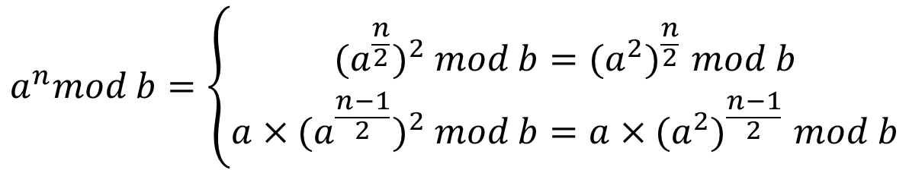
FAST EXPONENTIATION
Problem: a^{n} mod b = r = a^{n} – k × b (k ∈ ℤ)
  cannot firstly compute a^{n}, then mod b (because a^{n} may be large)
  Note: a^{n} mod b = [(a^{n – 1} mod b) × a] mod b.
  Code (C/C++)
    long kq = 1;
    while(n--){ // loop n times (first check, then decrease)
      kq = kq*a % b;
    }
Improvement from below formula:
$$a^{n}mod b=\left\{\begin{aligned}{{(a}^{\frac{n}{2}})}^{2} mod b{={(a}^{2})}^{\frac{n}{2}}mod b \\ {{a×(a}^{\frac{n−1}{2}})}^{2} mod b{={a×(a}^{2})}^{\frac{n−1}{2}}mod b\end{aligned}\right.$$
if n even
if n odd

Slide 46
FAST EXPONENTIATION
Example: fast algorithm of a^{n} mod b
Lines | Description
1 | long modPow(long a, long b, long n){
2 | long kq = 1;
3 | for(; n > 0; n/=2){
4 | if(n % 2 == 1) kq = kq*a % b;
5 | a = a*a % b;
6 | }
7 | return kq;
8 | }
Example a = 3, n = 5 & b = 12
The zero: kq = 1 & a = 3 & n = 5
The first: kq = 3 & a = 4 & n = 2
The second: kq = 3 & a = 1 & n = 1
The third: kq = 3 & a = 1 & n = 0
Finally kq = 3

Slide 47
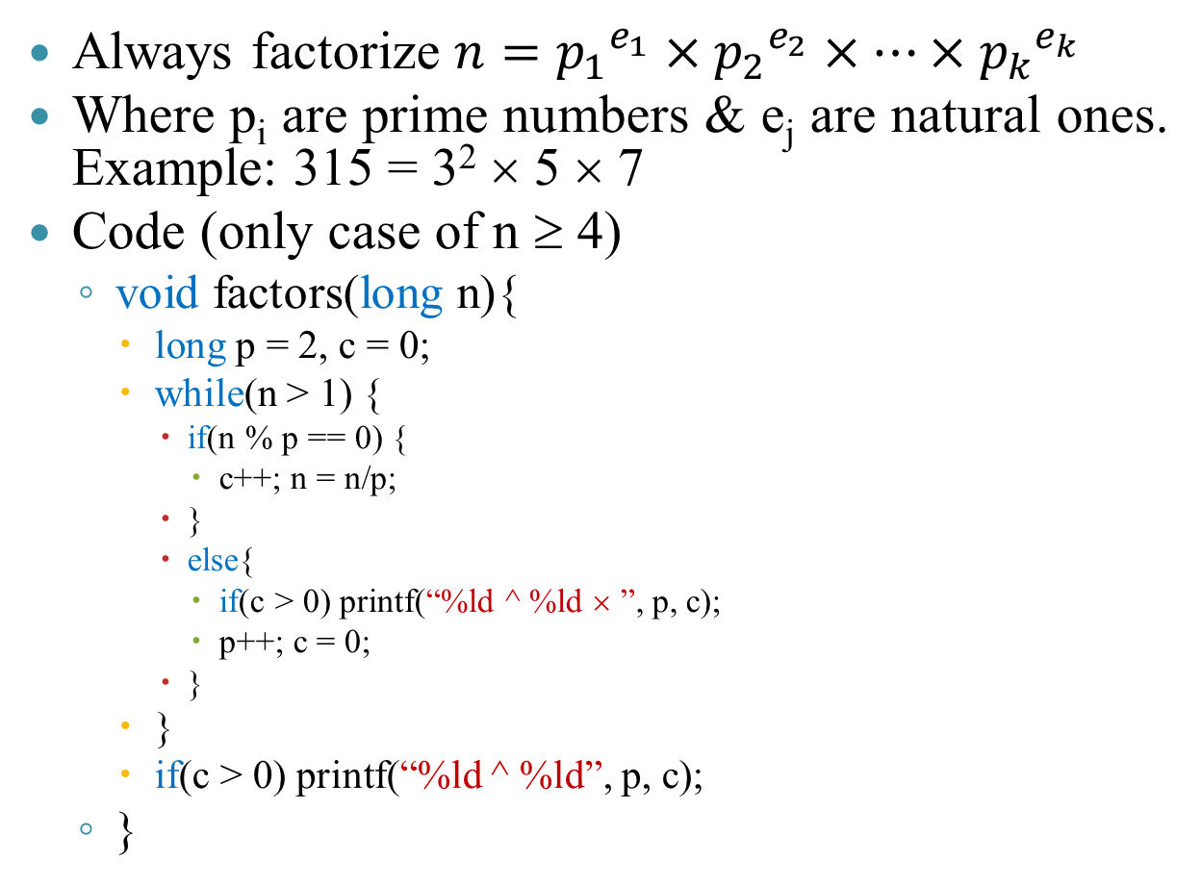
NUMBER FACTORIZATION
Always factorize $n={p_{1}}^{e_{1}}×{p_{2}}^{e_{2}}×…×{p_{k}}^{e_{k}}$
Where p_{i} are prime numbers & e_{j} are natural ones. Example: 315 = 3² × 5 × 7
Code (only case of n ≥ 4)
  void factors(long n){
    long p = 2, c = 0;
    while(n > 1) {
      if(n % p == 0) {
        c++; n = n/p;
      }
      else{
        if(c > 0) printf(“%ld ^ %ld × ”, p, c);
        p++; c = 0;
      }
    }
    if(c > 0) printf(“%ld ^ %ld”, p, c);
  }
p = 3
c = 2
p = 4
p = 7
p = 5
p = 6
c = 0
p = 2
c = 1
n = 315
n = 35
n = 1
n = 105
n = 7
3 ^ 2 ×
5 ^ 1 ×
7 ^ 1

Slide 48
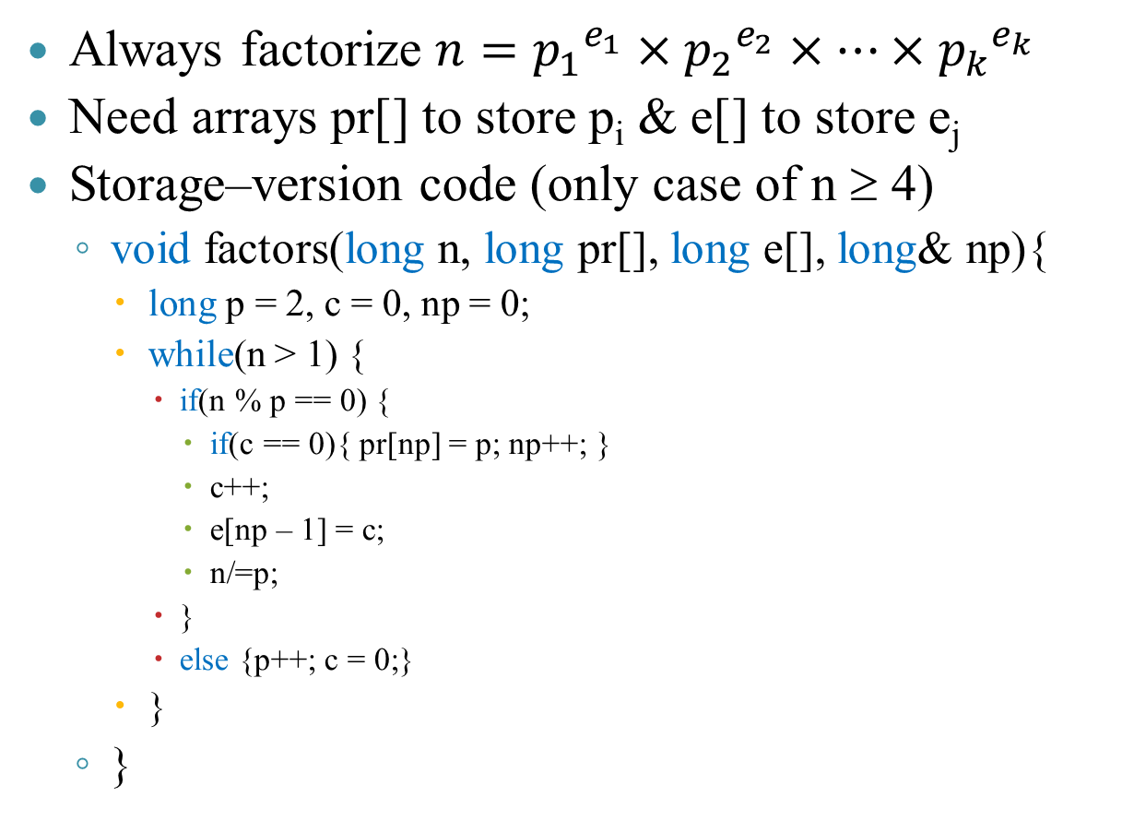
NUMBER FACTORIZATION
Always factorize $n={p_{1}}^{e_{1}}×{p_{2}}^{e_{2}}×…×{p_{k}}^{e_{k}}$
Need arrays pr[] to store p_{i} & e[] to store e_{j}
Storage–version code (only case of n ≥ 4)
  void factors(long n, long pr[], long e[], long& np){
    long p = 2, c = 0, np = 0;
    while(n > 1) {
      if(n % p == 0) {
        if(c == 0){ pr[np] = p; np++; }
        c++;
        e[np – 1] = c;
        n/=p;
      }
      else {p++; c = 0;}
    }
  }
e
1
2
1
1
pr
3
5
7
np =
1
3
2
0
n =
315
1
105
7
35
p =
4
5
6
2
3
7
1
c =
2
0

Slide 49
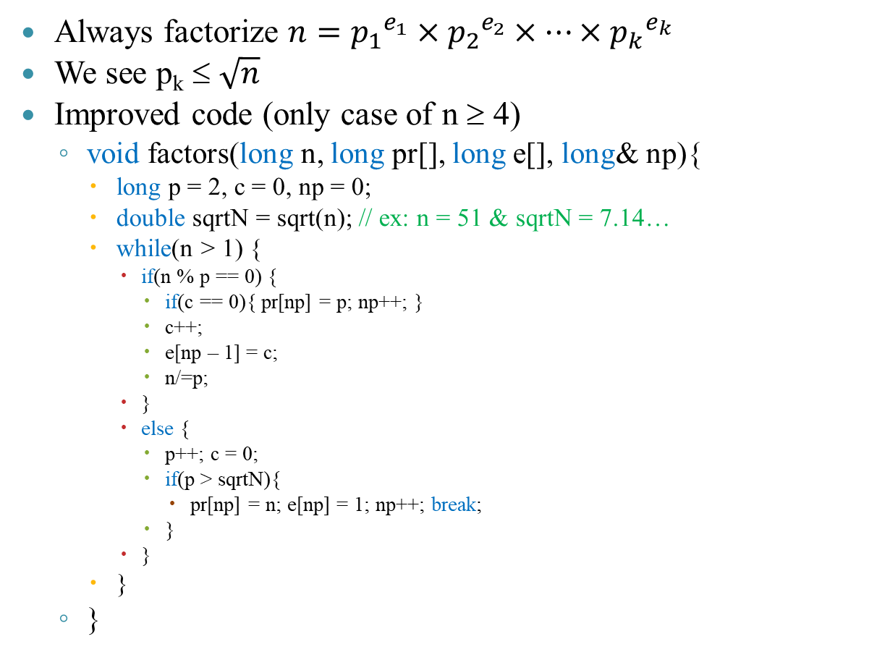
NUMBER FACTORIZATION
Always factorize $n={p_{1}}^{e_{1}}×{p_{2}}^{e_{2}}×…×{p_{k}}^{e_{k}}$
We see p_{k} ≤ $\sqrt{n}$
Improved code (only case of n ≥ 4)
  void factors(long n, long pr[], long e[], long& np){
    long p = 2, c = 0, np = 0;
    double sqrtN = sqrt(n); // ex: n = 51 & sqrtN = 7.14…
    while(n > 1) {
      if(n % p == 0) {
        if(c == 0){ pr[np] = p; np++; }
        c++;
        e[np – 1] = c;
        n/=p;
      }
      else {
        p++; c = 0;
        if(p > sqrtN){
          pr[np] = n; e[np] = 1; np++; break;
        }
      }
    }
  }
e
1
1
pr
3
17
np =
1
2
0
n =
17
51
p =
6
4
5
8
2
3
7
c =
1
0

Slide 50
CONTENTS
Some basic iteration algorithms
Stop condition
Prime number verification
Fast exponentiation
Number factorization
Iteration techniques
Loop techniques in array
Recursion

Slide 51
ITERATION TECHNIQUES
Consider Fibonacci number
F₀ = F₁ = 1
F_{n} = F_{n – 1} + F_{n – 2} (n ≥ 2)
Code
  Fibo(int n){
    if n = 0 or n = 1 then return 1
    while(k < n)
      U ← F // F ⇔ F_{n}
      F ← lastF + F // LastF ⇔ F_{n – 1}
      lastF ← U
      k ← k + 1;
  }
Remove U
F ← F + lastF
lastF ← F – lastF

Slide 52
ITERATION TECHNIQUES
Consider: x³ + ax² + bx + c = 0. Compute S_{n} = x^{n} + y^{n} + z^{n}.
Based on equation’s characteristic, we have
S₀ = 3
S₁ = x + y + z = -a
S₂ = x² + y² + z² = a² – 2b
S_{n} = -aS_{n – 1} – bS_{n – 2} – cS_{n – 3} (n ≥ 3)
Code
  TinhS(int n){
    lastS ← 3, S ← -a, nextS ← a*a – 2*b
    while(k < n)
      U ← nextS // nextS ⇔ S_{n + 1}
      nextS ← -a*nextS – b*S – c*lastS // lastS ⇔ S_{n – 1}
      lastS ← S
      S ← U // S ⇔ S_{n}
      k ← k + 1;
  }

Slide 53
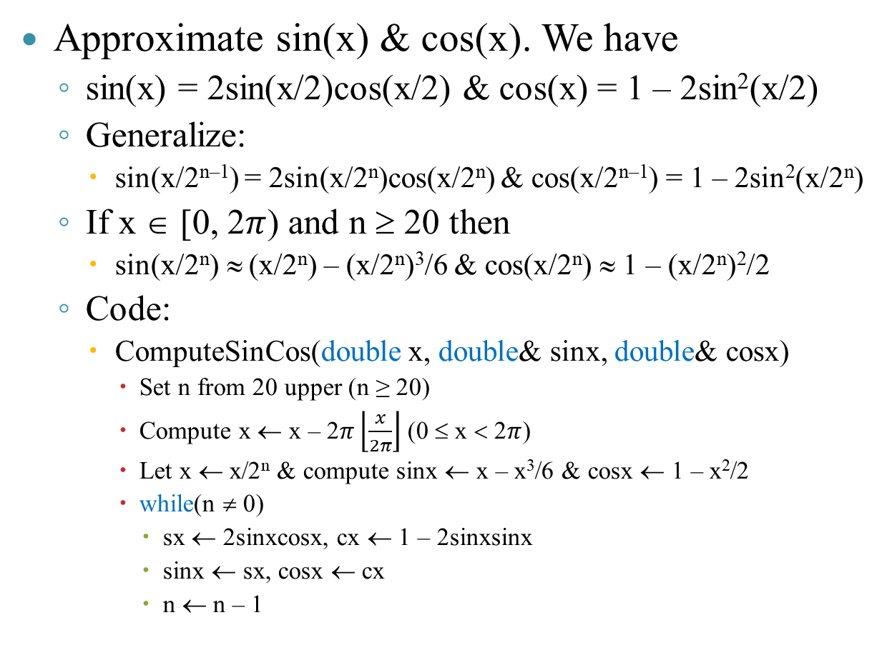
ITERATION TECHNIQUES
Approximate sin(x) & cos(x). We have
  sin(x) = 2sin(x/2)cos(x/2) & cos(x) = 1 – 2sin²(x/2)
  Generalize:
    sin(x/2^{n–1}) = 2sin(x/2^{n})cos(x/2^{n}) & cos(x/2^{n–1}) = 1 – 2sin²(x/2^{n})
  If x ∈ [0, 2$π$) and n ≥ 20 then
    sin(x/2^{n}) ≈ (x/2^{n}) – (x/2^{n})³/6 & cos(x/2^{n}) ≈ 1 – (x/2^{n})²/2
  Code:
    ComputeSinCos(double x, double& sinx, double& cosx)
      Set n from 20 upper (n ≥ 20)
      Compute x ← x – 2$π\left\lfloor \frac{x}{2π}\right\rfloor$ (0 ≤ x < 2$π$)
      Let x ← x/2^{n} & compute sinx ← x – x³/6 & cosx ← 1 – x²/2
      while(n ≠ 0)
        sx ← 2sinxcosx, cx ← 1 – 2sinxsinx
        sinx ← sx, cosx ← cx
        n ← n – 1

Slide 54
ITERATION TECHNIQUES
Square root 2 of float number a (a ∈ ℝ)
  x₀ = 1 & x_{n} = x_{n – 1}/2 + a/(2 × x_{n – 1}) (n ≥ 1)
  Note:
    To compute n^{th} component, we need n – 1th component
    If n → +∞ then |x_{n} – x_{n – 1}| → 0
  Code
    #define epsilon 0.0000001
    double sqrtR(double a)
      if a <= 0 then return 0
      double xLast, x = 1
      do{
        xLast ← x
        x ← xLast/2 + a/(2*xLast)
      }while(|x - xLast| >= epsilon)
      return x

Slide 55
CONTENTS
Some basic iteration algorithms
Stop condition
Prime number verification
Fast exponentiation
Number factorization
Iteration techniques
Loop techniques in array
Recursion

Slide 56
LOOP TECHNIQUES IN ARRAY
(Loop – up table)
If there are many cases, using if and switch is hard to maintain code
Example 1: programming to convert a number to a string
  0 → “Zero”, 1 → “One” if 0 ≤ n ≤ 10
  If 10 < n ≤ 15 → “Eleven to fifteen”
  If n > 15 → “Greater than fifteen”
Code
  char* toString(int n){
    char* s[] = {“zero”, “one”, …, “ten”}, *res = “Negative”;
    if(n >= 0)
    {
      if(0 <= n && n <= 10) res = s[n];
      else if(n <= 15) res = “Eleven to fifteen”;
      else res = “Greater than fifteen”;
    }
    return res;
  }
<10>
<50>
<50>
<???>
<14>
z
e
r
o
0
o
n
e
0
t
e
n
0
<10>
<55>
…
s
…
<55>
<100>
<100>

Slide 57
LOOP TECHNIQUES IN ARRAY
(Loop – up table)
Computing lunar year
  Example: 1968 is the year of monkey
  “Sign” is called zodiac (10 ones), “monkey” is called animal designation (12 ones)
Using following table
thân
thân
mùi
dậu
mùi
dậu
tân
canh
tân
quý
nhâm
quý
ngọ
tuất
ngọ
tuất
canh
nhâm
nhâm
giáp
Left rotate
2 positions
tỵ
kỷ
quý
hợi
tỵ
tân
ất
hợi
mậu
giáp
canh
bính
thìn
tý
thìn
tý
đinh
bính
ất
kỷ
mậu
đinh
mẹo
sửu
mẹo
sửu
dần
dần

Slide 58
LOOP TECHNIQUES IN ARRAY
(Loop – up table)
Code
  string toString(int y){
    string c[] = {“canh”, “tan”, “nham”, …, “ky”};
    string g[] = {“than”, “dau”, “tuat”, …, “mui”};
    return c[y % 10] + “ ” + g[y % 12];
  }
Using following table
thân
thân
mùi
dậu
mùi
dậu
tân
canh
tân
quý
nhâm
quý
ngọ
tuất
ngọ
tuất
canh
nhâm
nhâm
giáp
Left rotate
2 positions
tỵ
kỷ
quý
hợi
tỵ
tân
ất
hợi
mậu
giáp
canh
bính
thìn
tý
thìn
tý
đinh
bính
ất
kỷ
mậu
đinh
mẹo
sửu
mẹo
sửu
dần
dần

Slide 59
LOOP TECHNIQUES IN ARRAY
(Loop – up table)
Computing the day of month & year
  Solved by using switch – case
  Simpler with array
Code
  int checkLeap(int y){
    return (y % 4 == 0 && y % 100 != 0) || (y % 400 == 0);
  }
  int nDayOfMonth(int m, int y){
    int Days[] = {-1, 31, 28, 31, 30, 31, 30, 31, 31, 30, 31, 30, 31};
    int nDay = -1;
    if(checkLeap(y)) Days[2] = 29;
    nDay = Days[m];
    return nDay;
  }

Slide 60
LOOP TECHNIQUES IN ARRAY
(Loop – up table)
Payment of electricity: using array
Code
  const int _ext = -1;
  const int L[] = {0, 100, 150, 200, 300, 400, _ext};
  const double P[] = {1242, 1304, 1651, 1788, 1912, 1962};
  int nP = sizeof(P)/sizeof(P[0]), nL = sizeof(L)/sizeof(L[0]);
  double subCompute(int Lm1, int Lm2, double Prc, int kWh){
    if(kWh >= Lm1){
      if(kWh < Lm2 || Lm2 == _ext) return (kWh – Lm1)*Prc;
      else return (Lm2 – Lm1)*Prc;
    }
    return 0;
  }
  double TienDien(int kWh){
    double s = 0;
    for(int i = 0; i < nL – 1; i++) s+=subCompute(L[i], L[i+1], P[i], kWh);
    return s*1.1; // tax
  }

Slide 61
LOOP TECHNIQUES IN ARRAY
(Sort)
Sort problem “rearranges” the positions of elements with some order
Example: array 8.5, -3.4, -7, 5, 8, 4.7, -2
  Ascending: -7, -3.4, -7, 5, 8, 4.7, -2
  Descending: 8.5, 8, 5, 4.7, -2, -3.4, -7
  Absolute ascending: -2, -3.4, 4.7, 5, -7, 8, 8.5
Interchange sort
  Scan all pairs of indexes (i, j: i < j)
    If a[i] & a[j] are wrong position
      Swap a[i] & a[j] // swap(a[i], a[j])

Slide 62
LOOP TECHNIQUES IN ARRAY
(Sort)
Example: absolute ascending sort
  Array {-2.7, 14.5, -5, 8.5, 0.8, 4.5, 8.33}
  Sorted array: {0.8, -2.7, 4.5, -5, 8.33, 8.5, 14.5}
Code:
  void absSort(double a[], int n){
    for(int i = 0; i < n – 1; i++){
      for(int j = i + 1; j < n; j++){
        if(fabs(a[i]) > fabs(a[j])){
          double temp = a[j];
          a[j] = a[i];
          a[i] = temp;
        }
      }
    }
  }
i
j
0
1
2
3
4
5
6
-2.7
14.5
-5
8.5
0.8
4.5
8.33

Slide 63
LOOP TECHNIQUES IN ARRAY
(Sort)
Sort problem “rearranges” the positions of elements with some order
Selection sort
  Idea:
    At position i ∈ [0, n – 2], find the smallest element from i → n – 1
    When targeted ⇒ swap with a[i]
    Exactly swap n – 1 times
  Pseudo code
    Loop i = 0 → n – 2 // Loop n – 1 times
      idxMin = i;
      Loop j = i + 1 → n – 1
        If a[j] & a[idxMin] are wrong position
          idxMin = j;
      Swap a[i] & a[idxMin]

Slide 64
LOOP TECHNIQUES IN ARRAY
(Sort)
Example: absolute ascending sort
  Array {-2.7, 14.5, -5, 8.5, 0.8, 4.5, 8.33}
  Sorted array: {0.8, -2.7, 4.5, -5, 8.33, 8.5, 14.5}
Selection sort algorithm:
  void absSelectionSort(double a[], int n){
    for(int i = 0; i < n – 1; i++){
      int idxMin = i;
      for(int j = i + 1; j < n; j++){
        if(fabs(a[idxMin]) > fabs(a[j]))
          idxMin = j;
      }
      swap(a[idxMin], a[i]);
    }
  }
idxMin
i
j
0
1
2
3
4
5
6
-2.7
14.5
-5
8.5
0.8
4.5
8.33

Slide 65
LOOP TECHNIQUES IN MAXTRIX
In case of matrix with small size, we can use typedef to define:
Example:
  #define MaxSz 20
  typedef double MATRIX[MaxSz][MaxSz];
  void mtPrint(MATRIX& A, int n){
    for(int i = 0; i < n; i++){
      for(int j = 0; j < n; j++)
        printf(“%lf ”, A[i][j]);
    }
    printf(“\n”);
  }
  void main(){
    MATRIX A = {{1, 2, 3}, {0, 4, 1}, {1, 5, 6}};
    mtPrint(A, 3);
  }

Slide 66
LOOP TECHNIQUES IN MAXTRIX
There are 2 ways of scanning
  Method 1:
    Scan each row (from up to bottom)
    At each row, scan all column (from left to right)
    Example: array a includes m rows & n columns
      for(int i = 0; i < m; i++)
        for(int j = 0; j < n; j++)
  Method 2:
    Scan each column (from left to right)
    At each column, scan all rows (from up to bottom)
    Example: array a includes m rows & n column
      for(int j = 0; j < n; j++)
        for(int i = 0; i < m; i++)

Slide 67
LOOP TECHNIQUES IN MAXTRIX
Scan fixed-k row
  for(int j = 0; j < n; j++)
  {
    // Process a[k][j]
  }
Scan fixed-k column
  for(int i = 0; i < m; i++)
  {
    // Process a[i][k]
  }
0
1
2
3
1
0
1
2
3
0
1
2

Slide 68
LOOP TECHNIQUES IN MAXTRIX
Example: sum at row indexed k
  typedef double MAT[10][10];
  double sumR(MAT& A, int n, int k){
    if(k < 0 || k >= n || n <= 0 || n > 10)
      return 0;
    double sum = 0;
    while(n--){ // first check, later increase
      sum+=A[k][n];
    }
    return sum;
  }
0
1
2
3
1

Slide 69
LOOP TECHNIQUES IN MAXTRIX
Diagonal scanning
  Main diagonal:
    Scan all columns (from left to right)
    Example: array a includes n rows & n columns
      for(int i = 0; i < n; i++)
        // process a[i][i];
  Sub diagonal:
    Scan all columns (from left to right)
    Example: array a includes n rows & n columns
      for(int i = 0; i < n; i++)
        // process a[i][n – 1 – i];
0
1
2
0
1
2
0
1
2
0
1
2

Slide 70
LOOP TECHNIQUES IN MAXTRIX
Scan all elements in above/below diagonal
  Above main diagonal:
    Scan all rows (from up to bottom)
    At each row, scan desired column
    Example: array a includes n rows & n columns
      for(int i = 0; i < n; i++)
        for(int j = i + 1; j < n; j++)
          // process a[i][j];
  Below main diagonal:
    Scan all rows (from up to bottom)
    At each row, scan desired column
    Example: array a includes n rows & n columns
      for(int i = 0; i < n; i++)
        for(int j = 0; j < i; j++)
          // process a[i][j];
0
1
2
0
1
2
0
1
2
0
1
2

Slide 71
LOOP TECHNIQUES IN MAXTRIX
Scan all elements in above/below diagonal
  Above sub diagonal:
    Scan all rows (from up to bottom)
    At each column, scan desired column
    Example: array a includes n rows & n columns
      for(int i = 0; i < n; i++)
        for(int j = 0; j < n – 1 – i; j++)
          // process a[i][j];
  Below sub diagonal:
    Scan all rows (from up to bottom)
    At each row, scan desired column
    Example: array a includes n rows & n columns
      for(int i = 0; i < n; i++)
        for(int j = n – i; j < n; j++)
          // process a[i][j];
0
1
2
0
1
2
0
1
2
0
1
2

Slide 72


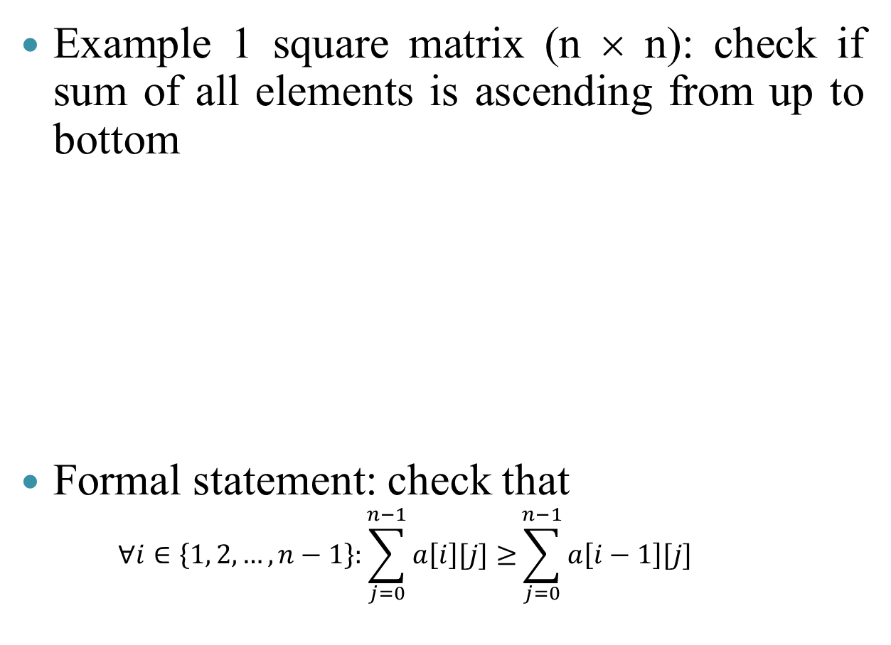
LOOP TECHNIQUES IN MAXTRIX
Example 1 square matrix (n × n): check if sum of all elements is ascending from up to bottom
Formal statement: check that
      $$∀i∈\left\{1, 2, …,n−1\right\}:\sum_{j=0}^{n−1}{a\left[i\right][j]≥}\sum_{j=0}^{n−1}{a\left[i−1\right][j] }$$
6
1 | 2 | 3
4 | 5 | 6
7 | 8 | 9
4 | 5 | 6
1 | 2 | 3
7 | 8 | 9
15
15
6
24
24

Slide 73
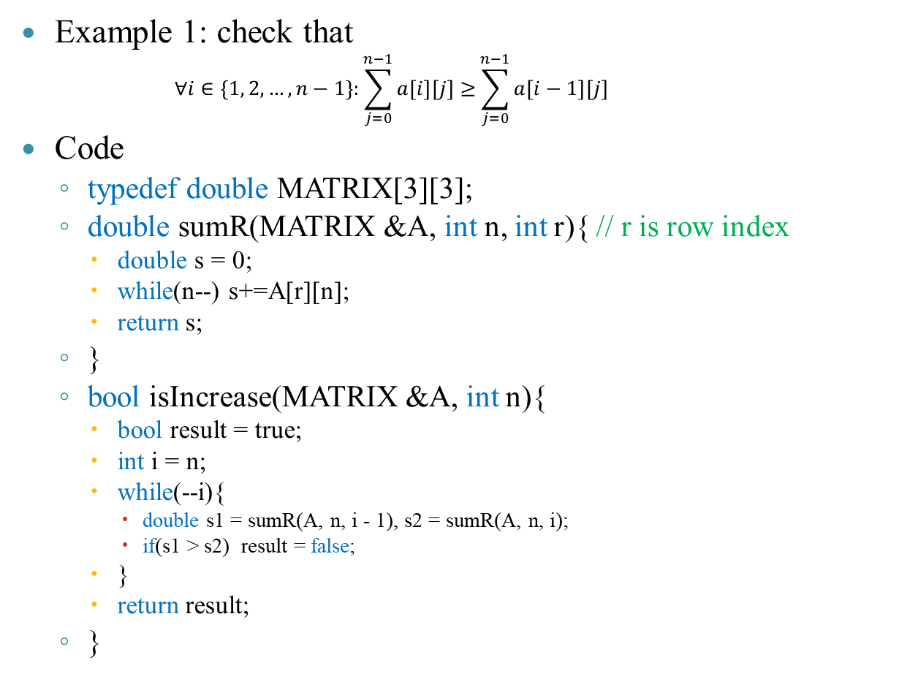
LOOP TECHNIQUES IN MAXTRIX
Example 1: check that
      $$∀i∈\left\{1, 2, …,n−1\right\}:\sum_{j=0}^{n−1}{a\left[i\right][j]≥}\sum_{j=0}^{n−1}{a\left[i−1\right][j] }$$
Code
  typedef double MATRIX[3][3];
  double sumR(MATRIX &A, int n, int r){ // r is row index
    double s = 0;
    while(n--) s+=A[r][n];
    return s;
  }
  bool isIncrease(MATRIX &A, int n){
    bool result = true;
    int i = n;
    while(--i){
      double s1 = sumR(A, n, i - 1), s2 = sumR(A, n, i);
      if(s1 > s2) result = false;
    }
    return result;
  }
Example n = 3
Need to compute:
sumR(1) & sumR(2)
sumR(0) & sumR(1)
0
1 | 2 | 3
4 | 5 | 6
7 | 8 | 9
1
2

Slide 74
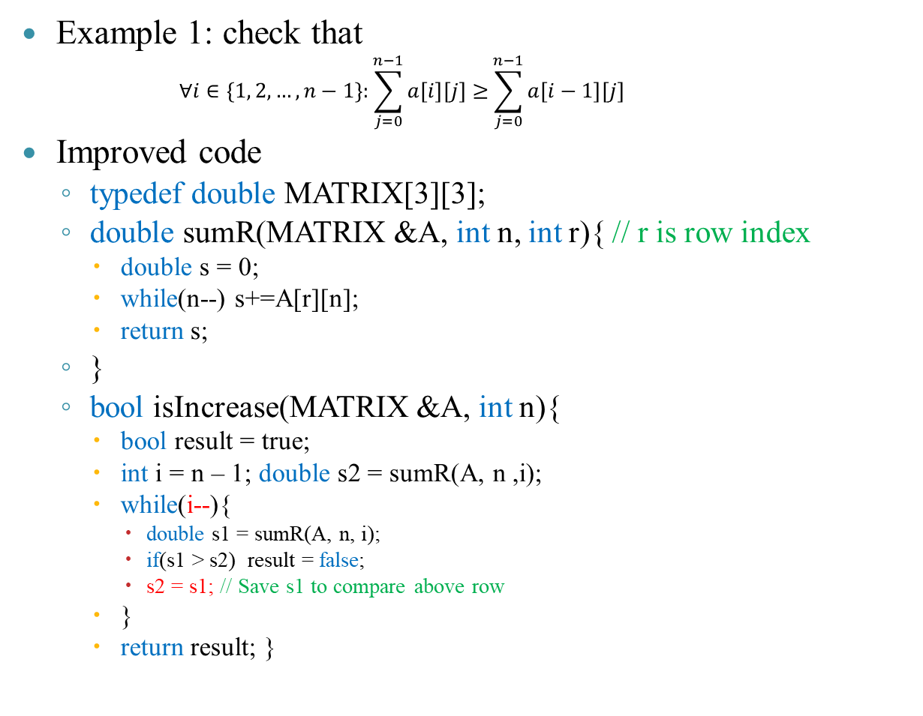
LOOP TECHNIQUES IN MAXTRIX
Example 1: check that
      $$∀i∈\left\{1, 2, …,n−1\right\}:\sum_{j=0}^{n−1}{a\left[i\right][j]≥}\sum_{j=0}^{n−1}{a\left[i−1\right][j] }$$
Improved code
  typedef double MATRIX[3][3];
  double sumR(MATRIX &A, int n, int r){ // r is row index
    double s = 0;
    while(n--) s+=A[r][n];
    return s;
  }
  bool isIncrease(MATRIX &A, int n){
    bool result = true;
    int i = n – 1; double s2 = sumR(A, n ,i);
    while(i--){
      double s1 = sumR(A, n, i);
      if(s1 > s2) result = false;
      s2 = s1; // Save s1 to compare above row
    }
    return result; }
Example n = 3
Precompute sumR(2), then
sumR(1) & save sumR(1)
sumR(0) & save sumR(0)
0
1 | 2 | 3
4 | 5 | 6
7 | 8 | 9
1
2

Slide 75

LOOP TECHNIQUES IN MAXTRIX
Example 2: sort square matrix (n × n) such that sum of all elements at row descending from up to bottom
Formal statement: check that
      $$∀i∈\left\{1, 2, …,n−1\right\}:\sum_{j=0}^{n−1}{a\left[i\right][j]≤}\sum_{j=0}^{n−1}{a\left[i−1\right][j] }$$
6
1 | 2 | 3
4 | 5 | 6
7 | 8 | 9
7 | 8 | 9
4 | 5 | 6
1 | 2 | 3
24
15
15
24
6

Slide 76
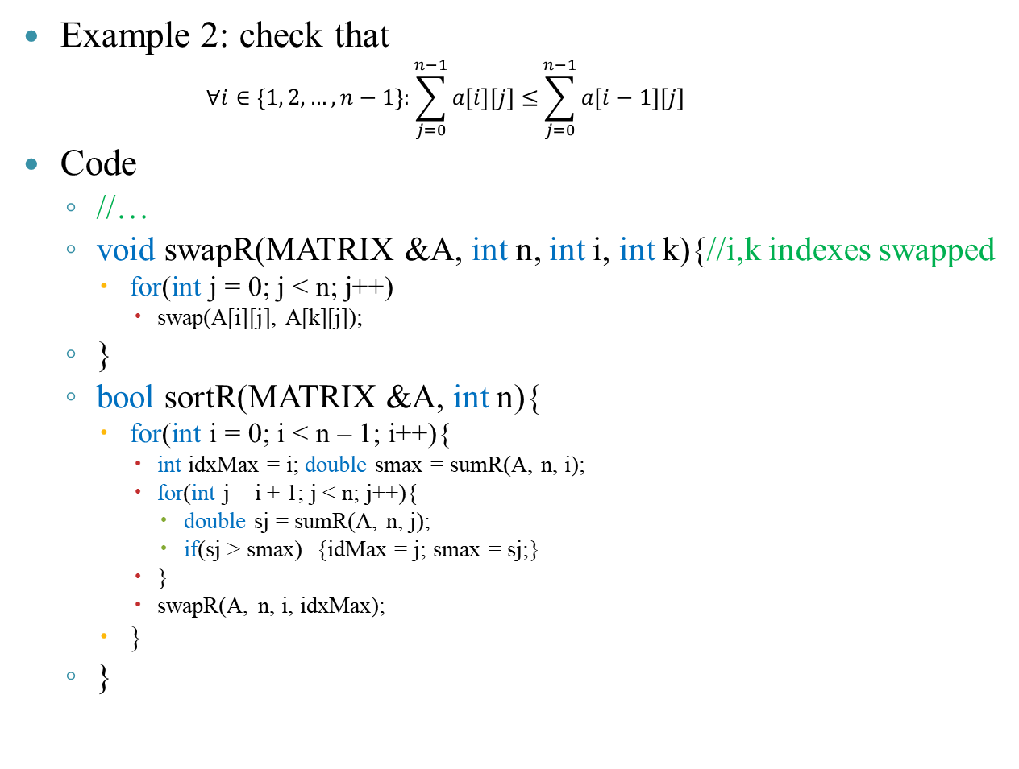
LOOP TECHNIQUES IN MAXTRIX
Example 2: check that
      $$∀i∈\left\{1, 2, …,n−1\right\}:\sum_{j=0}^{n−1}{a\left[i\right][j]≤}\sum_{j=0}^{n−1}{a\left[i−1\right][j] }$$
Code
  //…
  void swapR(MATRIX &A, int n, int i, int k){//i,k indexes swapped
    for(int j = 0; j < n; j++)
      swap(A[i][j], A[k][j]);
  }
  bool sortR(MATRIX &A, int n){
    for(int i = 0; i < n – 1; i++){
      int idxMax = i; double smax = sumR(A, n, i);
      for(int j = i + 1; j < n; j++){
        double sj = sumR(A, n, j);
        if(sj > smax) {idMax = j; smax = sj;}
      }
      swapR(A, n, i, idxMax);
    }
  }
smax =
10
26
42
58
idMax
0
1
2
3
4
i
1
5
6
7
8
2
9
10
11
12
3
13
14
15
16
j
sj =
26
10
42
58

Slide 77
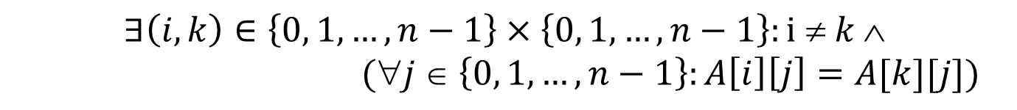
LOOP TECHNIQUES IN MAXTRIX
Example 3: check if square matrix (n × n) contains coincided rows?
Formal statement:
1 | 2 | 3
4 | 5 | 6
7 | 8 | 9
7 | 8 | 9
7 | 8 | 9
1 | 2 | 3
$$∃\left(i,k\right)∈\left\{0, 1, …,n−1\right\}×\left\{0, 1, …, n−1\right\}:i ≠ k $$
$(j ∈ \left\{0, 1, …,n−1\right\}:A\left[i\right]\left[j\right]=A[k][j])$

Slide 78
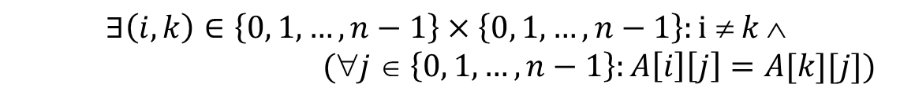
LOOP TECHNIQUES IN MAXTRIX
Example 3: check that
Code
  bool rowsEqual(MATRIX &A, int n, int i, int k){
    while(n--)
      if(A[i][n] != A[k][n])
        return false;
    return true;
  }
  bool rowsDup(MATRIX &A, int n){
    for(int i = 0; i < n – 1; i++)
      for(int k = i + 1; k < n; k++)
        if(rowsEqual(A, n, i, k)) return true;
    return false;
  }
$$∃\left(i,k\right)∈\left\{0, 1, …,n−1\right\}×\left\{0, 1, …, n−1\right\}:i ≠ k $$
$(j ∈ \left\{0, 1, …,n−1\right\}:A\left[i\right]\left[j\right]=A[k][j])$
0
1
i
2
k
3
4

Slide 79
LOOP TECHNIQUES IN MAXTRIX
Example 4: find the smallest positive number at main diagonal in square matrix (n × n)
Code
  int PositiveMinOnDiag(MATRIX& A, int n){
    int idx = -1;
    for(int i = 0; i < n; i++){
      if(A[i][i] > 0)
        if(idx == -1 || A[idx][idx] > A[i][i])
          idx = i;
    }
    return idx;
  }
0
1
2
0
7 | 8 | 9
4 | -5 | 6
1 | 2 | 3
1
2

Slide 80
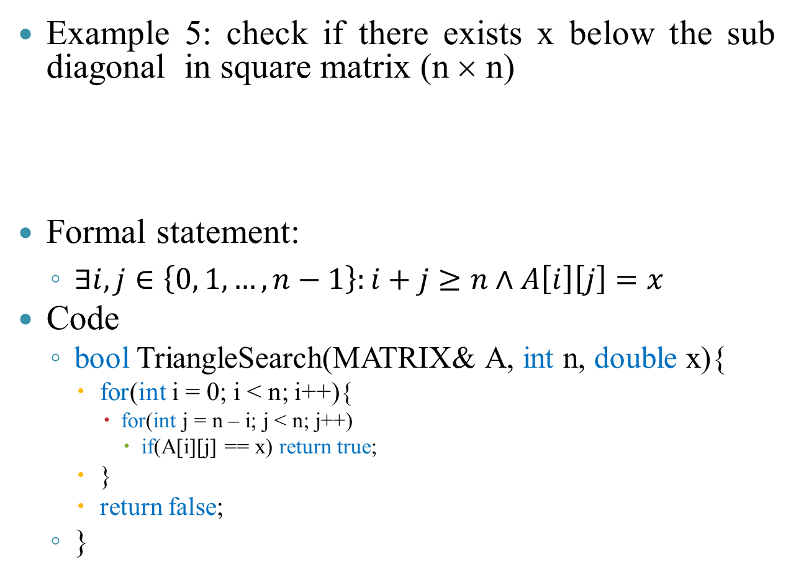
LOOP TECHNIQUES IN MAXTRIX
Example 5: check if there exists x below the sub diagonal in square matrix (n × n)
Formal statement:
  $∃i,j∈\left\{0, 1, …, n−1\right\}:i+j≥n∧A\left[i\right]\left[j\right]=x$
Code
  bool TriangleSearch(MATRIX& A, int n, double x){
    for(int i = 0; i < n; i++){
      for(int j = n – i; j < n; j++)
        if(A[i][j] == x) return true;
    }
    return false;
  }
0
1
2
0
7 | 8 | 9
4 | -5 | 6
1 | 2 | 3
1
2

Slide 81
RECURSION
Recursion algorithm includes
  Linear recursion
  Binary recursion
  Non–linear recursion
  Mutual recursion
Images

Slide 82
RECURSION
Example 1: compute n! = 1 × … × n
Note:
  n! = (1 × … × n – 1) × n = (n – 1)! × n
  n = 0 ⇒ 0! = 1
Lines | Description
1 | long Factorization(long n){
2 | if(n <= 0) return 1;
3 | long kq = n*Factorization(n - 1);
4 | return kq;
5 | }
6 | void main(){
7 | long r;
8 | r = Factorization(5);
9 | cout << r << endl;
10 | }
Main
F(5)
n = 5
kq = 5 ×…
n = 4
kq = 4×…
n = 3
kq = 3×…
n = 2
kq = 2×…
n = 1
kq = 1×…
n = 0
120
24
6
2
1
1

Slide 83
RECURSION
Example 2: sum S = a[0] + … + a[n – 1]
Note:
  If n ≥ 1 ⇒ S_{n-1} = (a[0] + … + a[n – 2]) + a[n – 1] = S_{n-2} + a[n – 1]
  If n ≤ 0 ⇒ S = 0
Lines | Description
1 | long sum(long a[], int n){
2 | if(n <= 0) return 0;
3 | long kq = a[n – 1] + sum(a, n - 1);
4 | return kq;
5 | }
6 | void main(){
7 | long b[]={1,2,3,4,5}, r;
8 | r = sum(b, 5);
9 | cout << r << endl;
10 | }
Main
sum(b,5)
n = 5
kq = 5 +…
n = 4
kq = 4 +…
n = 3
kq = 3 +…
n = 2
kq = 2 +…
n = 1
kq = 1 +…
n = 0
15
10
6
3
1
0

Slide 84
RECURSION
Example 3: sum with n ∈ ℤ*
  E_{n} = 1/1^{k} + 1/2^{k} + … + 1/n^{k}.
  E_{n} = 1/1^{k} + … + 1/(n – 1)^{k} + 1/n^{k} = E_{n – 1} + 1/n^{k}
Lines | Description
1 | long eulerFunc(int n, int k){
2 | if(n <= 0 || k < 1) return 0;
3 | int a = 1/pow(n, k);
4 | int b = eulerFunc(n – 1, k);
5 | return a + b;
6 | }

Slide 85
RECURSION
Example 4: find the largest element in array
Idea:
  If array size is one, it is the only max value
  Else, we find the largest element among n – 2 ones, then compare it with the last element (a[n – 1]) to find the max value
0
1
2
3
4
Lines | Description
1 | double Max(double a[], int n){
2 | if(n <= 1) return a[0];
3 | double m = Max(a, n - 1);
4 | if(m < a[n - 1]) m = a[n – 1];
5 | return m;
6 | }
5
2
6
9
7
6
5
9
9
5
m=
n = 5
6
m=
n = 4
m=
n = 3
5
m=
n = 2
6
9
5
n = 1
9 (main)

Slide 86
RECURSION
Xample 5: compute sin & cos
  sin(x) = 2sin(x/2)cos(x/2)
  cos(x) = 1 – 2sin²(x/2)
  If |x| < ε then
    sin(x) = x – x³/6
    cos(x) = 1 – x²/2
1 | #define epsilon 0.000001
2 | double Sin(double x){
3 | if(-epsilon<=x && x <= epsilon)
4 | return x – x*x*x/6;
5 | return 2*Sin(x/2)*Cos(x/2);
6 | }
1
2 | double Cos(double x){
3 | if(-epsilon<=x && x <= epsilon)
4 | return 1 – x*x/2;
5 | return 1 - 2*Sin(x/2)*Sin(x/2);
6 | }

Slide 87




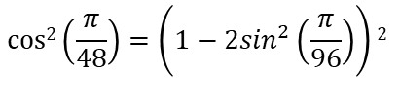










RECURSION
Example 5:
= 0.502372
$$\sin\left(\frac{π}{6}\right)=2\sin\left(\frac{π}{12}\right)cos⁡(\frac{π}{12})$$
$$2sin\left(\frac{π}{12}\right)=4\sin\left(\frac{π}{24}\right)cos⁡(\frac{π}{24})$$
= 0.52
0.9661 =
$$\cos\left(\frac{π}{12}\right)=1−2\sin^{2}\left(\frac{π}{24}\right)$$
$$4sin\left(\frac{π}{24}\right)=8\sin\left(\frac{π}{48}\right)cos⁡(\frac{π}{48})$$
$$\cos\left(\frac{π}{24}\right)=1−2\sin^{2}\left(\frac{π}{48}\right)$$
$$2sin{2\left(\frac{π}{24}\right)=8sin2\left(\frac{π}{48}\right)cos2⁡(\frac{π}{48})}$$
= 0.522
= 0.9914
= 0.0339
$$\cos\left(\frac{π}{48}\right)=1−2\sin^{2}\left(\frac{π}{96}\right)$$
$$2sin{2\left(\frac{π}{48}\right)=8sin2\left(\frac{π}{96}\right)cos2⁡(\frac{π}{96})}$$
$$cos2\left(\frac{π}{48}\right)=\left(1−2\sin^{2}\left(\frac{π}{96}\right)\right)2$$
$$8sin\left(\frac{π}{48}\right)=16\sin\left(\frac{π}{96}\right)cos⁡(\frac{π}{96})$$
= 0.9979
= 0.5229
= 0.0086
$$8sin{2\left(\frac{π}{48}\right)=32sin2\left(\frac{π}{96}\right)cos2⁡(\frac{π}{96})}$$
= 0.996
= 0.034
$16\sin\left(\frac{π}{96}\right)$=0.523
$\cos\left(\frac{π}{96}\right)$=0.999
$32sin2\left(\frac{π}{96}\right)$=0.034
$cos2\left(\frac{π}{96}\right)$=0.999

Slide 88
RECURSION
Example 6: square root approximation
  x₀ = 1 if n = 0
  x_{n} = x_{n – 1}/2 + a/(2 × x_{n – 1}) (n ≥ 1 & a ∈ ℝ*)
Sqrt(6, 5)
→ t/2 + 5/(2*t)
2.236067978
1 | double Sqrt(int n, double a){
2 | double t;
3 | if(a <= 0) return 0;
4 | if(n <= 0) return 1;
5 | t = Sqrt(n – 1, a);
6 | return t/2 + a/(2*t);
7 | }
Sqrt(5, 5)
→ t/2 + 5/(2*t)
2.236067978
Sqrt(4, 5)
→ t/2 + 5/(2*t)
2207/987
47/21
Sqrt(3, 5)
→ t/2 + 5/(2*t)
7/3
Sqrt(2, 5)
→ t/2 + 5/(2*t)
Sqrt(1, 5)
→ t/2 + 5/(2*t)
3
Sqrt(0, 5)
1

Slide 89
RECURSION
Example 7: quick exponentiation
  x^{n} = (x^{n/2})² if n is even
  x^{n} = (x^{(n – 1)/2})² if n is odd
1 | double Power(double x, int n){
2 | double r;
3 | if(n < 0) return 1/(Power(x, -n));
4 | if(n == 0) return 1;
5 | if(n == 1) return x;
6 | r = Power(x, n/2);
7 | if(n % 2 == 0) return r*r;
8 | return r*r*x;
9 | }
Power(2, 5)
→ r*r*2
32
Power(2, 2)
→ r*r
4
Power(2, 1)
2

