Slide 1
INTRODUCTION
Introduction to Programming – Nhập môn lập trình
Advisor: Trương Toàn Thịnh

Slide 2
CONTENTS
Goals
Program
Compiler
Programming environment
Examples

Slide 3
GOALS
Understanding basic conceptions of programming language, for example C/C++.
Using techniques in C/C++ to deal with the practical/academic problem.
Knowing some programming strategy
Programming environment:
  Visual Studio 2022.

Slide 4
GOALS
Grade scale
  Midterm: 25%
  Assignments: 25%
  Final: 25%
Class organization
  Group of about 2 mems:
    Discuss
    Doing exercises.
  Student: read more any materials
Discuss at:
  Forum: https://courses.fit.hcmus.edu.vn/
  Advisor: Trương Toàn Thịnh
    Email: ttthinh@fit.hcmus.edu.vn
    Place: Room I82, Information technology department, University of Science, VNU-HCM

Slide 5
GOALS
References:
  Kĩ thuật lập trình C – Prof Phạm Văn Ất
  Nhập môn lập trình – Prof Trần Đan Thư, PhD Nguyễn Thanh Phương, PhD Đinh Bá Tiến và Prof Trần Minh Triết.
  The C++ Programming Language – Bjame Stroustrup
  Introduction to Algorithms – Thomas H. Cormen, Charles E. Leiserson, Ronald L. Rivest, và Clifford Stein

Slide 6
GOALS
Main contents
  Overview of computer programming
  Basic operators
  Control structure
  Modular programming
  Algorithm
  Conditional programming strategy
  Array
  Loop technique
  Structural datatype
  File – handling

Slide 7
CONTENTS
Goals
Program
Compiler
Programming environment
Examples

Slide 8
PROGRAM
What program is
  A sequence of instructions
  To solve practical/academic problems
Who programs is developer
There are two basic programs
  Machine code
  Assembly & assembler

Slide 9





PROGRAM
Process of machine code
Some limitations
  Depend on CPU
  Organized by OS
  Difficult to understand
Unable to directly program machine code
Run
Search
Load
Process

Slide 10





PROGRAM
Assembly is a low-level language
  Easier to understand than machine code
  Need Assembler to translate into machine code
Defect: depend on CPU
Merit: take advantage of CPU
File
assembly 1
Assembler A
File
assembly 2
Assembler B

Slide 11
PROGRAM
Traditional high – level programming language
  More abstract than assemly
  Easier to understand than assembly
  More compatible than assemly
Compiler B
High – level
Language
File
Compiler A

Slide 12
PROGRAM
There are many languages with various objectives
  Web applications: PHP, ASP.net, Ruby
  Administration systems: Java, C#
  Science computations: Fortran
  Machine learning algorithms: Python
  Operating systems: C/C++

Slide 13


PROGRAM
Limitation of traditional high–level programming languages: their compilers directly translate into machine code
The modern high–level programming languages’ compilers translate into intermediate code (byte–code)
Compiler
Byte - code
Modern high – level
language
File
Virtual machine

Slide 14
CONTENTS
Goals
Program
Compiler
Programming environment
Examples

Slide 15
COMPILER
There are two high – level ones
  Compiler
    All source code is performed syntax analysis
    Translates a programming language into another language (machine code + management information)
    Results saved on hard-disk are execution files
  Interpreter
    Checks syntax at each line of codes
    Perform its behavior directly

Slide 16
COMPILER
Process of compiling high–level language
  Developer chooses another text-editor to compose source – code
  Compiler translates it into target language (intermedia code)
  Linker connects all intermedia codes into executable files
  Run the program

Slide 17
COMPILER
Diagram
Compose & save
Source-code files
Translated by Compiler
Syntax analysis
Yes
Fix & save
No
Connected by Linker
Object files
Execution files

Slide 18
CONTENTS
Goals
Program
Compiler
Programming environment
Examples

Slide 19
PROGRAMMING ENVIRONMENT
A place where we perform some tasks, such as, compiling, linking (called Integrated Development Environment)
Main features
  Text Composing
  Source code management
  Version management
  Syntax analysis, compiling and linking
  Debug
  …
For instances: visual studio 2019, 2022…

Slide 20
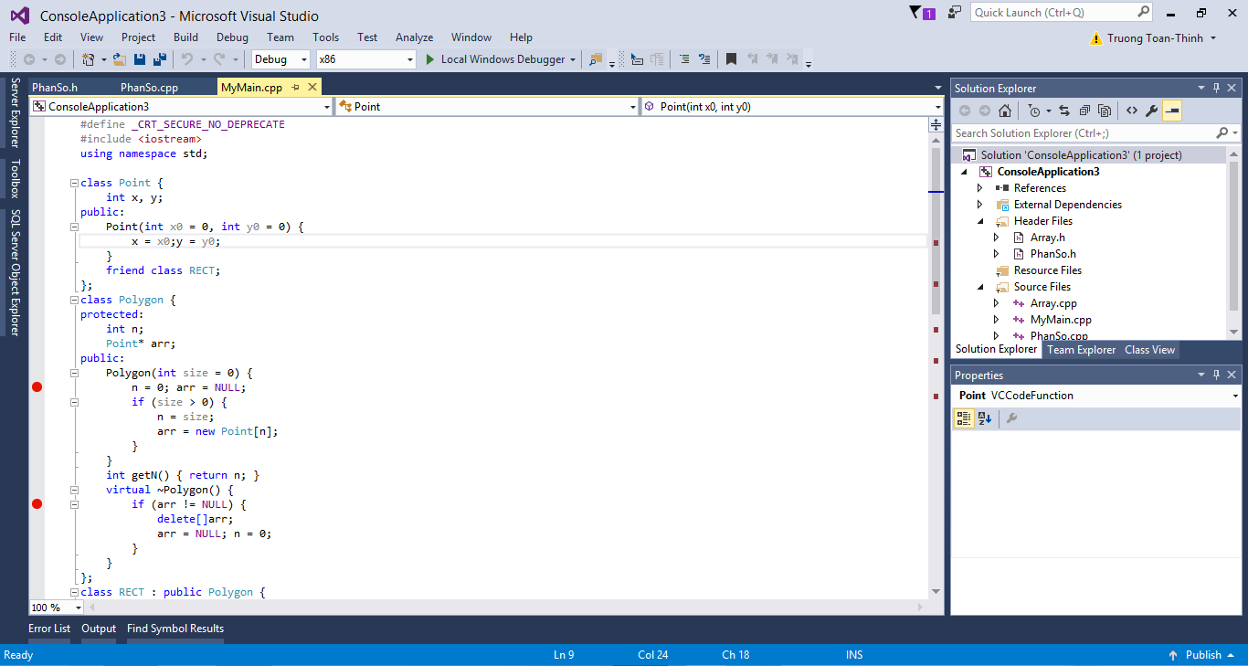
PROGRAMMING ENVIRONMENT

Slide 21
CONTENTS
Goals
Program
Compiler
Programming environment
Examples

Slide 22
EXAMPLES
Lines | Description
1 | //File Hello.c
2 | #include <stdio.h>
3 | void main()
4 | {
5 | printf(“Hello World!!!”); COUT << “HELLO WORLD”;
6 | }
Line 1: comment line
Line 2: include some libraries
Line 3: declare at the beginning
Line 4: symbol ‘{’ begins the definition
Line 5: print ‘Hello…’ to screen
Line 6: symbol ‘}’ finishes the definition

Slide 23
EXAMPLES
Lines | Description
1 | //File Hello.c
2 | #include <stdio.h>
3 | void main()
4 | {
5 | printf(“Hello World!!!\n”);
6 | printf(“I am a student”);
7 | }
Line 1: …
Line 2: …
Line 3: …
Line 4: …
Line 5: …
Line 6: …
Line 7: …

Slide 24
EXAMPLES
Lines | Description
1 | //File Sum.c
2 | #include <stdio.h>
3 | void main()
4 | {
5 | int a = 2, b = 3;
6 | int kq = a + b;
7 | printf(“Ket qua la: %d”, kq);
8 | }
Line 1, 2, 3, 4: …
Line 5: declare & define 2 integer variables called a & b valued 2 & 3
Line 6: declare & define integer variable kq valued the sum of a & b
Line 7: print the result kq to screen, representation string standing for integer variable is “%d”

Slide 25
EXAMPLES
Lines | Description
1 | //File Sum.c
2 | #include <stdio.h>
3 | void main()
4 | {
5 | int a , b;
6 | printf(“Nhap a: ”);
7 | scanf(“%d”, &a);
8
9
10 | int kq = …
11 | printf(“Ket qua la: %d”, kq);
12 | }

Slide 26
EXAMPLES
Lines | Description
1 | //File Subtract.c
2 | #include <stdio.h>
3 | void main()
4 | {
5 | int a , b;
6 | printf(“Nhap a: ”);
7 | scanf(“%d”, &a);
8
9
10 | int kq = …
11 | printf(“Ket qua la: %d”, kq);
12 | }

Slide 27
EXAMPLES
Lines | Description
1 | //File Sin.c
2 | #include <stdio.h>
3 | #include <math.h>
4 | void main()
5 | {
6 | double a ;
7 | printf(“Nhap a: ”);
8 | scanf(“%lf”, &a);
9 | double kq = sin(a);
10 | printf(“Ket qua la: %lf”, kq);
11 | }

Slide 28
EXAMPLES
Lines | Description
1 | //File Tinh_can_so.c
2 | #include <stdio.h>
3 | #include <math.h>
4 | void main()
5 | {
6 | double a ;
7 | printf(“Nhap a: ”);
8 | scanf(“%lf”, &a);
9 | double kq = …; // Ham tinh can so trong Math.h la sqrt()
10 | printf(“Ket qua la: %lf”, kq);
11 | }

Slide 29
EXAMPLES
Lines | Description
1 | //File Divide.c
2 | #include <stdio.h>
3 | void main()
4 | {
5 | double a , b;
6 | printf(“Nhap a: ”);
7 | scanf(“%lf”, &a);
8
9
10 | double kq = a/b;
11 | printf(“Ket qua la: %lf”, kq);
12 | }

