Slide 1

Building Tomorrow's Innovations on Today's Connected Data
Taesung Brian Kim¹, Hsiang Ting Su², and Chia-Yu Lu¹
¹ Tunghai University, Taichung, Taiwan
² National Chung Hsing University, Taichung, Taiwan
8th International Conference on Knowledge Innovation and Invention, August 22-24, 2025 || Fukuoka, Japan

Slide 2
Contents
Introduction
  Background
  Problem Questions
  Objective
Methods
Results
Discussion

Slide 3
Introduction
Generative AI transforms innovation management
Traditional patents  Academic publications as strategic tools
AI field characteristics
  Open innovation dominance
  Rapid experimentation cycles
  Strategic knowledge sharing
New strategic functions
  Signal innovative capabilities
  Attract talent and influence standards
  Shape industry narratives
  Monitor competitors

Slide 4
Research Questions & Objective
Research Questions
  How do different publication types correlate in knowledge flow?
  How do incumbents vs. emerging players use academic publications strategically?
Objective
  Build a comprehensive cross-source knowledge database
  Map connections: academic publishing  technological development  commercial innovation
  Enable organizations to understand innovation trajectories and competitive positioning in a rapidly evolving tech landscape

Slide 5
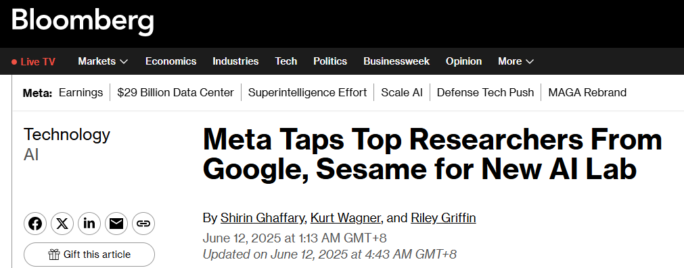
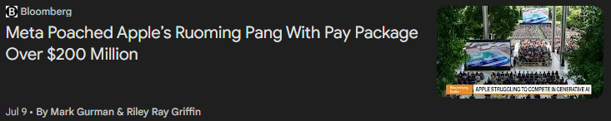


Slide 6


Methods – Data Collection
Heterogeneous Dataset Collection
  Academic publications: Scopus database (journals + conference proceedings,1975–2025, English)
  Patent data: Lens.org (USPTO database interface)
  Purpose: Analyze knowledge flow from fundamental research to innovative technologies

Slide 7

Methods
K-means clustering: Three productivity variables (journal pubs, conference pubs, patents)
Silhouette score: Evaluate clustering quality
PCA visualization: Project results in 2D space for interpretation
Patent Paper Ratio (PPR) calculated by organization type and region
$$Patent Paper Ratio(PPR)=\frac{Pi}{Ji+Ci}$$

Slide 8
Results – Data Overview
Type | Data | N | %
Document type | Journal papers Scopus | 7,341 | 54.0
 | Conference papers Scopus | 4,770 | 35.1
 | Patent Lens.org (USPTO) | 1,487 | 10.9
Organization type | Academic | 3,039 | 54.7
 | Non-academic | 2,521 | 45.3

Slide 9
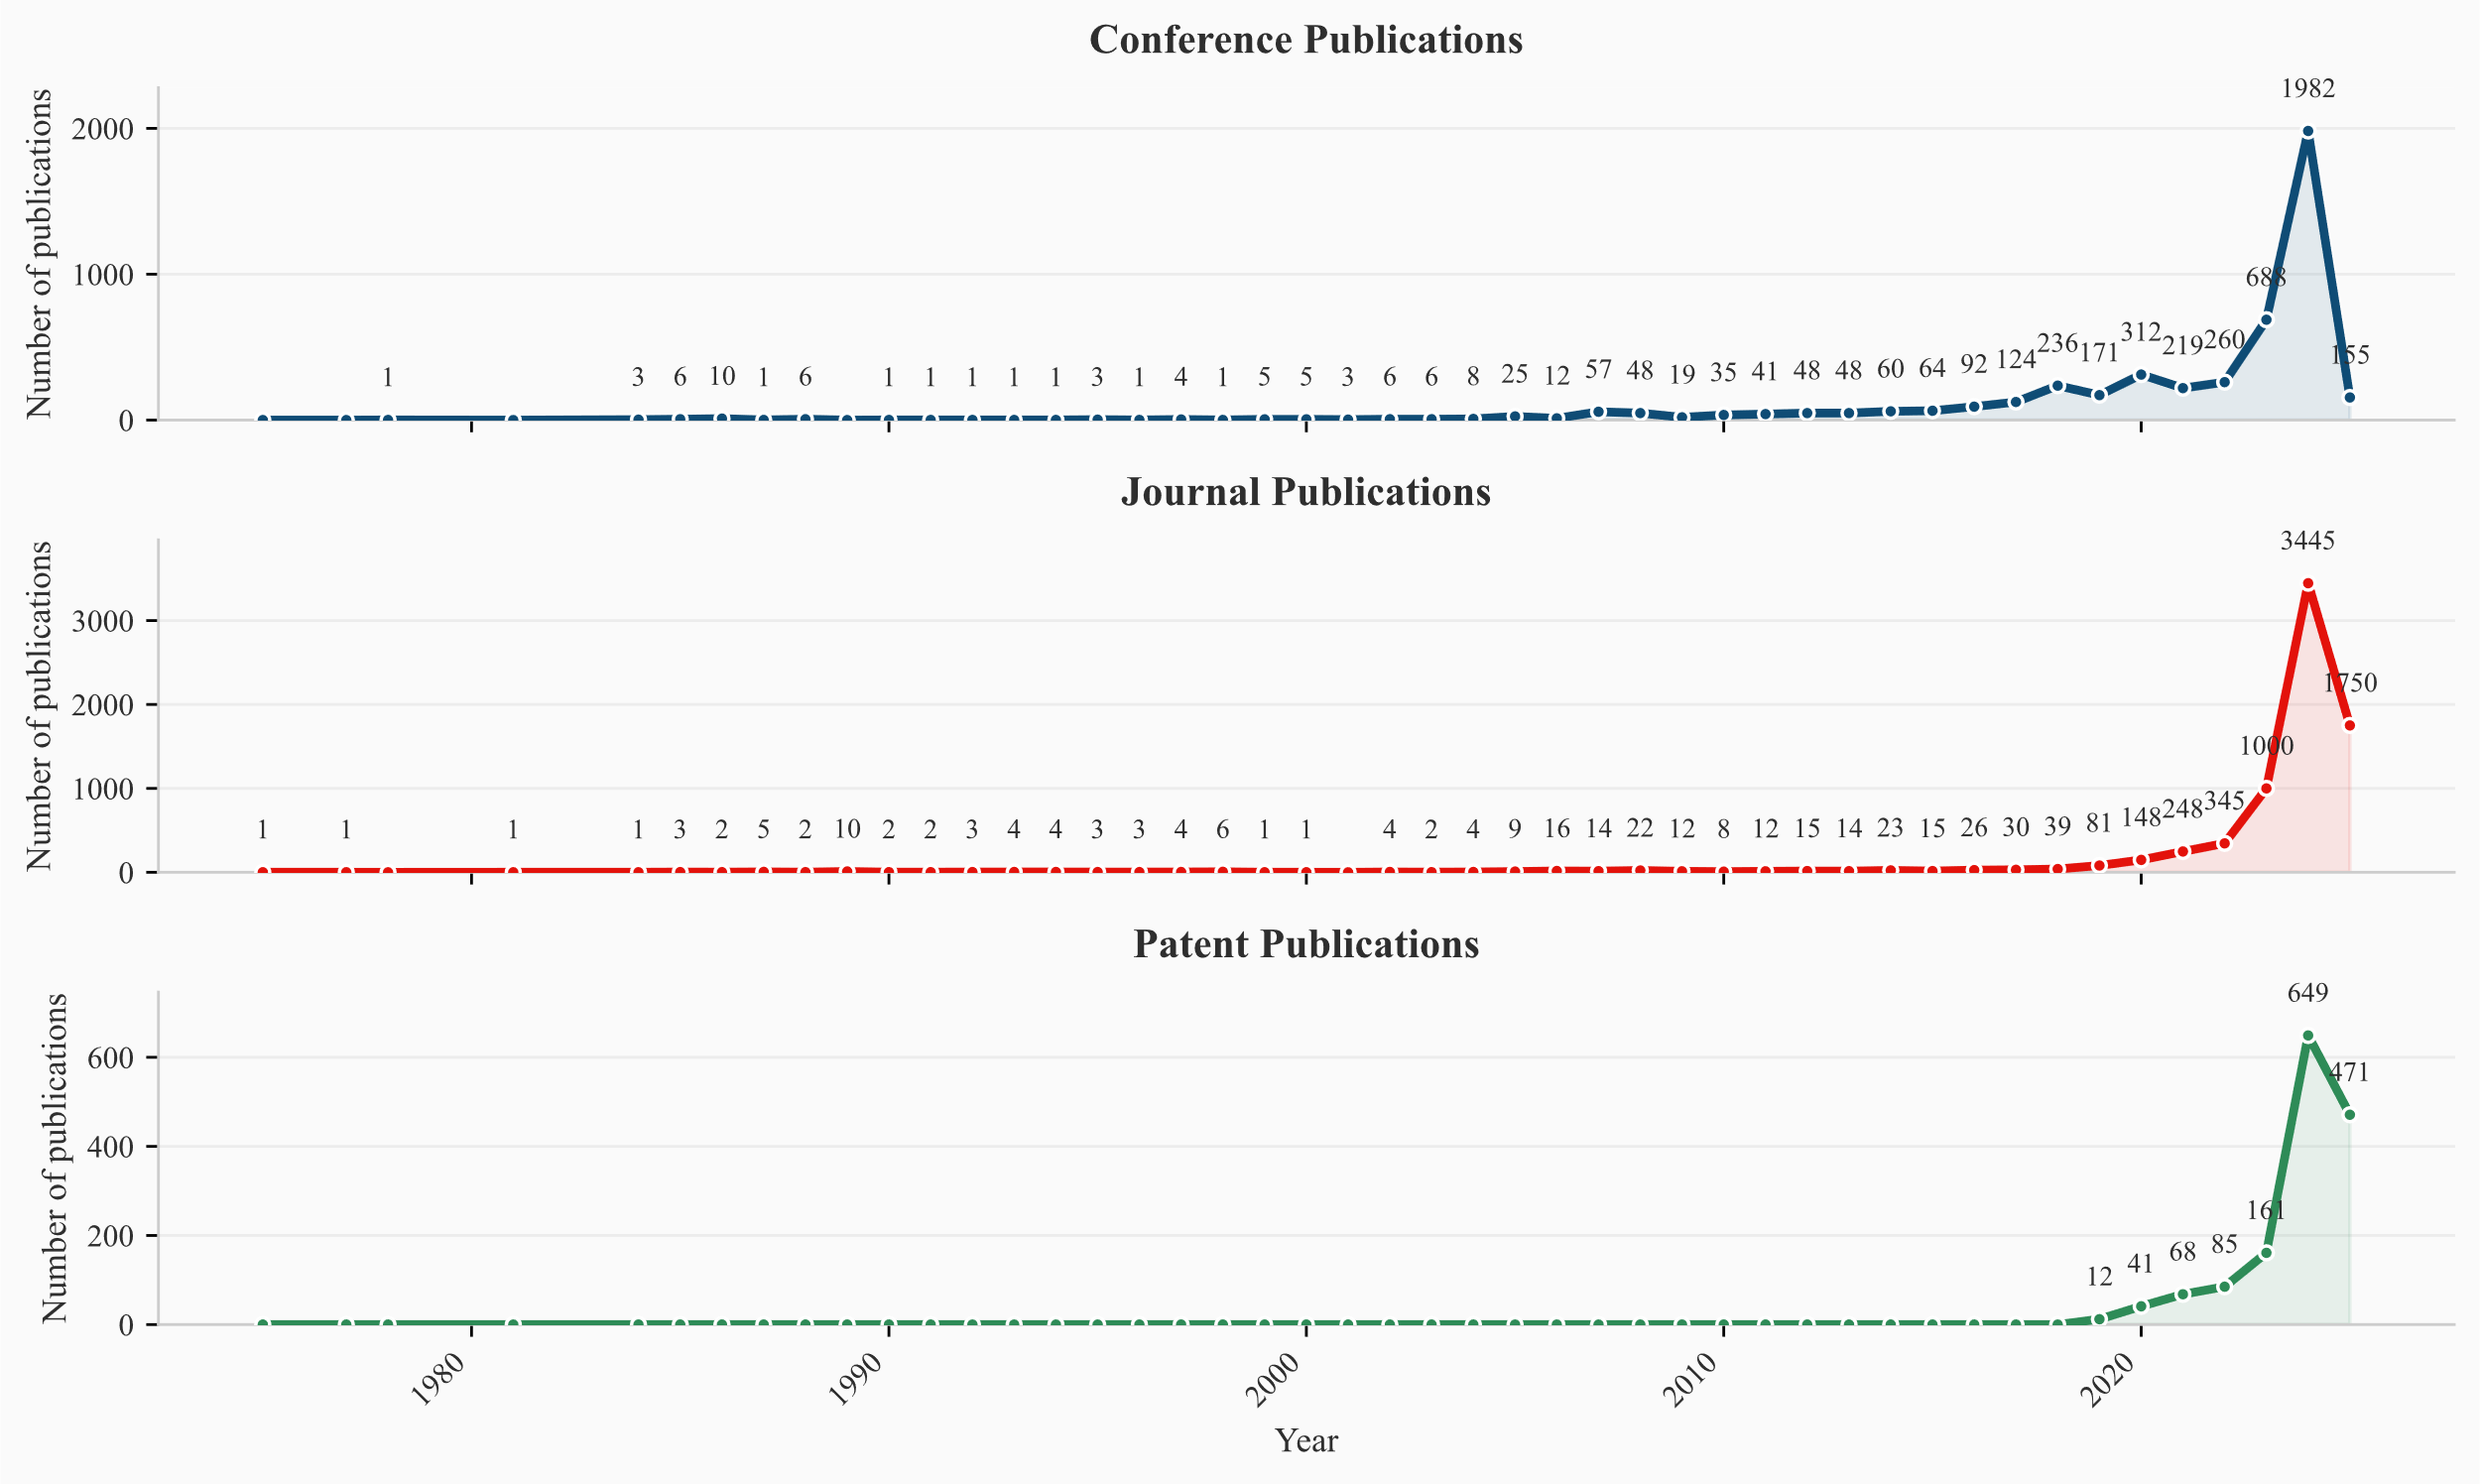
Results
Research output growth trends

Slide 10
Results – Data Overview
Three Growth Phases
  Phase 1 (1975-2010): Slow growth across all publication types
  Phase 2 (2010-2020): Conference publications gain momentum, journals follow
  Phase 3 (2020-2025): Exponential growth in all categories
Key Findings
  Temporal relationships: Conferences → Journals/Patents (synchronized movement)
  2025 data drop: Mid-year collection artifact
  Heterogeneous drops: Conferences > Journals/Patents (reviewing process delays)
  Knowledge flow pattern: Academic research precedes patent applications

Slide 11
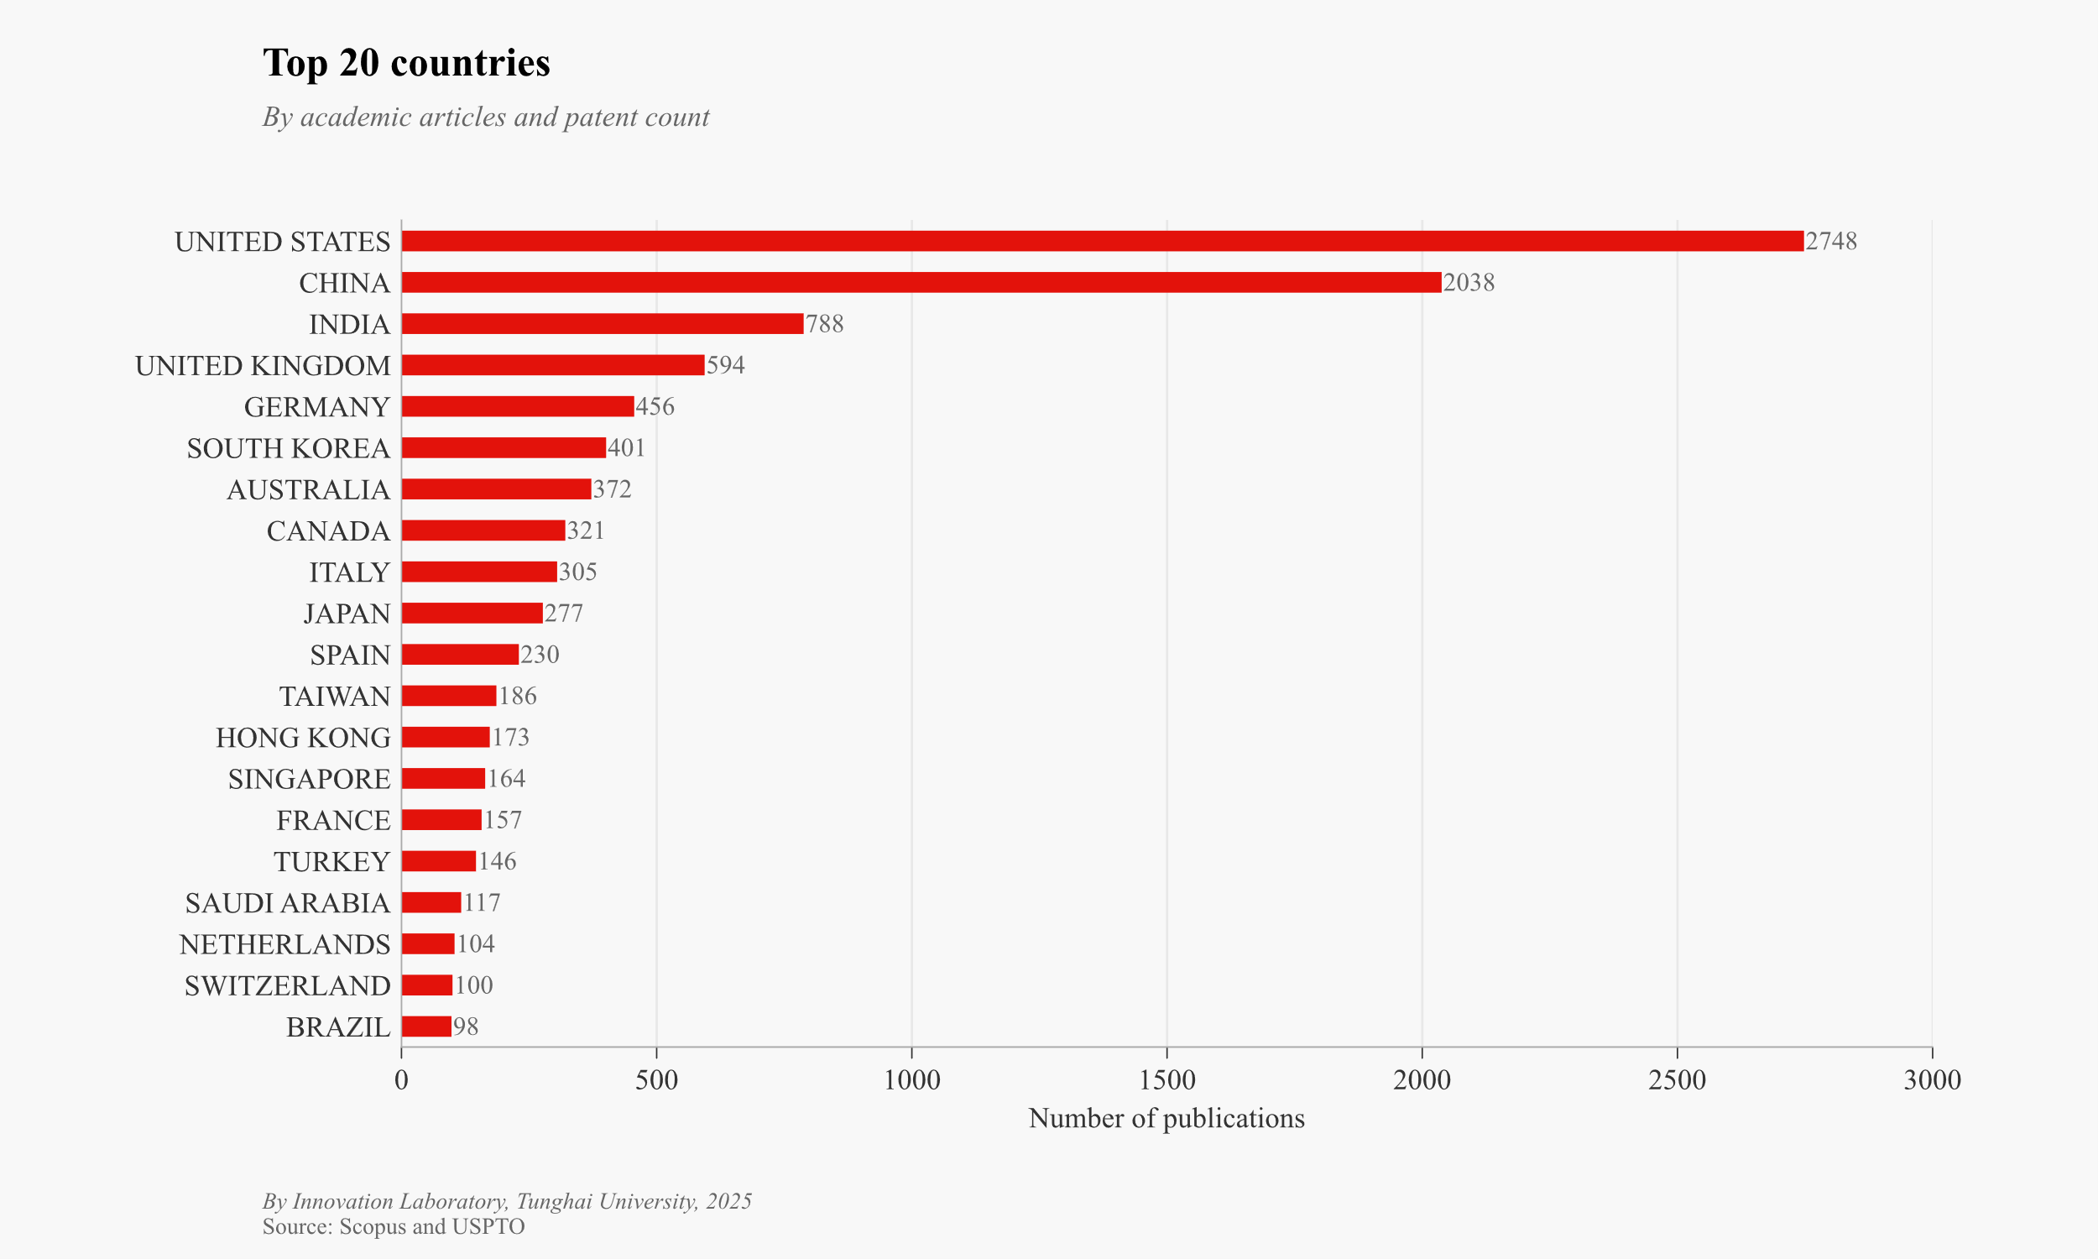
Results

Slide 12
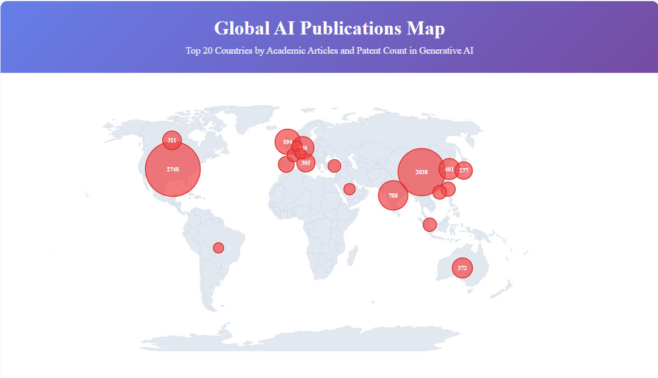

Slide 13
Results
Leading Nations
  Top 2 dominance: Significant gap after leading countries
  Third tier: India (788), UK (594), Germany (456)
  Middle tier: South Korea (401), Australia (372), Canada (321), Italy (305), Japan (277), Taiwan(186)
Regional Distribution
  Asia: Nearly half of the top 20 countries - major AI research powerhouses
  Europe: 8 countries represented, active EU cross-country collaborations
  Global spread: Technologically advanced nations across diverse regions

Slide 14
Results
Organization | Journal | Conference | Patent | PPR
NVIDIA | 0 | 3 | 122 | 40.7
ORACLE | 0 | 1 | 15 | 15.0
ADOBE | 2 | 2 | 33 | 8.3
QUALCOMM | 0 | 1 | 8 | 8.0
ACCENTURE | 1 | 3 | 28 | 7.0
UIPATH INC | 0 | 1 | 5 | 5.0
VOLVO | 0 | 1 | 4 | 4.0
INFOSYS | 0 | 1 | 4 | 4.0
SONY | 0 | 3 | 10 | 3.3
MICROSOFT | 7 | 12 | 56 | 2.9
SAMSUNG | 3 | 7 | 24 | 2.4
FUJITSU | 0 | 2 | 4 | 2.0
NEC | 1 | 3 | 7 | 1.8
BAIDU | 0 | 5 | 6 | 1.2
IBM | 7 | 34 | 45 | 1.1
SIEMENS | 3 | 7 | 10 | 1.0
HUAWEI | 0 | 6 | 6 | 1.0
VOLKSWAGEN | 0 | 4 | 3 | 0.8
AMAZON | 5 | 9 | 7 | 0.5
GOOGLE | 11 | 19 | 13 | 0.4

Slide 15
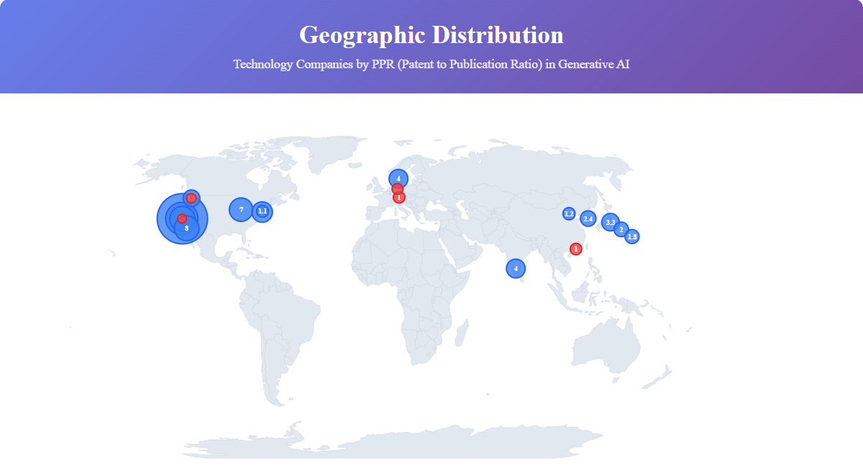

Slide 16
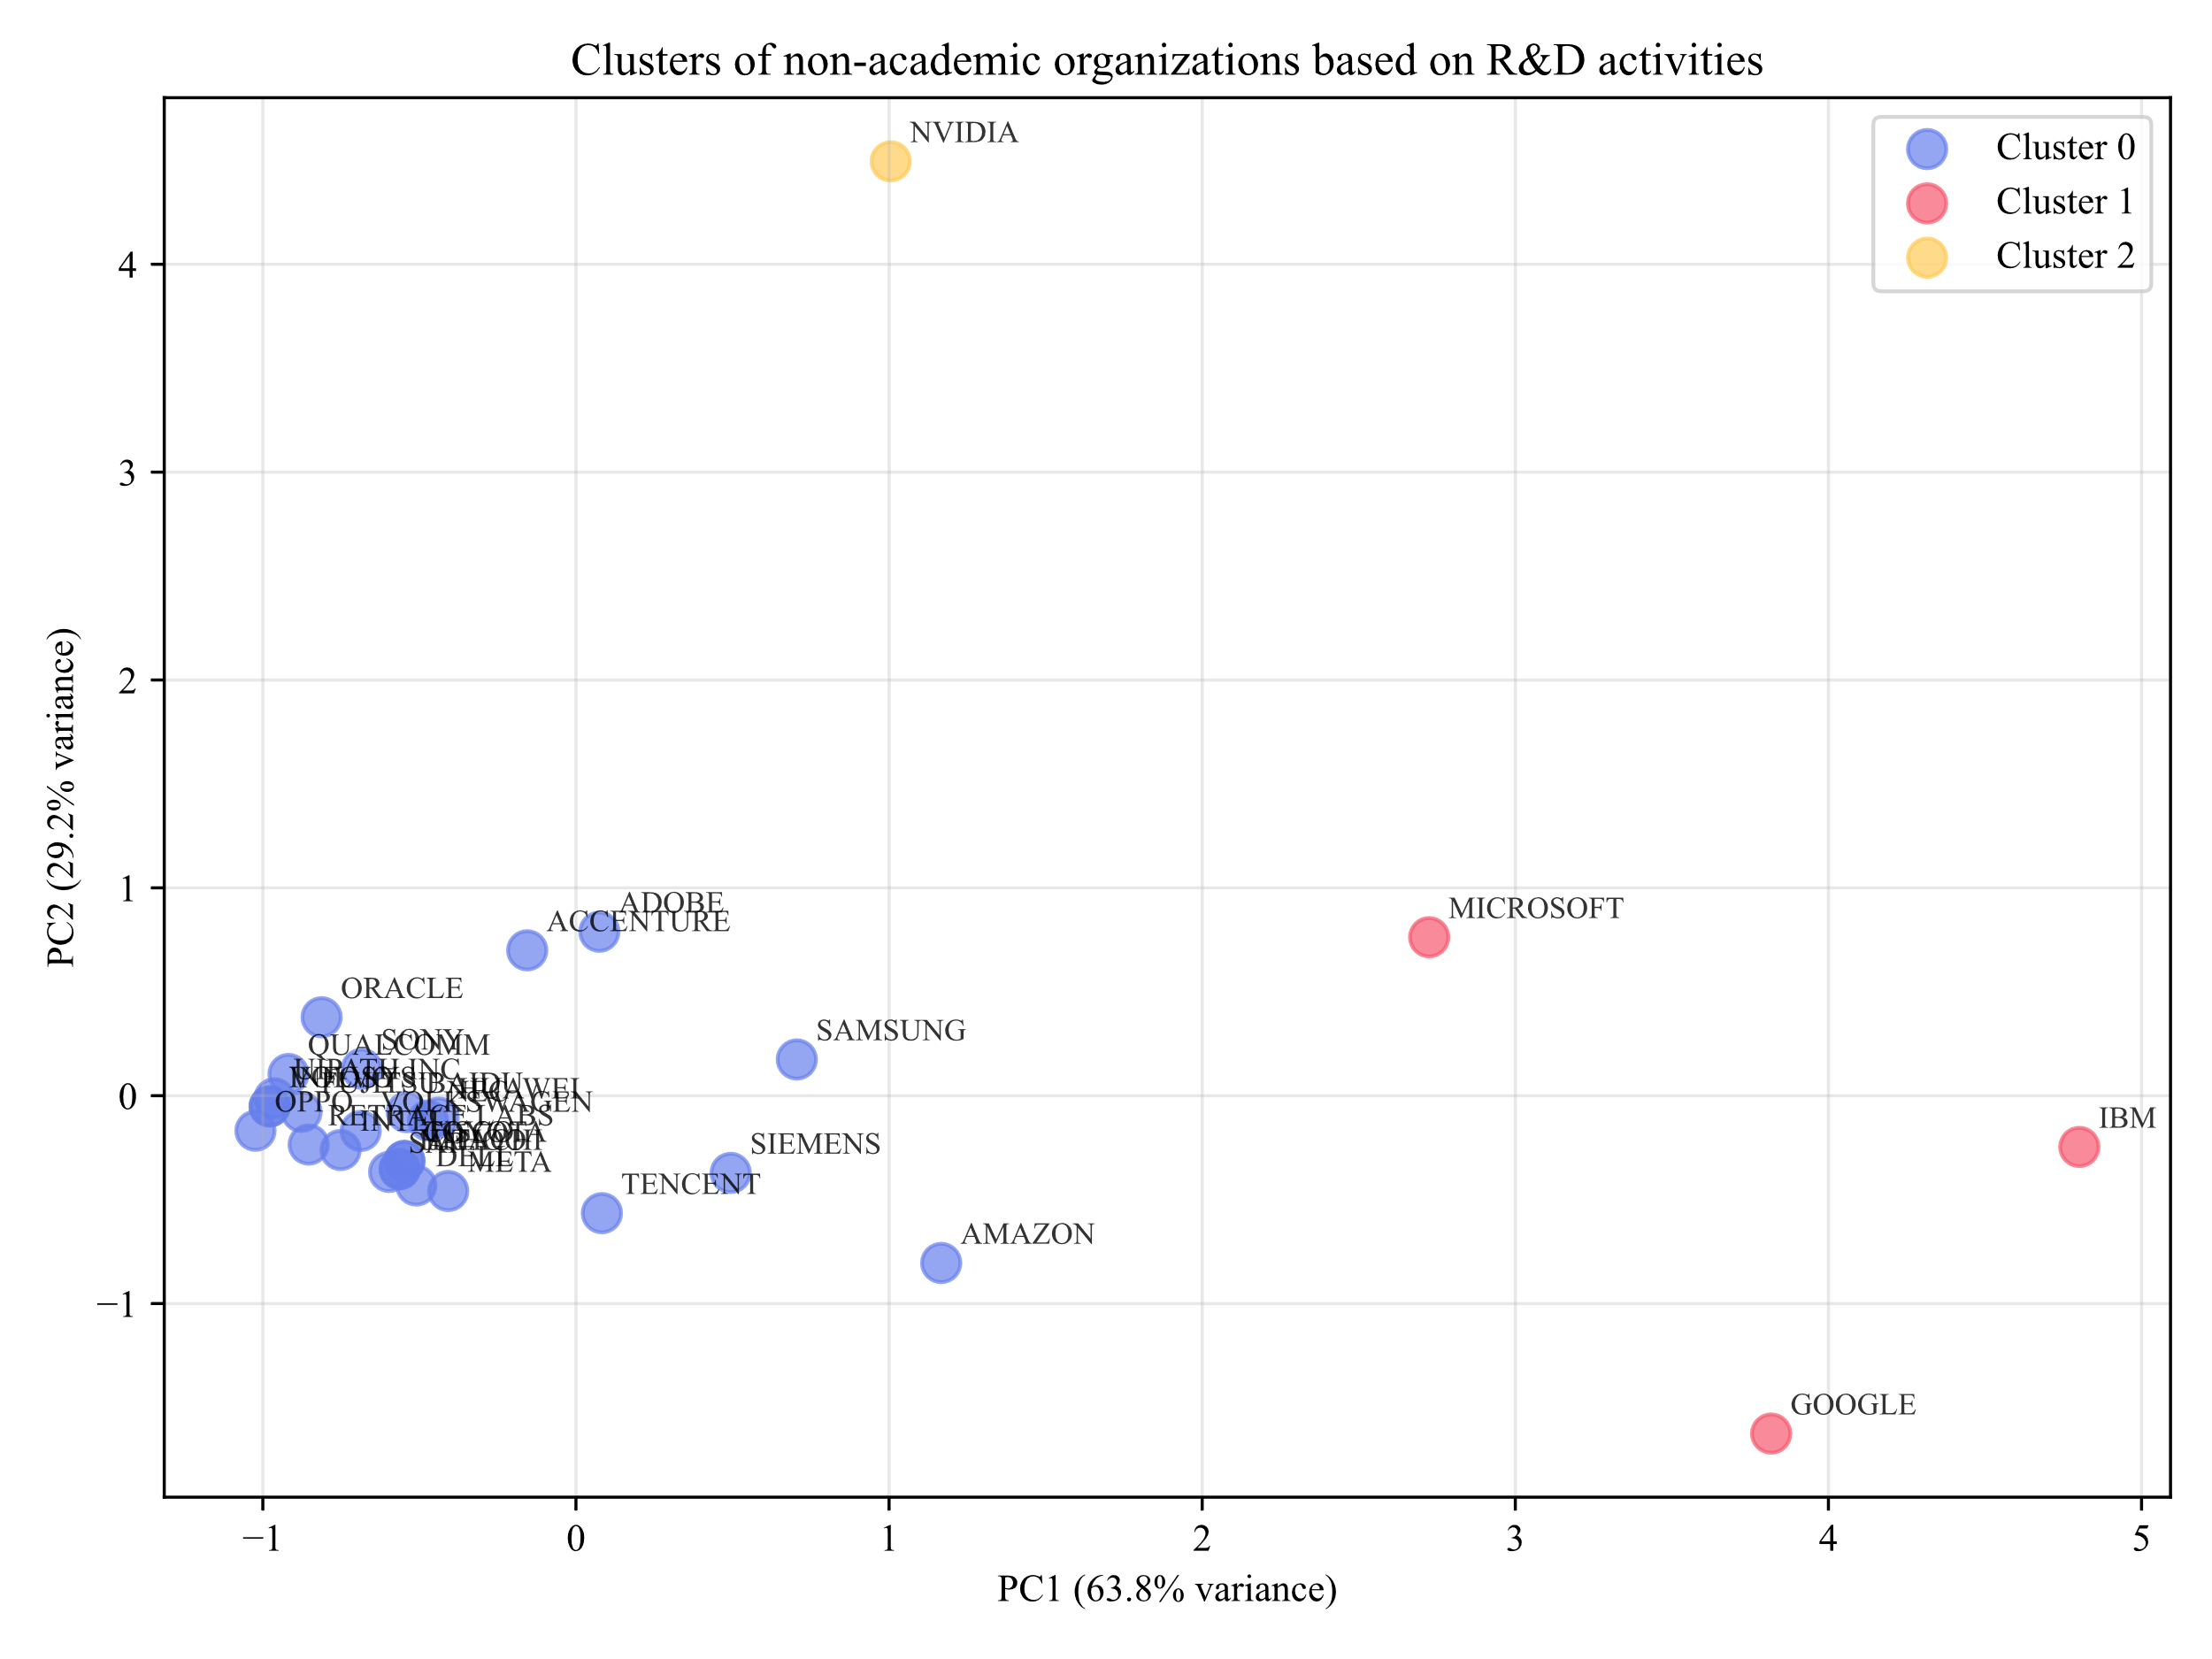
Results
Cluster | Organization | AJ¹ | AC² | AP³
0 | ADOBE, SAMSUNG, ACCENTURE, AMAZON, SIEMENS, ORACLE, SONY, HUAWEI, BAIDU, NEC, TENCENT, QUALCOMM, VOLKSWAGEN, UIPATH INC, TOYOTA, CISCO, FUJITSU, META, VOLVO, INFOSYS, HITACHI, YAHOO, DELL, SAP, INTEL, RETRACE LABS, OPPO | 1.1 | 2.9 | 7.1
1 | IBM, MICROSOFT, GOOGLE | 8.3 | 21.7 | 38.0
2 | NVIDIA | 0 | 3 | 122

Slide 17
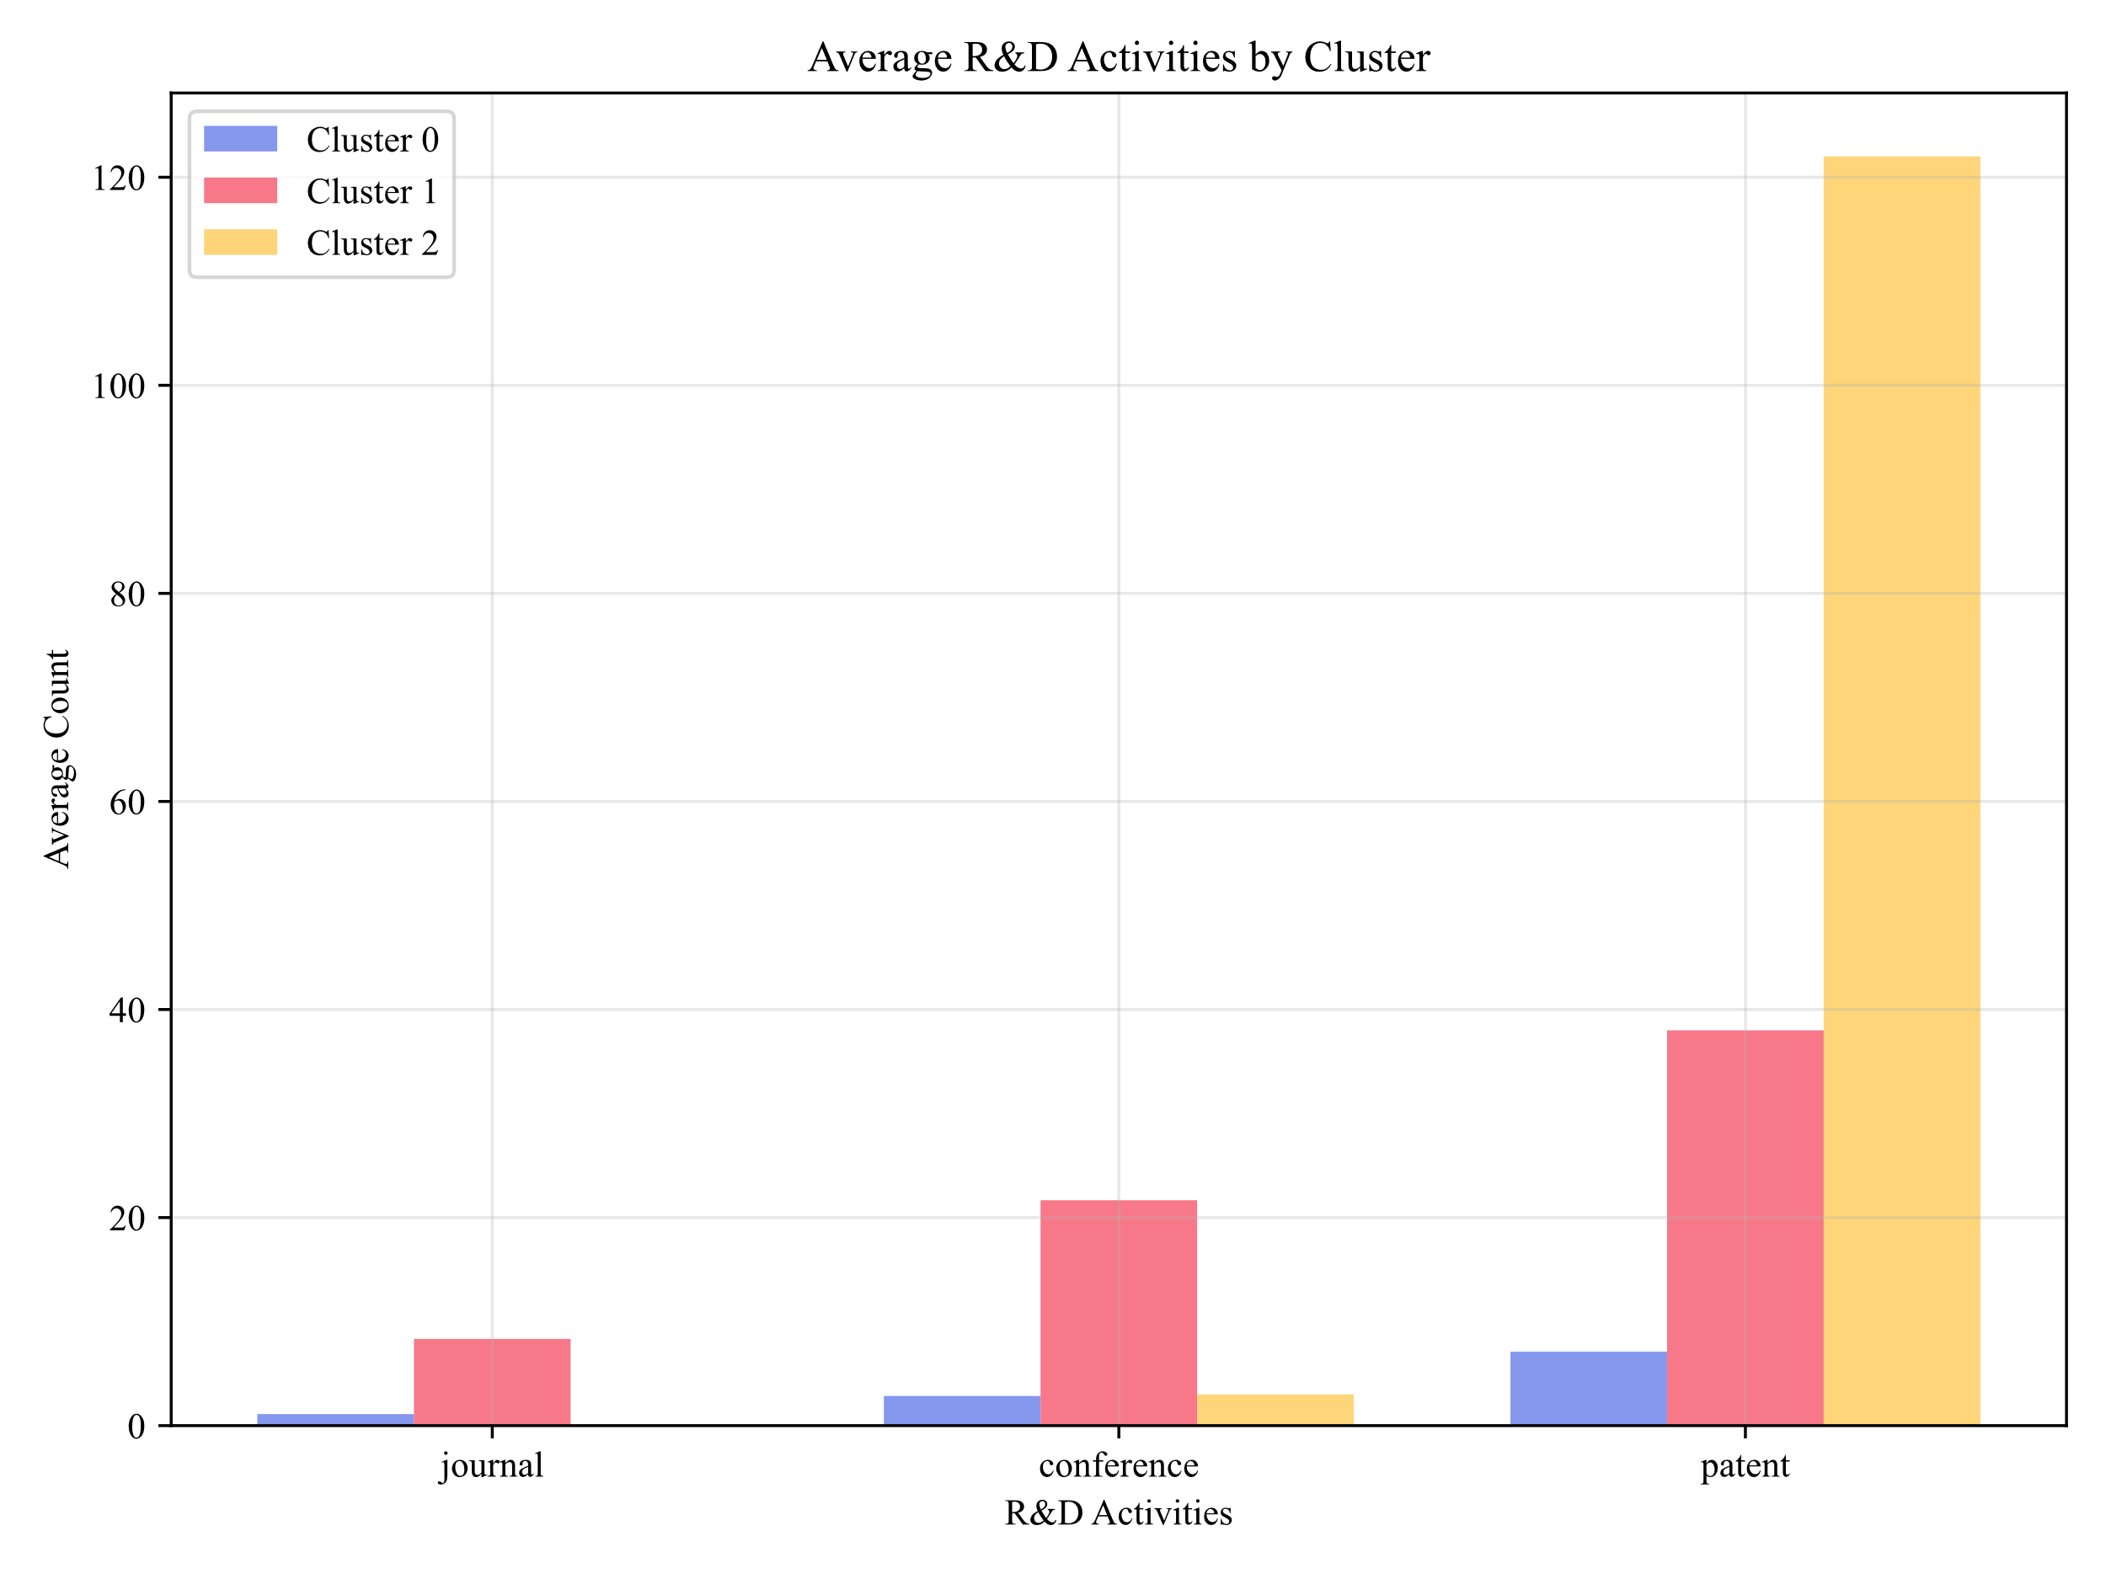
Results

Slide 18
Conclusion
K-means Clustering Results: Three Strategic Approaches
  Cluster 0 - Low Activity: Traditional manufacturing (Sony, Samsung, Volvo, Siemens, Hitachi, Toyota)
    Minimal academic publishing and patent filing
  Cluster 1 - Balanced Strategy: Service-oriented tech giants (IBM, Microsoft, Google)
    Equal focus on academic publications and patents
    Leadership in fundamental research + product development
  Cluster 2 - Patent-Focused: Core technology providers (Nvidia)
    Prioritize commercialization over academic sharing
    Focus on IP protection rather than knowledge dissemination

Slide 19
Conclusion
Geographic Distribution
  US companies: Spread across all clusters (multiple strategies)
  Chinese companies: Low presence (academic institutions lead R&D)
  Korea/Japan/Germany: Minimal activity, patent-focused approach
Industry Patterns
  IT service/cloud companies: Active in journals + conferences
  Hardware/semiconductor companies: Patent-focused strategy
  Tech giants: Balance sharing research with IP protection

Slide 20
Thank you

