Slide 1



AN INVESTIGATION ON VIETNAMESE CREDIT SCORING BASED ON BIG DATA PLATFORM AND ENSEMBLE LEARNING
Author:
Quang-Linh Tran - 18520997
Van-Binh Duong - 18520505
Gia-Huy Lam - 18520832
Advisor: PhD. Trong-Hop Do

Slide 2
Table of Content
INTRODUCTION
RELATED WORKS
METHODOLOGIES
EXPERIMENT
RESULTS
CONCLUSION AND FUTURE WORK

Slide 3
INTRODUCTION
Credit score: an important indicator for everyone.
Evaluating manually: time-consuming and ineffective.
Financial data increasing continuously requires a big data platform to handle.
Feature engineering and ensemble learning are used to build predictive models.
Input
Output
0
Credit scoring model
Financial and personal data
1

Slide 4
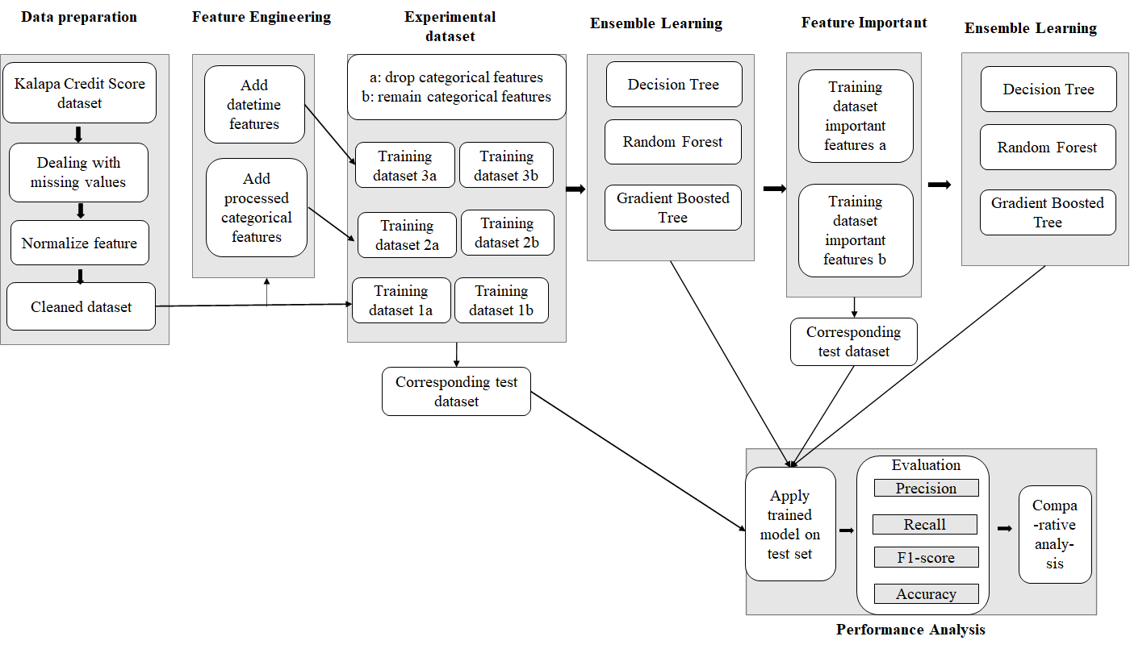

Slide 5
RELATED WORK
Machine Learning-Based Empirical Investigation For Credit Scoring In Vietnam’s Banking
(Khanh Quoc Tran et al)
  Kalapa Credit Score dataset
  Using machine learning models
  83% F1-score with Random Forest
  A comparative assessment of ensemble learning for credit scoring
  (GangWang et al)
  Australia, Germany, China credit dataset.
  Using bagging, boosting, and stacking
  80.76% accuracy
Credit scoring in the age of Big Data - A State-of-the-Art
  (Youssef Tounsi et al.)
  Use social data instead of traditional financial data to evaluate credit score.
  Survey on proposed methods are given to address this problem
  Apache Hadoop and ApacheSpark are considered to use.

Slide 6
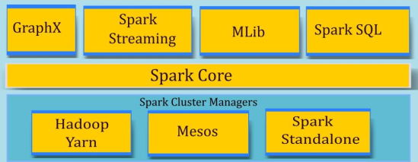
METHODOLOGIES
Big data platform
Big Data
5 V’s
Volume
Variety
Value
Vecolity
Veracity
How to utilize big data ?
Fig1: Spark structure
Notes:
Spark Core is the base engine for large-scale parallel anddistributed data processing

Slide 7
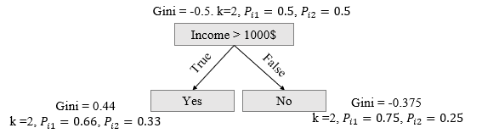
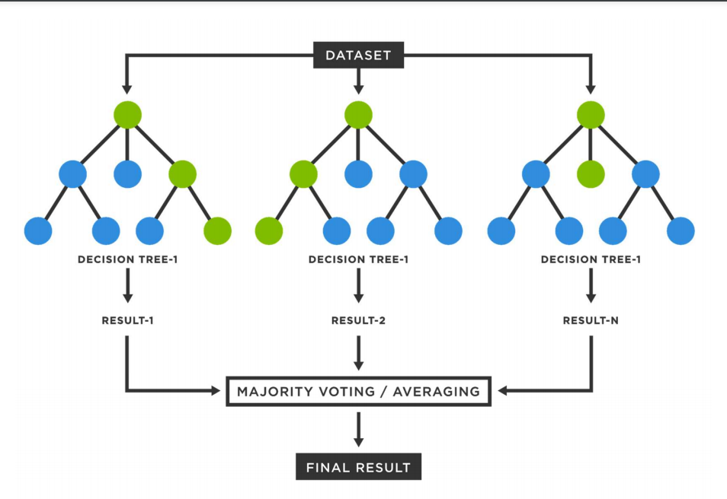
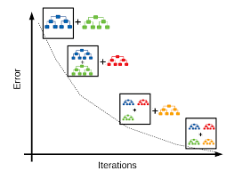
METHODOLOGIES
Ensemble Learning
Bagging
Boosting
Fig2: Decision Tree
Fig3: Random Forest
Fig4: Gradient Boosted Trees

Slide 8
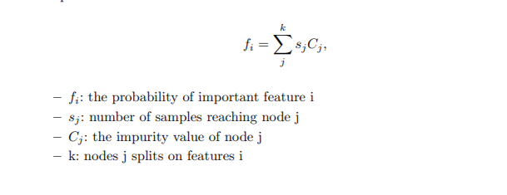
METHODOLOGIES
Feature Importance Extraction
The higher the value of probability, the more important the feature
Features extracted from best tree-based model
Depend on the probability → Chooses important features
Fig5: Formula of probability of important features

Slide 9

EXPERIMENT
Dataset and processing
Kalapa Credit Score:
  193 attributes (117 attributes, missing rate >= 50%)
  Remove columns with >= 90% missing rate
  53030 rows (68% label 0)
Attribute group | # of attributes | Processing
Date and datetime | 28 | Correct datatype and format
Unicode ones | 30 | Normalize the values
The rest | 135 | ---------------------------
['Field_34', 'ngaySinh'] -> “%Y%m”
["Field_{}".format(i) for i in [1, 2, 43, 44]] -> "%Y-%m-%dT%H:%M:%S"
["Field_{}".format(i) for i in [5, 6, 7, 8, 9, 11, 15, 25, 32, 33, 35, 40]] -> "%Y-%m-%d"
"Zero" → 0, "One" → 1, "Two" → 2, "Three" -> 3, "Four" → 4
'thành phố Hà Nội' or “Ha nội city” → “hà nội”

Slide 10
EXPERIMENT
Feature Engineering
Generating new features:
- Datetime: DT_A_B = Field_A - Field_B (seconds)
- Date:
+ DT_C_D = Field_C - Field_D (days)
+ days_from_now = current processing date – Field_X
+ age: 2021 – year('ngaySinh')
+ x_start_end = x_srartDate – x_endDate
+ x_y_startDate = x_srartDate – y_startDate
+ x_y_endDate = x_endDate – y_endDate
+ weekend, weekday or not.
- Categoricals:
gender = gioiTinh & info_social_sex
48 columns removed
81 columns added

Slide 11
EXPERIMENT
C. Input Preparation
Data type group
Vectors
Category
String
Boolean
Interger: {Field_82,
birth_month}
OneHotEncoder
StringIndexer
Vector1
OneHotEncoder
Estimator
Output
Dataset
Cleaned
dataset
Vector
Assembler
Vector Final
Vector2
Numeric
Integer
Double
Vector
Assembler
Skew >= - 2 and Kurtosis <= 2
StandardScaler
Vector3
Skew < - 2 and Kurtosis >2
VectorAssembler

Slide 12
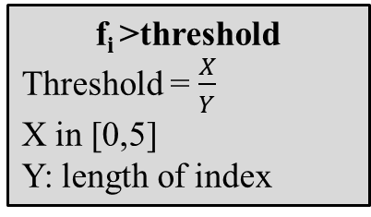
EXPERIMENT
D. Most important features
GBT
Data set 2
GBT
Model
Feature importance
Most important features
Sparse Vector
Index: [1,3,..,180,182]
Weight: [0.02,0.03,…,0.07,0.05]
Sum_{weight} = 1
f_{i} >threshold
Threshold = $\frac{X}{Y}$
X in [0,5]
Y: length of index
X | 0 | 1 | 2 | 3 | 4 | 5
Scenario A (# features) | 82 | 23 | 13 | 9 | 6 | 4
Scenario B (# features) | 62 | 20 | 10 | 5 | 2 | 1

Slide 13
EXPERIMENT
E. Experimental dataset statistics
Data set | # features in Scenario A (retaining raw categorical features) | # features in Scenario B (removing raw categorical features)
Data set1: Original | 117 | 91
Data set2: feature engineering for datetime features | 184 | 158
Data set3: data set 2 + feature engineering for categorical | 196 | 168
Data set important features | 23 | 20

Slide 14
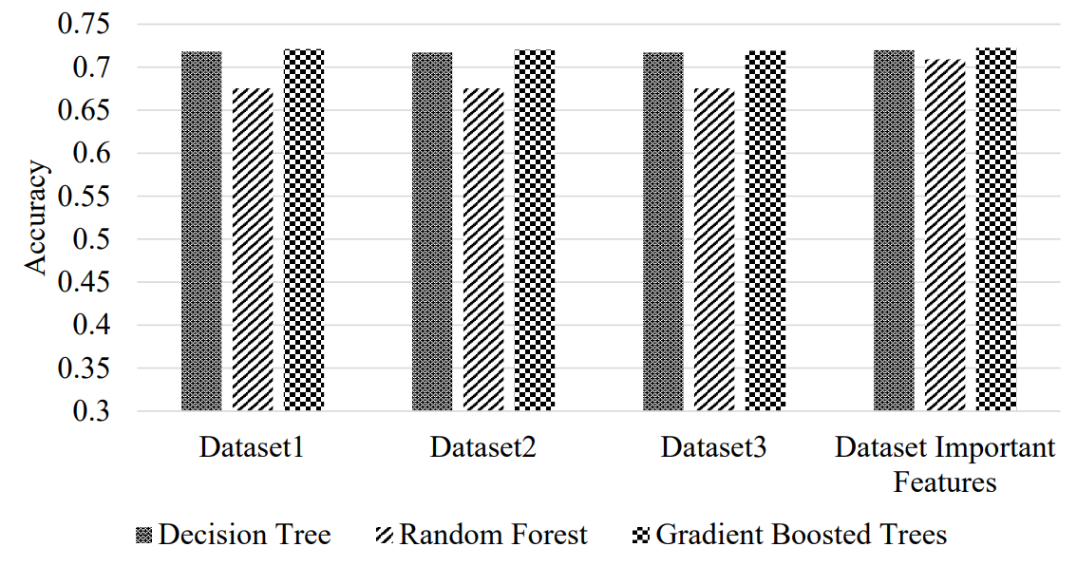
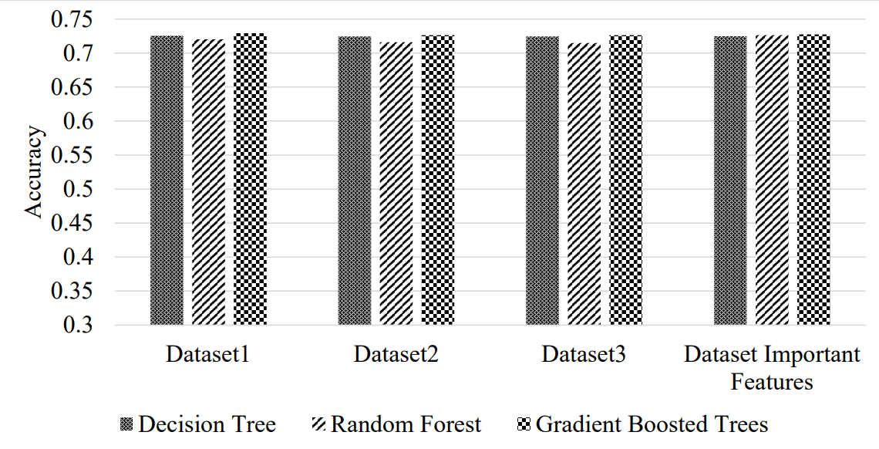
5. RESULT
Scenario A
Scenario B
Fig6: Accuracy of different models on 4 data set

Slide 15
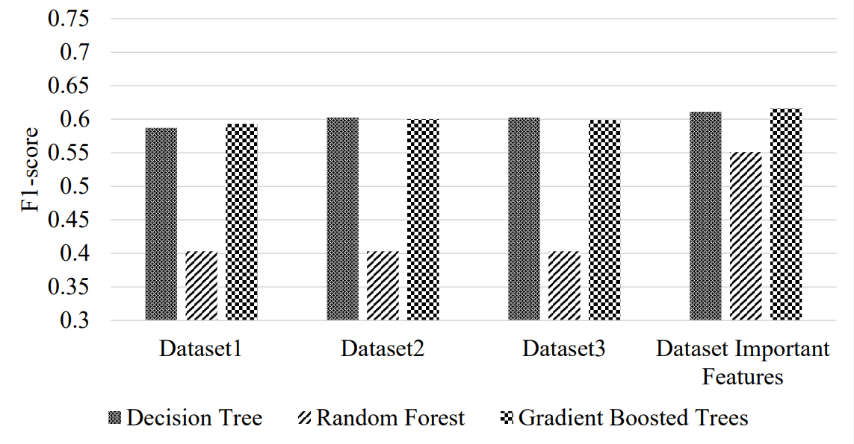
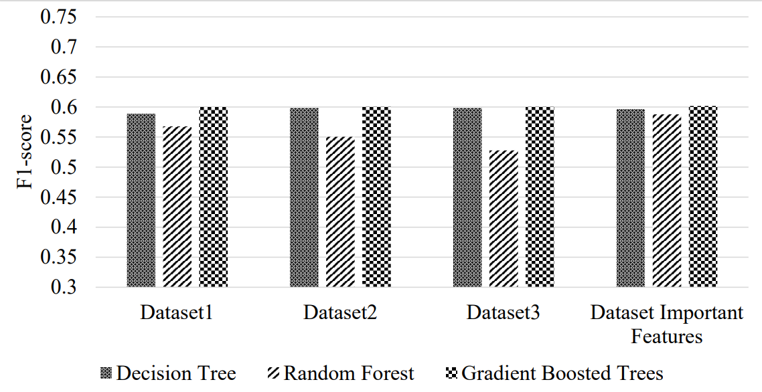
5. RESULT
Scenario A
Scenario B
Fig7: F1-score of different models on 4 data set

Slide 16
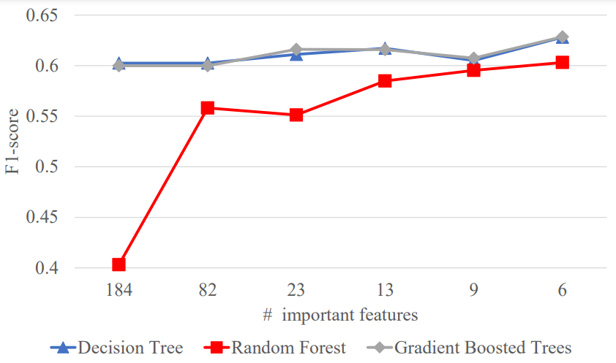
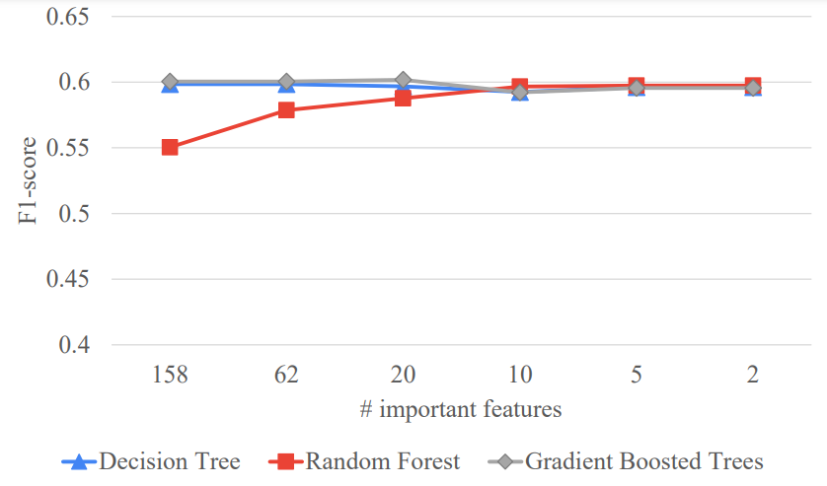
5. RESULT
Scenario A
Scenario B
Fig8: F1-score on different numbers of important features in data set 2

Slide 17
CONCLUSION AND FUTURE WORK
Summary:
  Best performance: 60% F1_score and 72.92% Accuracy
    Scenario B of data set 1
    GBT model
  Removing raw categorical features better than retaining them.
  Using important features improves efficiency
  Number of most important features in [5,10] gives the best f1-score.
Future work:
  Use streaming data (real-time financial activities or social data)
  Apply Deep Learning models

Slide 18
THANK YOU FOR WATCHING

Slide 19
ANN (512 -> 256 -> Dropout(0.2)->Output(2))
LR = 1e-06, Epochs = 100
Scenario A | Accuracy | Recall | Precision | F1 score
Other case (only dataset 2) | 0.675411 | 0.337706 | 0.5 | 0.403132
6 features | 0.716608 | 0.675549 | 0.621995 | 0.628072
4 features | 0.699797 | 0.662109 | 0.570527 | 0.556345
Scenario B | Accuracy | Recall | Precision | F1 score
Other case (include 3 datasets) | 0.675411 | 0.337706 | 0.5 | 0.403132
2 features | 0.687973 | 0.628702 | 0.565617 | 0.554611
1 features | 0.687973 | 0.628702 | 0.565617 | 0.554611

Slide 20
EXPERIMENT
E. Experiment scenarios
Dataset:
  Original (1)
  (1) + feature engineering for datetime features(2)
  (2) + feature engineering for categorical features(2)
Scenarios
  Remain raw categorical features (A)
  Drop raw categorical features (B)
1 → 3
A
2.1 → 2.6
1 → 3
a
.1 → .6
Important features:
  f_{i} > threshold (x in [0,5])
  Total: 6 case (.1)->(.6)
1 → 3
B
2.1 → 2.6

Slide 21
Scenario A
Dataset | Model | Accuracy | Recall | Precision | F1 score
Data set1 | Decision Tree | 0.7183 | 0.5935 | 0.7068 | 0.587
 | Random Forest | 0.6754 | 0.5 | 0.3377 | 0.4031
 | Gradient Boosted Tree | 0.721 | 0.5979 | 0.7114 | 0.5931
Data set2 | Decision Tree | 0.717 | 0.6029 | 0.6888 | 0.6025
 | Random Forest | 0.6754 | 0.5 | 0.3377 | 0.4031
 | Gradient Boosted Tree | 0.7203 | 0.602 | 0.7017 | 0.5999
Data set3 | Decision Tree | 0.717 | 0.6029 | 0.6888 | 0.6025
 | Random Forest | 0.6754 | 0.5 | 0.3377 | 0.4031
 | Gradient Boosted Tree | 0.7192 | 0.601 | 0.6988 | 0.5988

Slide 22
Scenario B
Data set | Model | Accuracy | Precision | Recall | F1 score
data set1 | Decision Tree | 0.7254 | 0.593 | 0.7028 | 0.5891
 | Random Forest | 0.7202 | 0.5791 | 0.7021 | 0.5677
 | Gradient Boosted Tree | 0.7292 | 0.6008 | 0.7075 | 0.6001
data set2 | Decision Tree | 0.7244 | 0.5987 | 0.6921 | 0.5984
 | Random Forest | 0.7158 | 0.5685 | 0.6997 | 0.5504
 | Gradient Boosted Tree | 0.7263 | 0.6004 | 0.6968 | 0.6004
data set3 | Decision Tree | 0.7244 | 0.5987 | 0.6921 | 0.5984
 | Random Forest | 0.7147 | 0.5575 | 0.7271 | 0.5278
 | Gradient Boosted Tree | 0.7263 | 0.6004 | 0.6968 | 0.6004

