Slide 1
CLASSIFICATION AND REGRESSION OF TAXI TIPS IN CHICAGO
Final
Student:
Nguyễn Quang Thuận – 18521470
Võ Trung Hiếu – 18520758
Trương Thanh Thiên – 18521431
Lecture:
TS. Đỗ Trọng Hợp

Slide 2
Outline
Introduction
Dataset
Methods
Experiments
Conclusion

Slide 3
INTRODUCTION

Slide 4

INTRODUCTION

Slide 5
DATASET

Slide 6
DATASET
Taxi Trips
3.597.307 rows
23 columns
Used Data
500.000 rows
23 columns
Add column
Add Have Tips column

Slide 7
Attributes of Dataset
Ordinal numbers | Attribute | Explanation
1 | Trip ID | Trip code
2 | Taxi ID | Taxi code
3 | Trip Start Timestamp | Trip start time
4 | Trip End Timestamp | Trip end time
5 | Trip Seconds | Total trip time (s)
6 | Trip Miles | Distance traveled (miles)
7 | Pickup Census Tract | Population at pick-up point
8 | Dropoff Census Tract | Population at drop off point
9 | Pickup Community Area | Pickup Community Area
10 | Dropoff Community Area | Dropoff Community Area
11 | Fare | Fare
12 | Tips | Money tips

Slide 8
Attributes of Dataset
Ordinal numbers | Attribute | Explanation
13 | Tolls | Tolls
14 | Extras | Additional fees
15 | Trip Total | Total cost of the trip
16 | Payment type | Payment method
17 | Company | Management company
18 | Pickup Centroid Latitude | Latitude at pick up point
19 | Pickup Centroid Longitude | Longitude at pick up point
20 | Pickup Centroid Location | Pick-up point location
21 | Dropoff Centroid Latitude | Latitude at drop off point
22 | Dropoff Centroid Longitude | Longitude at drop off point
23 | Dropoff Centroid Location | Drop-off point location
24 | Have Tips | Have money tips or not? 0: No; 1: Yes

Slide 9
METHODS

Slide 10
METHODS
EDA
Exploratory Data Analysis
Data Processing
Transform And Normalize Data
Model
Choose Model For Training And Testing
Score
Evaluation criteria

Slide 11
EDA
Handle nan and invalid value
Drop or replace nan or invalid value in dataset
Handle outlier value
Drop outlier in dataset
Handle coordinate value
Divide the longitudes and latitudes into four parts

Slide 12
DATA PROCESSING
StringIndexer
Convert string values to index values
OneHotEncoder
Convert index values to vector
VectorAssembler
Combine all features for training to vector

Slide 13
DATA PROCESSING
StandardScaler
Normalize data
PCA
Decreasing data dimentions
Pearson Correlation
Choose important features

Slide 14
MODELS
CLASSIFICATION
Decision Tree
Random Forest
Naïve Bayes
Support Vector Machine

Slide 15
MODELS
REGRESSION
Linear Regression
Gradient-Boosted Trees (GBTs)
Random Forest

Slide 16
SCORE
Accuracy
Ratio between the number of correctly predicted points and the total number of points in the test dataset.
Precision
Ratio of True Positive scores among those classified as Positive
Recall
Ratio of True Positive scores among those that are actually Positive
F1
Harmonic mean of Precision and Recall (assuming that these two quantities are non-zero)

Slide 17
SCORE
RMSE
An estimator is the average of the squares of the errors, i.e. the difference between the estimates and what is evaluated (the actual value).
R-Square
Explain how much the variance of one variable explains the variance of the second.

Slide 18
EXPERIMENTS

Slide 19
EXPERIMENTS
Implementation Process
EDA Result
Experimental results and evaluation

Slide 20
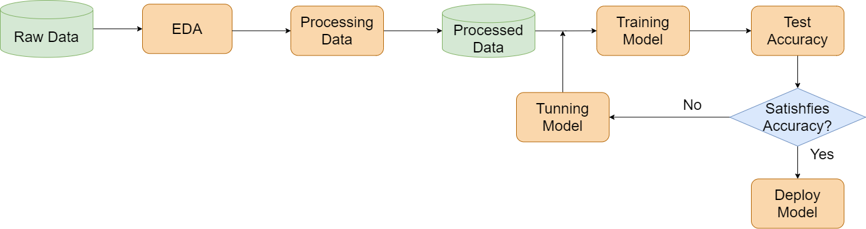
IMPLEMENTATION PROCESS

Slide 21
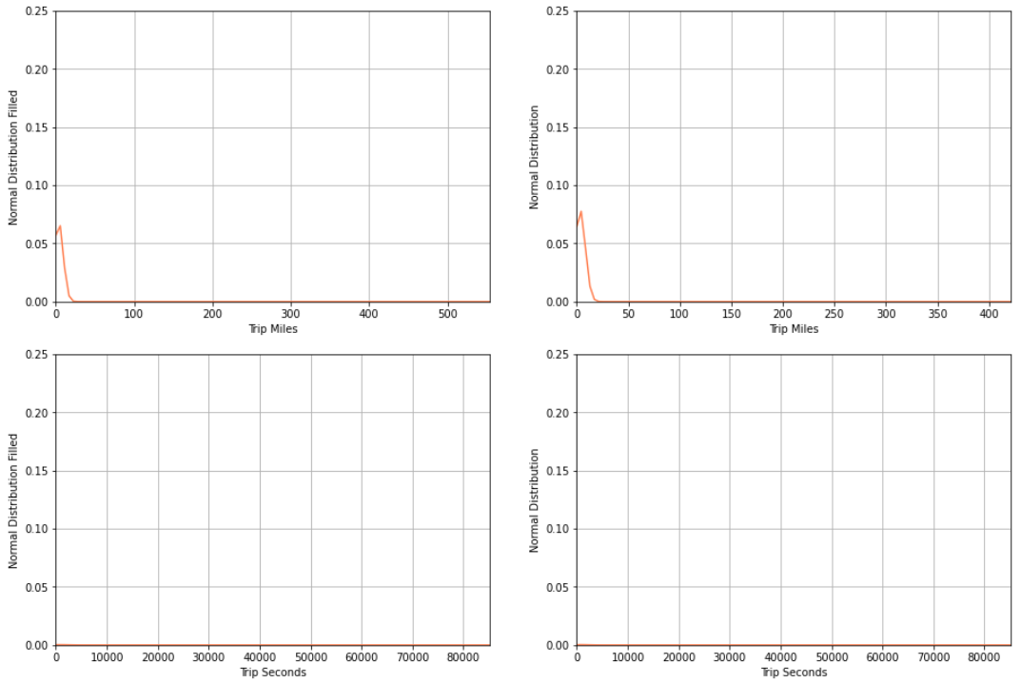
EDA RESULT

Slide 22
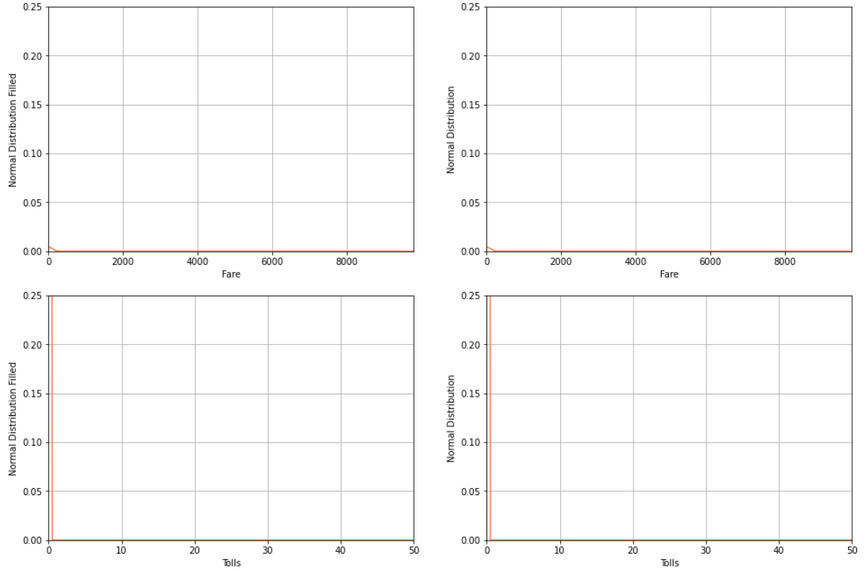
EDA RESULT

Slide 23
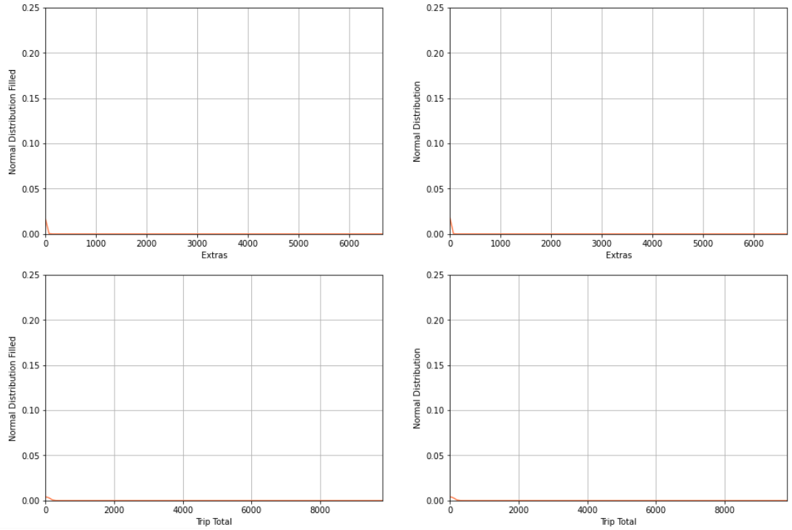
EDA RESULT

Slide 24
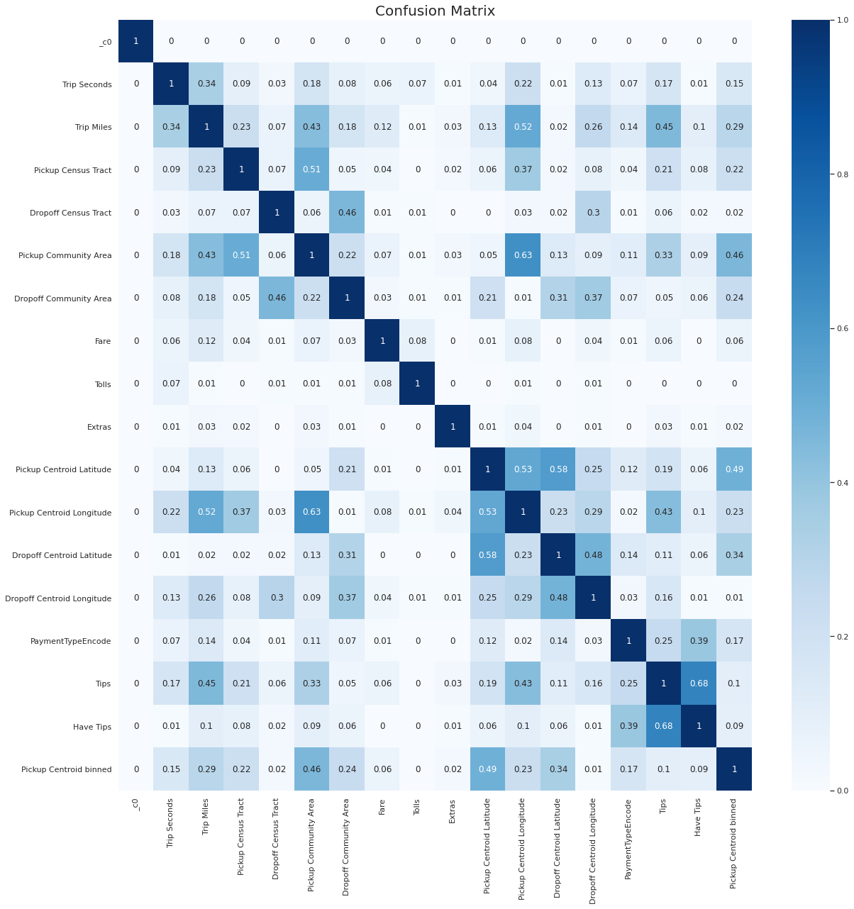
EDA RESULT

Slide 25
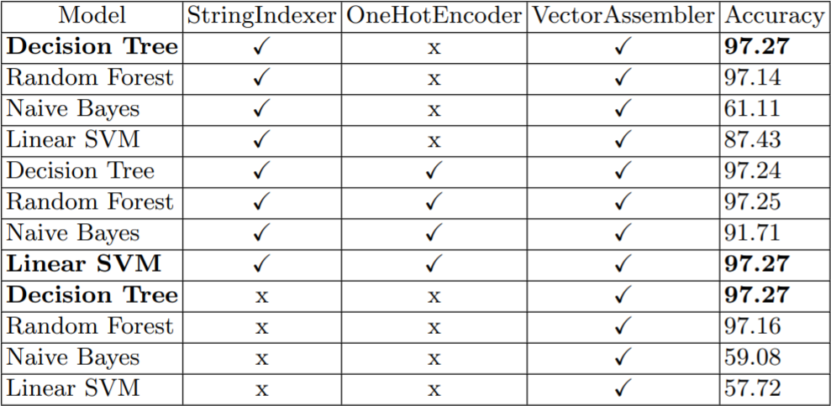
CLASSIFICATION EVALUATION

Slide 26
CLASSIFICATION EVALUATION

Slide 27
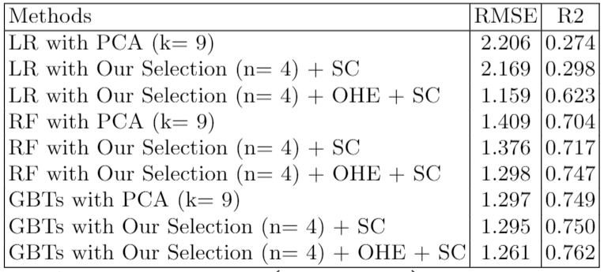
REGRESSION EVALUATION

Slide 28
REGRESSION EVALUATION

Slide 29
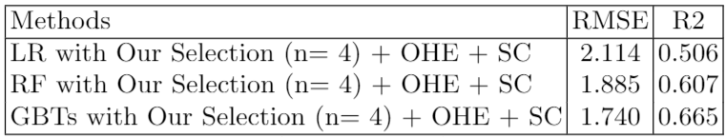
REGRESSION EVALUATION

Slide 30
CONCLUSION

Slide 31
CONCLUSION
Basically solve the problem posed.
Performed the steps of exploratory analysis, data preprocessing, data normalization before being included in the training process.
Suggested suitable and efficient solving methods in the experimental part.

Slide 32
CONCLUSION
LinearSVM classifier model has an accuracy of 97.28%.
The GBTs Regression model has an accuracy of 76.2%.
The dual system of classification and regression achieved an overall accuracy of 66.50%.

Slide 33
THANK YOU!
Any Questions?

