Slide 1
LEAD SCORE CASE STUDY
LOGESTIC REGRESSION

Slide 2
Problem statement
X-Education is an education company sells online Education courses to professionals and does its marketing through many online advertisements. Company gets information through different channels and if candidates enquring with certain education level it calls lead. Typically lead conversion is 30% of certain education. Company identifying Hot Leads on certain criteria also. Lead conversion ratio is lesser than number of enrollment. comapny given Target to achieve 80% of total enrollment

Slide 3
Business Goal
Build a logistic regression model to assign a lead score between 0 and 100 to each of the leads which can be used by the company to target potential leads. A higher score would mean that the lead is hot, i.e. is most likely to convert whereas a lower score would mean that the lead is cold and will mostly not get converted. There are some more problems presented by the company which your model should be able to adjust to if the company's requirement changes in the future so you will need to handle these as well. These problems are provided in a separate doc file. Please fill it based on the logistic regression model you got in the first step. Also, make sure you include this in your final PPT where you'll make recommendations.

Slide 4
Strategy
Import Data
Clean and prepare the required data for future analysis
Perform EDA to list out the significant features for lead conversion
Select the features using RFE
Scale the features using Standard scaling
Create the dummy values for categorical variables and prepare the data for creating the model
Split the train and test data
Build a fine logistic model by dropping the columns with high p-value as they are insignificant for the predictions
Assign the lead score for each model based on the final prediction evaluated using optimal cut off value
Calculate the metrics like confusion matrix,Accuracy,sensitivity,specificity
Plot ROC curve using the precision and recall values
Test the model on test data
Repeat the metrics calculations and validate these values with train data metrics

Slide 5
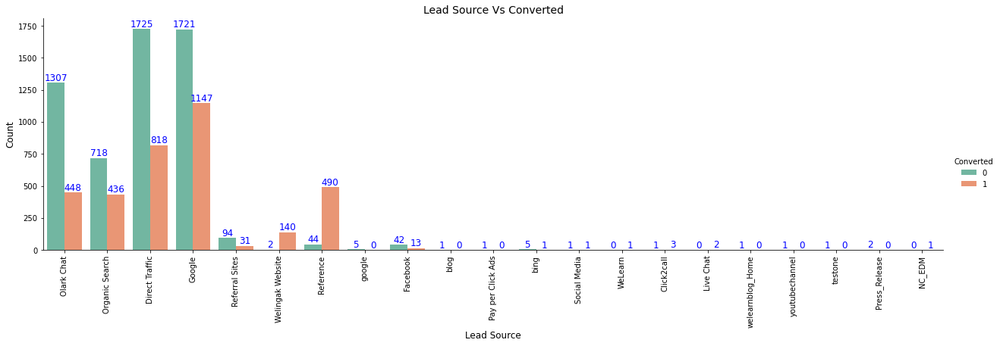
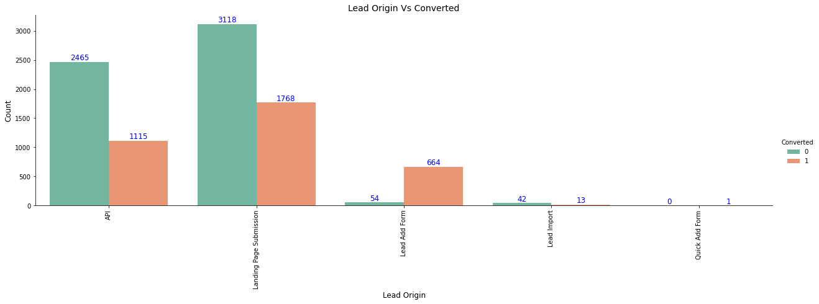
Exploratory Data Analysis
Major conversion in the lead source is from google
Maximum conversion happened from Landing Page Submission

Slide 6
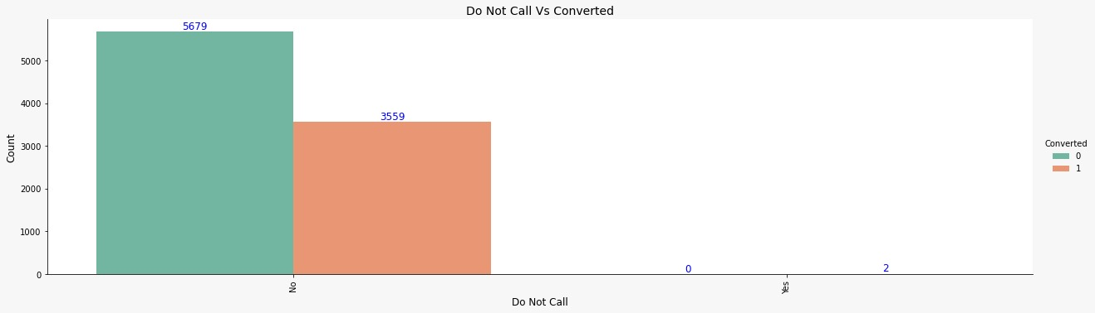
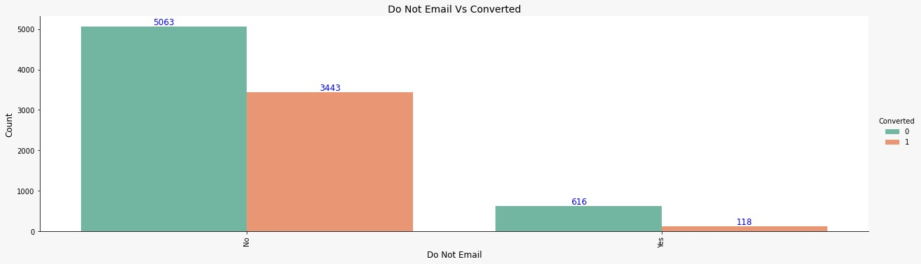
EDA Continues…
Major conversions happened when calls were made
Major conversion has happend from the emails that have been sent

Slide 7

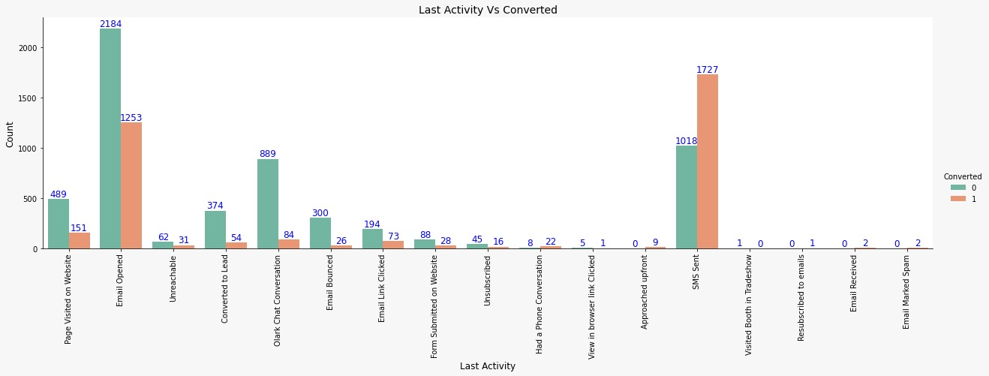
EDA Continues…
Huge number of convertions happened with Email Opened last activity, but the conversion rate is high for SMS Sent
Conversion rate is high on leads who are not through search

Slide 8
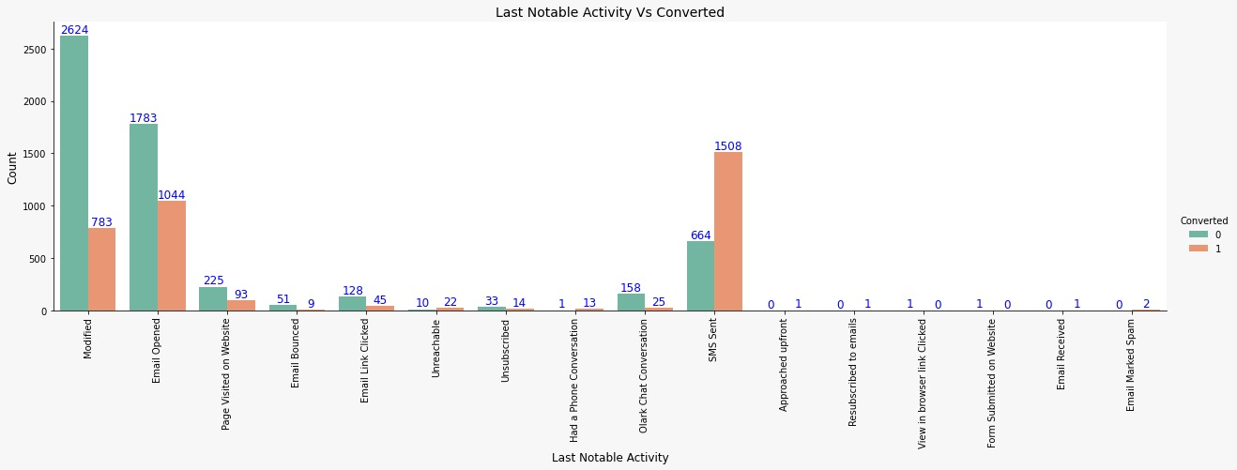
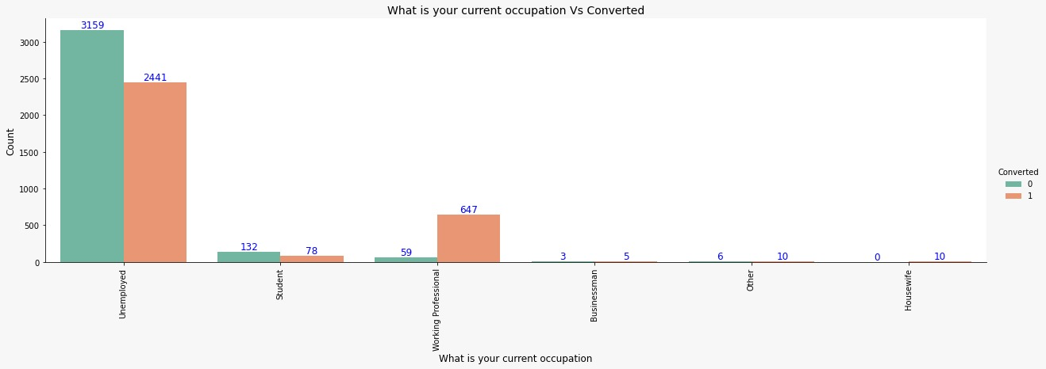
EDA Continues…
More conversion happened with people who are unemployed
Most Leads are converted with messages , even Emails also include leads

Slide 9
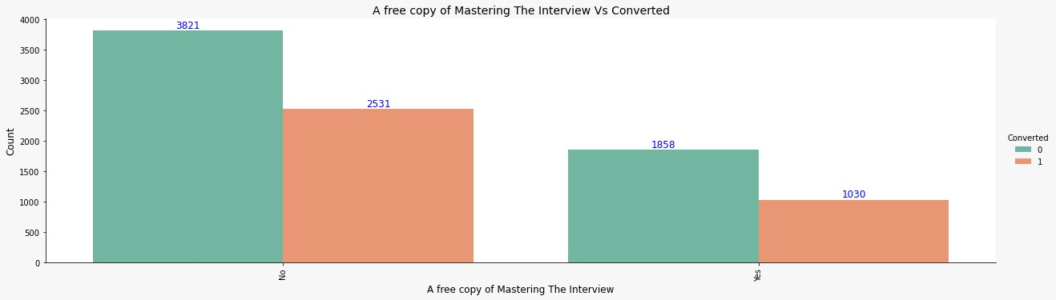
EDA Continues…
Leads prefer less copy of interviews

Slide 10
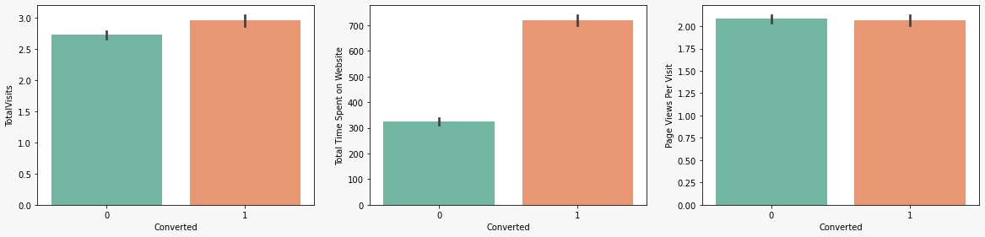
EDA Continues
People spending more time on website are converting to leads
More number of visits have slightly more chances to get converted to lead

Slide 11
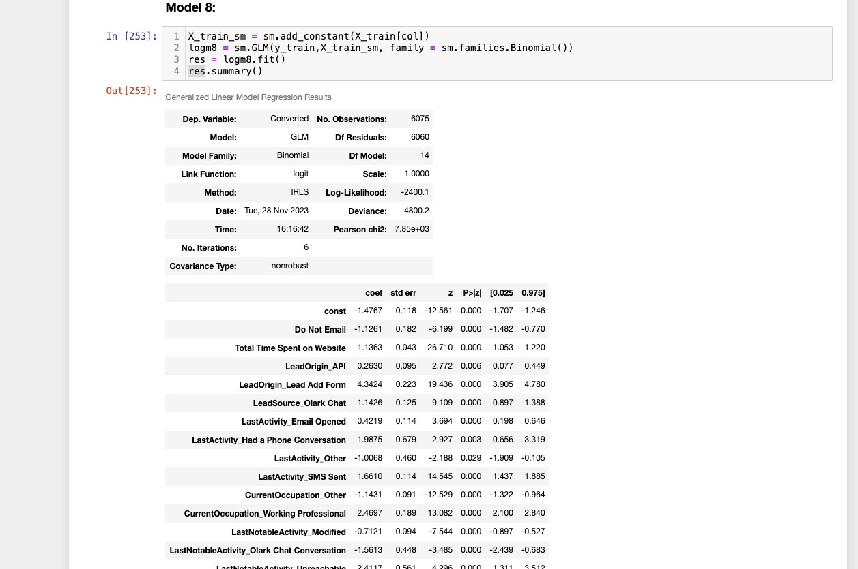
Final Model Summary

Slide 12
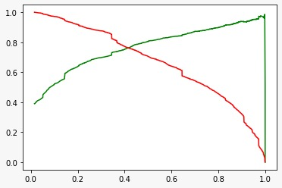
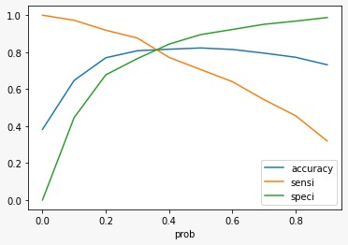
Model Evaluation on Train Data
Optimal CutOff
Precision Recall Tradeoff

Slide 13
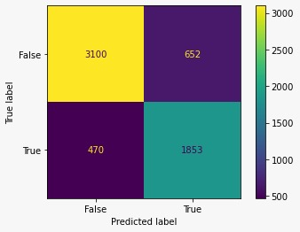
Model Metrics
Confusion Matrix
Accuracy:81.5%
Sensitivity: 79.8%
Specificity:82.6%
Precision:80.1%
Recall:&1%

Slide 14
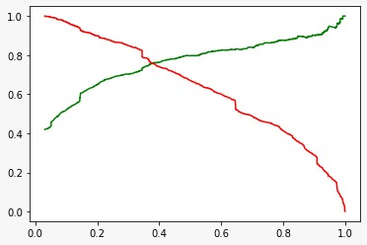
Model evaluation test
Precision recall trade off
Accuracy: 81.2%
Sensitivity: 77%
Specificity : 84%
Precision:75.4
Recall:76.6

Slide 15
Conclusion
-We have achieved final prediction using Sensitivity and Specificity based on optimal cut off value
Accuracy, Sensitivity and Specificity values of test set are around 81%, 77% and 84% which are approximately closer to the respective values calculated using trained set.
Also the lead score calculated in the trained set of data shows the conversion rate on the final predicted model is around 80%
Hence overall this model seems to be good.

