Slide 1
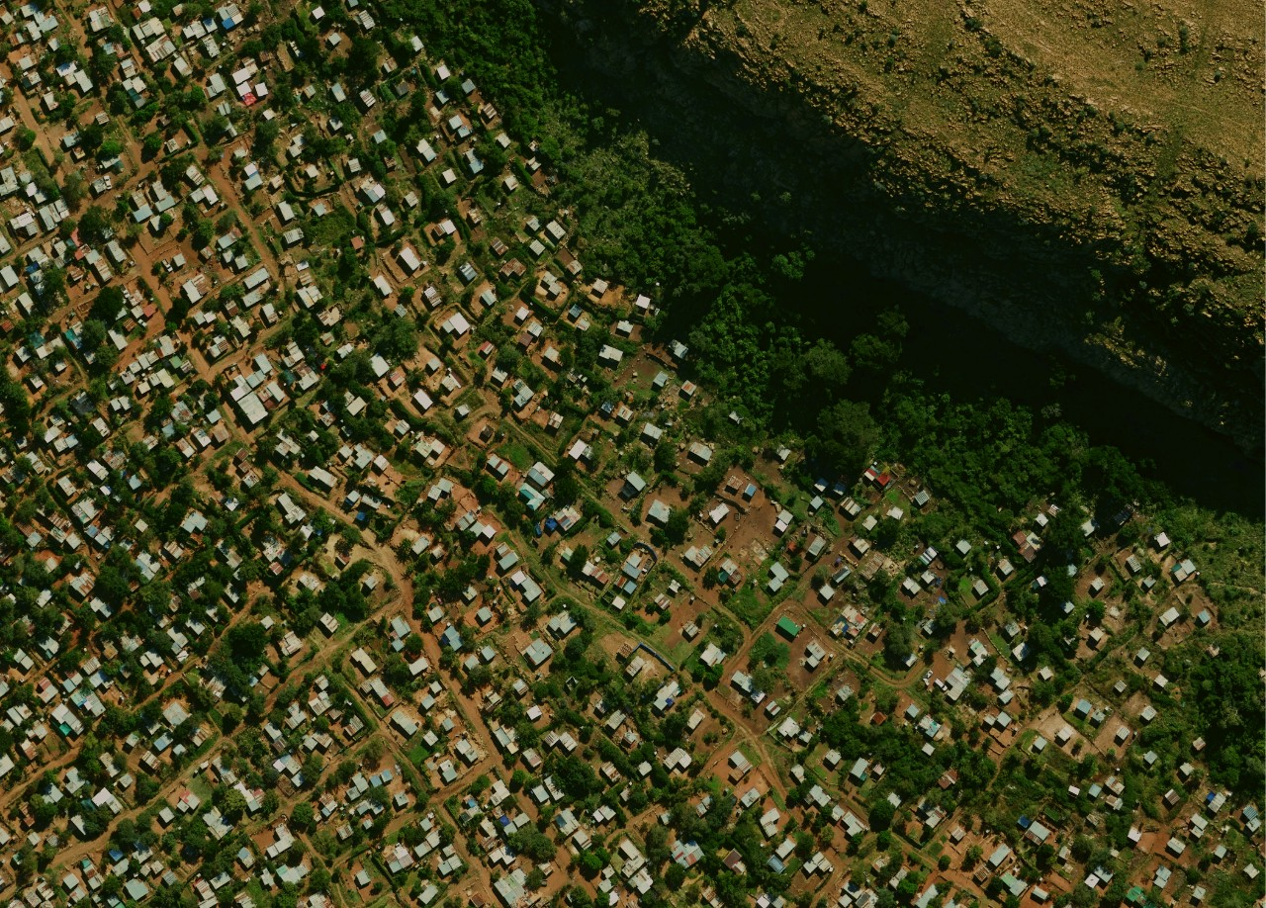


Project Demonstration 1
By
GeoAid
1 October
2020

Slide 2
Introduction

Slide 3
Sustainable Development Goals

Slide 4
Static Maps

Slide 5
Web Map

Slide 6
Website

Slide 7
Project Management tools

