Slide 1
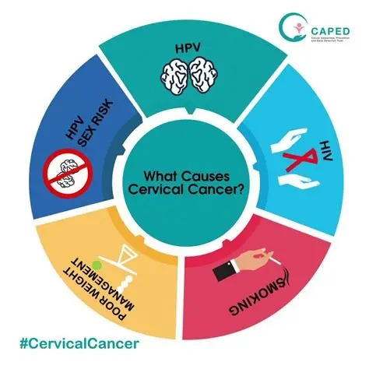
From Behavior to Burden: Understanding Cervical
Cancer Risks
Student Name: Ramya Thulluri
Student ID: 23097466
Course: MSc Data Science with research year
https://github.com/thulluri-ramya/Graduation-project-

Slide 2

Introduction & motivation
Cervical cancer is one of the most preventable cancers, yet many women still struggle to access early screening. Using machine learning, this project aims to predict cervical cancer risk based on behavioural, demographic, and medical factors. Using the Cervical Cancer Behaviour Risk Dataset from Hospital Universitario de Caracas, the study explores which factors contribute most to risk and how predictive models can support early detection and better clinical decision-making.
https://github.com/thulluri-ramya/Graduation-project-

Slide 3
literature survey
Fernandes et al. (2017): Introduced a transfer-learning approach for cervical cancer screening using shared model knowledge across tests and experts.
Kessler (2017): Provided medical and public-health insights on HPV, vaccination, and screening, motivating early detection but without ML methods.
My Project: Uses the original UCI Caracas dataset (858 patients) and applies classical ML models (LR, RF, SVM, XGBoost, Decision Tree) with a strong focus on preprocessing, baseline comparison, and interpretability rather than advanced transfer learning or large ensembles.
https://github.com/thulluri-ramya/Graduation-project-

Slide 4
research questions
Which behavioural & medical factors contribute most to cervical cancer?
Can ML accurately predict high‑risk individuals?
How does this compare to existing literature?
https://github.com/thulluri-ramya/Graduation-project-

Slide 5

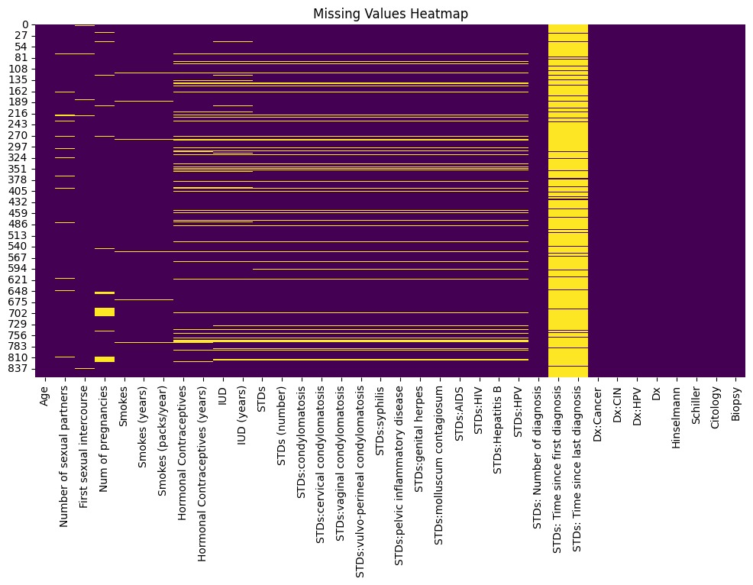
data set overview & data processing
Source: UCI Machine Learning Repository
Hospital Universitario de Caracas, Venezuela
858 patients, 36 features
Handled missing values (median/mode/mean).
Normalized numerical values.
Dataset Link
https://github.com/thulluri-ramya/Graduation-project-

Slide 6
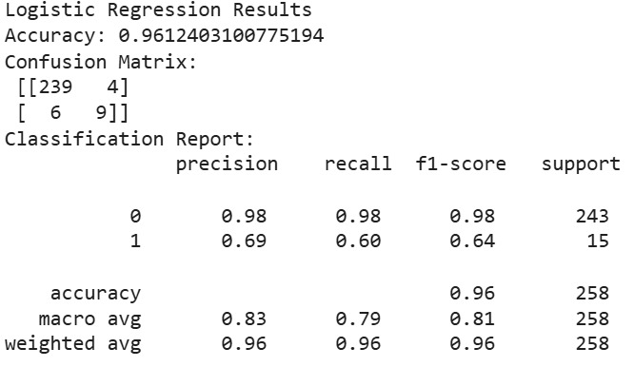
Implementation & methodology
Implementation:-
Used Google Colab for preprocessing and model training
Generated confusion matrices and feature-importance plots
Complete workflow available on GitHub
Models Used:-
LR, Decision Tree, Random Forest, SVM, XGBoost, ANN.
Training Setup:- 70/30 train–test split
Standard preprocessing applied (cleaning, encoding, scaling)
Evaluation Metrics:-
Accuracy, Precision, Recall, F1-score
Main Goal:-
Maximize recall to reduce false negatives in medical diagnosis
https://github.com/thulluri-ramya/Graduation-project-

Slide 7
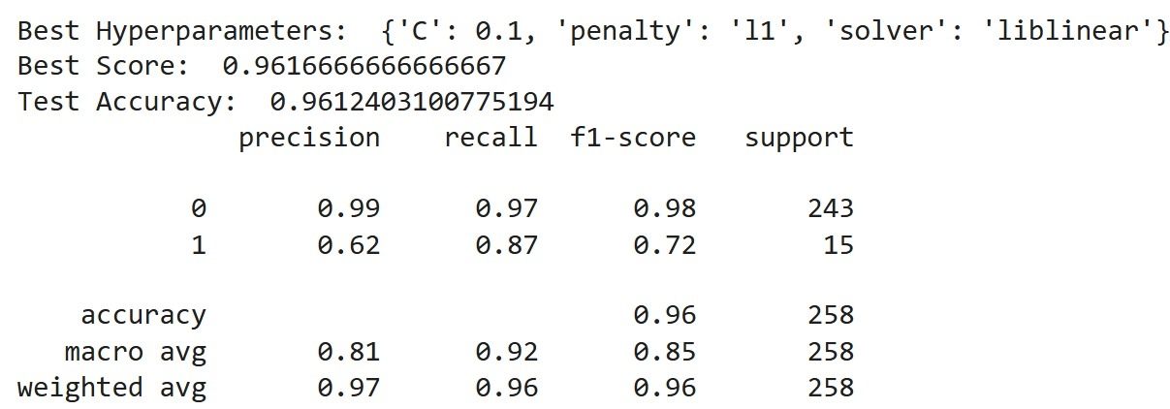
Hyperparameter Tuning
Why Tuning?
Improve model performance
Reduce overfitting
Optimize recall for medical prediction
Key Parameters Tuned:-
For Logistic Regression Best Parameters
C(0.1), penalty(l1), solver(liblinear)
Tuning Methods Used:-
Grid Search: tests predefined parameter combinations
Outcome:-
Tuned models achieved better recall, reducing missed positive cases Performance improved compared to baseline models
https://github.com/thulluri-ramya/Graduation-project-

Slide 8
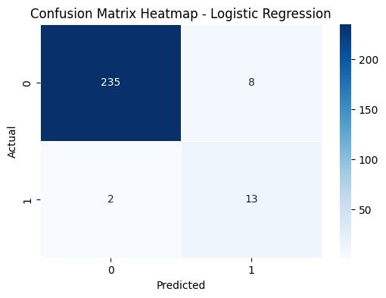
results
Recall Performance:-
Logistic Regression (Tuned): 87% — Best-performing model
Random Forest: 53%
Logistic Regression (Baseline): 53%
XGBoost: 47%
Key Findings:-
Tuned Logistic Regression achieved the highest recall (87%), making it the most reliable model for detecting positive cervical cancer biopsy cases.
Random Forest and XGBoost performed reasonably but missed more positive cases compared to LR.
The large improvement from 53% → 87% after tuning shows the importance of hyperparameter optimization for medical prediction tasks.
https://github.com/thulluri-ramya/Graduation-project-

Slide 9
challenges
Missing Data:-
The UCI dataset contains many missing values because some patients did not answer sensitive questions (sexual behaviour, STDs, etc.).
Required careful preprocessing to avoid losing important information.
Model Performance Variability:-
Some models (e.g., SVM, Decision Tree) gave lower recall.
For Other Models needed tuning to identify the best-performing model (Tuned Logistic Regression).
Computational Limits:-
Running tuning methods like GridSearchCV in Colab requires time.
https://github.com/thulluri-ramya/Graduation-project-

Slide 10
conclusion
Machine Learning demonstrates strong potential for predicting cervical cancer risk using simple, non-invasive behavioural and clinical features.
The combination of behavioural factors (e.g., smoking, STDs) and medical history variables provided meaningful predictive signals, especially after proper preprocessing and feature handling.
After comparing multiple models, Tuned Logistic Regression achieved the highest recall (87%), making it the most suitable for early-risk detection where identifying positive cases is critical.
Overall, the project highlights how data-driven methods can support early screening, reduce missed diagnoses, and contribute to improving women’s healthcare outcomes, particularly in low-resource settings.
https://github.com/thulluri-ramya/Graduation-project-

Slide 11
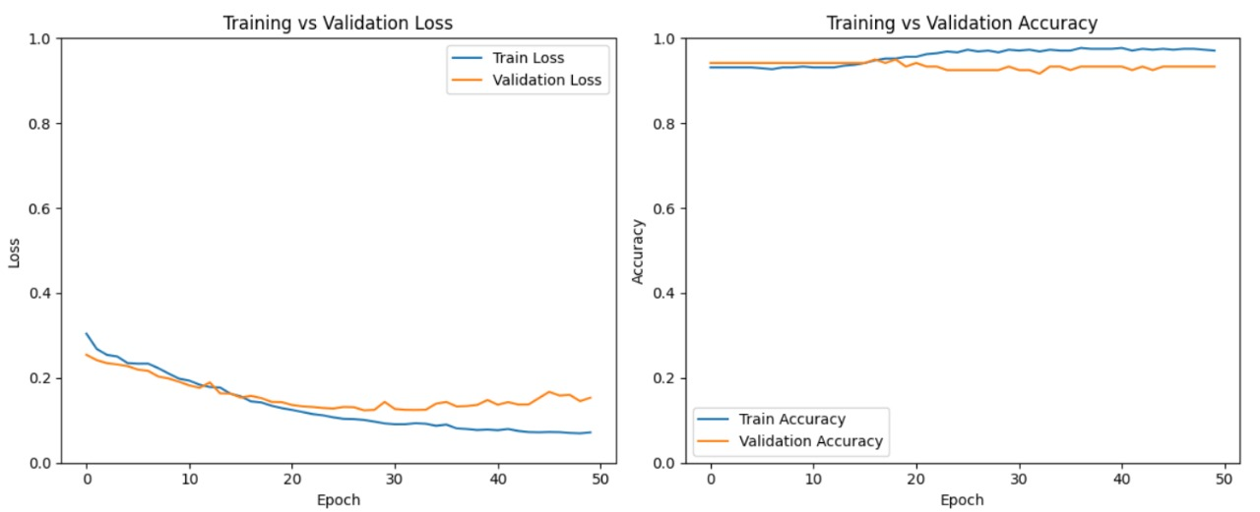
future work
Advanced Hyperparameter Tuning:-
I need to use more systematic tuning methods (GridSearchCV, RandomizedSearchCV, Bayesian optimization) to improve overall model performance and stability.
Handle Class Imbalance with SMOTE:-
I need to apply SMOTE or other resampling techniques to synthetically balance positive biopsy cases, which can further improve recall and reduce false negatives.
Modifications in Deep Learning Model (ANN):-
https://github.com/thulluri-ramya/Graduation-project-

Slide 12
REFRERENCE
Fernandes, K., Cardoso, J.S. & Fernandes, J., 2017. Transfer learning with partial observability applied to cervical cancer screening. Iberian Conference on Pattern Recognition and Image Analysis (IBPRIA), pp. 1–8.
https://ieeexplore.ieee.org/abstract/document/10725056
Kessler, T.A., 2017. Cervical cancer: Prevention and early detection. Seminars in Oncology Nursing, 33(2), pp.172–183.
https://archive.ics.uci.edu/dataset/383/cervical+cancer+risk+factors
Varshini, S.H., Aadhil, M., Sasvath, K.R., Thangamani, R. & Vimaladevi, M., 2024. Cervical cancer prediction using machine learning. 15th ICCCNT Conference, pp. 1–7.
https://www.sciencedirect.com/science/article/pii/S0749208117300153
https://github.com/thulluri-ramya/Graduation-project-

