Slide 1
How to use Jenkins to deploy workloads in Kubernetes
Thulsi Krishnan

Slide 2

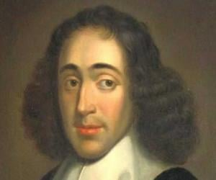
LEarning

Slide 3
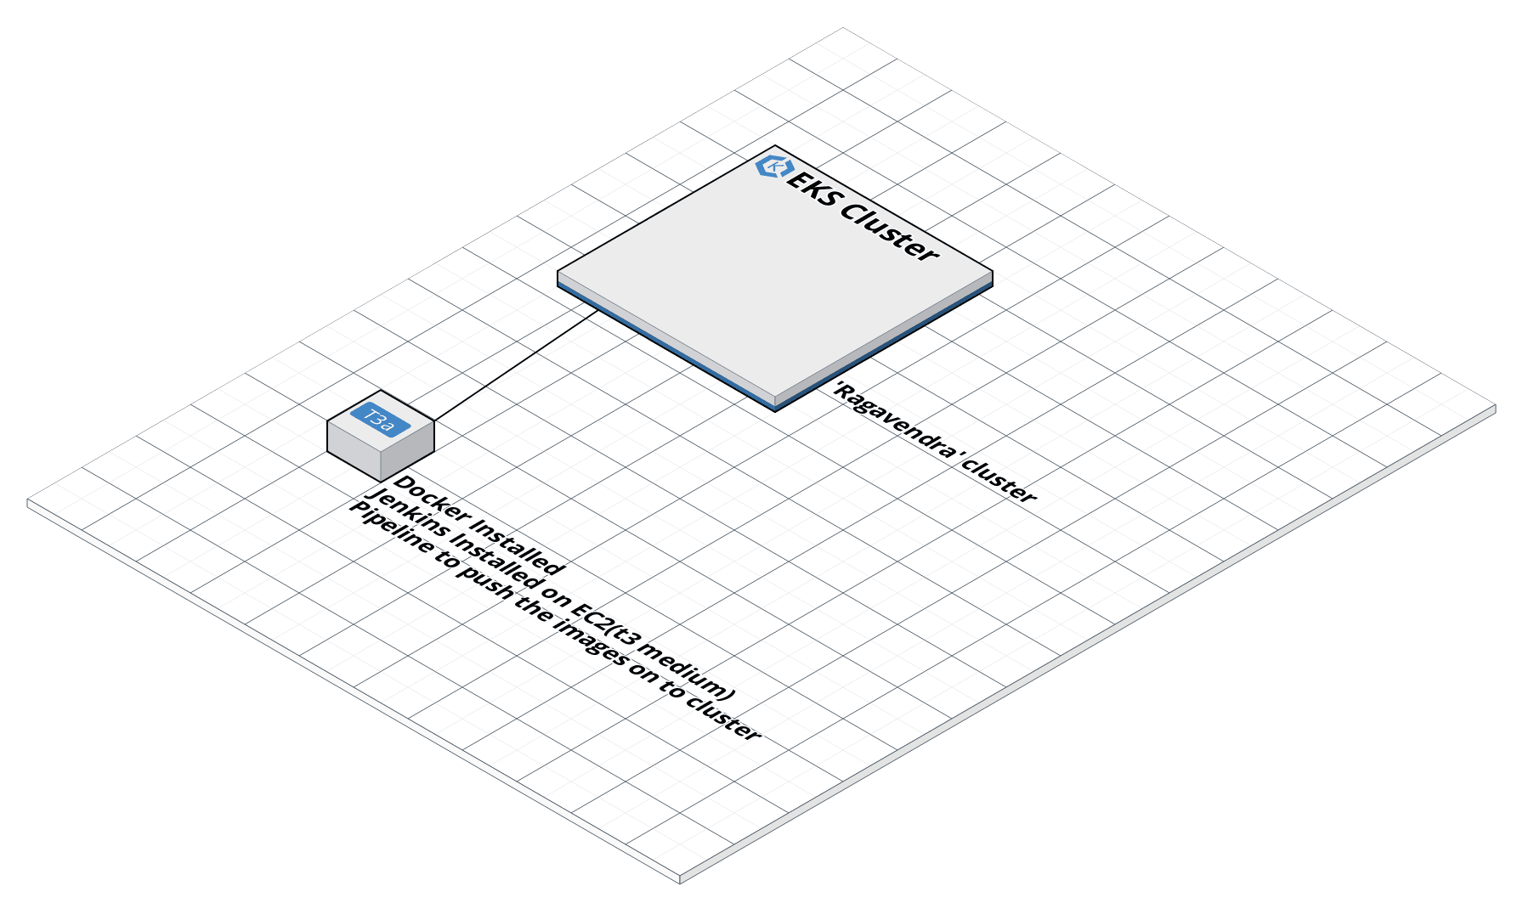
AWS Infra DIAGRAM

Slide 4
Why Jenkins is becoming the CI/CD tool of choice for more and more DevOps
There are several reasons why Jenkins is gaining momentum.
First, it is open source and free.
Second, it is user-friendly, easy to install and does not require additional installations or components
Jenkins is also quite easy to configure, modify and extend.
It deploys code instantly, generates test reports.
Jenkins can be configured according to the requirements for continuous integrations and continuous delivery

Slide 5
Jenkins For DeVOPS
Jenkins is available for all platforms and different operating systems, whether it is OS X, Windows or Linux.
It also boasts rich plugin ecosystem. The extensive pool of plugins makes Jenkins flexible and allows building, deploying and automating across various platforms.
Since it is open source, there is no shortage of support from large online communities of agile teams.
Finally, most of the integration work is automated. Hence fewer integration issues.
This saves both time and money over the lifespan of a project.

Slide 6
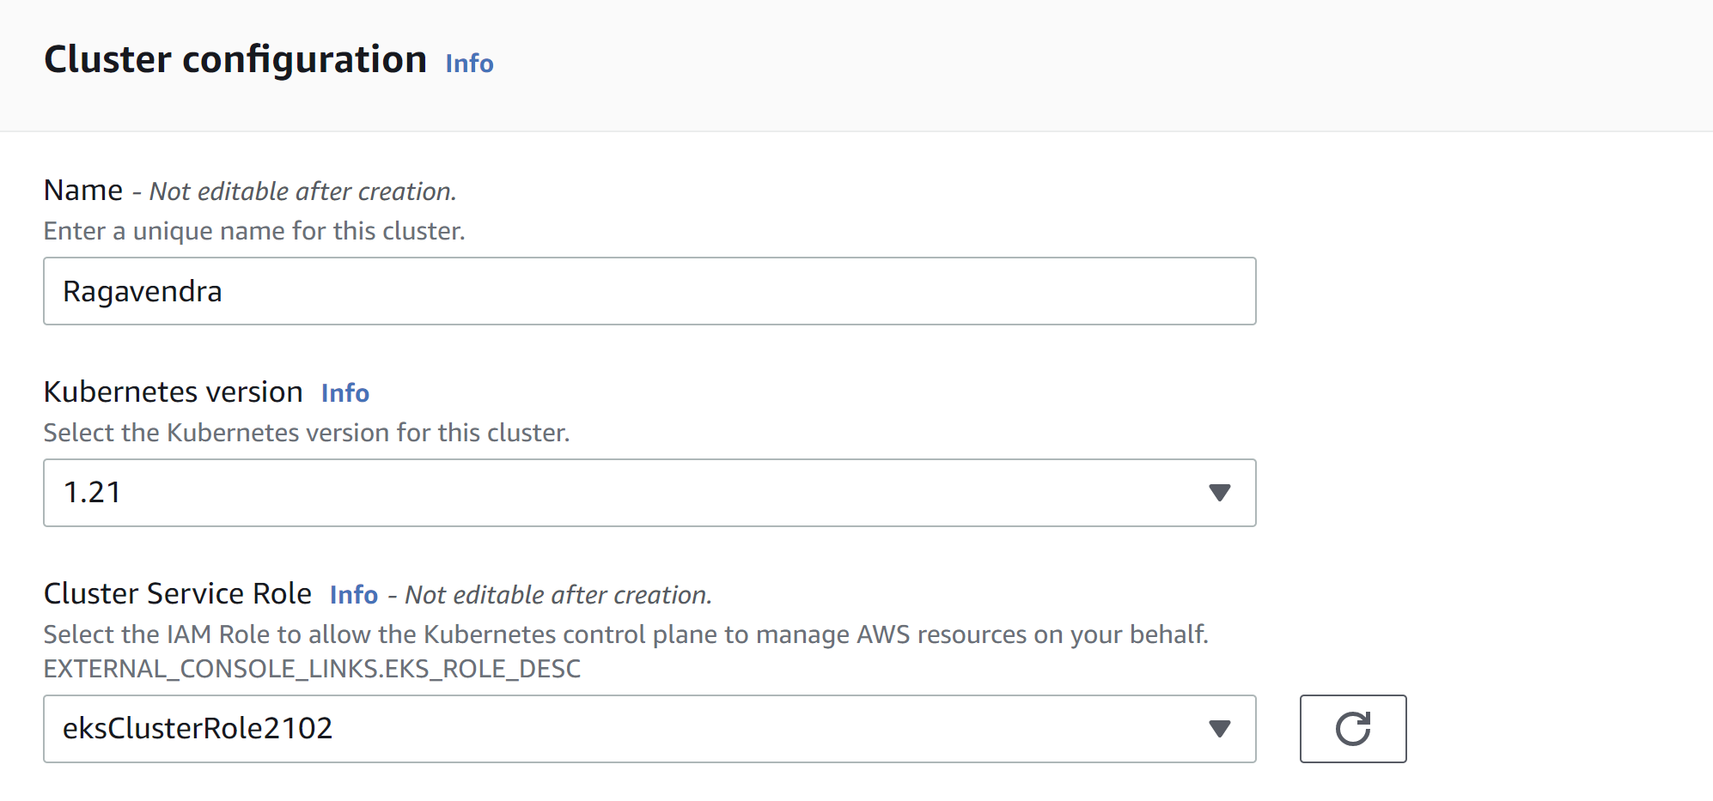
EKS-CLUSTER-STEP1

Slide 7
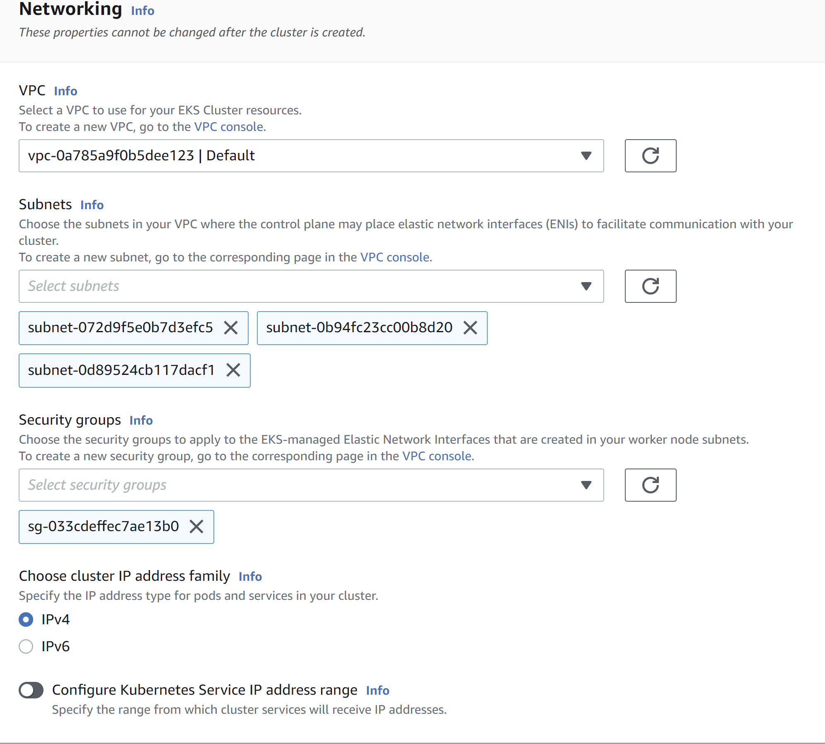
EKS-CLUSTER-STEP2

Slide 8
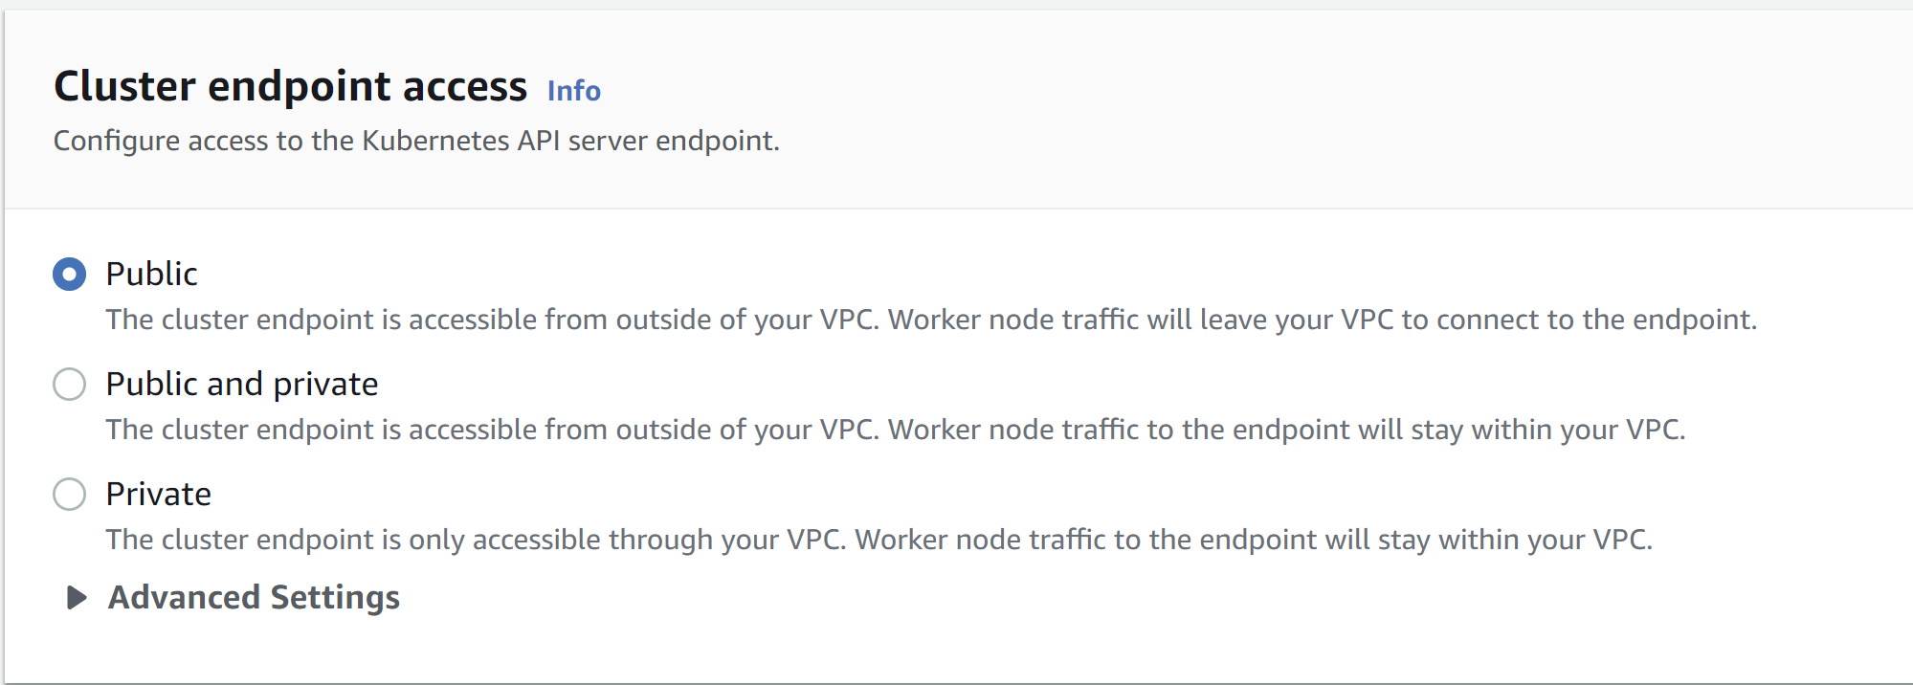
EKS-CLUSTER-STEP3

Slide 9
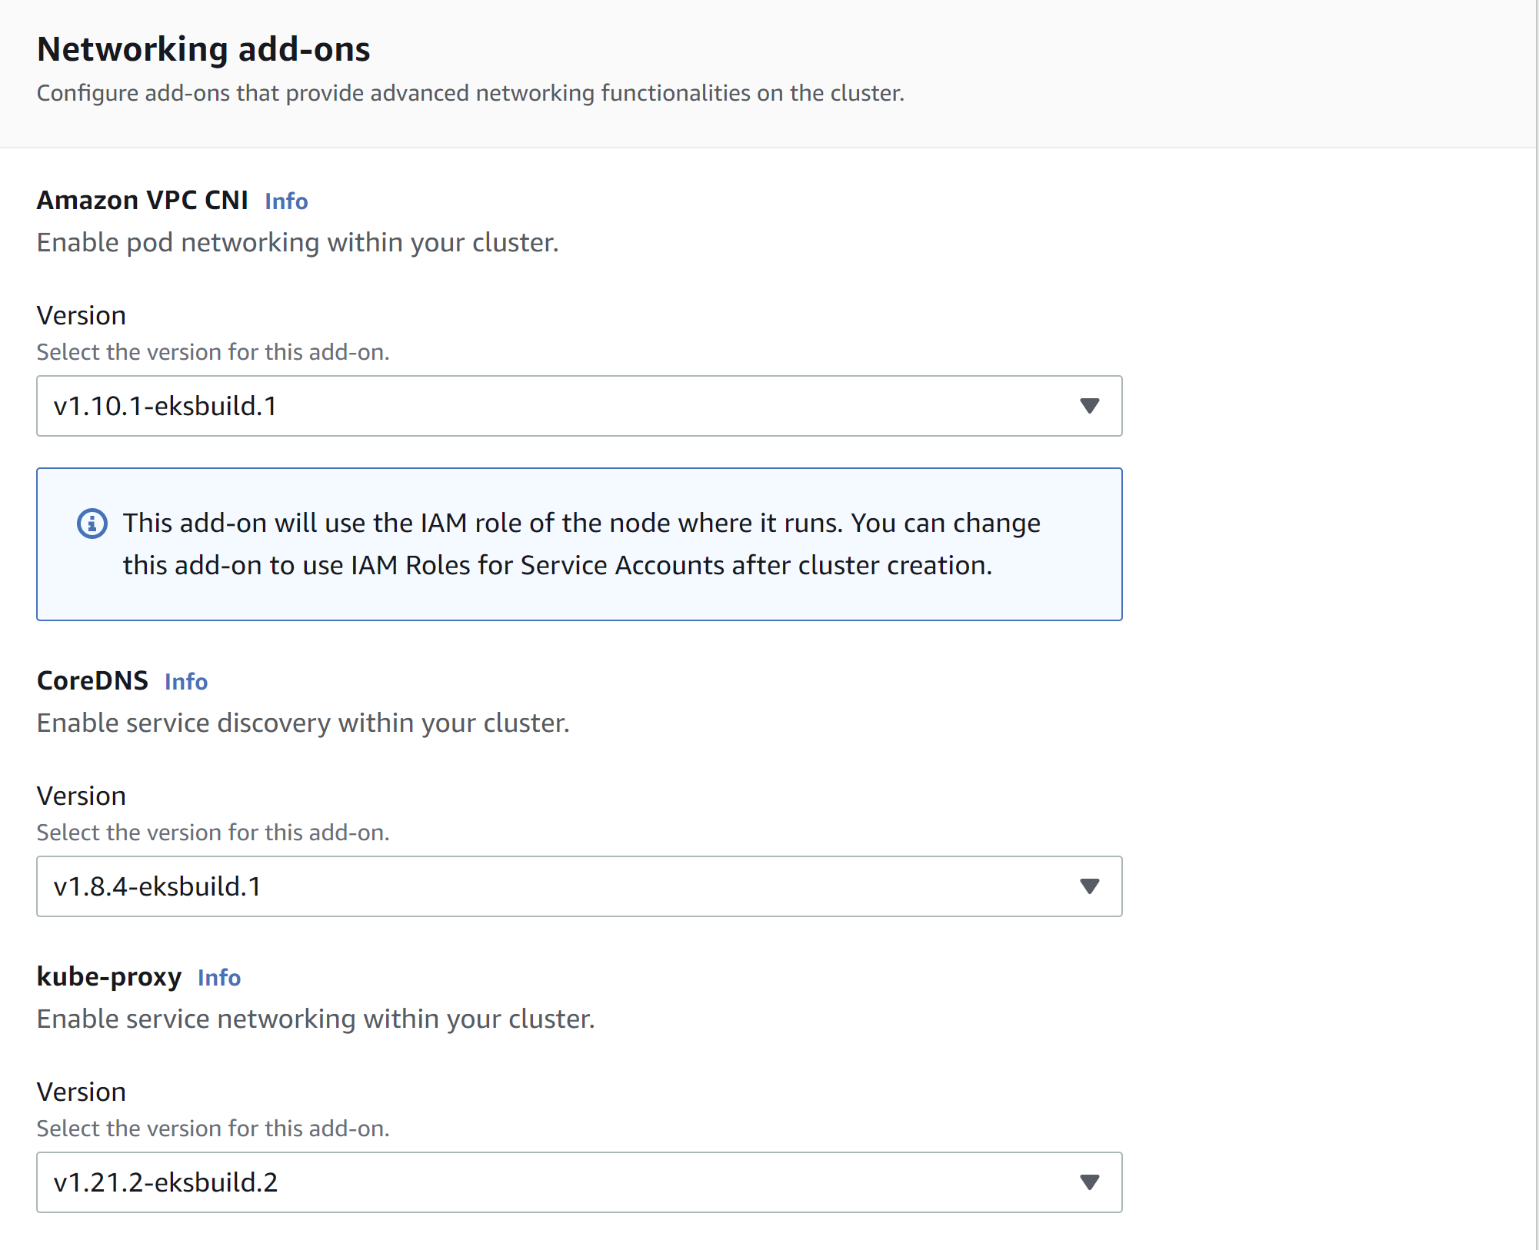
EKS-CLUSTER-STEP4

Slide 10
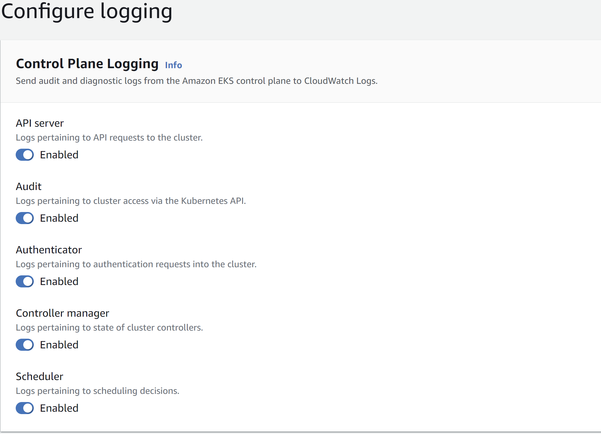
EKS-CLUSTER-STEP5

Slide 11
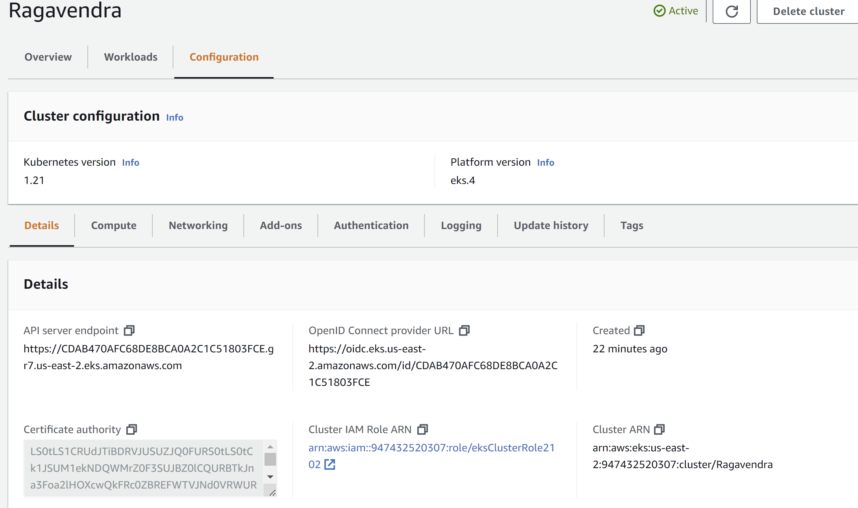
EKS-CLUSTER-STEP6

Slide 12
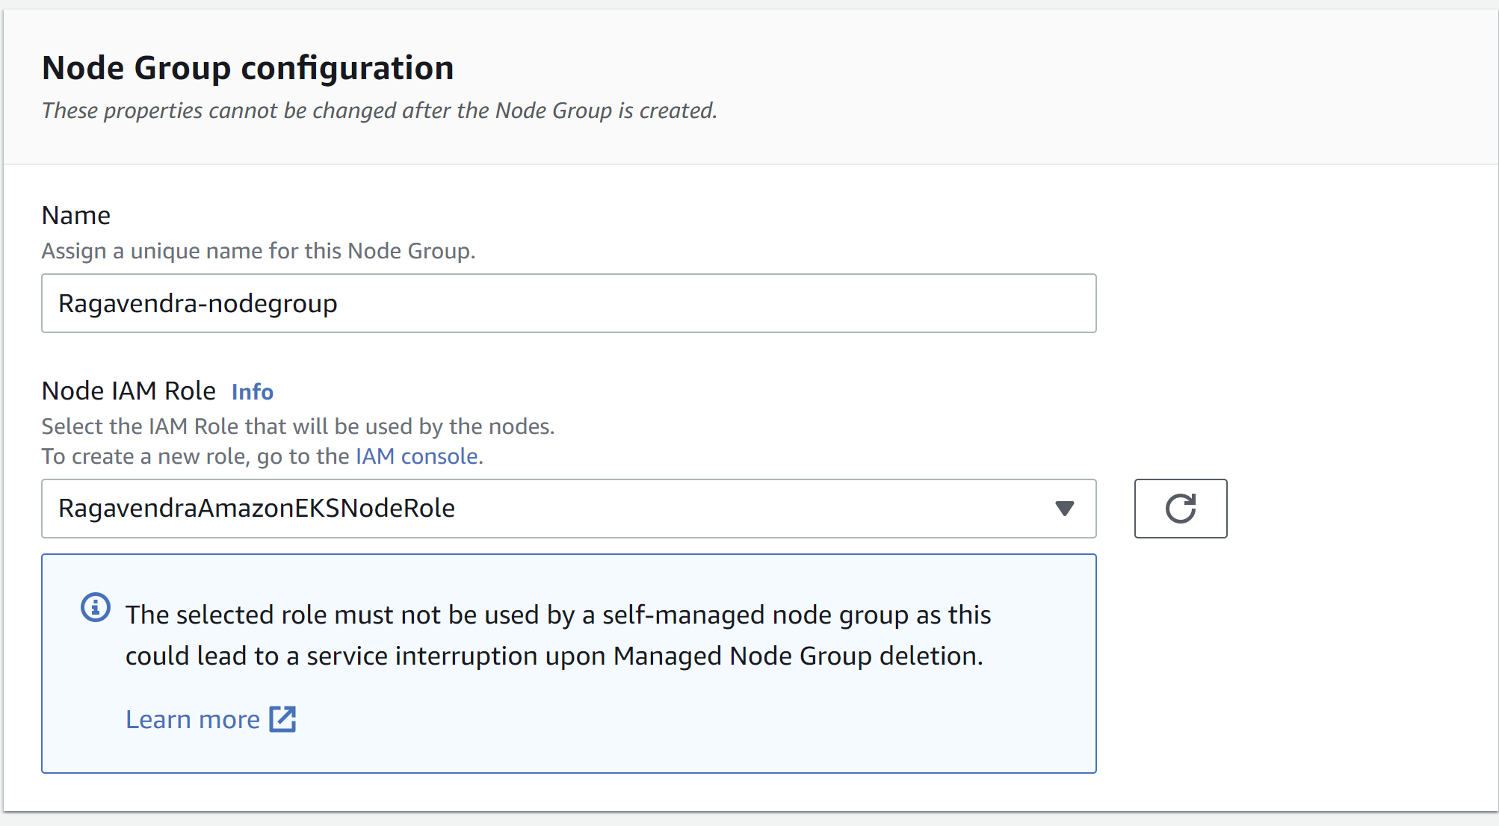
EKS-CLUSTER-STEP7

Slide 13
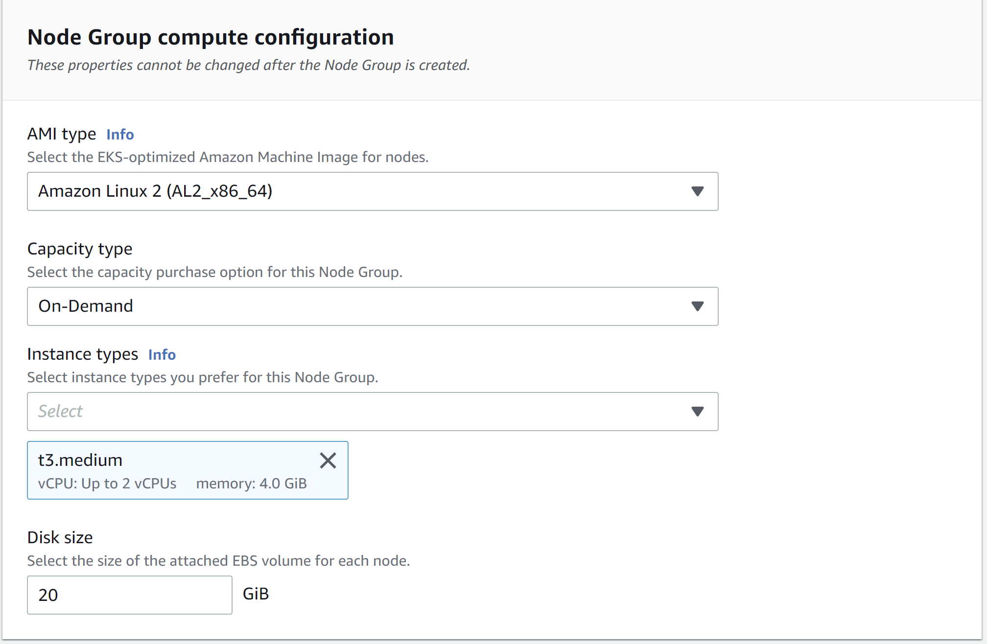
EKS-CLUSTER-STEP8

Slide 14
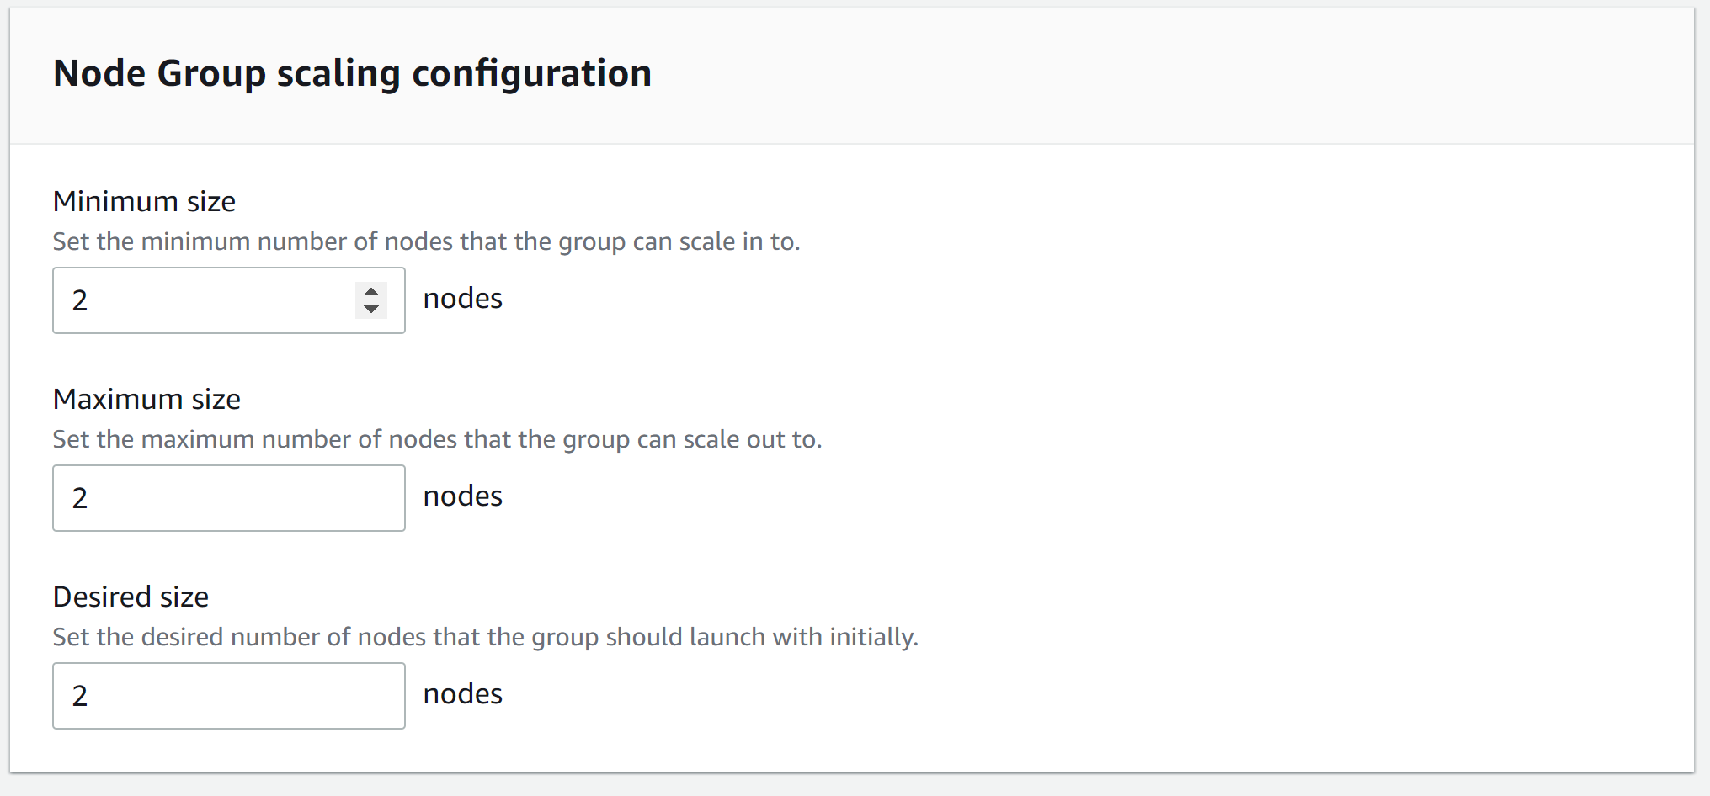
EKS-CLUSTER-STEP9

Slide 15
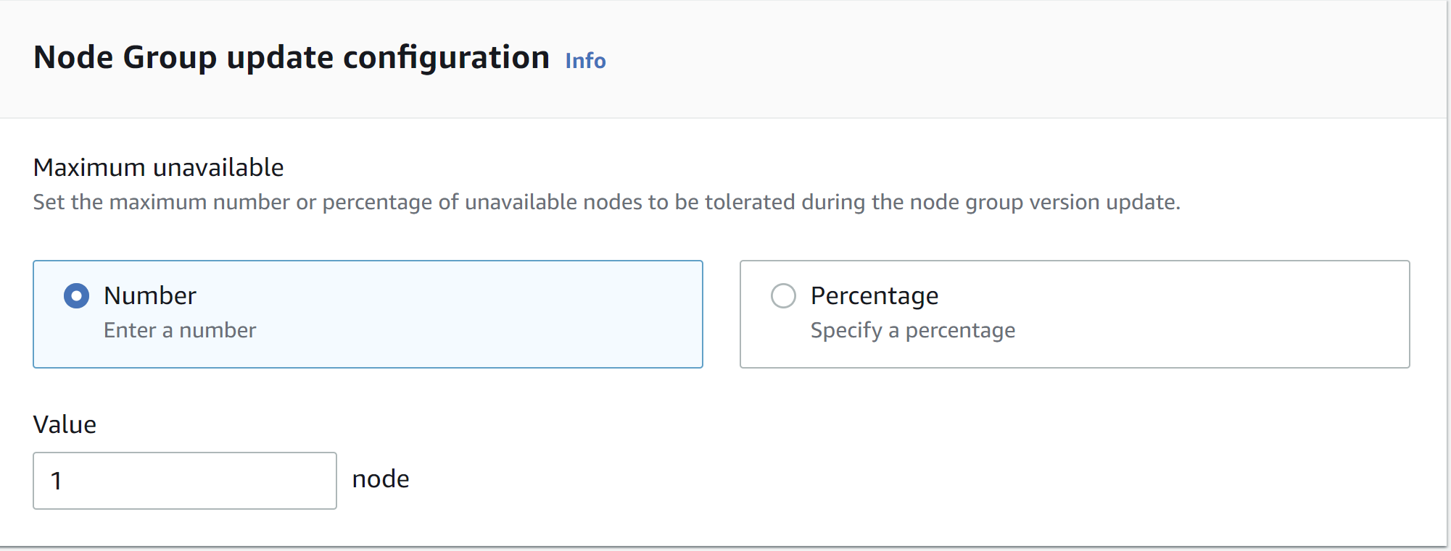
EKS-CLUSTER-STEP10

Slide 16
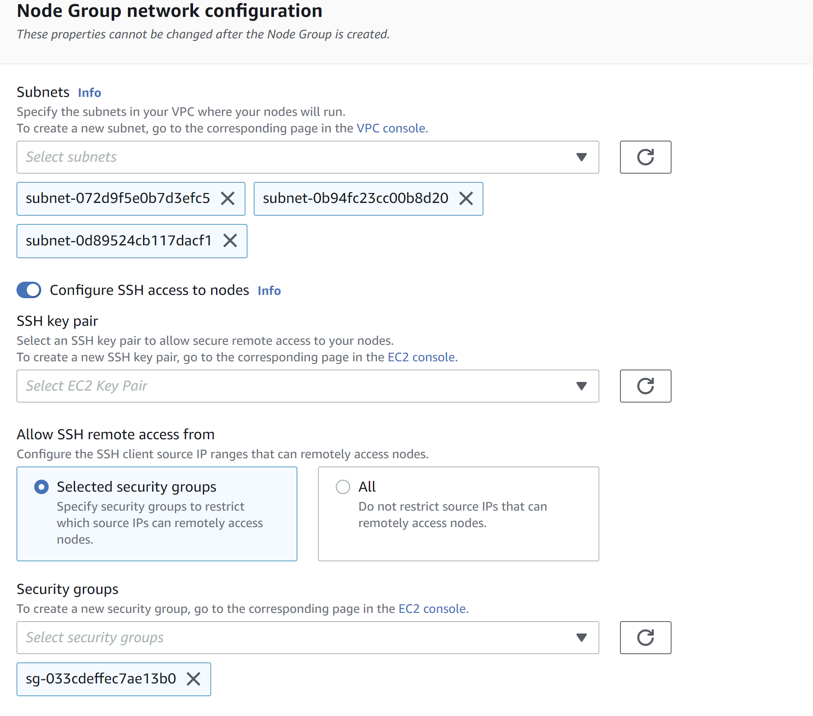
EKS-CLUSTER-STEP11

Slide 17
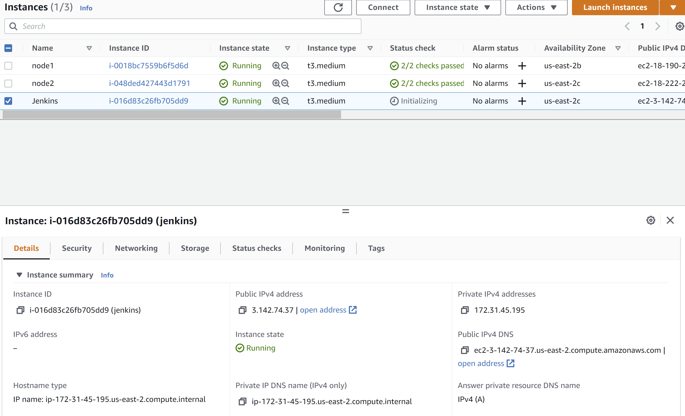
Create a new EC2 instance
Use the EC2 dashboard to create a new EC2 instance which will have the Jenkins installed.
You are free to choose a existing key pair or already created one.

Slide 18
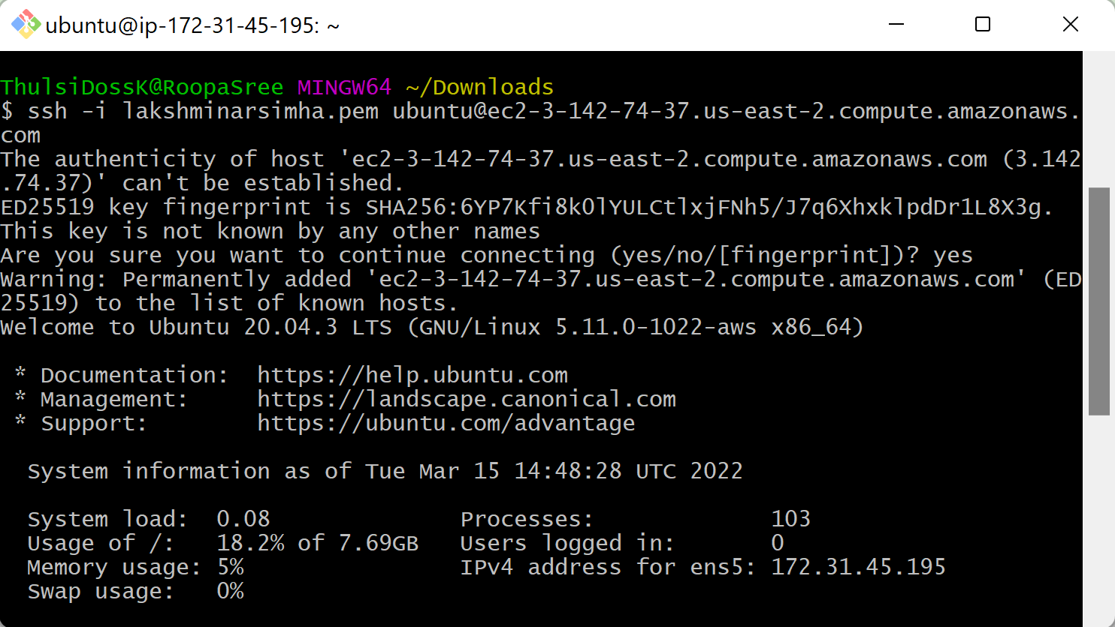
Accessing the EC2 instance
ssh -i lakshminarsimha.pem ubuntu@ec2-3-142-74-37.us-east-2.compute.amazonaws.com
Ssh -i <<pem>> role@public DNS

Slide 19
Install Docker Instance on EC2
https://docs.docker.com/engine/install/ubuntu/
Update the apt package index and install packages to allow apt to use a repository over HTTPS☺
$ sudo apt-get update
$ sudo apt-get install \
ca-certificates \
curl \
gnupg \
lsb-release
Add Docker’s official GPG key:
$ curl -fsSL https://download.docker.com/linux/ubuntu/gpg | sudo gpg --dearmor -o /usr/share/keyrings/docker-archive-keyring.gpg

Slide 20
Docker -contd
Use the following command to set up the stable repository.
echo \
"deb [arch=$(dpkg --print-architecture) signed-by=/usr/share/keyrings/docker-archive-keyring.gpg] https://download.docker.com/linux/ubuntu \
$(lsb_release -cs) stable" | sudo tee /etc/apt/sources.list.d/docker.list > /dev/null
Update the apt package index, and install the latest version of Docker Engine and containerdsudo apt-get update
sudo apt-get install docker-ce docker-ce-cli containerd.io
*** Tip ***https://www.digitalocean.com/community/questions/how-to-fix-docker-got-permission-denied-while-trying-to-connect-to-the-docker-daemon-socket

Slide 21
Install JDK
Now before we do the JDK installation lets first update the package manager of the virtual machine –
sudo apt-get update
Check if you have java already installed onto your EC2 machine by running the following command –
java -version
Then you can install java by running the following command
sudo apt install openjdk-11-jre-headless

Slide 22
Install Jenkins
First, we need to add the Jenkins repository to the package manager –
wget -q -O - https://pkg.jenkins.io/debian-stable/jenkins.io.key | sudo apt-key add –
sudo sh -c 'echo deb https://pkg.jenkins.io/debian-stable binary/ > /etc/apt/sources.list.d/jenkins.list’
sudo apt-get update
sudo apt-get install Jenkins
On successful installation, you should see Active Status
sudo service jenkins status (*** Tip use this command to check the Status)

Slide 23
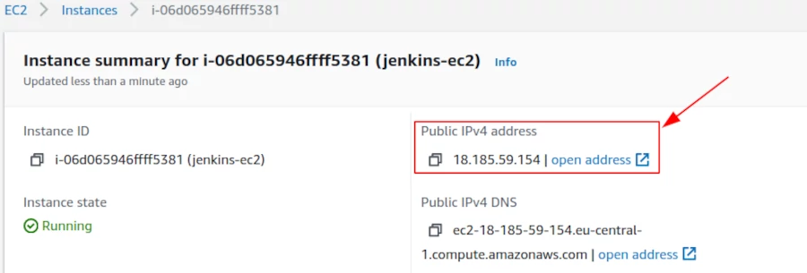
Configure Jenkins
Now we need to find the public IP address of the EC2 machine so that we can access the Jenkins

Slide 24
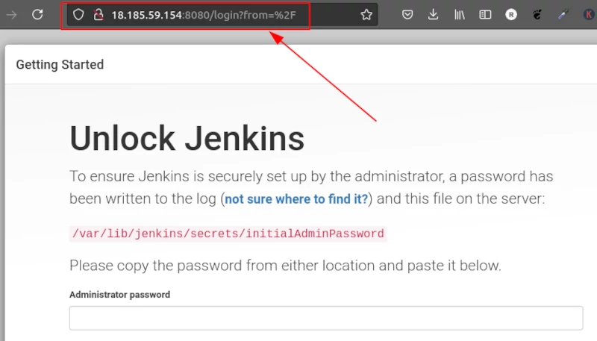
Jenkins configure
Alright now we know the public IP address of the EC2 machine, so now we can access the Jenkins from the browser using the public IP address followed by the port 8080

Slide 25
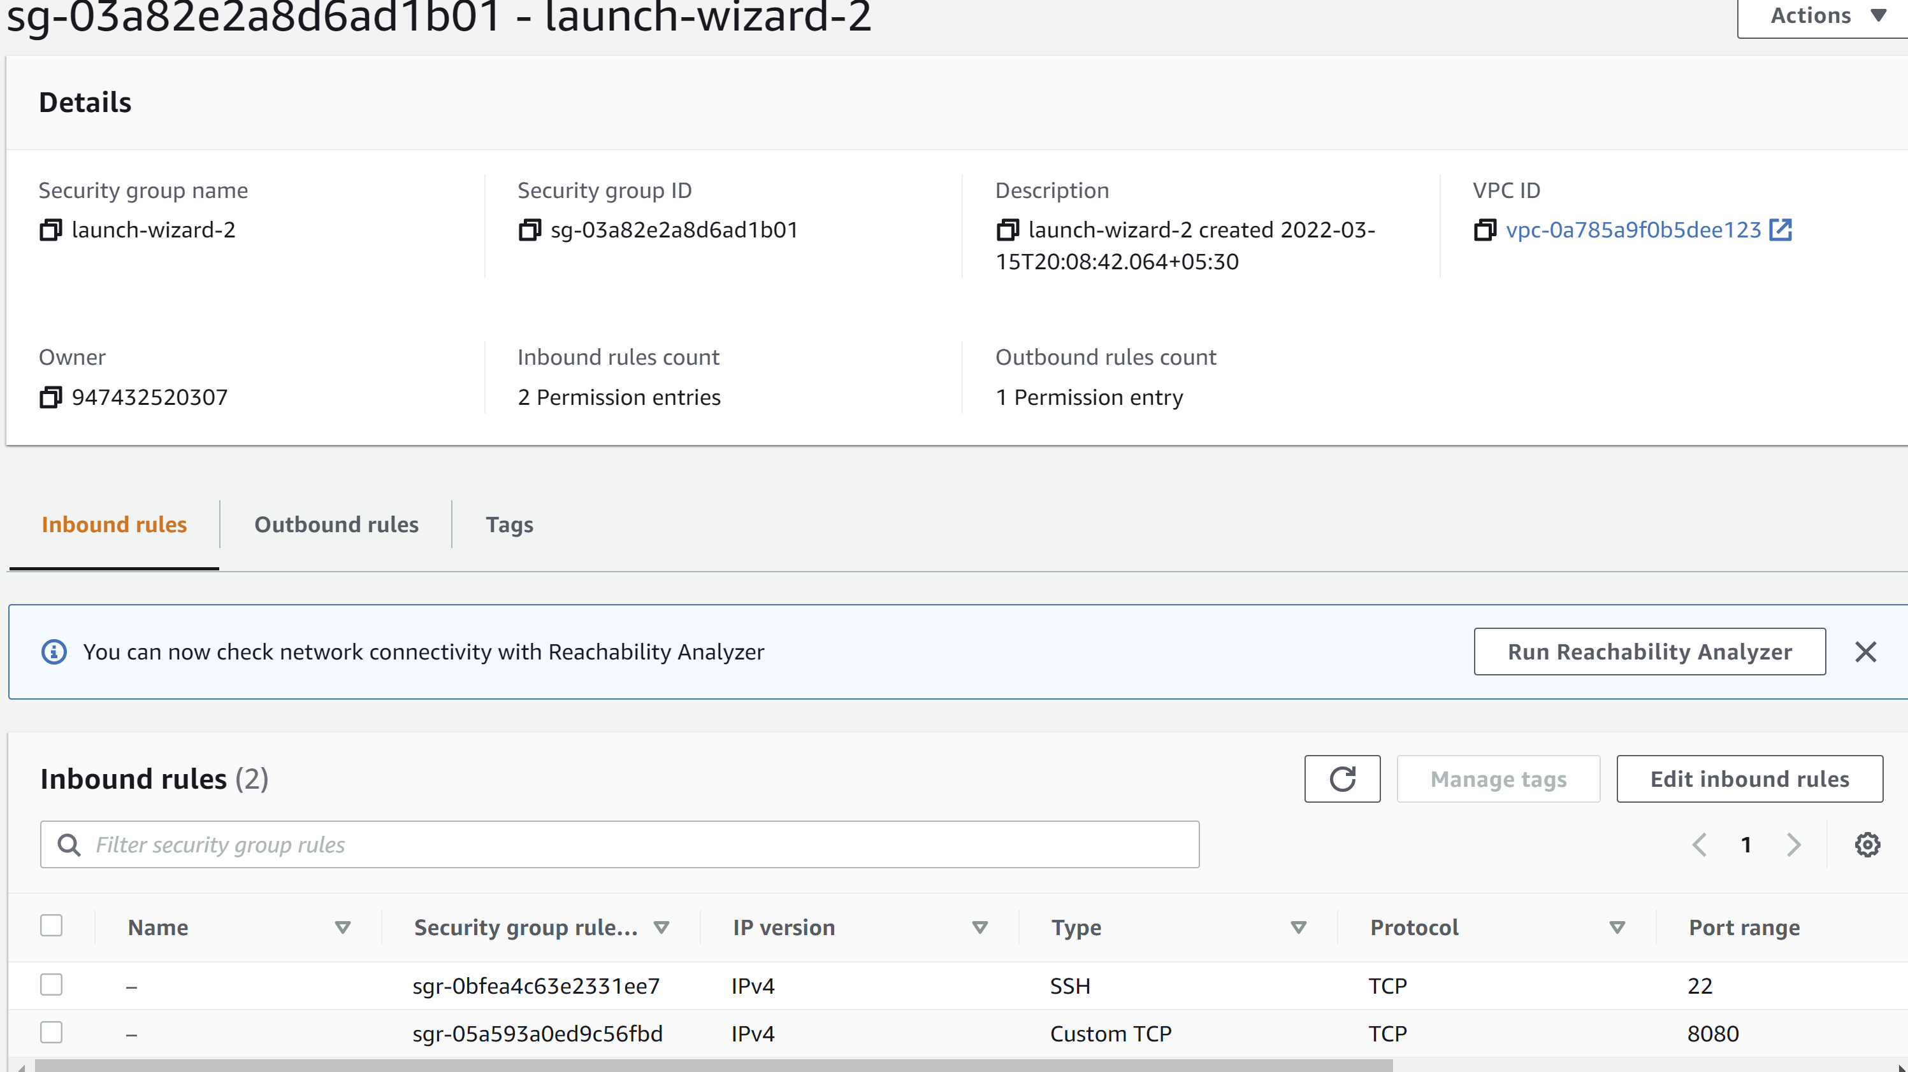
Jenkins Configure -Tip
Please make sure that you allow 8080 access to inbound security rule of the EC2 instance

Slide 26
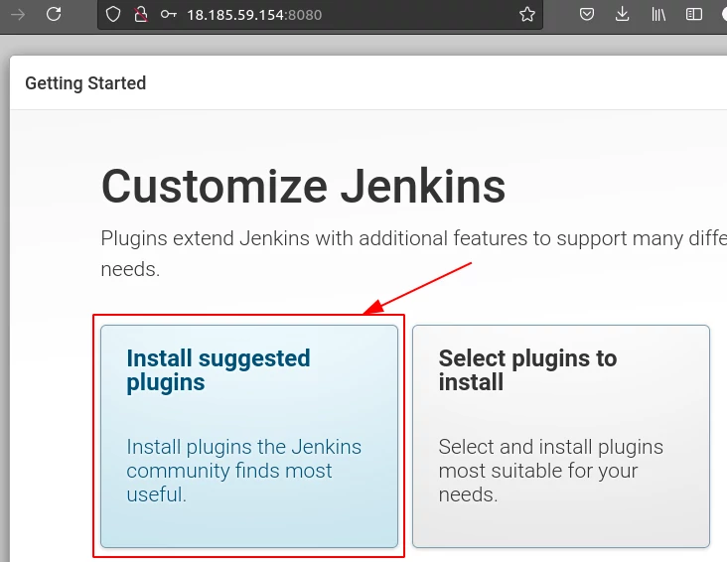
Jenkins Install Suggested Plugins

Slide 27
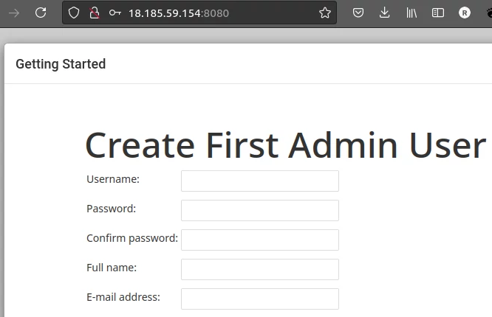
First Admin User for Jenkins

Slide 28
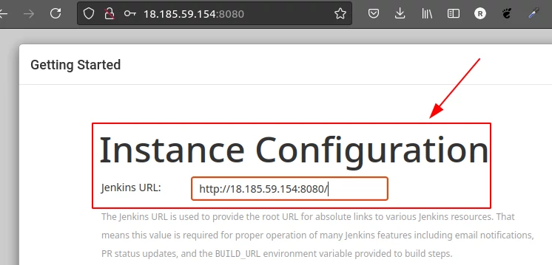
Jenkins

Slide 29
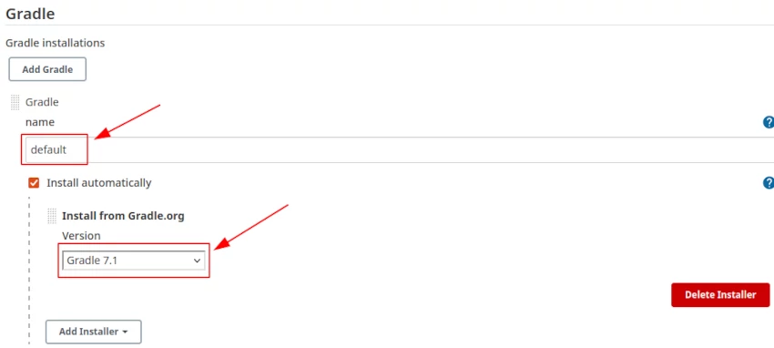
Setup Gradle
For setting up the gradle Goto -> Manage Jenkins -> Global Tool Configuration -> Gradle

Slide 30
assign administration privileges to jenkins user
Now we have installed the Jenkins on the EC2 instance. To interact with the Kubernetes cluster Jenkins will be executing the shell script with the Jenkins user, so the Jenkins user should have an administration(superuser) role assigned forehand.
Open the file /etc/sudoers in vi mode
sudo vi /etc/sudoers
Add the following line at the end of the file
jenkins ALL=(ALL) NOPASSWD: ALL

Slide 31
Install and Setup AWS CLI
Let us get the installation done for AWS CLI
sudo apt install awscli
Verify your AWS CLI installation by running the following command : aws --version
It should return you with the version of CLI
aws-cli/1.18.69 Python/3.8.5 Linux/5.4.0-1045-aws botocore/1.16.19

Slide 32
Configure AWS CLI
To configure the AWS the first command we are going to run is –
aws configure
Once you execute the above command it will ask for the following information -
AWS Access Key ID [None]:
AWS Secret Access Key [None]:
Default region name [None]:
Default output format [None]:

Slide 33
Install and Setup Kubectl
curl -LO https://storage.googleapis.com/kubernetes-release/release/`curl -s https://storage.googleapis.com/kubernetes-release/release/stable.txt`/bin/linux/amd64/kubectl
chmod +x ./kubectl
sudo mv ./kubectl /usr/local/bin/kubectl
Verify the kubectl installation
Client Version: version.Info{Major:"1", Minor:"21", GitVersion:"v1.21.2", GitCommit:"092fbfbf53427de67cac1e9fa54aaa09a28371d7", GitTreeState:"clean", BuildDate:"2021-06-16T12:59:11Z", GoVersion:"go1.16.5", Compiler:"gc", Platform:"linux/amd64"}
Error from server (Forbidden): <html><head><meta http-equiv='refresh' content='1;url=/login?from=%2Fversion%3Ftimeout

Slide 34
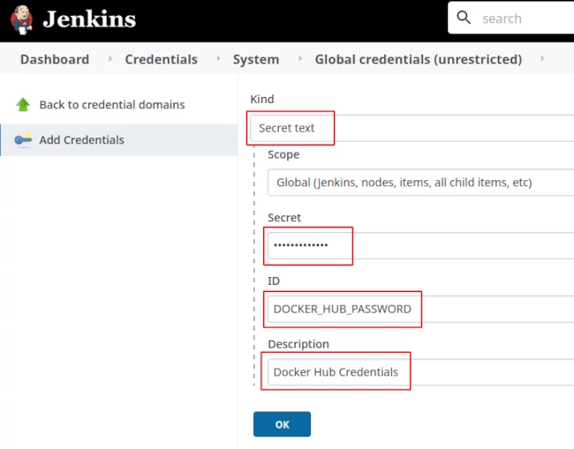
Add Docker and GitHub Credentials into Jenkins
Setup Docker Hub Secret Text in Jenkins
Goto -> Jenkins -> Manage Jenkins -> Manage Credentials -> Stored scoped to jenkins -> global -> Add Credentials

Slide 35
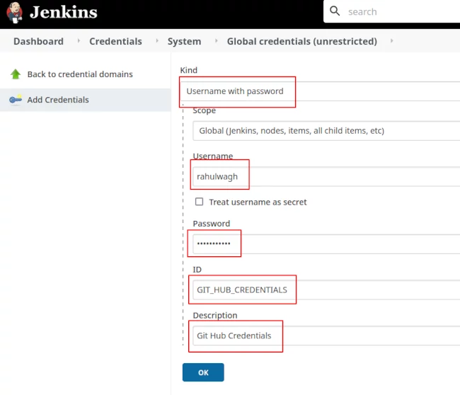
Setup GitHub Username and password into Jenkins
Goto -> Jenkins -> Manage Jenkins -> Manage Credentials -> Stored scoped to jenkins -> global -> Add Credentials

Slide 36
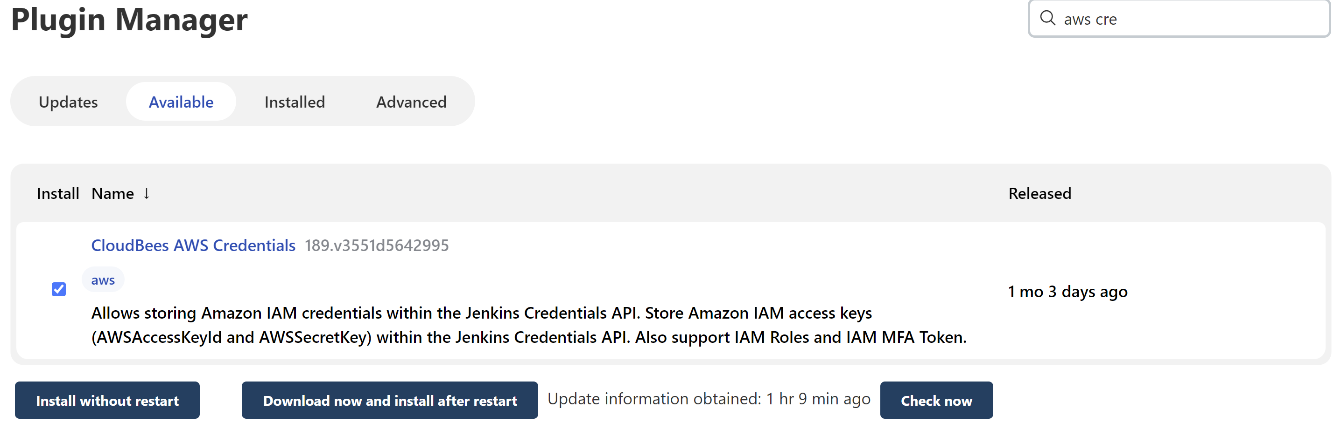
Install aws credentials plugin

Slide 37
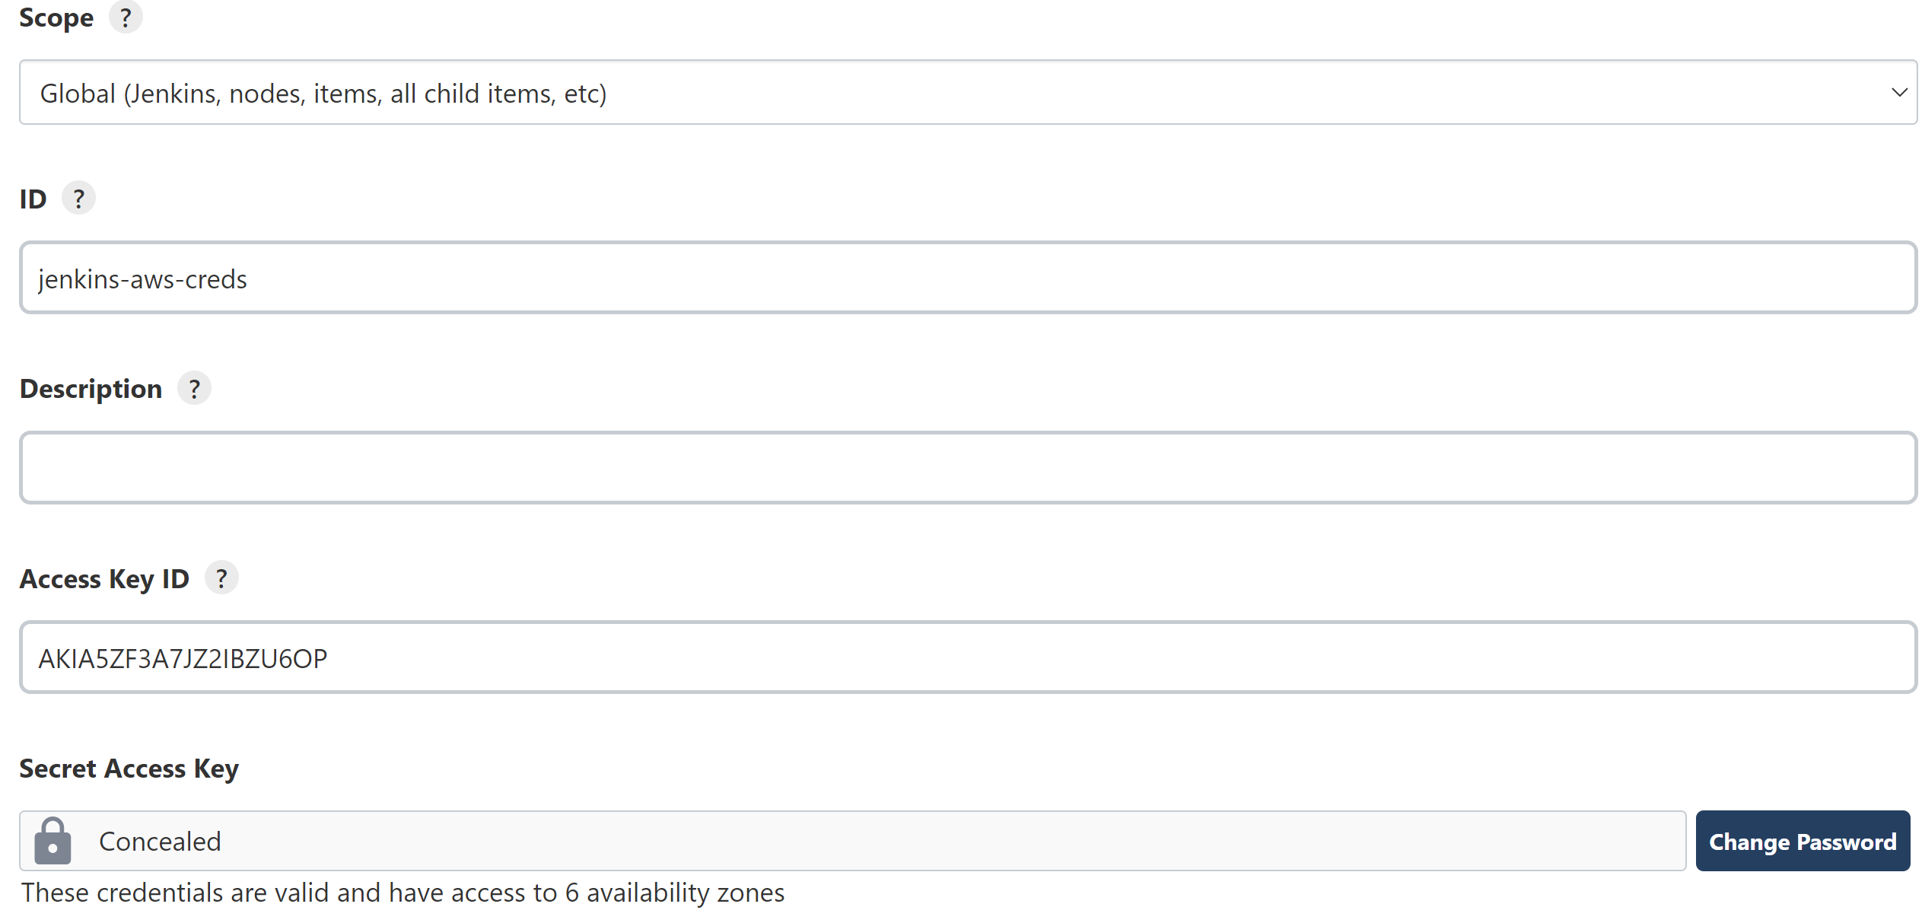
Configure aws credentials

Slide 38
Test aws test pipeline
Use the sample pipeline code to test the aws pipeline
https://gist.github.com/darinpope/cbdc036cec4cd49ae2548a4d2d050abd

Slide 39
Test aws test pipeline to run ec2 instances
pipeline {
agent { label "linux" }
environment {
AWS_DEFAULT_REGION="us-east-2"
}
stages {
stage('Hello') {
steps {
sh '''
aws --version
aws ec2 describe-instances
'''
}
}
}
}

Slide 40
K8s Deployment PIPELINE
Step 1 add Checkout the GitHub Repository
stage("Git Clone"){
steps{
git credentialsId: 'GIT_HUB_CREDENTIALS', url: 'https://github.com/thulsidk1/k8s-jenkins-aws’
}
}
Step2 Gradle compilation and build
stage('Gradle Build') {
steps{
sh './gradlew build’
}
}

Slide 41
K8s Deployment PIPELINE
Step3 :Create Docker Container and push to Docker Hub
stage("Docker build"){
steps{
sh 'docker build -t jhooq-docker-demo .’
sh 'docker tag jhooq-docker-demo thulsidk1/jhooq-docker-demo:version1.0’
}
}

Slide 42
K8s Deployment PIPELINE
Step4 : Login to docker
stage("Docker Login"){
steps{
withCredentials([string(credentialsId: 'DOCKER_HUB_PASSWORD', variable: 'PASSWORD')]) {
sh 'sudo docker login -u thulsidk1 -p $PASSWORD’
}
}
}

Slide 43
K8s Deployment PIPELINE
Step5 : Push image to Docker Hub
stage("Push Image to Docker Hub"){
steps{
sh 'sudo docker push thulsidk1/jhooq-docker-demo:version1.0’
}
}
Step6 : Kubernetes Deployment
stage("kubernetes deployment"){
steps{
withCredentials([aws(accessKeyVariable:'AWS_ACCESS_KEY_ID',credentialsId:'jenkins-aws-creds’,KeyVariable:'AWS_SECRET_ACCESS_KEY')]){
sh 'aws --version'
sh 'aws eks --region us-east-2 update-kubeconfig --name Ragavendra'
sh 'kubectl apply -f k8s-spring-boot-deployment.yml'
}
}

Slide 44
ReFERENCES
https://jhooq.com/aws-kubernetes-jenkins-pipeline/ Inspiration , cloned the sample app from Author
https://www.youtube.com/watch?v=iiF2iQV-3eM Darin Pope Cloud Bees (*****)
https://docs.docker.com/engine/install/ubuntu/
https://www.digitalocean.com/community/questions/how-to-fix-docker-got-permission-denied-while-trying-to-connect-to-the-docker-daemon-socket
https://medium.com/containerum/configuring-ci-cd-on-kubernetes-with-jenkins-89eab7234270

Slide 45
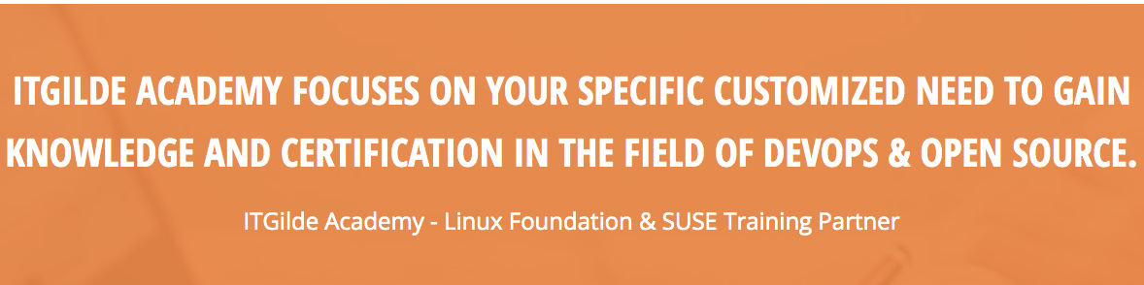
About ITGilde

