Slide 1


T.Deepthi Mery ID: 21NN1A0516
Final Project

Slide 2
KEYLOGGER
A keylogger is a type of surveillance technology used to monitor and record each keystroke typed on a specific computer's keyboard. This can include passwords, emails, chat messages, and any other typed information. Keyloggers can be used for various purposes, ranging from legitimate to malicious.
The use of keyloggers is heavily regulated and can be illegal if used without consent. In many jurisdictions, installing a keylogger without the knowledge and consent of the person being monitored is considered an invasion of privacy and is subject to legal penalties. It's essential to understand and comply with local laws regarding surveillance and data privacy when considering the use of keyloggers.

Slide 3


AGENDA
The presentation starts by emphasizing the significance of keyloggers, and then provides a comprehensive examination of the project's goals. It delves into the technical aspects of capturing key presses and the functionality of logging keystrokes into both text and JSON files.
The agenda features a demonstration of the graphical user interface (GUI), a discussion on the ethical implications of using keyloggers, and a live demonstration showcasing the keylogger in action.
3/21/2024 Annual Review

Slide 4

PROBLEM STATEMENT
Create an advanced keylogger using Python, incorporating the pynput library for monitoring key presses and a user-friendly GUI developed with tkinter. The primary goal is to develop a secure and efficient keylogging tool that accurately records and stores keystrokes in various file formats.
This project aims to meet the need for a dependable keylogging solution that balances technical complexity with user accessibility, ensuring data integrity and ethical use in cybersecurity and software development.
3/21/2024 Annual Review

Slide 5

PROJECT OVERVIEW
Embark on a journey into cybersecurity by creating a sophisticated Python keylogger featuring a sleek graphical interface built with tkinter. This project aims to merge the art of key press monitoring with user-friendly design, resulting in a dynamic tool that accurately captures keystrokes and presents them in an engaging format.
By combining technical expertise with aesthetic design, this endeavor not only improves data logging efficiency but also enhances the user experience, offering a fresh perspective on the intersection of functionality and style in software development.

Slide 6

WHO ARE THE END USERS?
This project could benefit a variety of end users, including cybersecurity professionals, software developers, ethical hackers, and individuals looking to monitor and log keystrokes for security or productivity purposes.
Additionally, students and researchers interested in cybersecurity concepts and Python programming may find this project valuable for learning and experimentation. The user-friendly GUI could also attract those who prefer an intuitive and visually appealing interface for interacting with the keylogging tool.

Slide 7

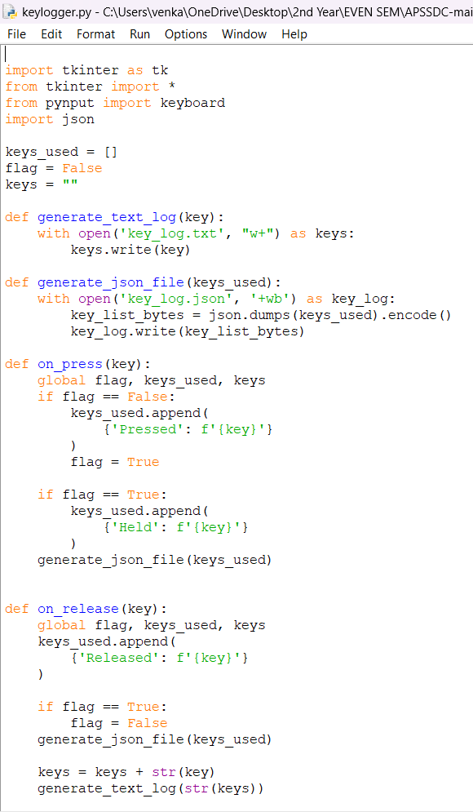
YOUR SOLUTION AND ITS VALUE PROPOSITION

Slide 8
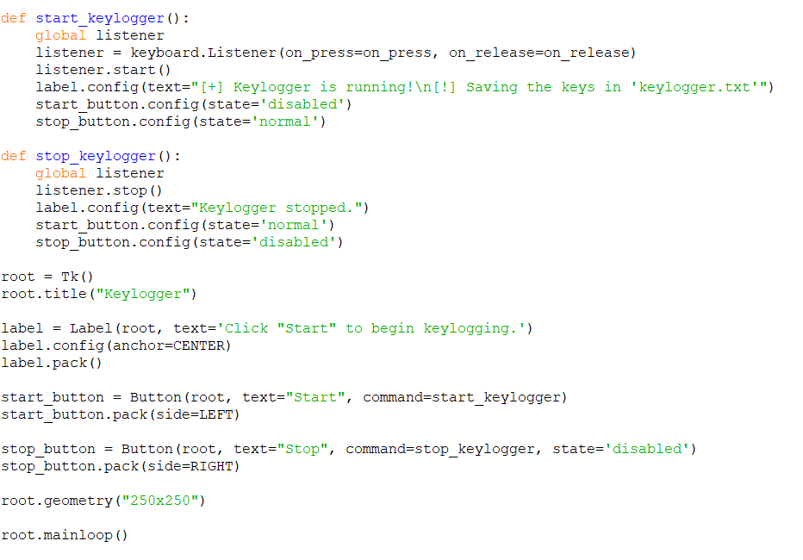

Slide 9

THE WOW IN YOUR SOLUTION
The Wow factor in the keylogger project lies in its seamless integration of advanced functionality with an intuitive and aesthetically pleasing user interface.
Factors:
Sophisticated Keystroke Capture:
User-Friendly GUI:
Ethical and Secure Usage:
Versatile Application:
3/21/2024 Annual Review
9

Slide 10
MODELLING
The Main Modules used in this KeyLogger Project are:
Keylogger Module:This uses the ‘pynput’ library to maintain the keylogger functionality.
Pynput:This library enables you to control and monitor input devices such as the mouse and keyboard.
Jsonlib: This library is used for working with JSON data in Python.It provides functions for encoding python objects into JSON strings and decoding JSON strings into Python objects.
GUI module: The GUI module will be responsible for creating the graphical user interface using 'tkinter' to provide a visually appealing way for users to interact with the keylogger.
10

Slide 11
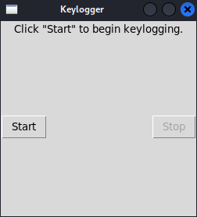
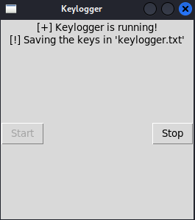
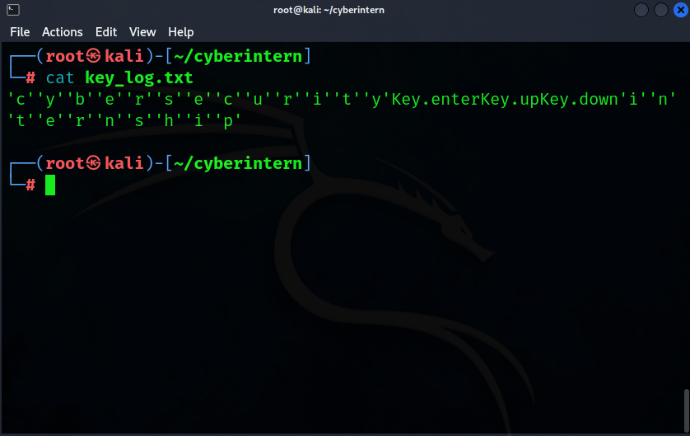
RESULTS
11

Slide 12
Output Explanation
When we click on the start button the keylogger will start.
Then you can type on your keyboard.
Whatever you type on your keyboard will be saved or recorded in a text file which is located in your project directory.

Slide 13
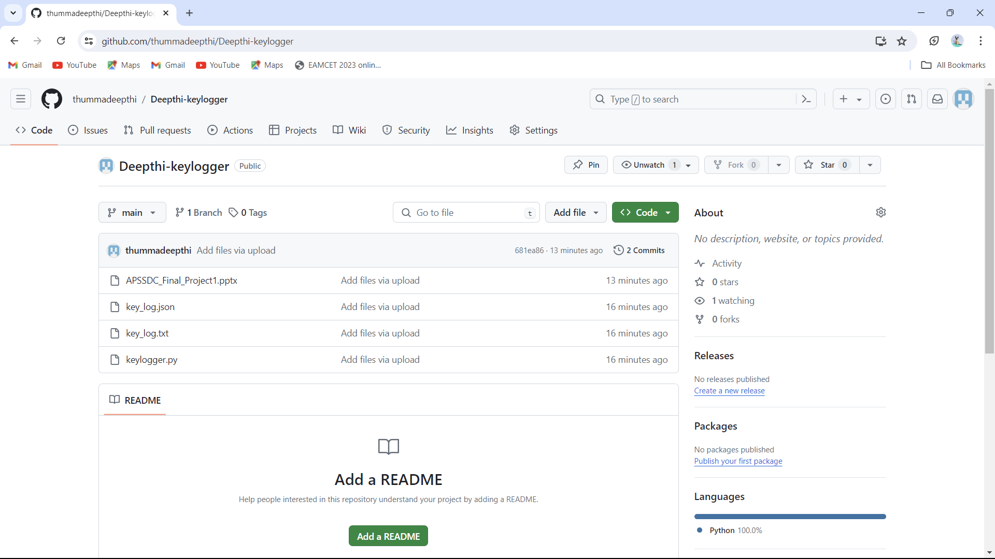
GitHub Link
Github Link: https://github.com/thummadeepthi/Deepthi-keylogger
ID: 21NN1A0516

Slide 14

THANK YOU

