Slide 1
Azure VPN

Slide 2
VPN stands for Virtual Private Network. It is a technology that allows you to create a secure and encrypted connection over a less secure network, such as the internet.
Azure VPN allows you to securely connect your on-premises network or individual devices to Azure virtual networks

Slide 3
Aspect | Point-to-Site VPN | Site-to-Site VPN
Connectivity | Connects individual client devices to Azure | Connects on-premises network to Azure
User Access | Remote workers, specific devices | Entire on-premises network
Configuration | Client device configuration required | On-premises VPN device configuration required
VPN Protocols | Secure Socket Tunneling Protocol (SSTP), OpenVPN | IPsec/IKE VPN protocols
Real-time Example | A remote employee connecting their laptop to Azure resources securely from a coffee shop or home network. | Establishing a secure connection between an on-premises data center and Azure cloud environment, allowing seamless access to resources hosted in Azure from the local network.

Slide 4
DELOY AZURE VIRTUAL NETOWRK GATEWAY
Active-active Mode (Disable)
Run the Powershell Script to create certificates.
Create root and Client Certificates
Enter command Certmgr
Move on Personal → Certificates →
Selcet → root Export->right Click → all Task→ export → default (except base 64)
Save the certificates care fully
Site
to Point VPN

Slide 5
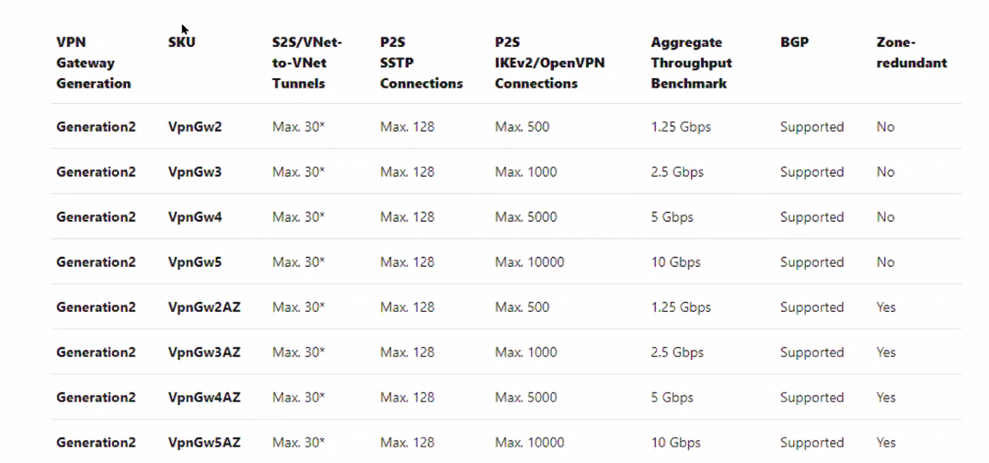

Slide 6
