Slide 1
WikiTrust
A Content-Driven Reputation System for the Wikipedia
Bo Adler / May 2012
Notes:
Hi, everyone. My name is Bo Adler, and today I will be describing my research on a reputation system for the Wikipedia that we have built and call WikiTrust.

Slide 2
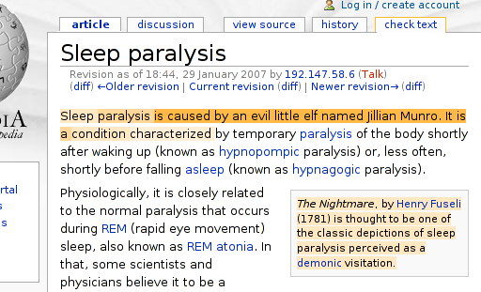
The Problem…
Notes:
At nearly four million articles, Wikipedia has become a household name. It’s the online encyclopedia that anyone can edit, which helps it stay current with evolving events and allows domain experts to contribute to articles without having to commit to writing a dissertation.
The downside of this openness is that anyone can make an edit without formal review, and vandals and bar bets contribute to the deterioration of this knowledge. Highlighted here in the screenshot is an article where the first sentence was vandalized into a slur.

Slide 3
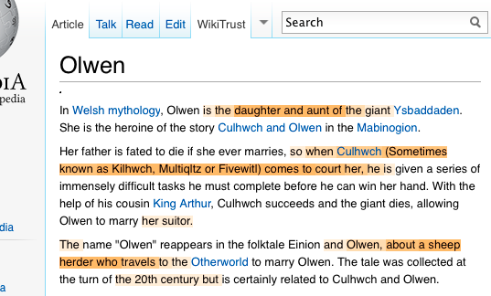
Insidious?

Slide 4
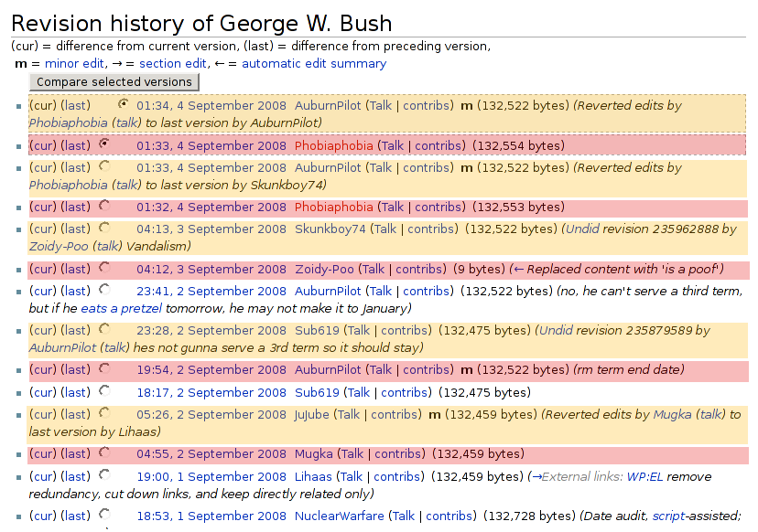
Wasted Human Effort
Notes:
The activity within Wikipedia is estimated at about 1 million revisions per week, with about 8% of that being vandalism. But even at only 8%, that’s quite a bit of effort that volunteers need to put into finding the vandalism and fixing it.
Some of that vandalism is predictable: for this screenshot, I chose the “George W. Bush” article as one likely to experience a lot of vandalism. I have color coded the revision history for this article so that you can see how much back and forth there is: red represents a bad edit which is reverted by the yellow edit immediately on top of it.
The upshot of this is that there is a lot of human capital which is wasted just to maintain the status quo. And readers of Wikipedia must always be on guard that what they read was not purposefully corrupted.

Slide 5
Our Approach
Q: Can we guide readers about the quality of an article?
A: Build a reputation system for authors.
a kind of summary of article history.
can predict quality of future contributions.
Notes:
When we started this research, there were many newspaper articles warning of the dangers of trusting information from Wikipedia. In trying to formulate a research project, we wondered at whether it was possible to give readers any kind of guidance on the quality of an article.
We initially had some common ideas, like looking for f-bombs, but the approach we settled on was to build a reputation system for the contributors to Wikipedia. That is, use the quality of previous work from an author to estimate what the quality of their current work will be.
This can also be used to annotate the revision history or even to color the text in an article.

Slide 6
Architecture
Calculate text changed by author
Good work?
yes
no
Increase reputation
Decrease reputation
Notes:
Just to be clear, here is a simple diagram explaining how the reputation system basically works.
When an author submits a new revision, we calculate what text was changed to find out what work the author actually did. Then we decide whether this was good work or bad, and update the reputation accordingly. Easy, peasy.

Slide 7
Architecture
Calculate text changed by author
Modified diff for author attribution over multiple past revisions.
Good work?
Need a way to measure “quality” of an edit.
yes
no
Increase reputation
Decrease reputation
How should reputation be adjusted?
Notes:
The reality, once we got started, was that each of these pieces has its challenges.
For example, to calculate the text changed by the author sounds like a simple ‘diff’ algorithm, right? We thought so, too, except that one idea we had depended on knowing “who should get credit for saying something”. Given that vandals can erase, and a helpful volunteer might recover text, we actually found that we needed to scan backwards through the revision history and account for several different ways that text might evolve with multiple authors involved.
And once you’ve figured out who has said what, then you need to decide whether it was good work or not, but how do you do that??
Finally, how much do you adjust the reputation by?

Slide 8
Outline
Measuring Quality of an Edit
Tracking Reputation
Vandalism Detection
Conclusions
Notes:
During the rest of this talk, I’ll describe a bit of what we did to address those challenges.
First, I will describe two ways we invented to measure the quality of an edit.
In the next segment, I’ll describe the actual rules we used to update the reputation of authors. The third segment follows up on that with another look at evaluating the quality of our reputation system by measuring its performance in a vandalism detection system.
And finally, a final statement of the contributions of this work.

Slide 9
Measuring edit quality
Notes:
So, how do we go about measuring the quality of a single edit? A naïve approach would be to ask users to rate edits when they read the Wikipedia, but this increases the workload on the volunteers.
A more automated idea we came up with was page views: as more people read an article, it’s more likely that someone will spot an error and correct it. But at the time we began our research, data on page views wasn’t available.
And then, aha!

Slide 10
An Idea
Principle: Older text is more likely to be correct.
So… measure how it survives over time.
Notes:
If more page views means that an error is more likely to be spotted and corrected, then we should also find that older text within an article is more reliable. If we could measure how text survives over time, then we could get a sense of both how reliable that text is and how good a job the original author did.

Slide 11
Text Longevity Quality
Text survival looks a lot like exponential decay.
Can we model it that way?
number
of words
time
Notes:
So how would that work?
After manually examining lots of revisions, the pattern that we noticed is that added text is either completely removed, or it’s whittled away over a few revisions until it reaches a stable state.
The figure here depicts that graphically, with the yellow bar representing the original text contribution of a single author. Over the following revisions, words and sentences are replaced with new ones, and sometimes the original wording is brought back. And one of the things we’ve noticed is that as the text gets older, it’s less likely to be monkeyed with, so is has this feel of looking like exponential decay.

Slide 12
Text Longevity Quality
Text survival looks a lot like exponential decay.
Can we model it that way?
T_{i}
T_{i} · α_{text}^{j-i}
number
of words
time
i
j
Notes:
Modeling it that way isn’t very hard, either. You have an initial size of text which is added, and then you have a bunch of points along the curve… so you just need to calculate what alpha approximates that. Essentially, this is a geometric series, where alpha can vary between zero and one… and the closer to one it is, the more of the contribution lasts into the future, so we call this measure “text longevity.”

Slide 13
Seeking Alpha
Notes:
The way we decided to compute alpha was by computing the sum of the geometric series and setting it to the sum we actually got. We get an equation out of this, which we can solve for in each specific case using Newton’s iterative method.

Slide 14
Two Issues
How do we find and count survived text?
What about text which is deleted or rearranged? Writers get credit, but not editors.
Notes:
We were pretty excited by this model when we first came up with it, but there were a couple of issues that came up once we got into it.
The first was, how do we go about finding and counting survived text? The text is moving around and being edited by later people, so how do we know who said what?
Another thing that really bugged us was that this model works great for contributors who add text, but we found that some users take on very specific jobs, like deleting vandalism. How do we reward them for their efforts?

Slide 15
Detecting Text Survival
We need to track who wrote what, using diff.
What about copied text?
What about rearranged text?
What about text from the past?
Who gets credit for common words?
Notes:
The first problem seems very related to one we are all familiar with from source code repositories: who do we blame when we find a bug in the code? Of course we use a text differencing algorithm to find out what was changed from one revision to the next, but even at this level we found that there were certain complications when wanting to give credit for work. The questions here are all ones that we wrestled with, especially because we didn’t want someone to be able to game the system
I won’t go into any details here, but you can refer to my dissertation to see how we modified the diff algorithm to address these concerns.

Slide 16
Text Differencing
Tichy algorithm has shortest edit script:
A B C C D E F D E A B
C D E A B C
WikiTrust algorithm does longest match:
A B C C D E F D E A B
C D E A B C

Slide 17
Credit to Editors
Problem: Measuring deletions, replacements, and swaps.
“Edit distance” can capture these behaviors.
Calculated from output of difference algorithm.
Lends itself to physical analogy.
Suppose grad school was like hiking through the forest…
Notes:
Instead, I want to focus on the other major issue raised by our text survival work: how do we give credit to people who do something other than adding text to the Wikipedia? How can we measure deletions and moving text around?
The answer we chose is to use the notion of edit distance, which quantifies how large an edit is by computing a text difference and examining the components. For example, a common edit distance formula is to sum the number of words inserted, deleted, and replaced in going from one revision to the next.
What is most useful about this choice is that the idea of distance encourages a physical analogy that allows us to draw on our intuition. So, to explain our second quality measure, I want you to consider what it would look like if grad school were a hike through the forest…

Slide 18



Notes:
From frantic start to graceful finish, a well-prepared student can make a beeline for graduation by taking the most direct path.

Slide 19

Start
Graduation
Notes:
But some of us veer off, and end up lost in research --- far away from our intended goal.

Slide 20

Start
Graduation
Notes:
Now the advisor must come save the grad student, by acting as a guide.

Slide 21
Lost in Research
Start
Graduation
Notes:
And through the efforts of the advisor, the grad student finds his way to graduation!

Slide 22
Lost in Research
work of grad student
work of advisor
Start
Graduation
necessary work
Notes:
Abstracting the situation, we are left with these important features: the grad student starts here, does some amount of work, and ends up lost in research; the advisor gets involved at this point and rescues the grad student, bringing him to graduation.
Given this diagram, how do we measure the “useful work” done by the grad student?

Slide 23
Useful Work?
Lost in Research
Start
Graduation
Grad student’s “forward” progress
Notes:
I know that every grad student in the room is thinking, “that’s easy: drop a normal and measure the distance in the direction of graduation.” And that’s a very reasonable approach, but I argue that the advisor has a different view of their relative contributions…

Slide 24
Advisor’s Viewpoint
Lost in Research
Start
Graduation
Grad student’s “useful work”
Notes:
From the advisor’s point of view, his time is very valuable and contributes more directly towards reaching the goal. So, instead of dropping a normal, he drops an arc based on his own contribution. Anything left over is the “useful work” done by the grad student.
In effect, the advisor assigns a discount to the work of the grad student based on the magnitude of his own contribution.

Slide 25
Edit Longevity Quality
the edit being reviewed
i
i-1
j
the previous edit
a future judge
Notes:
To create a quality measure for the Wikipedia, we want to promote the efficient use of human capital in the same sort of way… For example, if you add an unnecessary paragraph to an article then you are creating work which someone else has to repair, so the advisor’s viewpoint provides the proper incentive.
We construct a triangle using edit distance to compute the distances between the revision we want to evaluate, the immediately preceding revision, and some revision after it. We define the quality of the edit as the amount of “useful work” normalized by the amount of “actual work.” Again, It measures how much of the contribution lasts into the future, so we call this measure “edit longevity.”

Slide 26
Edit Longevity Quality
i-1
i
j
Good:
i
i-1
j
Bad:
Notes:
The nice thing about this quality measure is that it varies from -1 to +1.
In the best case, the edit is built upon to create a future revision and it gets a score of +1.
The worst case is that the edit has to be completely undone, as in this second example, and it gets a score of -1.

Slide 27
Evaluation?
PAN-WVC-10 vandalism detection corpus:
32k edits annotated as “regular” or “vandalism.”
Nearly 8% are vandalism.
To evaluate quality measures:
Use quality to directly predict “vandalism” class.
Rank results by AUC-PR.
Variations of diff, edit distance.
Notes:
Having defined these quality measures, the next question is “how do we evaluate this?” Since quality and vandalism are related, we decided to evaluate the performance using a vandalism corpus.
For each quality measure, we vary the threshold predicting vandalism to get a range of precision-recall values. We then calculate the area under these precision-recall curves to arrive at a single number representing the performance, where higher is better.

Slide 28
Results
Text longevity quality:
No detectable impact by diff algorithm.
AUC-PR ≈ 29.31%
Edit longevity quality:
Performance primarily determined by edit distance.
edit distance formula | AUC-PR
I + D – min(I, D)/2 | 43.77% - 44.46%
I + D | 42.33% - 43.03%
max(I, D) – min(I, D)/2 + M | 37.29% - 39.28%
i
i-1
j
Notes:
And here are the results. Text longevity is able to get 29% of the area under the precision-recall curve, with the parameters we varied having little effect.
For edit longevity, the results are much better --- reaching a maximum area of 44% under the precision-recall curve.
For comparison, the median score of the vandalism detection competition based on the same corpus was 42%. In our case, there are many situations which are not vandalism but have bad quality, such as writing with a biased viewpoint, so this result seems quite good!

Slide 29
Most people don’t make lots of changes
Most people are trying to be good
Notes:
On the right-hand graphs, notice that there’s a big bump in the frequency of the very worst qualities. This is akin to saying that when people contribute bad text, most often it is very obviously bad.
Notice also that the y-axis has a smaller scale for the edit views. There is more “spread” in both the size of an edit, and its quality.

Slide 30
A reputation system
Notes:
With a way to judge the quality of an edit, the last step in our little architecture diagram is to increase or decrease the reputation based on that judgement.
[[Old wording: To guide and predict behavior: In our conception, a reputation system has two purposes. First, it acts as a predictor of future behavior --- we expect someone with high reputation to do good work. Second, when reputation scores are public it also acts as a guide to good behavior, molding the users who strive for high reputation.]]

Slide 31
Basis of Approach
Use future revisions as judges of past revisions.
Measure the contribution (quantity * quality).
Established contributors are better judges.
Notes:
In the design of our reputation system, we brought together three key ideas.
First, we used multiple future revisions to judge an edit. This has the effect of letting the Wikipedia community itself decide what is good and what is bad, and helps to limit the damage of vandals.
Our second principle was to incorporate the size of an author’s work. That is, if you contribute a ton of good text, that is surely more valuable than a tiny amount of perfect text.
The third principle we felt important was to trust the opinion of established authors more than that of new comers, when judging earlier revisions.

Slide 32
Text Component
We increment the reputation of A_{i} by:
T_{i}
T_{j}
number
of words
i
j
(versions)‏
A_{i}
A_{j}
(authors)‏
Notes:
Like our two quality measures, we defined two aspects to how we update reputation. The first was a text component, related to the idea of text survival.
When an author A_i makes an edit, we consider each of the ten revisions after the edit is made as a judge of that original edit. We update the reputation of A_i with this value as each subsequent edit is made.

Slide 33
Text Component
We increment the reputation of A_{i} by:
T_{i}
T_{j}
number
of words
i
j
(versions)‏
A_{i}
A_{j}
(authors)‏
Notes:
The three main components of this value are the size of the original edit…

Slide 34
Text Component
We increment the reputation of A_{i} by:
T_{i}
T_{j}
number
of words
i
j
(versions)‏
A_{i}
A_{j}
(authors)‏
Notes:
the quality of the original edit as judged by measuring how many of the original words are left in the latest revision…

Slide 35
Text Component
We increment the reputation of A_{i} by:
T_{i}
T_{j}
number
of words
i
j
(versions)‏
A_{i}
A_{j}
(authors)‏
Notes:
and the reputation of the author making the judgement. Notice that we actually take the log of the reputation here, which has the effect of bringing super high reputation scores closer to the value of lower reputation users and leveling the playing field a bit between established authors and new comers.

Slide 36
Text Component
We increment the reputation of A_{i} by:
T_{i}
T_{j}
number
of words
i
j
(versions)‏
A_{i}
A_{j}
(authors)‏
Notes:
There are also some constants that we included because we weren’t sure how quickly reputation should grow or how important the initial size of the contribution should be. We computed the value for these constants by using a hill-climbing algorithm and optimizing the overall reputation score for predicting low edit quality.

Slide 37
Edit Component
We increment the reputation of A_{i} by:
where:
i
i-1
j
Notes:
The other half of our reputation increment is a component based on the idea of edit quality we defined. It’s a little bit more complicated looking, but it is based on the same principles that we’ve already seen.

Slide 38
Edit Component
We increment the reputation of A_{i} by:
where:
i
i-1
j
Notes:
There is the size of the original contribution, which is based on the edit distance from the previous revision, a quality based on the current judging revision, and a factor based on the reputation of the judge.
The difference in this formula is this additional “punishing” term. We included this term to make the threat of a negative judgment more severe, but made it a constant that we determined through the hill-climbing optimization process.

Slide 39
Evaluation?
annotated of 680 edits of itwiki as good, bad, neutral.
immediate deletions
for short-lived edits
Reputation | Judged Bad | Judged Good
Low | 66% | 19%
Normal | 16% | 68%
for short-lived text
Reputation | Judged Bad | Judged Good
Low | 74% | 13%
Normal | 14% | 85%
Pr(deleted | fresh) | = 0.0387
Pr(deleted | fresh, low rep) | = 0.0636
Notes:
Having built this fancy system, we then faced the question of how to evaluate it.
Our first idea was to manually annotate a bunch of edits and see how well reputation correlates with the predictions of our annotators. Looking at short-lived contributions as defined by our quality measures, you can see that low reputation authors were most often judged as having bad contributions, while normal reputation authors were judged as having good contributions. This was particularly encouraging when you consider that we’re only looking at contributions that were deemed “bad” by the quality measures, so our reputation score doesn’t just mirror the results of the quality measures.
Another angle we looked at was test which was immediately deleted after it was submitted. This happens to nearly 4% of text which is freshly submitted, but when you look at text submitted by authors with low reputation, the numbers jump up to over 6% of the text being immediately deleted!

Slide 40
Low Reputation Predicts Short-Lived Work
Rep System | Short-lived Edits |  | Short-lived Text
 | Precision | Recall | Precision | Recall
French Wikipedia:
Content-driven reputation | 23.9% | 32.2% | 5.9% | 37.8%
Edit count reputation | 21.6% | 28.3% | 5.6% | 37.9%
Italian Wikipedia:
Content-driven reputation | 14.2% | 19.4% | 3.9% | 38.7%
Edit count reputation | 11.5% | 19.1% | 3.3% | 39.5%
Notes:
In order to evaluate our reputation system, we defined low reputation as the bottom 20% of the allowed range, and similarly defined “short-lived” for both quality measures as the bottom 20% of their ranges. We calculated the precision and recall of low reputation predicting low quality, with the results you see here.
As a benchmark, we constructed another reputation system which just uses the number of edits made by authors to represent their reputation score. The performance of the two systems is very comparable based on our analysis.
====
Italian Wikipedia: until Oct-2005. 154,261 pages and 714,280 revisions.
French Wikipedia: until Jul-2006. 536,930 pages and 4,873,243 revisions.
We used “edit count” as a comparison reputation because it has been often proposed, and gives us some baseline.

Slide 41
Edit Count
Very simple to compute
Performs well because authors leave after bad edits
But…it is trivial to artificially increase your count
Pr(quitting after edit) | = 0.1
Pr(quitting after edit | edit was reverted) | = 0.5
Notes:
Well, it’s actually a bit surprising that the two systems perform so similarly: our work includes a mechanism for reputation to go down if bad work is done, so how is edit count able to do so well? It turns out that authors tend to self-select for quality: overall, the chances of a user never editing again after they make an edit is only 1 in 10, but if their work was undone then the probability that they never edit again jumps to 1 in 2. Because of that, edit count doesn’t get very large if you don’t do well.
Of course, if we were to announce that reputation on Wikipedia were computed based on edit count, you can be sure that people would immediately start gaming the system, so we feel that our system is a more appropriate solution.

Slide 42
Vandalism detection
Notes:
Given a reputation system, a natural application is to use it as part of a vandalism detection system.

Slide 43
Another Evaluation
PAN-WVC-10 vandalism corpus as source of truth.
Feed data to Random Forest machine learning.
Features: author reputation, edit size, time of day, etc.
Compare results to other works.
Notes:
In 2010, a competition was held to compare vandalism detection solutions, using the manually annotated PAN corpus as the benchmark. We entered that competition and took second place, but we were forced to leave out “reputation” as a feature in our machine learning because of lacking historical data. I decided to reconstruct the necessary historical data and see whether reputation improves the performance.

Slide 44
Features
Features Used
PAN 2010 Is anonymous? Time of day Time since previous revision Edit distance from previous revision Comment length Previous text trust histogram Current text trust histogram Text trust histogram difference
WikiTrust 2011 Same author as previous revision? Overall trust of page previous length of page current length of page comment marked as revert? | Thesis Author reputation
Notes:
In our original submission to the competition, we used the features listed on top. There is some standard metadata features, like what time of day the edit was made.
We also joint work in 2011 with other vandalism detection systems, where we added a few more metadata features shown on the bottom left.
For the current evaluation, I used the same base features as our 2010 work and added author reputation.

Slide 45
Our Results
System | AUC-PR
PAN 2010 WikiTrust | 0.49263
WikiTrust + metadata (2011) | 0.61047
WikiTrust + reputation (thesis) | 0.61152
Notes:
Here are the results for the three sets of features we used, and we see that including author reputation as a feature performs the best out of the systems we have built. This demonstrates that our reputation score provides useful information which machine learning algorithms are able to make use of.
And you’ll notice that the gap between our second and third result is not so big, Our reputation only applies to authors with registered accounts, but the worst vandals tend to use Wikipedia anonymously. Still, this is plenty encouraging and suggests that we should look at computing reputations for IP subnets.

Slide 46
Results in Context
System | AUC-PR
PAN 2010 WikiTrust | 0.49263
STiki (2011) | 0.52534
WikiTrust + metadata (2011) | 0.61047
WikiTrust + reputation (thesis) | 0.61152
Mola-Velasco (2011) | 0.73121
Mola-Velasco + topic (2011) | 0.7541
PAN 2010 metadetector (2010) | 0.77609
Mola-Velasco + WikiTrust + STiki (2011) | 0.81829
Notes:
Putting our results into the larger context of the best performing systems currently published, we see that another interesting fact: the top three systems use somewhat orthogonal ideas which are able to be combined into a very effective single system (demonstrated by the last line).

Slide 47
Conclusions

Slide 48
Our Contribution
Two quality measures reflecting the co-author reaction to edits of a collaborative document.
A reputation system for authors of a collaborative document.
Notes:
To wrap it up, there are two major contributions we have made in this work.
First, we have defined two quality measures for collaborative works that measure how the work of an author survives into the future
Our second contribution is a working reputation system for the Wikipedia, and a framework for future exploration of the ideas contained within.
Both contributions were evaluated using a corpus manually annotated for vandalism, with positive results.

