Slide 1

Workshop
What should User Rep
be on the Wikipedia?
Leaders:
Luca de Alfaro
Bo Adler
Ian Pye

Slide 2

Who are we?
Research Team
  Background
    Game theory, Virtual reality, Internet services, etc.
  You might have seen our recent work
    Reputation used in Google Maps
    Computational linguistics: xurch.com
    Lebanese elections: sharek961.org

Slide 3
Our Wiki Work
WikiTrust Project
  “Developing algorithmic notions of trust for Internet-scale collaboration.”
  Published papers
    “A Content-Driven Reputation System for the Wp.”
    “Measuring Author Contributions to Wikipedia”
    “Assigning Trust to Wikipedia Content”
    “Robust Content-Driven Reputation”
  A “bleeding edge” demo
    Google for “Firefox Wikitrust”

Slide 4
How does it work?
Trust-colored Text
  Blah blah blah

Slide 5
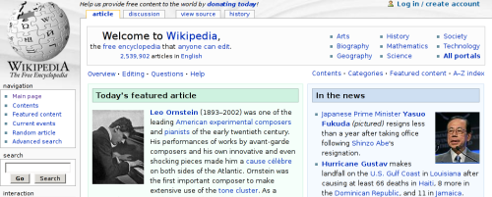
Who cares?
Wikipedia
  Internal recognition for Barnstars and administrator status.
  Does content come from the unwashed masses, or the devoted volunteers?

Slide 6
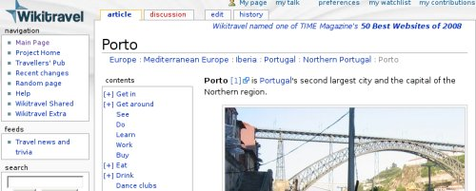
Who cares?
Wikitravel
  License requires attribution for every author that contributes.
  Is deleted content still a contribution?

Slide 7
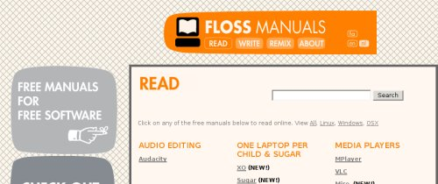
Who cares?
FLOSS Manuals
  Wikis are now being used to collaborate on books.
  How do you decide on the order of the authors?

Slide 8
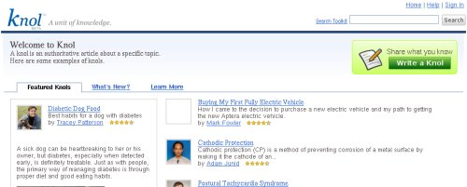
Who cares?
Google Knol
  Wikis can make money, through ads for example.
  How should the revenue be split?

Slide 9
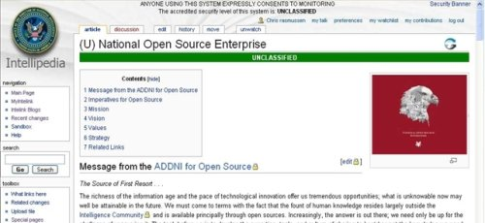
Who cares?
Intellipedia
  Companies use wikis to share information with other organizations.
  How can they track the work done?
www.spy-world.com

Slide 10
Who cares?
Summary
  Collaboration has two trends: getting used more widely, and happening between more people.
  Examples might use different motivations, but all depend on recognition of “work”.
  Computing reputations provides a concrete way to do this.

Slide 11
What can we measure?
Simple Ideas
  Text amount – gives credit to people who write a lot.
  Edit count – gives credit to people who work on many things, such as editors who correct grammar.
  Neither gives much credit to the other group.
  Both can be manipulated with spam methods.

Slide 12
More Ingredients
We can track blocks of text
version 9
bla
ble
wuga
boink
5
8
9
6
version 10
bla
ble
wump
wump
boink
wuga
5
8
10
10
6
9

Slide 13
More Ingredients
Text survival
  We can compute how much contributed text is left after each revision (text life).
number
of words
time
(versions)‏
Amount of
new text
Amount of
surviving text

Slide 14
More Ingredients
What else can we measure?
  We can compute the edit distance between revisions, based on the block analysis.
Version
9
wuga
boing
bla
ble
10
wuga
boing
yak
bla
ble
11
wuga
boing
yak
wump
mump
bla
ble

Slide 15
More Ingredients
What else can we measure?
  We can compute the edit distance between revisions, based on the block analysis.
Version
9
wuga
boing
bla
ble
d(9,10) = 1 word
10
wuga
boing
yak
bla
ble
d(10,11) = 2 words
11
wuga
boing
yak
wump
mump
bla
ble

Slide 16
More Ingredients
What else can we measure?
  We can compute the edit distance between revisions, based on the block analysis.
Version
9
wuga
boing
bla
ble
d(9,11) = 3 words
10
wuga
boing
yak
bla
ble
11
wuga
boing
yak
wump
mump
bla
ble

Slide 17
More Ingredients
Edit distance
  We can use these distances to find the “direction” of a change.
the past
k-1
k
judged
the past
k
judged
k-1
d(k-1, j)‏
d(k, j)‏
d(k, j)‏
d(k-1, j)‏
j
judge
j
judge
the future
the future

Slide 18
More Ingredients
Edit Quality
  Computing the amount of work “towards the future” gives us edit longevity.
the past
k-1
“work done”
d(k-1, k)‏
d(k-1,j)-d(k,j)‏
“progress”
k
j
the future

Slide 19

Discussion Time
  What are your ideas?

Slide 20
Why?
Does Wikipedia need reputation?
  What purposes are there?

Slide 21
What should we measure?
  We have focused on text metrics.

Slide 22
How would it work?
  Technical issues
  Process issues

Slide 23
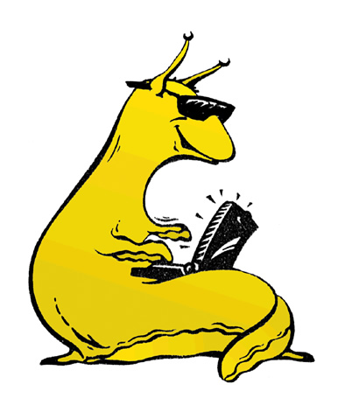
Thanks!
Our tools are available!
http://wikitrust.soe.ucsc.edu

