Slide 1

A Reputation System
for the Wikipedia
Presented by: Bo Adler

Slide 2

An Internet Encyclopedia
Wikipedia Quick Facts
  Debuted in 2001, 10K articles in first month.
  Currently has about 2.7 million articles.
  About 1 million user accounts, and many more anonymous contributions.
  An amazing success!
    Not the first internet encyclopedia...
Notes:
What makes the early history of Wikipedia amazing is that they weren't the first attempt at an Internet Encyclopedia. GNU has it's GNUpedia, Jimbo Wales has Nupedia.

Slide 3
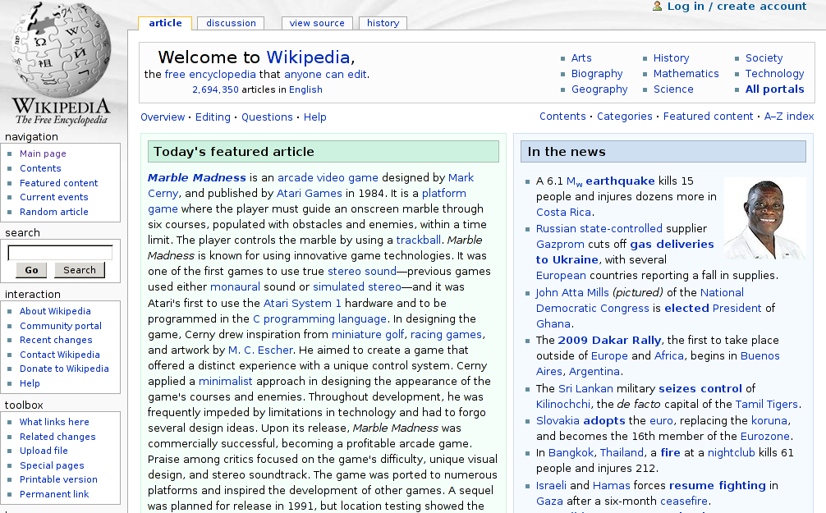

Slide 4
Reason for recency.
Recent!

Slide 5
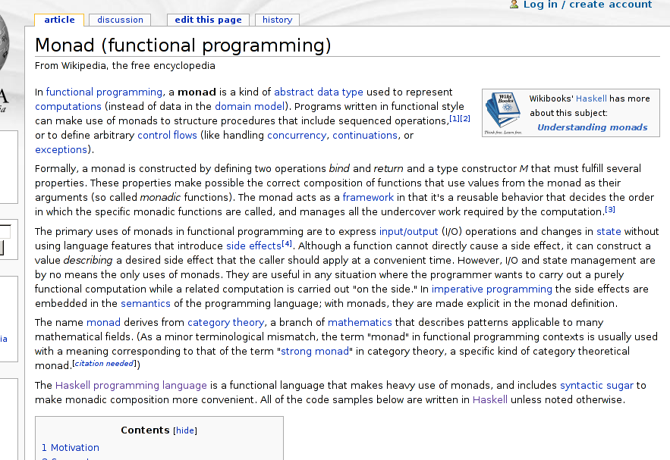
Notes:
What makes the early history of Wikipedia amazing is that they weren't the first attempt at an Internet Encyclopedia. GNU has it's GNUpedia, Jimbo Wales has Nupedia.

Slide 6
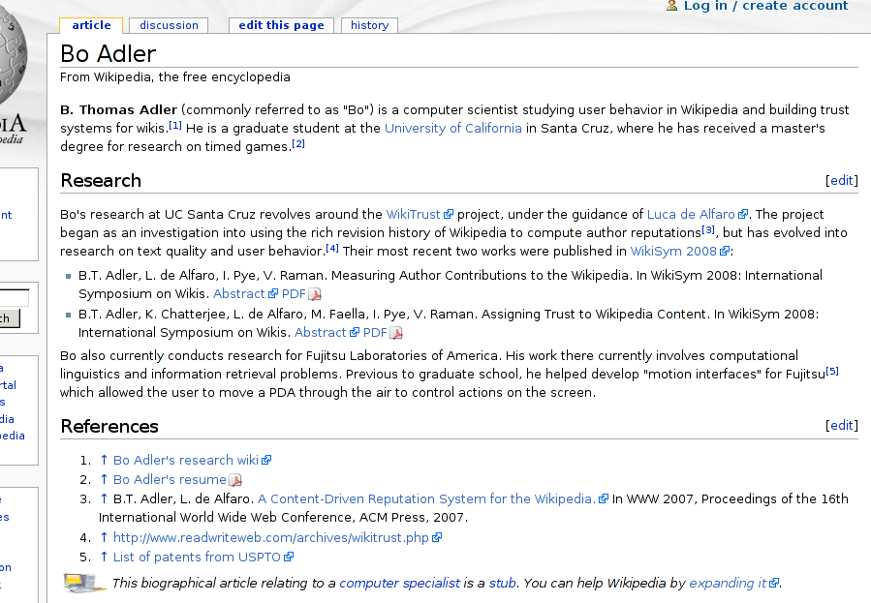
Notes:
...some vanity pages

Slide 7
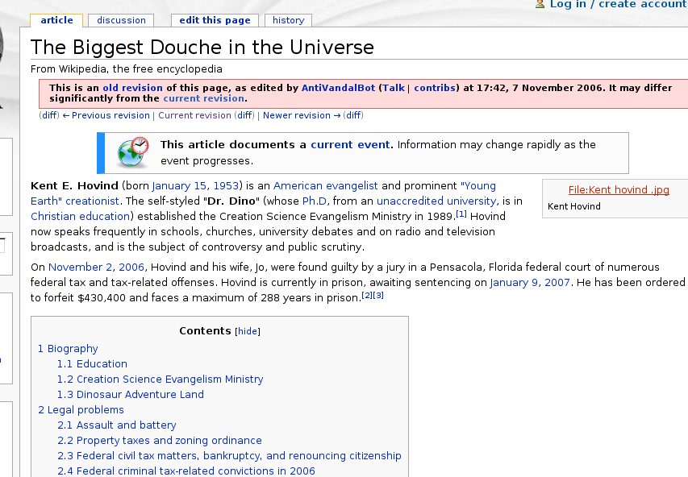
Notes:
... pages of questionable usefulness.

Slide 8
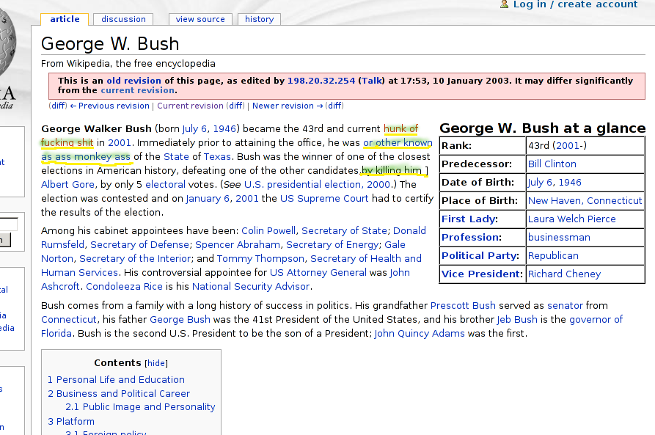
Notes:
And finally, pages which are clearly useful, but have been vandalized.

Slide 9

A Curse and A Blessing
Anyone Can Edit?
  Open collaboration spawns content growth.
  But is it reliable?
  Revision history has been saving grace.
    Most reverts happen in under 7min (itwiki, as of 2006).
Notes:
The open collaboration model is an outgrowth of the open source movement. Wikipedia was one of the first sites to try to harness the “wisdom of the crowds”, and its success has spawned a legion of other sites. This harnessing of users is now known as crowdsourcing.

Slide 10

UCSC WikiTrust Project
Project Goals
  “Can we help identify questionable content?”
  Provide readers with guidance about text trust.
  Provide an incentive to give lasting contributions.
  Provide a basis for policies:
    Recognition of authors.
    Sandboxing content.
Notes:
The open collaboration model is an outgrowth of the open source movement. Wikipedia was one of the first sites to try to harness the “wisdom of the crowds”, and its success has spawned a legion of other sites. This harnessing of users is now known as crowdsourcing.

Slide 11
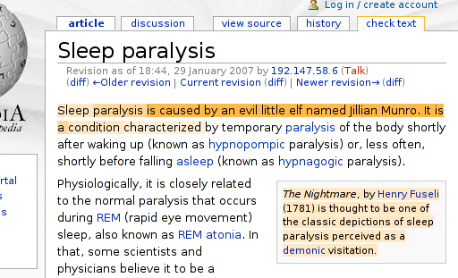
UCSC WikiTrust Project
Trust tab
A Minimally Intrusive UI
Color
indicator
Notes:
The open collaboration model is an outgrowth of the open source movement. Wikipedia was one of the first sites to try to harness the “wisdom of the crowds”, and its success has spawned a legion of other sites. This harnessing of users is now known as crowdsourcing.

Slide 12
Related Work
Informal
  Wikipedia quality efforts:
    The RC Patrol.
    Bots scanning for “obvious” problems.
    “Featured” articles.
    Currently working on “stable revisions.”
  Bloggers argue for reputation systems.
    Favorites: edit count, text count, text age.

Slide 13
Related Work
Academic
  Graph-based techniques
    “web of trust” (Guha et al., 2004)‏
    PageRank, etc. (McGuiness et al., 2006)‏
    Bayesian networks (McGuiness et al., 2006)‏
  Machine learning techniques
    Identify vandalism (Smets et al., 2008)‏
    Classify article quality (Rassbach et al., 2007)‏
  Content Evolution
    Edits ~ Quality (Lih 2004; Huberman et al., 2007)‏

Slide 14
Overview
Attacking the Problem
  Measuring user contributions.
  Reputation for authors.
  Text trust.
Future Work
  Category-specific reputations analysis.
  Content-driven “stable revisions.”

Slide 15
Attacking the Problem
Measuring User Contributions
B. Adler, L. de Alfaro, I. Pye, V. Raman.
Measuring Author Contributions to the Wikipedia.
In WikiSym 2008: International Symposium on Wikis.
Notes:
There is a wealth of information in the revision history!

Slide 16
How should we do it?
Simple Ideas
  Text count – gives credit to people who write a lot.
  Edit count – gives credit to people who work on many things, such as editors who correct grammar.
  Neither gives much credit to the other group.
  Both can be manipulated with spam methods.
Notes:
There is a wealth of information in the revision history!

Slide 17
Other considerations
Questions
  Is vandalism a “contribution?”
  Is spam? On-topic spam (advertising)?
  What about text which is ultimately deleted?

Slide 18
Ingredients
What can we measure?
  We can track blocks of text.
version 9
bla
ble
wuga
boink
version 10
bla
ble
wump
wump
boink
wuga

Slide 19
Ingredients
Text survival
  We can compute how much contributed text is left after each revision (text life).
number
of words
time
(versions)‏
Amount of
new text
Amount of
surviving text

Slide 20
Ingredients
Text Quality #1
  How is text preserved? Treat it as an exponential decay and find the constant.
T_{k}
T_{k} · _{text}^{j-k}
number
of words
time
k
j
(versions)‏

Slide 21
Ingredients
Text Quality #2
  How is text preserved? Add up the amount of text surviving the next ten revisions.
T_{k}
T_{j}
number
of words
time
k
j
(versions)‏

Slide 22
Ingredients
What else can we measure?
  We can compute the edit distance between revisions, based on the block analysis.
Version
9
wuga
boing
bla
ble
10
wuga
boing
yak
bla
ble
11
wuga
boing
yak
wump
mump
bla
ble

Slide 23
Ingredients
What else can we measure?
  We can compute the edit distance between revisions, based on the block analysis.
Version
9
wuga
boing
bla
ble
d(9,10) = 1 word
10
wuga
boing
yak
bla
ble
d(10,11) = 2 words
11
wuga
boing
yak
wump
mump
bla
ble

Slide 24
Ingredients
What else can we measure?
  We can compute the edit distance between revisions, based on the block analysis.
Version
9
wuga
boing
bla
ble
d(9,11) = 3 words
10
wuga
boing
yak
bla
ble
11
wuga
boing
yak
wump
mump
bla
ble

Slide 25
Ingredients
What else can we measure?
  We can compute the edit distance between revisions, based on the block analysis.
the past
Version
9
1
9
wuga
boing
bla
ble
10
10
wuga
boing
yak
bla
ble
3
2
11
wuga
boing
yak
wump
mump
bla
ble
11
the future

Slide 26
Ingredients
Edit distance
  We can use these distances to find the “direction” of a change.
the past
k-1
k
judged
the past
k
judged
k-1
d(k-1, j)‏
d(k, j)‏
d(k, j)‏
d(k-1, j)‏
j
judge
j
judge
the future
the future

Slide 27
Ingredients
Edit Quality
  Computing the amount of work “towards the future” gives us edit longevity.
the past
k-1
“work done”
d(k-1, k)‏
d(k-1,j)-d(k,j)‏
“progress”
k
j
the future

Slide 28
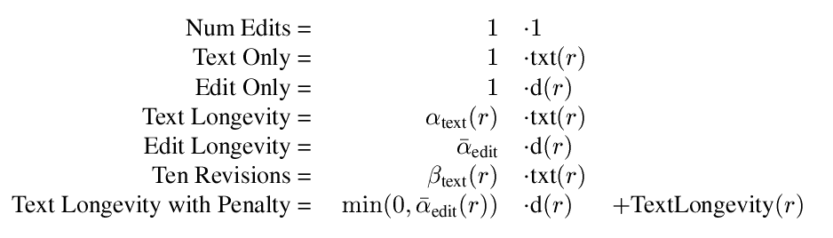
Recipes
We can mix ingredients in different ways:

Slide 29
Recipes
We can mix ingredients in different ways:
Basic size measurements

Slide 30
Recipes
We can mix ingredients in different ways:
Increasing quality complexity

Slide 31

Graphs
What to watch for:
  Measures mostly agree.
    (The crowd is mostly on a diagonal.)
  Comparisons reveal groups of “bad guys.”
    Wow, and we can do this programmatically!

Slide 32
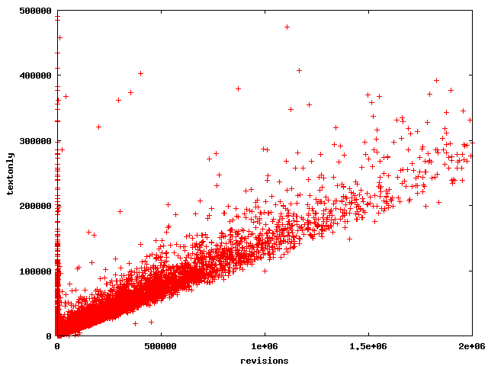
Ten Revisions
(zoomed)‏

Slide 33
Ten Revisions
(zoomed)‏
“perfect” contributors

Slide 34
Ten Revisions
(zoomed)‏
People aren't perfect as their contributions get large

Slide 35
Ten Revisions
(zoomed)‏
Except this guy.
He's a bot.

Slide 36
Ten Revisions
(zoomed)‏
These guys added text which was immediately erased.

Slide 37
Ten Revisions
(zoomed)‏
Added over 400K words, immediately erased?
That's dedication!!

Slide 38
Ten Revisions
(zoomed)‏
Actually, they are bots.

Slide 39
Text Longevity with Penalty
(zoomed)‏
“perfect” contributors

Slide 40
Text Longevity with Penalty
(zoomed)‏
same bad guys

Slide 41
Text Longevity with Penalty
(zoomed)‏
new bad guys.

Slide 42

Text Longevity with Penalty
Analysis
  The string of “old” bad guys is there.
    They all behave similarly: they add text which is completely removed right away.
  Notice that near the origin, there is more “dispersion” of people, particularly those who are punished.
  There are “new” bad guys.
    They deleted text, in addition to adding bad text.

Slide 43
TextLong vs EditLong
percentiles

Slide 44
TextLong vs EditLong
These guys are equivalent?
TextLong says “yes,” EditLong says “no.”

Slide 45
TextLong vs EditLong
Users who edit, but add no text.

Slide 46
What else?
  Most people don't make big changes.
  Most people are trying to be good.

Slide 47
The Take Away
Important Lessons
  People are mostly trying to be good.
  Most ideas basically agree.
    Because people are basically good?
  Can give “credit” in a formulaic way.
  Can distinguish “writers” from “editors.”

Slide 48
Attacking the Problem
Reputation for Authors
B. Adler, L. de Alfaro.
A Content-Driven Reputation System for the Wikipedia.
In WWW 2007, Proceedings of the 16th International World Wide Web Conference, ACM Press, 2007.
Notes:
There is a wealth of information in the revision history!

Slide 49
Content-driven reputation
  long-lived contributions increase reputation
  reverted contributions decrease reputation
A Wikipedia article
time

Slide 50
Content-driven reputation
  long-lived contributions increase reputation
  reverted contributions decrease reputation
A Wikipedia article
A
edits
time

Slide 51
Content-driven reputation
  long-lived contributions increase reputation
  reverted contributions decrease reputation
A Wikipedia article
A
edits
time
B
builds on A’s edit

Slide 52
Content-driven reputation
  long-lived contributions increase reputation
  reverted contributions decrease reputation
A Wikipedia article
A
edits
time
+
B
builds on A’s edit

Slide 53
Content-driven reputation
  long-lived contributions increase reputation
  reverted contributions decrease reputation
A Wikipedia article
A
edits
time
+
+
B
builds on A’s edit
-
C
reverts to A’s version

Slide 54

Updating a Reputation
Two components
  Text reputation – based on adding new text.
  Edit reputation – based on editing old text.
  Factors for reputation change:
    How big was the initial change?
    How much change is preserved by later authors?
    What is the reputation of judging authors?

Slide 55
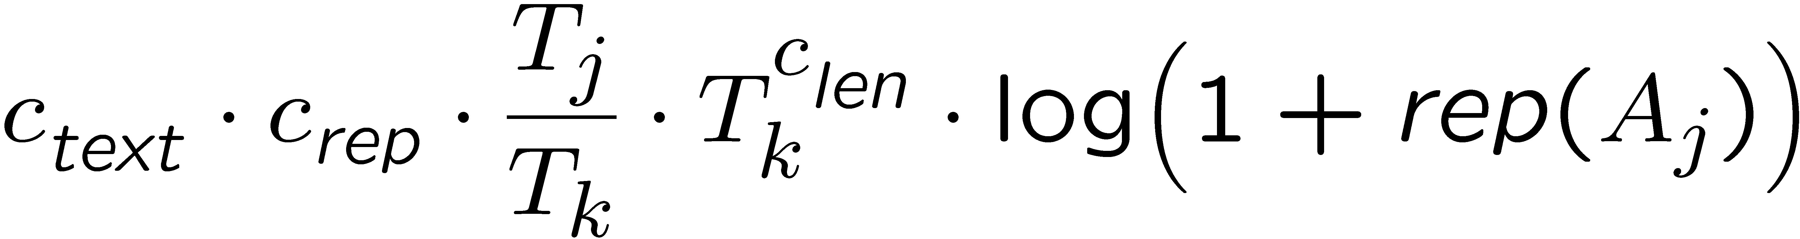
The Text Component
T_{k}
T_{j}
number
of words
time
k
j
(versions)‏
A_{k}
A_{j}
(authors)‏
As a consequence of version j, we increment the reputation of A_{k} by:

Slide 56
The Text Component
T_{k}
T_{j}
number
of words
time
k
j
(versions)‏
A_{k}
A_{j}
(authors)‏
As a consequence of version j, we increment the reputation of A_{k} by:
Determined via learning; goal: optimize predictive value.

Slide 57

How to evaluate?
Use an Oracle
  Asked 6 people to rate 680 revisions of Italian wiki articles; one of { -1, 0, +1 }.
    Noisy data (people often disagreed!).
Reputation
Short-lived edits:
Low [0.0 – 0.2]
Normal [0.2 – 1.0]
Short-lived text:
Low [ 0.0 – 0.2]
Normal [0.2 – 1.0]
Judged bad
66%
16%
74%
14%
Judged good
19%
68%
13%
85%
Notes:
There is a wealth of information in the revision history!

Slide 58
How to evaluate?
Use an Oracle
  Asked 6 people to rate 680 revisions of Italian wiki articles; one of { -1, 0, +1 }.
    Noisy data (people often disagreed!).
Reputation
Short-lived edits:
Low [0.0 – 0.2]
Normal [0.2 – 1.0]
Short-lived text:
Low [ 0.0 – 0.2]
Normal [0.2 – 1.0]
Judged bad
66%
16%
74%
14%
Judged good
19%
68%
13%
85%
Notes:
There is a wealth of information in the revision history!

Slide 59
Evaluate Predictive Ability
Article 1
Article 2
Article 3
Article 4
. . .
= edits by user A

Slide 60
Evaluate Predictive Ability
Article 1
Article 2
E
Article 3
Article 4
. . .
The reputation of author A
at the time of an edit E depends
on the history before the edit.
The longevity of an edit E
depends on the history
after the edit.
Can we show a correlation between author reputation and edit longevity?
Notes:
Modify to match later spacing

Slide 61

Datasets
Training Dataset
  Italian Wikipedia (until Oct-2005)‏
    154,261 pages; 714,280 versions
Evaluation Dataset
  French Wikipedia (until Jul-2006)‏
    536,930 pages; 4,873,243 versions

Slide 62
Predictive Power of
Low Reputation
  Short-lived edits
  edit  -0.8
  (almost entirely undone)
  Short-lived text
  text  0.2
  (less than 20%
  survives each revision)
Prec.
23.9%
21.6%
Recall
32.2%
28.3%
Prec.
5.9%
5.6%
Recall
37.8%
37.9%
French Wikipedia:
Content-driven reputation
Edit count as reputation
Italian Wikipedia:
Content-driven reputation
Edit count as reputation
14.2%
11.5%
19.4%
19.1%
3.9%
3.3%
38.7%
39.5%
(excluding anonymous users)
  Short-lived text
  text · 0.2
  (less than 20%
  survives each revision)
  Short-lived text
  text · 0.2
  (less than 20%
  survives each revision)
  Short-lived text
  text · 0.2
  (less than 20%
  survives each revision)
  Short-lived text
  text · 0.2
  (less than 20%
  survives each revision)
  Short-lived text
  text · 0.2
  (less than 20%
  survives each revision)

Slide 63
Edit Count
A Simpler Reputation?
  About as good as our fancy reputation!
  Why? Authors leave after bad edits:
    Pr (quitting after edit)  0.1
    Pr (quitting after edit | edit was reverted)  0.5
  Too easy to increase reputation, though.
(We also looked at a few other prediction metrics, with promising results.)

Slide 64
Attacking the Problem
Text Trust
B. Adler, K. Chatterjee, L. de Alfaro, M. Faella, I. Pye, V. Raman.
Assigning Trust to Wikipedia Content.
In WikiSym 2008: International Symposium on Wikis.
Notes:
There is a wealth of information in the revision history!

Slide 65
New Text
existing
text

Slide 66
New Text
existing
text
existing
new text, by low-rep author
text
The color of new text
is proportional to the
author's reputation

Slide 67
New Text
existing
text
existing
new text, by hi-rep author
text
The color of new text
is proportional to the
author's reputation
block boundary behavior
(see next slide)‏
Even top-reputation authors cannot single-handedly create trusted text: trust always requires consensus.

Slide 68
Rearranging Text
A
B
C
D
E
F
A
B
F
D
E
C
At every border between new neighbours, the text has the same trust as new text. The trust gradually returns to the original value as the distance from the disrupted border increases.

Slide 69
Reputation's Influence
max trust
trust 0
text
trust of existing text

Slide 70
Reputation's Influence
max trust
trust 0
text
trust of existing text
author reputation

Slide 71

Reputation's Influence
max trust
trust 0
text
trust of existing text
trust of new text
author reputation
If text has trust lower than the author's reputation, we update it as follows:
    trust_{new} = trust_{old} + (reputation – trust_{old})

Slide 72
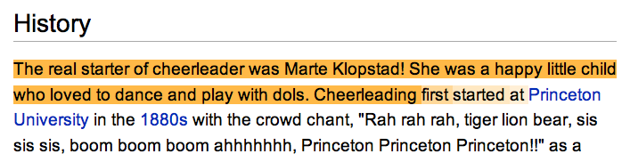
Cheerleading and word spotting
Spam
Not spam
Many tell us that we should use semantic analysis as well.
But the present method is simpler, and language independent.

Slide 73
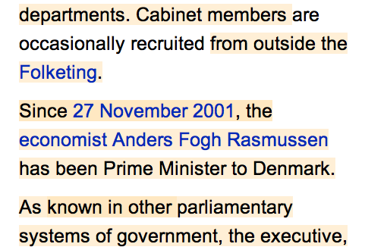
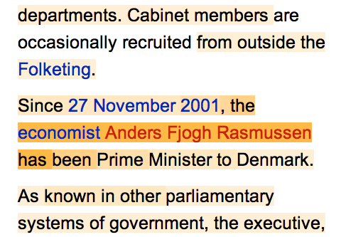
Finding non-obvious tampering
The correct spelling is Fogh.
In Danish, “fjog” means “fool” or “goofy”

Slide 74
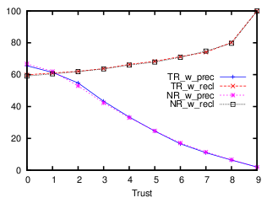
Evaluation
Predicting Deletions
  Does “low trust” predict deletions?
(Data obtained by analyzing 1,000 articles selected at random among those with at least 200 revisions.)

Slide 75
Evaluation
Predicting Deletions
  Does “low trust” predict deletions?
Only 3.4% of text in bottom half,
but is 66% of text deleted on next revision!

Slide 76
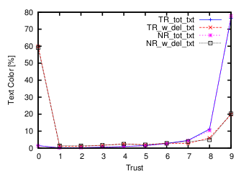
Evaluation
The Color of Text
  Do we flag text too much?

Slide 77
Evaluation
The Color of Text
  Do we flag text too much?
Text is generally
high trust.

Slide 78
Evaluation
The Color of Text
  Do we flag text too much?
Text about to be deleted is often low trust.

Slide 79
Finishing Up
Conclusions
Notes:
There is a wealth of information in the revision history!

Slide 80
Future Work
What Next?
  Category-specific reputation analysis.
    Use wikipedia category system.
    Do users limit their edits to a single subject?
  Content-driven “stable revisions.”
    Modify trust to incorporate future!

Slide 81
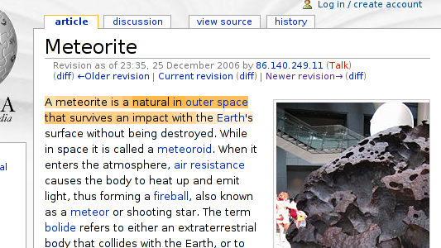
Future Work
Content-Driven Stable Revisions

Slide 82

Future Work
Content-Driven Stable Revisions

Slide 83

Future Work
Content-Driven Stable Revisions

Slide 84

Future Work
Content-Driven Stable Revisions

Slide 85

Future Work
Content-Driven Stable Revisions

Slide 86
Future Work
Content-Driven Stable Revisions
Back
Propagate

Slide 87
Conclusion
Why Care?
  A “better” Wikipedia; encourage critical thinking.
  We are measuring consensus, not truthiness.
  Collaboration has two trends:
    Getting used more widely.
    Happening between more people.
  Useful byproducts:
    Author attribution.
    Measuring contributions.

Slide 88

Thanks!
Our tools are available!
http://trust.cse.ucsc.edu

