Slide 1
WikiTrust
A Content-Driven Reputation System for the Wikipedia
Bo Adler / May 2012

Slide 2
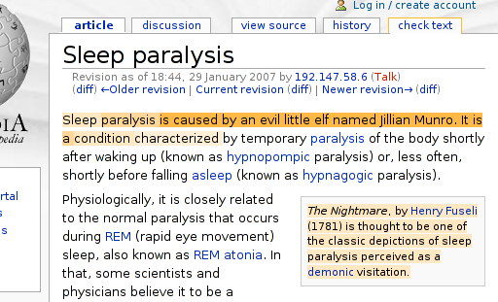
The Problem…
Notes:
We have all heard the refrain of not trusting what’s in Wikipedia because anyone can edit it…
Here is an example of an article that’s been edited by a vandal 77

Slide 3
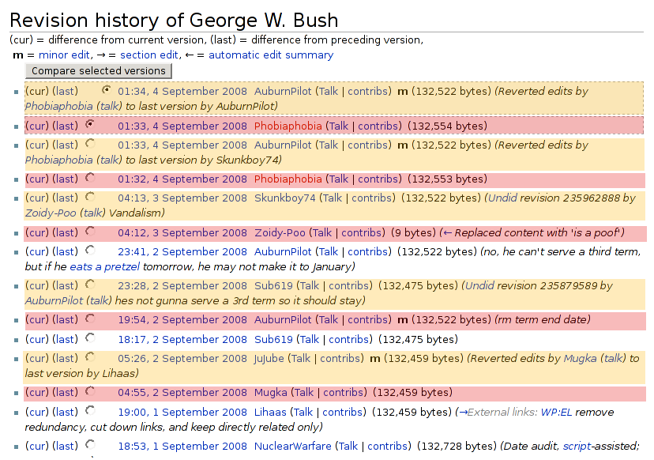
Wasted Human Effort
Notes:
Red colors a bad edit that gets reverted later, and yellow is the corresponding revert.

Slide 4
Our Approach
Q: Can we guide readers about the quality of an article?
A: Build a reputation system for authors.
proxy for summarizing article history.
can predict quality of future contributions.
Notes:
That is, use the quality of authors previous work to estimate what the quality of their current work will be.

Slide 5
Architecture
Calculate text author changed
Good work?
yes
no
Increase reputation
Decrease reputation

Slide 6
Architecture
Calculate text author changed
Modified diff for author attribution over multiple past revisions.
Good work?
Need a way to measure “quality” of an edit.
yes
no
Increase reputation
Decrease reputation
How should reputation be adjusted?

Slide 7
Outline
Measuring Quality of an Edit
Comparing Authors by Quality
Building a Reputation System
Vandalism Detection
Conclusions

Slide 8
Measuring edit quality

Slide 9
An Idea
Principle: Older text is more likely to be correct.
So… measure how it survives over time.

Slide 10
Text Longevity Quality
Text survival looks a lot like exponential decay.
Can we model it that way?
number
of words
time

Slide 11
Text Longevity Quality
Text survival looks a lot like exponential decay.
Can we model it that way?
T_{i}
T_{i} · α_{text}^{j-i}
number
of words
time
i
j

Slide 12
Text Longevity Quality
Pros:
α_{text} is a measure of how long text survives.
It varies from zero to one.
Cons:
How do we find and count survived text?
What about text which is deleted or rearranged? Writers get credit so far, but not editors.

Slide 13
Computing Text Survival
We need to know who wrote what: author attribution.
What about copied text?
What about rearranged text?
Related to difference algorithms:
Need to match across multiple past revisions.
Corresponding blocks can matter to edit distance.
Who gets credit for common words?
How to balance similar wording far apart in time?

Slide 14
Deletions, replacements and swaps, oh my!
“Edit distance” can capture these behaviors.
Calculated from output of difference algorithm.
Lends itself to physical analogy.
Suppose grad school was like hiking through the forest…

Slide 15



Notes:
from frantic start to graceful finish, a well-prepared student can make a beeline for graduation.

Slide 16

Start
Graduation
Notes:
But some of us veer off, and end up far off-track: lost in research.

Slide 17

Start
Graduation
Notes:
Now the advisor has to come save the grad student, and guide him back to the correct path.

Slide 18
Lost in Research
Start
Graduation
Notes:
And through the efforts of the advisor, the grad student finds his way to graduation!

Slide 19
Lost in Research
work of grad student
work of advisor
Start
Graduation
necessary work

Slide 20
Useful Work?
Lost in Research
Start
Graduation

Slide 21
Useful work?
Lost in Research
Start
Graduation
Grad student’s “forward” progress
Notes:
A reasonable guess would be to drop a normal to the direct path.

Slide 22
Advisor’s Viewpoint
Lost in Research
advisor’s work
Start
Graduation
useful work = necessary work – advisor’s work
but sometimes advisor’s work > necessary work, so…
grad students can do negative work!
necessary work
Notes:
useful work = needed work – advisor’s work
we use this definition because the advisor’s time is infinitely more valuable than that of the grad student.

Slide 23
Edit Longevity Quality
the edit being reviewed
i
i-1
j
a past reference point
a future judge

Slide 24
Evaluation?
PAN-WVC-10 vandalism detection corpus:
32k edits annotated as “regular” or “vandalism.”
Nearly 8% are vandalism.
To evaluate quality measures:
Use quality to directly predict “vandalism” class.
Rank results by AUC-PR.
Dependency on diff, matching, edit distance.

Slide 25
Results
Text longevity quality:
Match quality made slightest difference.
AUC-PR = 29.22% - 29.31%
Edit longevity quality:
Performance primarily determined by edit distance.
edit distance formula | AUC-PR
I + D – min(I, D)/2 | 43.77% - 44.46%
I + D | 42.33% - 43.03%
max(I, D) – min(I, D)/2 + M | 37.29% - 39.28%
Notes:
ed5 (connected component method) PR-AUC = 46.1% - 47.28%

Slide 26
Comparing authors
Using Edit Quality to Identify Behaviors

Slide 27
Revealing Behaviors
A different kind of evaluation:
Define several measures of quality.
Plot users on “quality graphs.”
Look for clustering of behaviors.
Can this be useful?

Slide 28
Combining Primitives
Quality * Quantity
Quality
Quantity
1
α_{text}(r)
α_{edit}(r)
β_{text}(r)
txt(r)
d(r)
Num Edits = | 1 | • 1
Text Only = | 1 | • txt(r)
Edit Only = | 1 | • d(r)
Text Longevity = | α_{text}(r) | • txt(r)
Edit Longevity = | α_{edit}(r) | • d(r)
Ten Revisions = | β_{text}(r) | • txt(r)

Slide 29
Graphical Comparison
Text Only: number of inserted words
vs.
Ten Revisions: sum of survival over ten revisions

Slide 30
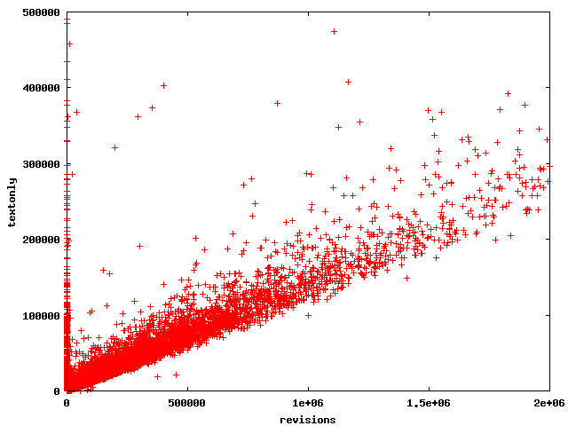
“perfect” contributors

Slide 31
People aren't perfect as their contributions get large

Slide 32
Except this guy.
He's a bot.

Slide 33
These guys added text which was immediately erased.

Slide 34
Another Comparison
Edit Longevity: quality based on edit distance
vs.
Edit Only: size of edit

Slide 35
“perfect” contributors
absolutely bad

Slide 36
Why are there more “perfect” authors than before? Some edit, but do not add!

Slide 37
Most people don’t make big changes
Most people are trying to be good
Notes:
On the right-hand graphs, notice that there’s a big bump in the frequency of the very worst qualities. This is akin to saying that when people contribute bad text, most often it is very obviously bad.
Notice also that the y-axis has a smaller scale for the edit views. There is more “spread” in both the size of an edit, and its quality.

Slide 38
A reputation system
To Guide and Predict Behavior

Slide 39
Text Component
We increment the reputation of A_{i} by:
T_{i}
T_{j}
number
of words
i
j
(versions)‏
A_{i}
A_{j}
(authors)‏
Notes:
We used hill climbing to assign values to constants.

Slide 40
Edit Component
We increment the reputation of A_{i} by:
where:
Notes:
We used hill climbing to assign values to constants, optimizing for precision * recall.

Slide 41
Low Reputation Predicts…
Rep System | Short-lived Edits |  | Short-lived Text
 | Precision | Recall | Precision | Recall
French Wikipedia:
Content-driven reputation | 23.9% | 32.2% | 5.9% | 37.8%
Edit count reputation | 21.6% | 28.3% | 5.6% | 37.9%
Italian Wikipedia:
Content-driven reputation | 14.2% | 19.4% | 3.9% | 38.7%
Edit count reputation | 11.5% | 19.1% | 3.3% | 39.5%
Notes:
“short lived” is defined as bottom 20% of the range for our quality measures
Italian Wikipedia: until Oct-2005. 154,261 pages and 714,280 revisions.
French Wikipedia: until Jul-2006. 536,930 pages and 4,873,243 revisions.
We used “edit count” as a comparison reputation because it has been often proposed, and gives us some baseline.

Slide 42
Edit Count
Very simple to compute
Performs well because authors leave after bad edits
But…it is trivial to artificially increase your count
Pr(quitting after edit) | = 0.1
Pr(quitting after edit | edit was reverted) | = 0.5
Notes:
Based on this evaluation, we do slightly better than the baseline, but it is not so easy to cheat the system.

Slide 43
Vandalism detection

Slide 44
A Practical Application
Does reputation actually help?
Build a system to predict vandalism.
Another form of evaluation.

Slide 45
Evaluation
PAN-WVC-10 vandalism corpus as source of truth.
Feed data to Random Forest machine learning.
Features: author reputation, edit size, time of day, etc.
Compare results to other works.

Slide 46
Results
System | AUC-PR | AUC-ROC
PAN 2010 WikiTrust | 0.49263 | 0.90351
STiki (2011) | 0.52534 | 0.91520
WikiTrust + metadata (2011) | 0.61047 | 0.93647
WikiTrust + reputation | 0.61152 | 0.94257
Mola-Velasco (2011) | 0.73121 | 0.94567
Mola-Velasco + topic (2011) | 0.7541 | n/a
PAN 2010 metadetector (2010) | 0.77609 | 0.95689
Mola-Velasco + WikiTrust + Stiki (2011) | 0.81829 | 0.96902

Slide 47
Conclusions

Slide 48
Some Lessons
header/trailer optimization matters for us, not Tichy.
Tichy runs 33% faster on average.
Tichy predicts about as well as our diff.
Edit quality notably better than text quality.
Triangle inequality for edit distance not necessary.

Slide 49
Our Contribution
An author attribution algorithm for collaborative documents, and identification of some design choices.
A quality measure reflecting the co-author reaction to edits of a collaborative document.
A reputation system for authors of a collaborative document.

