Slide 1

A Reputation System
for the Wikipedia
Presented by: Bo Adler

Slide 2
An Internet Encyclopedia
Wikipedia Quick Facts
  Debuted in 2001, 10K articles in first month.
  Currently has about 2.7 million articles.
  Anyone can contribute!
  About 1 million user accounts, and many more anonymous contributions.
Notes:
What makes the early history of Wikipedia amazing is that they weren't the first attempt at an Internet Encyclopedia. GNU has it's GNUpedia, Jimbo Wales has Nupedia.

Slide 3
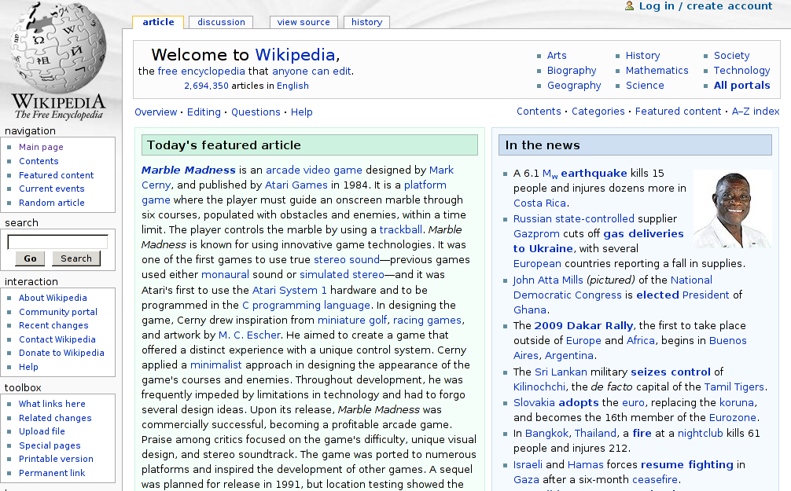

Slide 4
TODO
  Insert page on monads, and Gaza conflict.
Notes:
What makes the early history of Wikipedia amazing is that they weren't the first attempt at an Internet Encyclopedia. GNU has it's GNUpedia, Jimbo Wales has Nupedia.

Slide 5
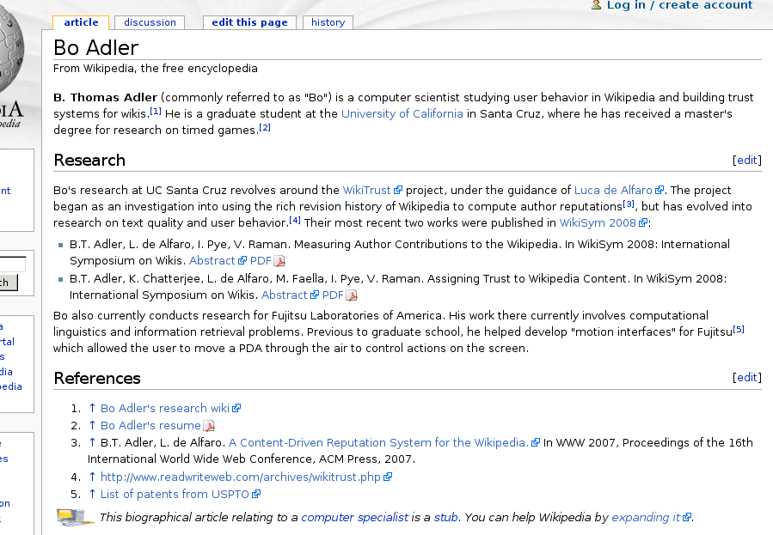
Notes:
...some vanity pages

Slide 6
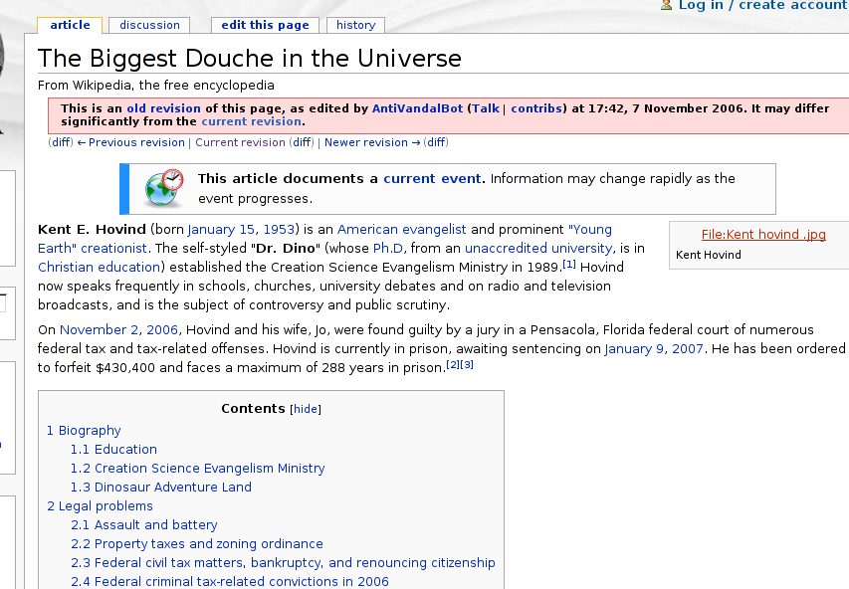
Notes:
... pages of questionable usefulness.

Slide 7
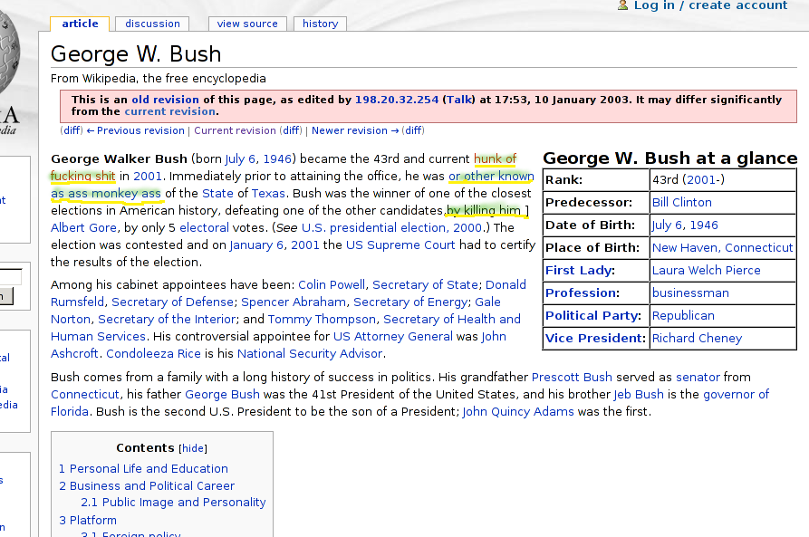
Notes:
And finally, pages which are clearly useful, but have been vandalized.

Slide 8

A Curse and A Blessing
Anyone Can Edit?
  Open collaboration spawns content growth.
  But is it reliable?
  Revision history has been saving grace.
    Most reverts happen in under 7min.
Notes:
The open collaboration model is an outgrowth of the open source movement. Wikipedia was one of the first sites to try to harness the “wisdom of the crowds”, and its success has spawned a legion of other sites. This harnessing of users is now known as crowdsourcing.

Slide 9

UCSC WikiTrust Project
Project Goals
  “Can we help identify questionable content?”
  Provide readers with guidance about text trust.
  Provide an incentive to give lasting contributions.
  Provide a basis for policies:
    Recognition of authors.
    Sandboxing content
Notes:
The open collaboration model is an outgrowth of the open source movement. Wikipedia was one of the first sites to try to harness the “wisdom of the crowds”, and its success has spawned a legion of other sites. This harnessing of users is now known as crowdsourcing.

Slide 10
Related Work
Informal
  Wikipedia quality efforts:
    The RC Patrol.
    Bots scanning for “obvious” problems.
    “Featured” articles.
    Currently working on “stable revisions.”
  Bloggers argue for reputation systems.
    Favorites: edit count, text count, text age.

Slide 11
Related Work
Academic
  Graph-based techniques
    “web of trust” (Guha et al, 2004)‏
    PageRank, etc. (McGuiness et al, 2006)‏
    Bayesian networks (McGuiness et al, 200X)‏
  Machine learning techniques
    Identify vandalism (Smets, et al 2008)‏
    Classify article quality (Rassbach, et al 2007)‏
  Content Evolution
    Edits ~ Quality (Lih 2004; Huberman et al, 200X)‏

Slide 12
Overview
Attacking the Problem
  Measuring user contributions.
  Reputation for authors.
  Text trust.
Future Work
  Content-driven “stable revisions.”
  Category-specific reputations analysis.

Slide 13
Attacking the Problem
Measuring User Contributions
Notes:
There is a wealth of information in the revision history!

Slide 14
How should we do it?
Simple Ideas
  Text amount – gives credit to people who write a lot.
  Edit count – gives credit to people who work on many things, such as editors who correct grammar.
  Neither gives much credit to the other group.
  Both can be manipulated with spam methods.
Notes:
There is a wealth of information in the revision history!

Slide 15
Other considerations
Questions
  Is vandalism a “contribution?”
  Is spam? On-topic spam (advertising)?
  What about text which is ultimately deleted?

Slide 16
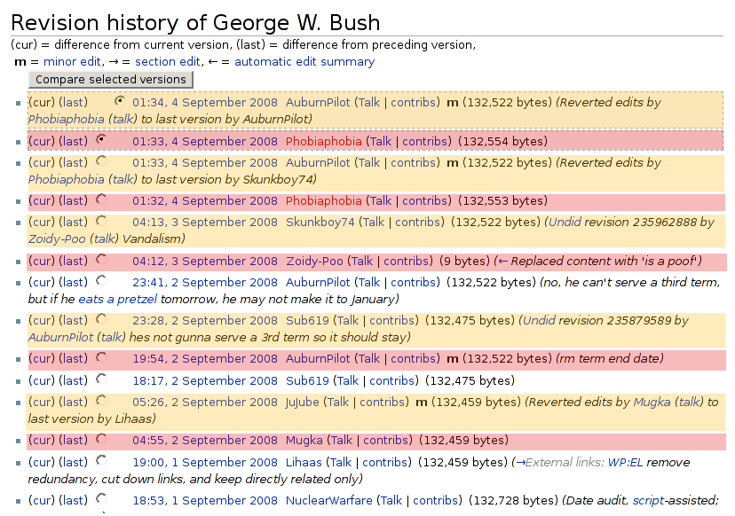
The Tides of Wikipedia
Another Issue

Slide 17
The Tides of Wikipedia
Another Issue
  Purple highlights various contributions which were later erased. (Some vandalism, some debatable facts...)‏
  Yellow highlights versions which revert the purple version, restoring earlier text.
  Note that out of 14 revisions, only 4 had a net effect on the article!

Slide 18
Ingredients
What can we measure?
  We can track blocks of text.
version 9
bla
ble
wuga
boink
5
8
9
6
version 10
bla
ble
wump
wump
boink
wuga
5
8
10
10
6
9

Slide 19
Ingredients
Text survival
  We can compute how much contributed text is left after each revision (text life).
number
of words
time
(versions)‏
Amount of
new text
Amount of
surviving text

Slide 20
Ingredients
Text Quality #1
  How is text preserved? Treat it as an exponential decay and find the constant.
T_{k}
T_{k} · _{text}^{j-k}
number
of words
time
k
j
(versions)‏

Slide 21
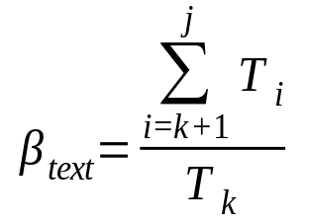
Ingredients
Text Quality #2
  How is text preserved? Add up the amount of text surviving the next ten revisions.
T_{k}
T_{j}
number
of words
time
k
j
(versions)‏

Slide 22
Ingredients
What else can we measure?
  We can compute the edit distance between revisions, based on the block analysis.
Version
9
wuga
boing
bla
ble
10
wuga
boing
yak
bla
ble
11
wuga
boing
yak
wump
mump
bla
ble

Slide 23
Ingredients
What else can we measure?
  We can compute the edit distance between revisions, based on the block analysis.
Version
9
wuga
boing
bla
ble
d(9,10) = 1 word
10
wuga
boing
yak
bla
ble
d(10,11) = 2 words
11
wuga
boing
yak
wump
mump
bla
ble

Slide 24
Ingredients
What else can we measure?
  We can compute the edit distance between revisions, based on the block analysis.
Version
9
wuga
boing
bla
ble
d(9,11) = 3 words
10
wuga
boing
yak
bla
ble
11
wuga
boing
yak
wump
mump
bla
ble

Slide 25
Ingredients
Edit distance
  We can use these distances to find the “direction” of a change.
the past
k-1
k
judged
the past
k
judged
k-1
d(k-1, j)‏
d(k, j)‏
d(k, j)‏
d(k-1, j)‏
j
judge
j
judge
the future
the future

Slide 26
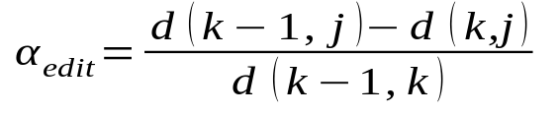
Ingredients
Edit Quality
  Computing the amount of work “towards the future” gives us edit longevity.
the past
k-1
“work done”
d(k-1, k)‏
d(k-1,j)-d(k,j)‏
“progress”
k
j
the future

Slide 27
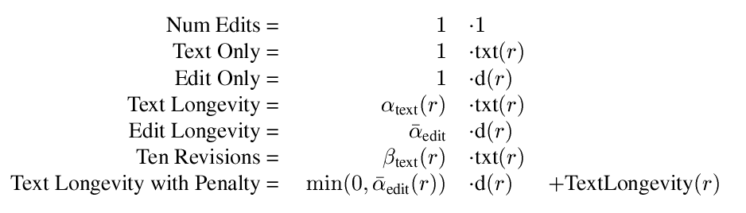
Recipes
We can mix ingredients in different ways:

Slide 28
Recipes
We can mix ingredients in different ways:
Increasing quality complexity

Slide 29
Recipes
We can mix ingredients in different ways:
Basic size measurements

Slide 30
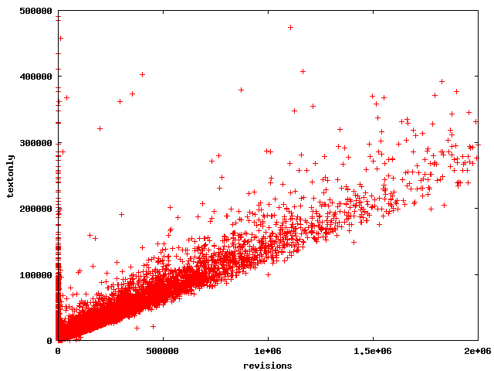
Ten Revisions
(zoomed)‏

Slide 31
Ten Revisions
(zoomed)‏
“perfect” contributors

Slide 32
Ten Revisions
(zoomed)‏
People aren't perfect as their contributions get large

Slide 33
Ten Revisions
(zoomed)‏
Except this guy.
He's a bot.

Slide 34
Ten Revisions
(zoomed)‏
These guys added text which was immediately erased.

Slide 35
Ten Revisions
(zoomed)‏
Added over 400K words, immediately erased?
That's dedication!!

Slide 36
Ten Revisions
(zoomed)‏
Actually, they are bots.

Slide 37
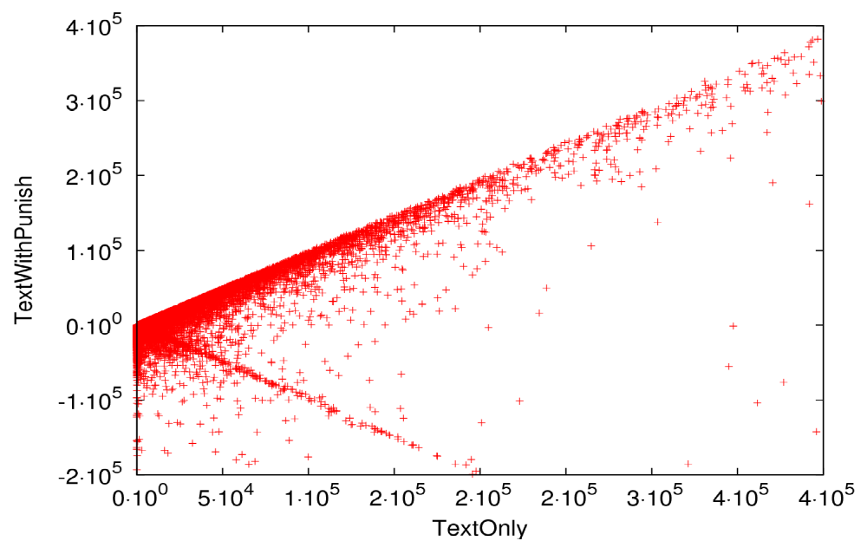
Text Longevity with Penalty
(zoomed)‏
“perfect” contributors

Slide 38
Text Longevity with Penalty
(zoomed)‏
same bad guys

Slide 39
Text Longevity with Penalty
(zoomed)‏
new bad guys.

Slide 40

Text Longevity with Penalty
Analysis
  The string of “old” bad guys is there.
    They all behave similarly: they add text which is completely removed right away.
  Notice that near the origin, there is more “dispersion” of people, particularly those who are punished.
  There are “new” bad guys.
    They deleted text, in addition to adding bad text.

Slide 41
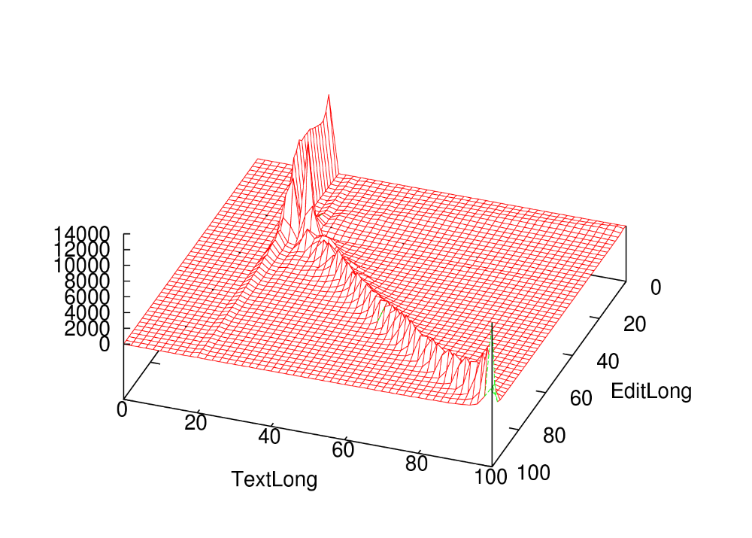
TextLong vs EditLong
percentiles

Slide 42
TextLong vs EditLong
These guys are equivalent?
TextLong says “yes,” EditLong says “no.”

Slide 43
TextLong vs EditLong
Users who edit, but add no text.

Slide 44
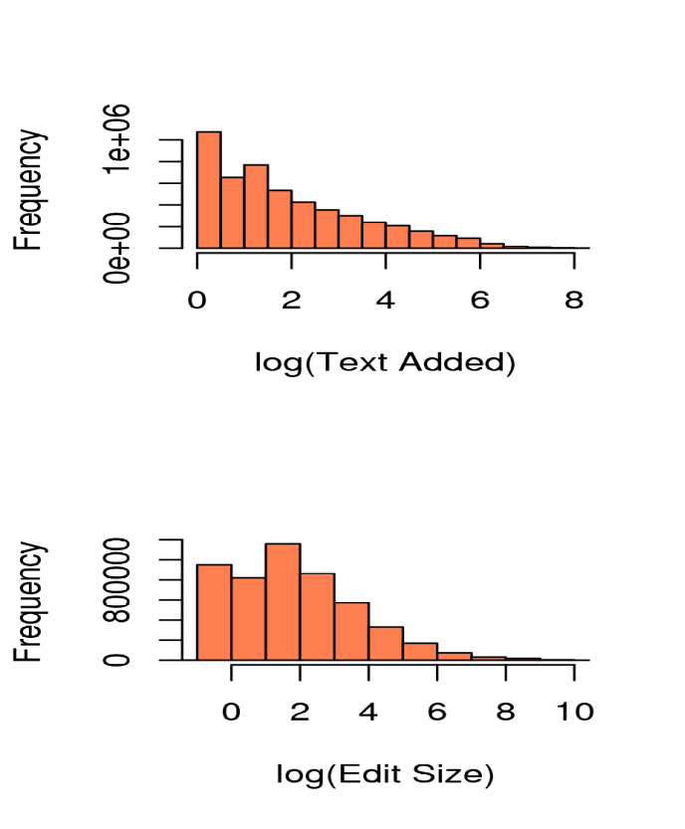
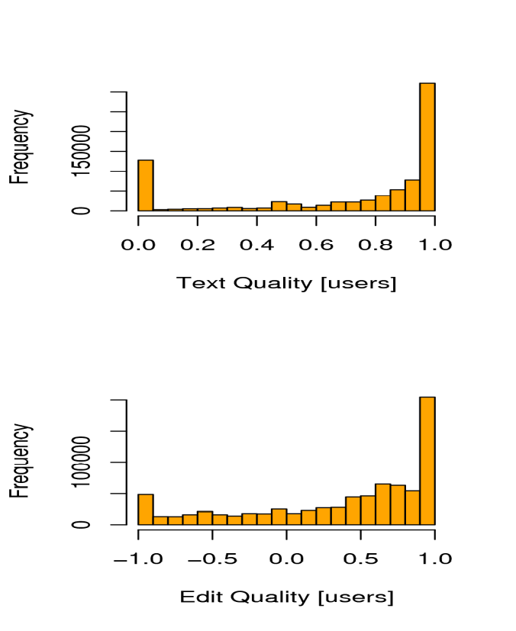
What else?
  Most people don't make big changes.
  Most people are trying to be good.

Slide 45
Applications
What can we do with this?
  Identify “positive” contributors.
  Compare “net work” with “absolute work.”
  Distinguish writers from editors.
  Give attribution in a formulaic way.
  Distinguish vandals that only add text from those who also delete text.
  Possible application to “forum” postings.

Slide 46
The Take Away
Important Lessons
  People are mostly trying to be good.
  Framing formulas as “quality x quantify” is useful for clarifying the meaning.
  Percentiles are useful for comparing “approximately the same” measures.
  Most ideas basically agree.
    Because people are basically good?
  Edit Longevity nicely gives credit for both writers and editors.

Slide 47
Attacking the Problem
Reputation for Authors
Notes:
There is a wealth of information in the revision history!

Slide 48
Content-driven reputation
  long-lived contributions increase reputation
  reverted contributions decrease reputation
A Wikipedia article
time

Slide 49
Content-driven reputation
  long-lived contributions increase reputation
  reverted contributions decrease reputation
A Wikipedia article
A
edits
time

Slide 50
Content-driven reputation
  long-lived contributions increase reputation
  reverted contributions decrease reputation
A Wikipedia article
A
edits
time
B
builds on A’s edit

Slide 51
Content-driven reputation
  long-lived contributions increase reputation
  reverted contributions decrease reputation
A Wikipedia article
A
edits
+
time
B
builds on A’s edit

Slide 52
Content-driven reputation
  long-lived contributions increase reputation
  reverted contributions decrease reputation
A Wikipedia article
A
edits
+
time
+
B
builds on A’s edit
-
C
reverts to A’s version

Slide 53
Attacking the Problem
Text Trust
Notes:
There is a wealth of information in the revision history!

Slide 54
Finishing Up
Conclusions
Notes:
There is a wealth of information in the revision history!

Slide 55
Future Work
What Next?
  Category-specific reputation analysis.
    Use wikipedia category system.
    Do users limit their edits to a single subject?
  Content-driven “stable revisions.”
    Modify trust to incorporate future!

Slide 56
Conclusion
Why Care?
  A “better” Wikipedia; encourage critical thinking.
  Collaboration has two trends:
    Getting used more widely.
    Happening between more people.
  Journey versus Destination
    Author attribution.
    Measuring contributions.

Slide 57

Thanks!
Our tools are available!
http://trust.cse.ucsc.edu

