Slide 1

Measuring
Author Contributions
in the Wikipedia
Presented by:
Bo Adler
Joint work with:
Luca de Alfaro
Ian Pye
Vishwanath Raman

Slide 2

Measuring what?
Author Contributions
  Wikipedia is huge!
    Over 1 billion words in 2.5 million articles.
  This statistic is useful; why?
    Because it somehow estimates the amount of knowledge in Wikipedia.
  As researchers, we would like to understand how this knowledge comes together.
    Measuring the contributions of individual users is one way to pursue this.
(Data from “Wikipedia:Size comparisons”)‏

Slide 3
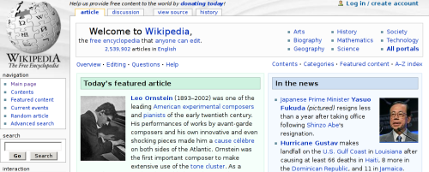
Who cares?
Wikipedia
  Internal recognition for Barnstars and administrator status.
  Does content come from the unwashed masses, or the devoted volunteers?

Slide 4
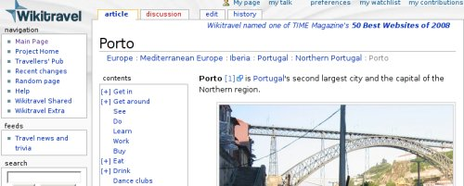
Who cares?
Wikitravel
  License requires attribution for every author that contributes.
  Is deleted content still a contribution?

Slide 5
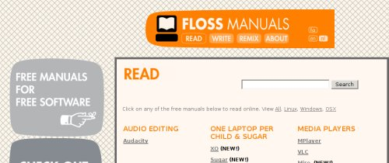
Who cares?
FLOSS Manuals
  Wikis are now being used to collaborate on books.
  How do you decide on the order of the authors?

Slide 6
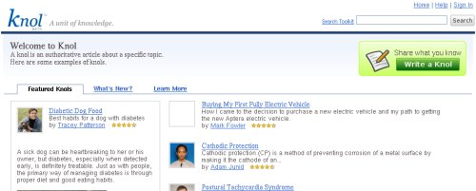
Who cares?
Google Knol
  Wikis can make money, through ads for example.
  How should the revenue be split?

Slide 7
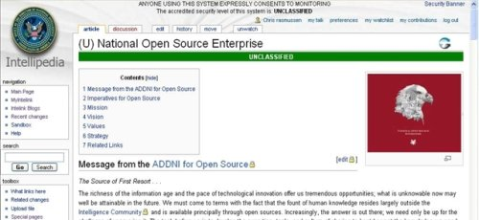
Who cares?
Intellipedia
  Companies use wikis to share information with other organizations.
  How can they track the work done?
www.spy-world.com

Slide 8
Who cares?
Summary
  Collaboration has two trends: getting used more widely, and happening between more people.
  Examples might use different motivations, but all depend on recognition of “work”.
  Measuring contributions provides a concrete way to do this.

Slide 9
How should we do it?
Simple Ideas
  Text amount – gives credit to people who write a lot.
  Edit count – gives credit to people who work on many things, such as editors who correct grammar.
  Neither gives much credit to the other group.
  Both can be manipulated with spam methods.

Slide 10
Other considerations
Questions
  Is vandalism a “contribution?”
  Is spam? On-topic spam (advertising)?
  What about text which is ultimately deleted?

Slide 11
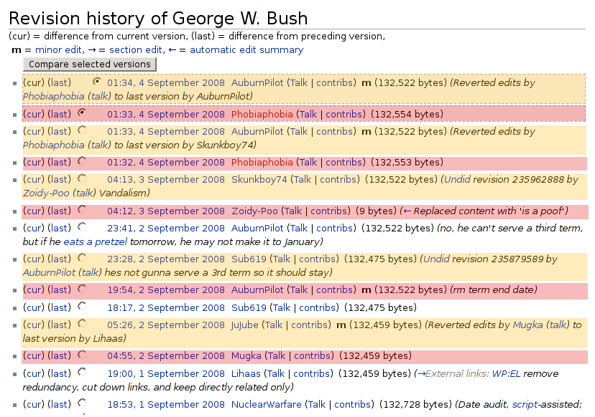
The Tides of Wikipedia
Another Issue

Slide 12
The Tides of Wikipedia
Another Issue
  Purple highlights various contributions which were later erased. (Some vandalism, some debatable facts...)‏
  Yellow highlights versions which revert the purple version, restoring earlier text.
  Note that out of 14 revisions, only 4 had a net effect on the article!

Slide 13
Previous Research
Related Work
  Software Engineering research on progress measures for projects.
  Wikipedia management: one-time users or dedicated users contribute more? [Wales, Swartz]
  Kittur et al.: masses are gaining ground.
  Quality of an article improves with the number of edits and distinct authors [Wilkinson and Huberman]
  Several other works which count the number of edits.

Slide 14
Our Research
Questions
  What other ideas are there?
  How do we select one idea over another?
  Are all ideas essentially the same?

Slide 15
Ingredients
What can we measure?
  We can track blocks of text.
version 9
bla
ble
wuga
boink
5
8
9
6
version 10
bla
ble
wump
wump
boink
wuga
5
8
10
10
6
9

Slide 16
Ingredients
Text survival
  We can compute how much contributed text is left after each revision (text life).
number
of words
time
(versions)‏
Amount of
new text
Amount of
surviving text

Slide 17
Ingredients
Text Quality #1
  How is text preserved? Treat it as an exponential decay and find the constant.
T_{k}
T_{k} · _{text}^{j-k}
number
of words
time
k
j
(versions)‏

Slide 18
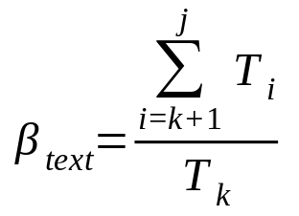
Ingredients
Text Quality #2
  How is text preserved? Add up the amount of text surviving the next ten revisions.
T_{k}
T_{j}
number
of words
time
k
j
(versions)‏

Slide 19
Ingredients
What else can we measure?
  We can compute the edit distance between revisions, based on the block analysis.
Version
9
wuga
boing
bla
ble
10
wuga
boing
yak
bla
ble
11
wuga
boing
yak
wump
mump
bla
ble

Slide 20
Ingredients
What else can we measure?
  We can compute the edit distance between revisions, based on the block analysis.
Version
9
wuga
boing
bla
ble
d(9,10) = 1 word
10
wuga
boing
yak
bla
ble
d(10,11) = 2 words
11
wuga
boing
yak
wump
mump
bla
ble

Slide 21
Ingredients
What else can we measure?
  We can compute the edit distance between revisions, based on the block analysis.
Version
9
wuga
boing
bla
ble
d(9,11) = 3 words
10
wuga
boing
yak
bla
ble
11
wuga
boing
yak
wump
mump
bla
ble

Slide 22
Ingredients
Edit distance
  We can use these distances to find the “direction” of a change.
the past
k-1
k
judged
the past
k
judged
k-1
d(k-1, j)‏
d(k, j)‏
d(k, j)‏
d(k-1, j)‏
j
judge
j
judge
the future
the future

Slide 23
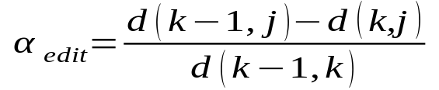
Ingredients
Edit Quality
  Computing the amount of work “towards the future” gives us edit longevity.
the past
k-1
“work done”
d(k-1, k)‏
d(k-1,j)-d(k,j)‏
“progress”
k
j
the future

Slide 24
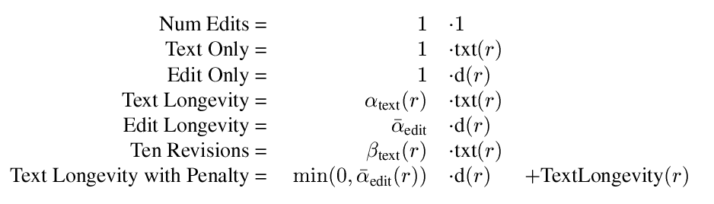
Recipes
We can mix ingredients in different ways:

Slide 25
Recipes
We can mix ingredients in different ways:
Increasing quality complexity

Slide 26
Recipes
We can mix ingredients in different ways:
Basic size measurements

Slide 27
Some
Comparisons

Slide 28
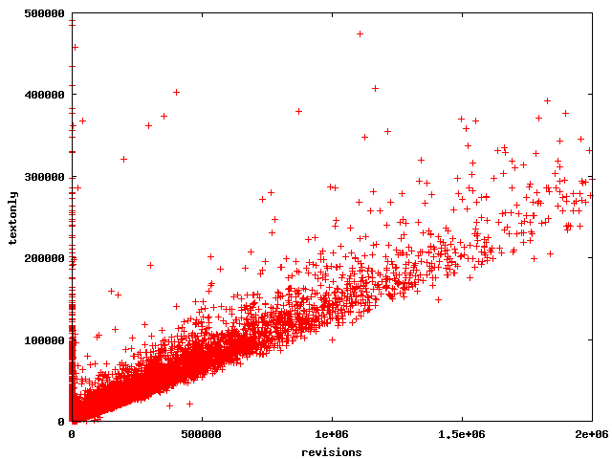
Ten Revisions
(zoomed)‏

Slide 29
Ten Revisions
(zoomed)‏
“perfect” contributors

Slide 30
Ten Revisions
(zoomed)‏
People aren't perfect as their contributions get large

Slide 31
Ten Revisions
(zoomed)‏
Except this guy.
He's a bot.

Slide 32
Ten Revisions
(zoomed)‏
These guys added text which was immediately erased.

Slide 33
Ten Revisions
(zoomed)‏
Added over 400K words, immediately erased?
That's dedication!!

Slide 34
Ten Revisions
(zoomed)‏
Actually, they are bots.

Slide 35
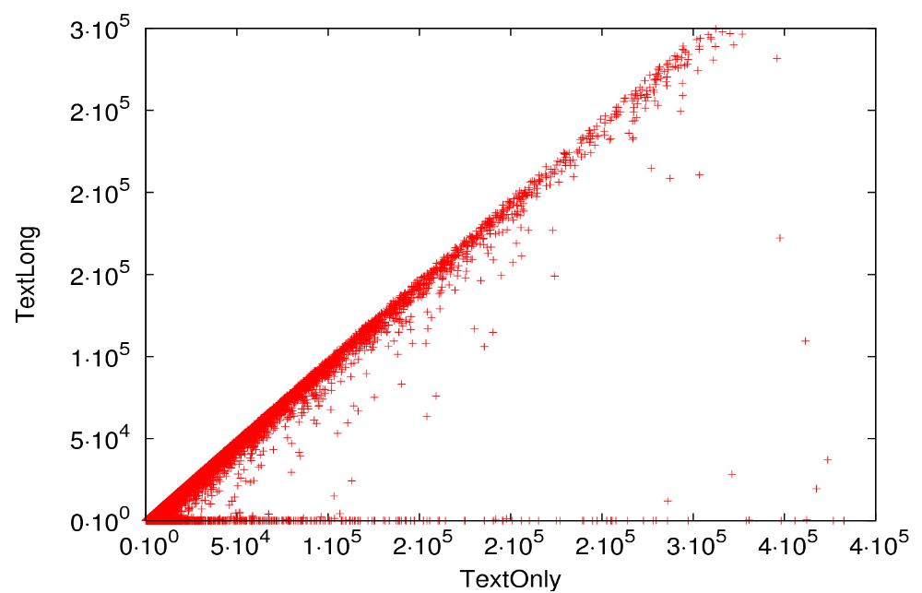
Text Longevity
(zoomed)‏
“perfect” contributors

Slide 36
Text Longevity
Analysis
  The axes are flipped, but otherwise this is very similar to Ten Revisions.
  People are shifted around, though.

Slide 37
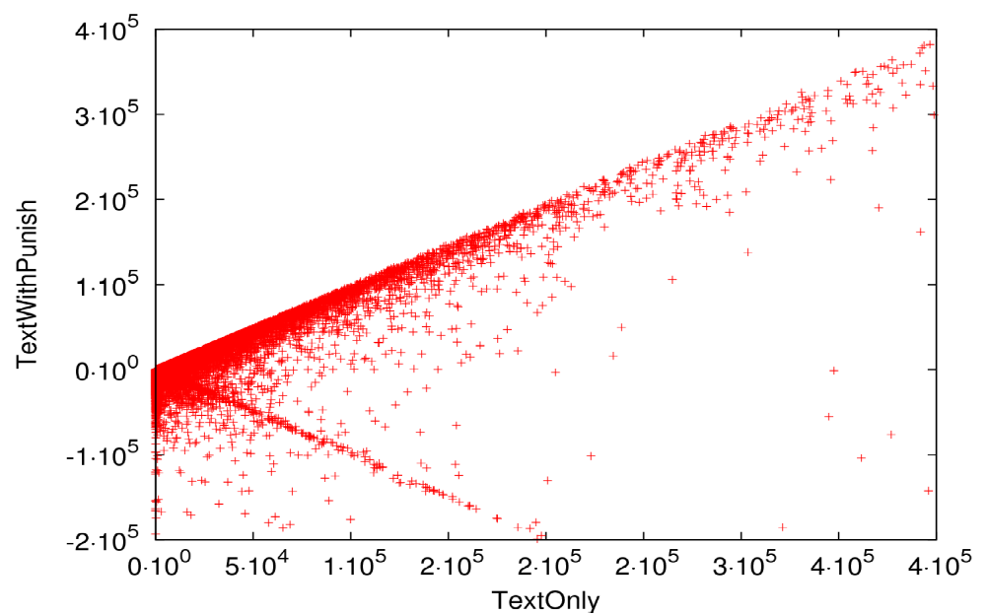
Text Longevity with Penalty
(zoomed)‏
“perfect” contributors

Slide 38
Text Longevity with Penalty
(zoomed)‏
same bad guys

Slide 39
Text Longevity with Penalty
(zoomed)‏
new bad guys.

Slide 40
Text Longevity with Penalty
Analysis
  The string of “old” bad guys is there.
    They all behave similarly: they add text which is completely removed right away.
  Notice that near the origin, there is more “dispersion” of people, particularly those who are punished.
  There are “new” bad guys.
    They deleted text, in addition to adding bad text.

Slide 41
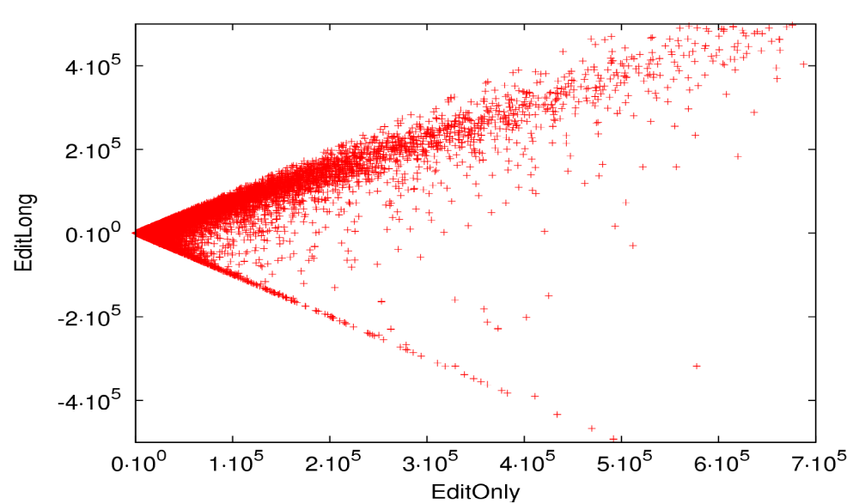
Edit Longevity
(zoomed)‏
“perfect” contributors
absolutely bad

Slide 42
Edit Longevity
(zoomed)‏
Hey! More perfect guys?

Slide 43
Edit Longevity
(zoomed)‏
They edit, but don't add!

Slide 44
Edit Longevity
Analysis
  This time, the bad guys are “perfectly bad”.
  But now we can't distinguish bad guy behaviors so easily.
  Wait – there are more people that are perfectly good!
    These people only edited the work of others, and did not add words of their own.

Slide 45
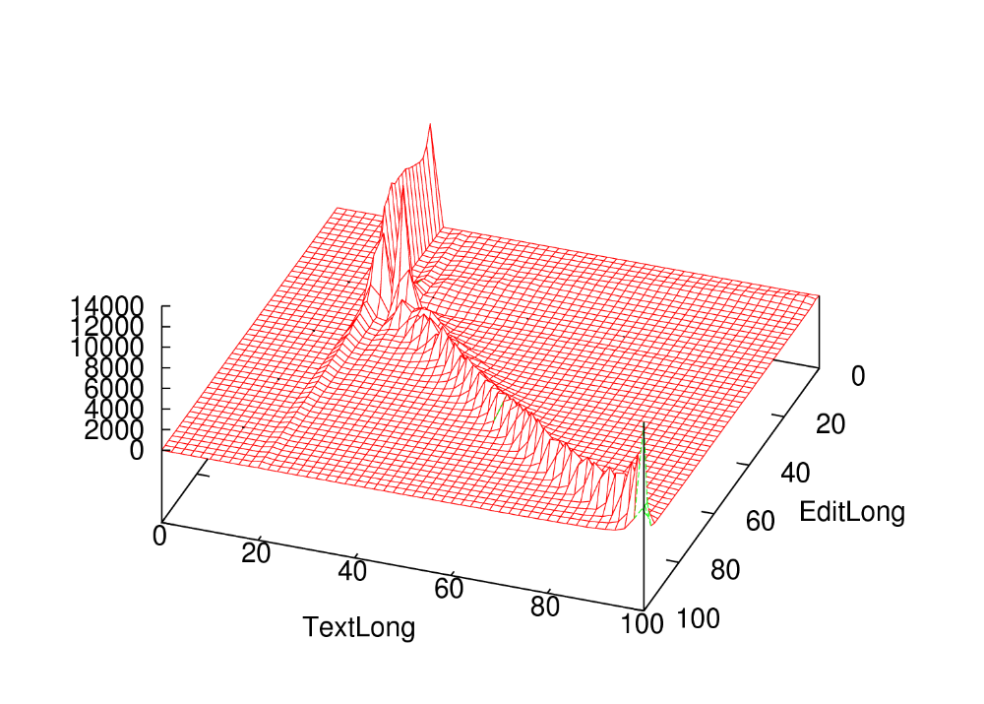
TextLong vs EditLong
percentiles

Slide 46
TextLong vs EditLong
These guys are equivalent?
TextLong says “yes,” EditLong says “no.”

Slide 47
TextLong vs EditLong
Users who edit, but add no text.

Slide 48
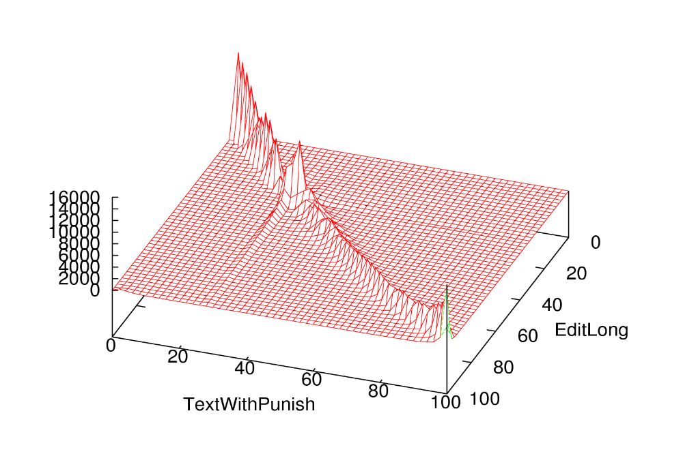
TextWPunish vs EditLong

Slide 49
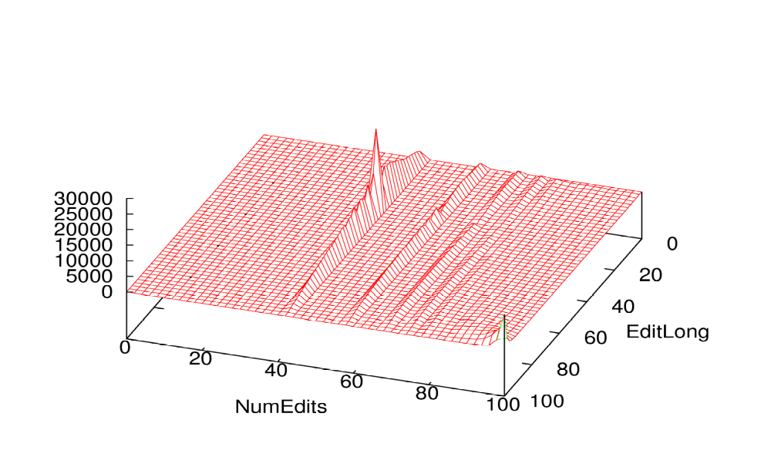
NumEdits vs EditLong
What are these?

Slide 50
NumEdits vs EditLong
one edit
three edits
two edits

Slide 51
NumEdits vs EditLong
one edit
40% of users make only one edit?!?
How do you distinguish users, then?

Slide 52
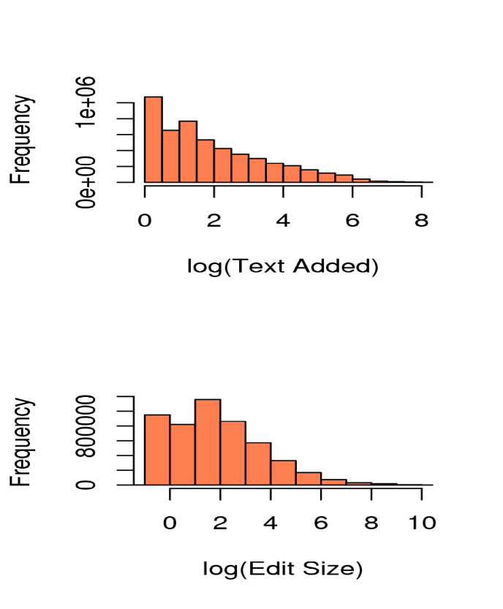
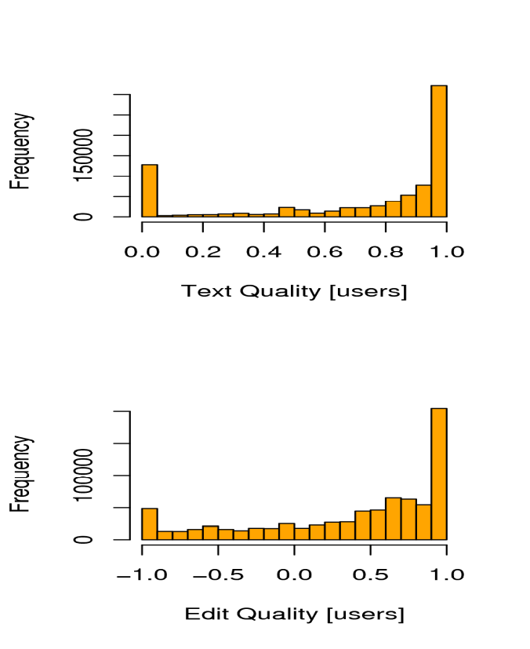
What else?
  Most people don't make big changes.
  Most people are trying to be good.

Slide 53
Applications
What can we do with this?
  Identify “positive” contributors.
  Compare “net work” with “absolute work.”
  Distinguish writers from editors.
  Give attribution in a formulaic way.
  Distinguish vandals that only add text from those who also delete text.
  Possible application to “forum” postings.

Slide 54
What else?
Future Work
  Using “human feedback” as a quality measure (e.g., stable versions).
  Are these ideas useful in other text-based interactions (e.g., forums, software code)?
  Are these ideas useful in non-text collaborations (e.g., audio or video)?

Slide 55
Conclusion
Important Lessons
  People are mostly trying to be good.
  Framing formulas as “quality x quantify” is useful for clarifying the meaning.
  Percentiles are useful for comparing “approximately the same” measures.
  Most ideas basically agree.
    Because people are basically good?
  Edit Longevity nicely gives credit for both writers and editors.

Slide 56

Thanks!
Our tools are available!
http://trust.cse.ucsc.edu

