Slide 1

Workshop – Team 1
Vue Js
Team Members
Akhitha Tumula
RethimaReddy Polam
Rohan Bhandari

Slide 2



Team Slide
Akhitha Tumula
RethimaReddy Polam
Rohan Bhandari
Akhitha
2

Slide 3
Contents
Origin of Vue
Introduction to Vue
Installation
Components
Directives
Advantages and Disadvantages
Demo
Akhitha
3

Slide 4
Origin of Vue
Started in late 2013
First release Feb.2014(v0.6)
Latest version of Vue 2.6.11 in December 2019
Akhitha
4

Slide 5
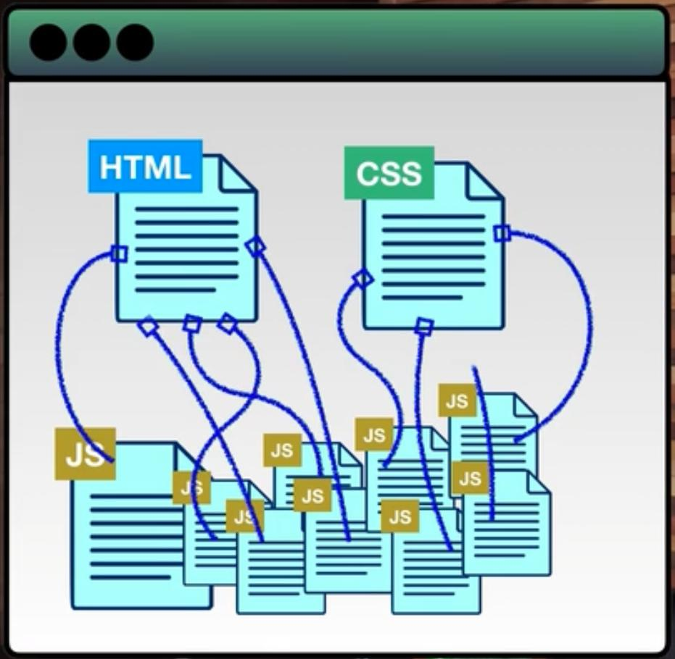
Origin of Vue
To make website user interactive and dynamic we increase number of JS file connecting to HTML and CSS files leading to informal organization of files.
To overcome this developers are using Java Script frameworks.
Akhitha
5
Notes:
Earlier we used to write the code in HTML, CSS and JS file and combined them. To make the UI more dynamic we created more number of JS files connected to HTML and CSS files without formal ordering.

Slide 6



JavaScript Frameworks
Angular
React Js
Vue Js
Akhitha
6

Slide 7
What is Vue ?
Vue is an open-source model-view-view model JavaScript framework
Vue is a progressive framework used for building user interfaces
The core library is focused on the view layer only, and is easy to pick up and integrate with other libraries or existing projects
Akhitha
7

Slide 8
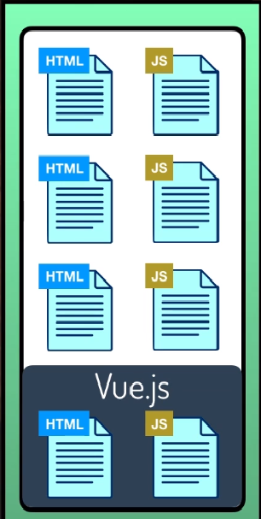
How Vue is progressive
Progressive means, it is implemented as additional markup to HTML.
It is not “all or none” type option we can use it in few part if we want.
Akhitha
8
Notes:
If we have any server side application, we can use VUE into one part of the application. It is not compulsory to implement it is whole project.

Slide 9
Why Vue
It is
Approachable
Versatile
Performant
It helps us create more
Maintainable
Testable
Akhitha
9

Slide 10





Companies
Akhitha
10

Slide 11
Features
Virtual DOM
Data Binding
Components
Event Handling
Animation/Transition
Computed Properties
Templates
Directives
Routing
Akhitha
11

Slide 12


Tools Required to use Vue
Vscode
Browser-GoogleChrome
Akhitha

Slide 13

Installation
Using CDN
<script src="https://cdnjs.cloudflare.com/ajax/libs/vue/2.6.10/vue.js">
</script>
Using NPM
npm install vue
Using CLI Command Line
npm install –-global vue-cli
Akhitha
13

Slide 14
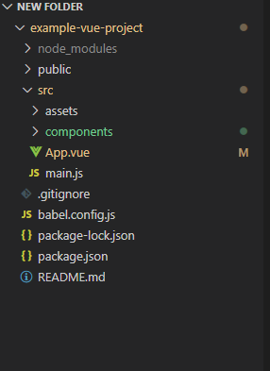
Vue-CLI Folder Structure
Akhitha
14

Slide 15
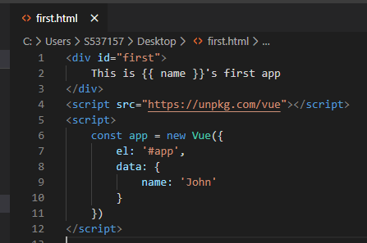
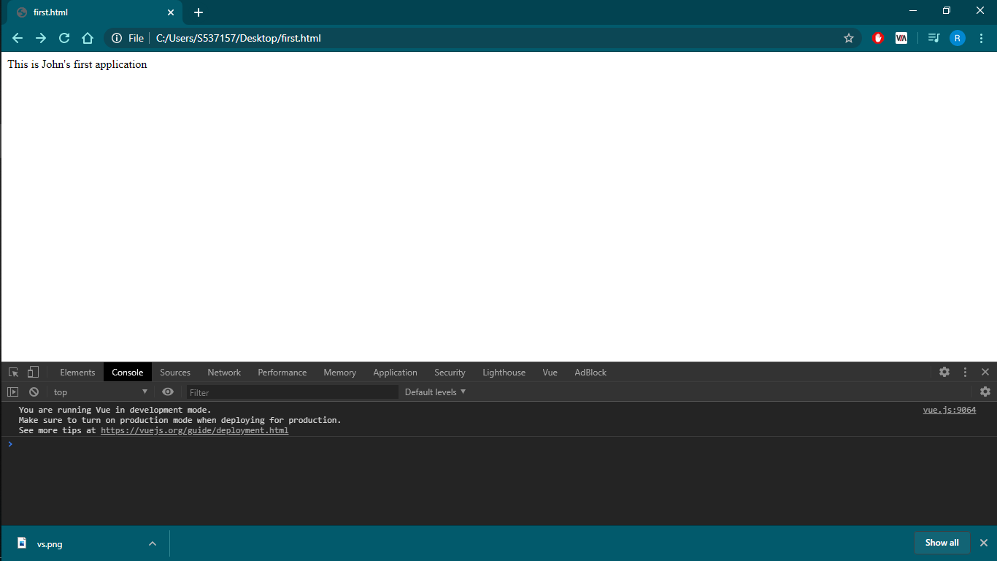
Cont..
For example output:
Akhitha
15

Slide 16
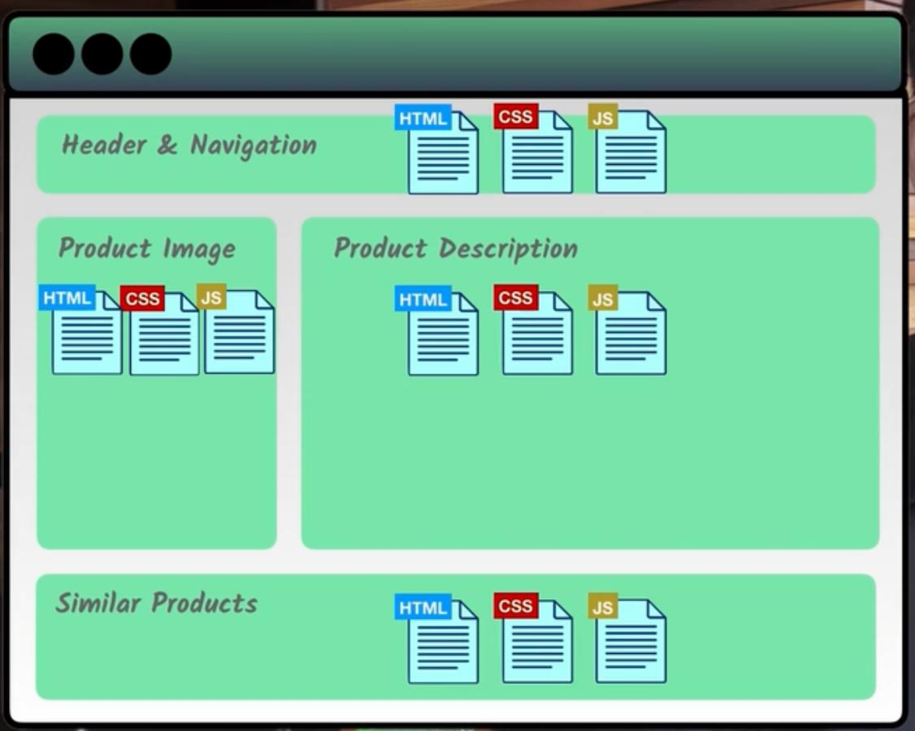
Vue Components
Vue can be written in reusable components.
Each component can have its own HTML, CSS and JS to render
Rethima
16

Slide 17
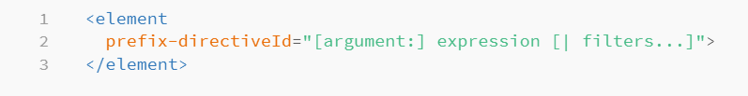
Vue directives
Directives are special tokens that are used in markup that tells library to so specific task to DOM element.
Syntax:
Rethima
17

Slide 18
Vue directives
The following are few directives that are most commonly used
v-text
v-on
v-for
v-bind
v-if v-else
v-model
Rethima
18

Slide 19
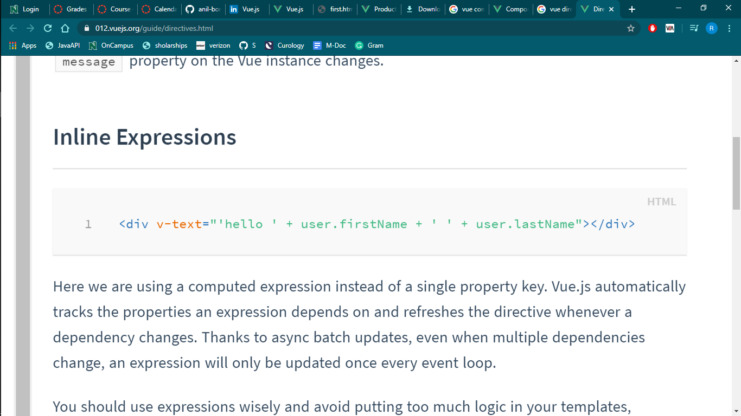
Vue directives
v-text
This tag is used on <div> tags to change the properties of text components.
For this directive, v is prefix and text is directive ID.
In this example, the text changes when ever the firstName and lastName of the user changes.
Rethima
19

Slide 20
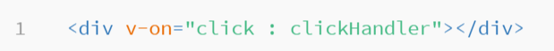
Vue directives
v-on
This tag attaches event listeners to an element.
For this directive, v is prefix and on is directive ID.
In this example, the event is mouse clicks.
Rethima
20

Slide 21
Vue directives
V-for
This directives works same as a normal for loop.
This is used when we need to repeat same code for more that one time.
For this directive, v is prefix and for is directive ID.
Rethima
21

Slide 22
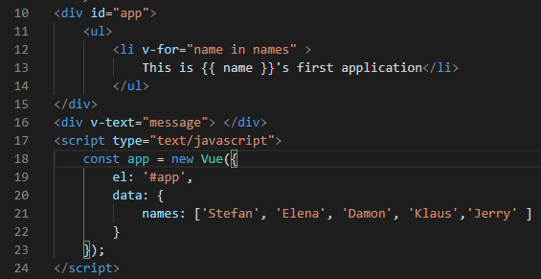
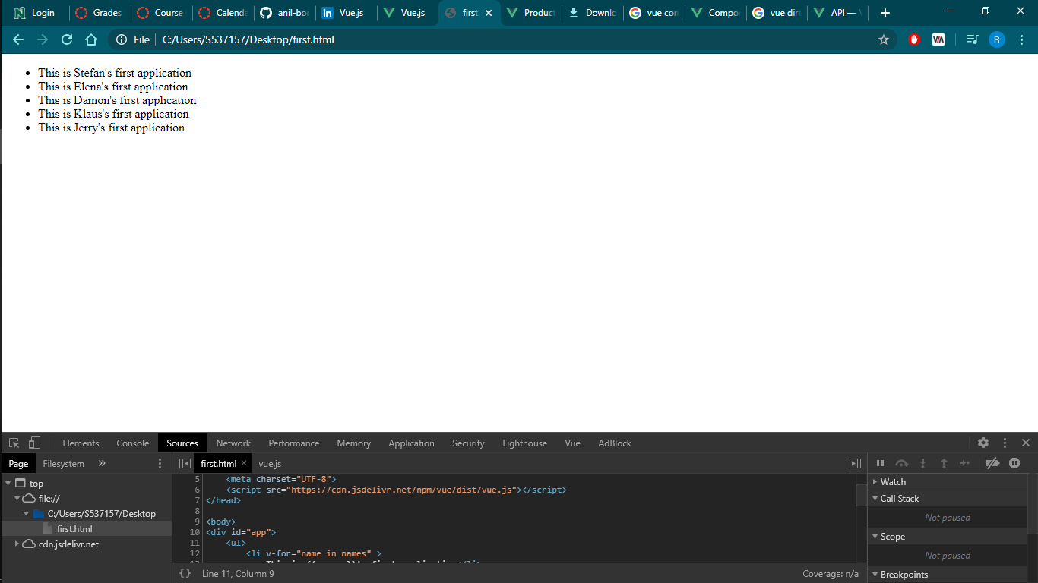
Vue directives
V-for
For example: Output:
Rethima
22

Slide 23
Vue directives
V-bind
This directives bind one or more attributes, or a component properties to an expression.
We can bind a element with other attributes like data.
For this directive, v is prefix and bind is directive ID.
Rethima
23

Slide 24
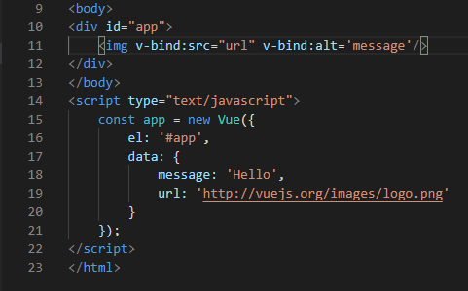
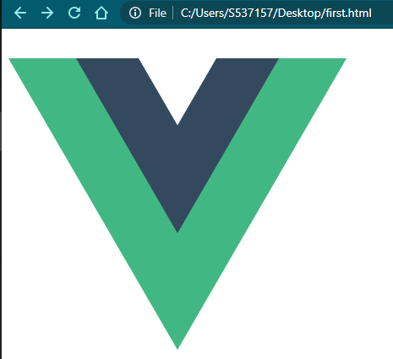
Vue directives
V-bind output:
Rethima
24

Slide 25
Vue directives
V-if, v-else
To write if else conditional statements in Vue, we use these directives.
For this directive, v is prefix and if, else are directive IDs.
Rethima
25

Slide 26
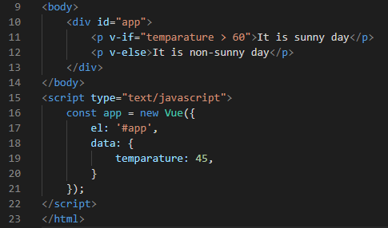
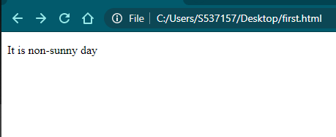
Vue directives
V-if, v-else
Example: output:
Rethima
26

Slide 27
Vue directives
V-Model
This tag will allow us to create a two-way binding.
For example, if we want to validate the data entered in the input field without reloading any page we can use this attribute to bind the input field and the error message.
Rethima
27

Slide 28
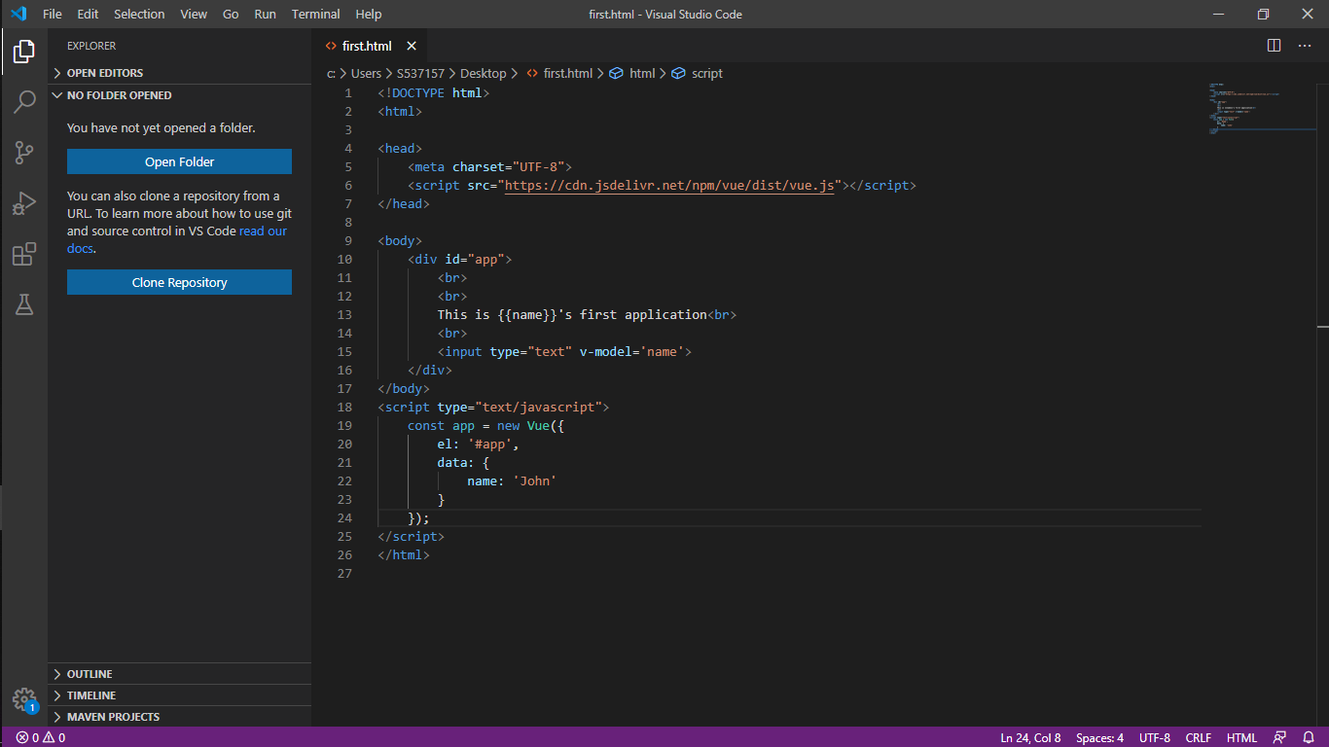
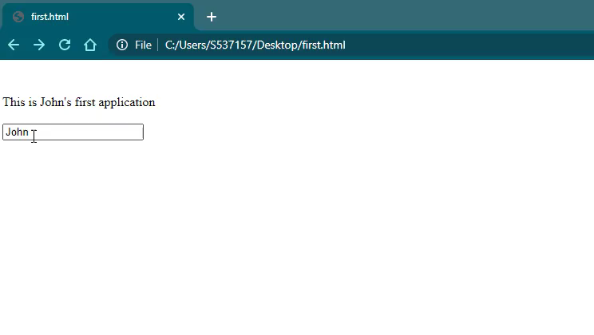
Vue directives
V-Model
Rethima
28

Slide 29
Custom Vue directives
In addition to the default directives Id’s Vue can use custom directives.
By using these custom directive Id, we can apply our own properties to the element.
Rethima
29

Slide 30
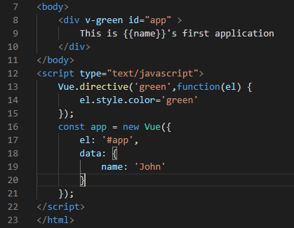
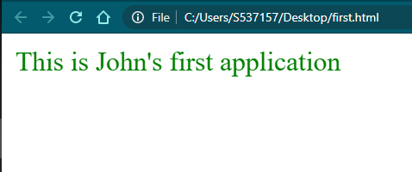
Custom Vue directives
Rethima
30

Slide 31
Advantages of Vue
Easy to understand and develop applications
Simple Integration
Flexibility
Concise Documentation
Reactive Two-way data binding
Solid Tooling Ecosystem
Rohan
31

Slide 32
Disadvantages of Vue
Reactivity Complexity
Lack of support for large scale projects
Risk of over flexibility
Limited Resources
Lack of experienced developers
Rohan
32

Slide 33
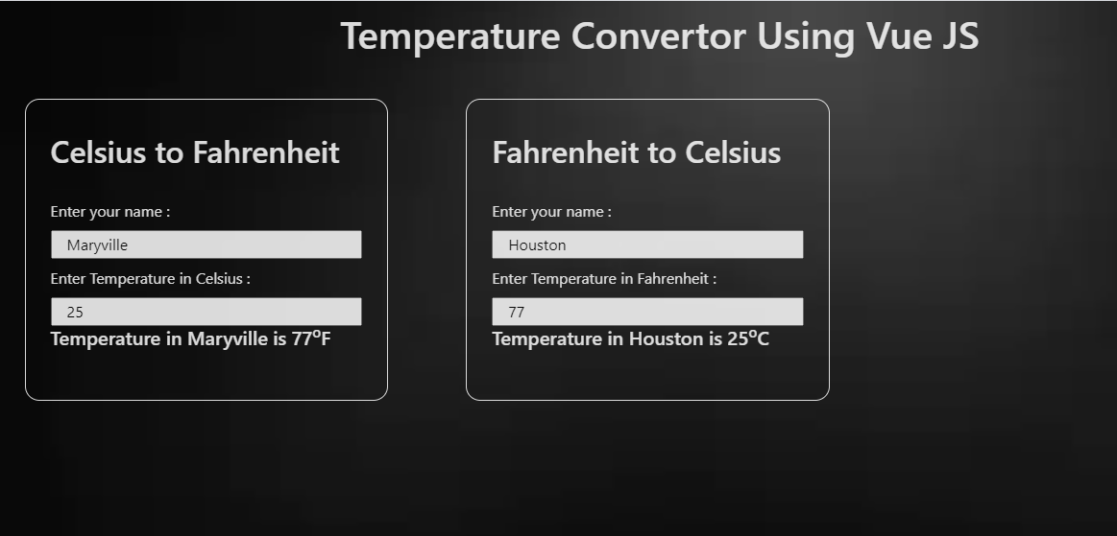
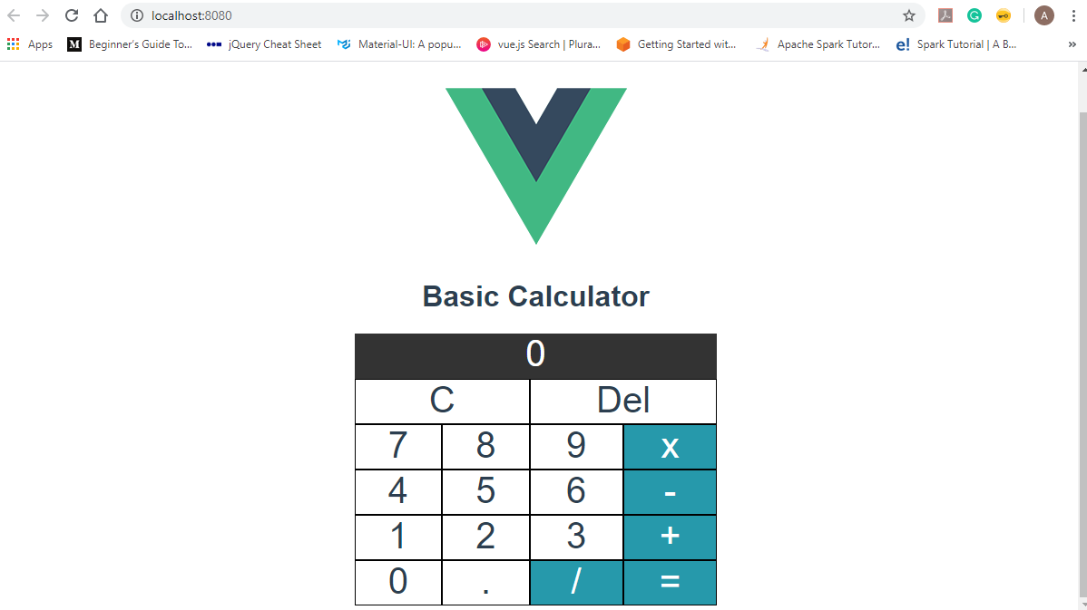
Demo
Rohan

Slide 34
Conclusion
This is just a brief overview of vue.js. There is lot more to learn about vue, but we hope this provides you with a general overview of this fun and progressive framework. We strongly encourage you to check out the official documentation https://vuejs.org/v2/guide/

Slide 35
References:
https://cli.vuejs.org/guide/html-and-static-assets.html
https://www.sitepoint.com/vue-cli-intro/
https://vuejs.org/v2/guide/
https://towardsdatascience.com/what-are-the-pros-and-cons-of-using-vue-js-3689d00d87b0#:~:text=Its%20small%20size%20and%20customization,to%20improve%20in%20the%20future.
Rohan
35

Slide 36
Questions..?
36
Rohan

Slide 37
Thank you ☺
Rohan
37

