Slide 1
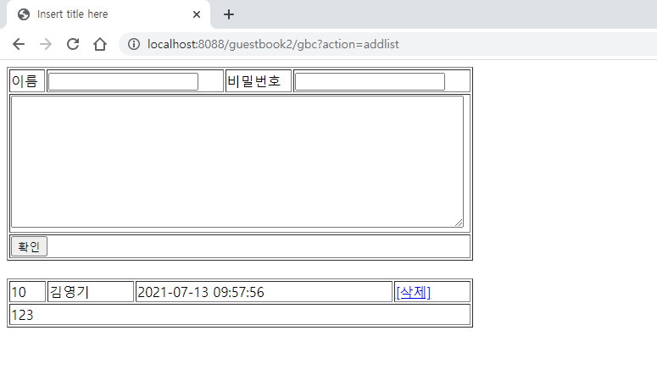
Guestbook2
01
List
Request(요청)
Tomcat
Request header
파라미터: action=addlist
Request body
phonebook2
http://localhost:8088/phonebook2/gbc?action=addlist
contoller(servlet)객체
guestbookDao 객체
list일때
getList
insert일때
delete일때
..
getList()
rquest
response
*포워드
addlist.jsp
객체
Response(응답)
Response header
Response body (html)
DB

Slide 2
Guestbook2
01
Add
action=add&name=***&password=***&content=***
http://localhost:8088/guestbook2/gbc?action=addlist
Request(요청)
Tomcat
Guestbook2
Request header
Request body
(파라미터)
Contoller(servlet) 객체
guestbookDao 객체
request
add일때
guestbookInsert()
response
리스트 요청
Response(응답)
Response header
Response body (리다이렉트코드)
DB
http://localhost:8088/phonebook2/pbc?action=addlist

Slide 3
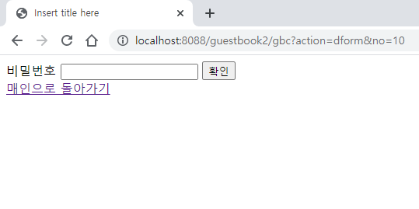
guestbook2
01
DeleteForm
Tomcat
Request(요청)
phonebook2
Request header
Request body
Contoller(servlet) 객체
phoneDao 객체
dform일때
http://localhost:8088/guestbook2/gbc?action=dform
request
dform
response
포워드
deleteForm.jsp
객체
Response(응답)
Response header
Response body (html)
DB

Slide 4
Guestbook2
01
Delete
action=delete&no=***&password=***
http://localhost:8088/guestbook2/gbc?action=dform
Tomcat
Request(요청)
phonebook2
Request header
Request body
(파라미터)
Contoller(servlet) 객체
guestbookDao 객체
request
delete일때
personDelete()
response
리스트 요청
Response(응답)
Response header
Response body (리다이렉트코드)
DB
http://localhost:8088/guestbook2/gbc?action=addlist

