Slide 1
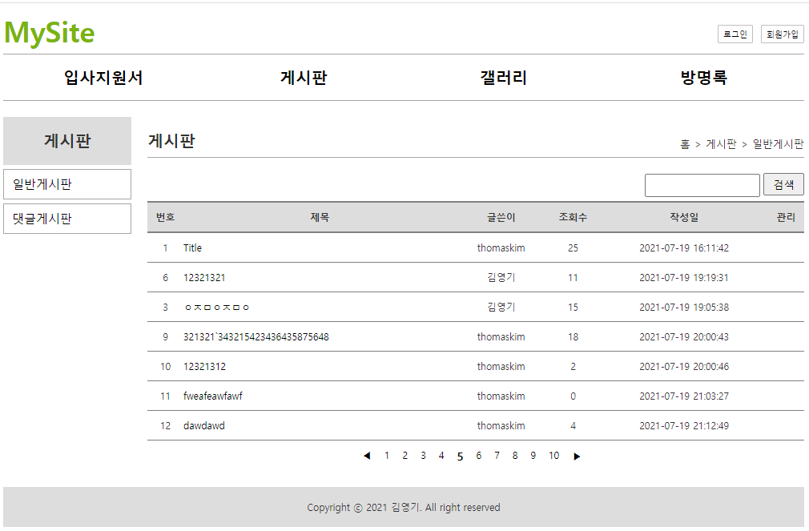
Mysite
01
List
Request(요청)
Tomcat
Request header
파라미터:
action=list
Request body
mysite
http://localhost:8088/mysite/bc?action=list
Controller(servlet)객체
BoardDao 객체
getList()
getList()
rquest
response
*포워드
list.jsp
객체
Response(응답)
Response header
Response body (html)
DB

Slide 2
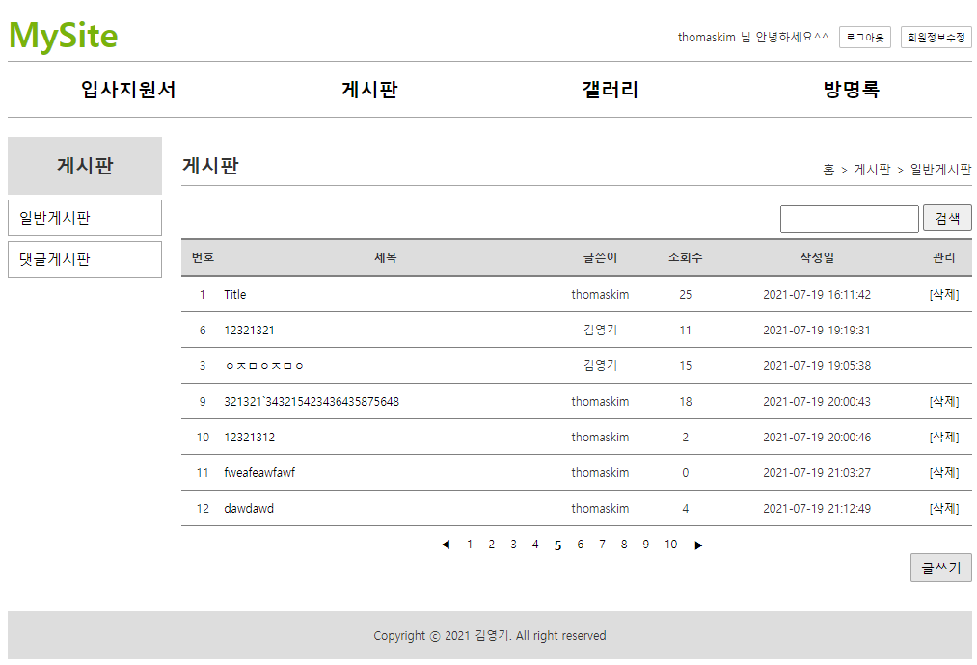
Mysite
01
Delete
action=delete&no=***
http://localhost:8088/mysite/bc?action=delete
Tomcat
Request(요청)
mysite
Request header
Request body
(파라미터)
Contoller(servlet) 객체
BoardDao 객체
request
delete일때
boardDelete()
response
리스트 요청
Response(응답)
Response header
Response body (리다이렉트코드)
DB
http://localhost:8088/mysite/bc?action=list

Slide 3
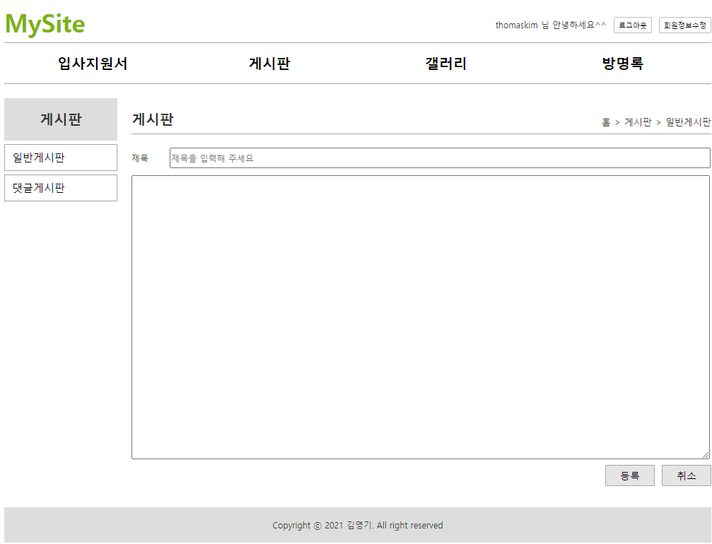
Mysite
01
WriteForm
http://localhost:8088/mysite/bc?action=writeform
Tomcat
Request(요청)
mysite
Request header
Request body
Contoller(servlet) 객체
BoardDao 객체
writeform일때
request
writeform
response
포워드
WriteForm.jsp
객체
Response(응답)
Response header
Response body (html)
DB

Slide 4
Mysite
01
Write
action=write&title=***&content=***
http://localhost:8088/mysite/bc?action=writeform
Request(요청)
Tomcat
Mysite
Request header
Request body
(파라미터)
Contoller(servlet) 객체
BoardDao 객체
request
write일때
boardInsert()
response
리스트 요청
Response(응답)
Response header
Response body (리다이렉트코드)
DB
http://localhost:8088/mysite/bc?action=list

Slide 5
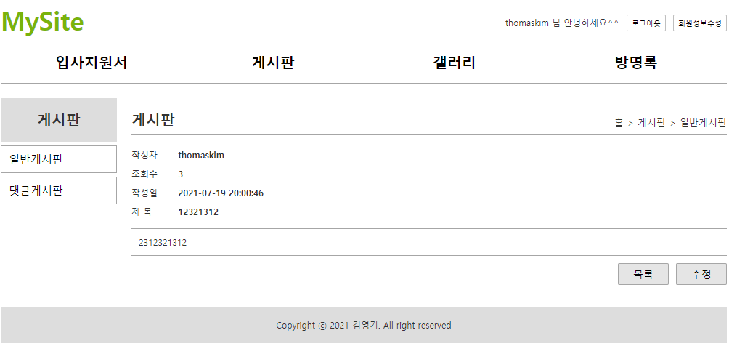
Mysite
01
Read
action=read&board_no=***
http://localhost:8088/mysite/bc?action=read
Tomcat
Request(요청)
mysite
Request header
Request body
(파라미터)
Contoller(servlet) 객체
BoardDao 객체
request
read일때
getBoardinfo()
response
Response(응답)
Response header
Response body (리다이렉트코드)
DB
http://localhost:8088/mysite/bc?action=read

Slide 6
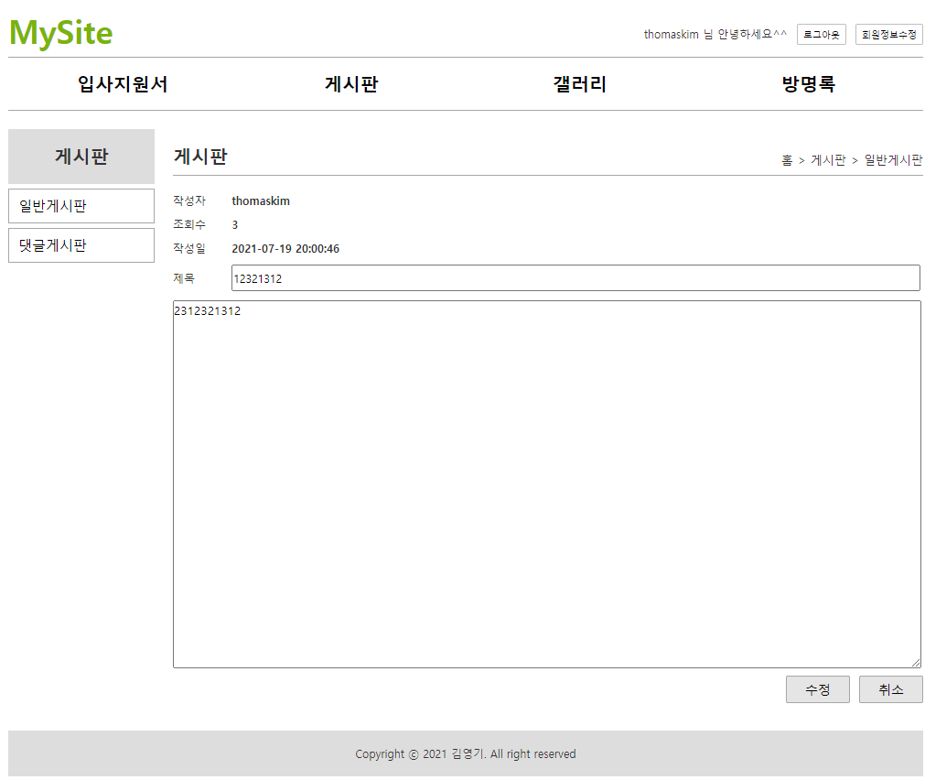
Mysite
01
ModifyForm
http://localhost:8088/mysite/bc?action=modifyform
Tomcat
Request(요청)
mysite
Request header
Request body
BoardDao 객체
Contoller(servlet) 객체
modifyform일때
request
modifyform
response
포워드
ModifyForm.jsp
객체
Response(응답)
Response header
Response body (html)
DB

Slide 7
Mysite
01
Modify
http://localhost:8088/mysite/bc?action=modifyform
action=modify&title=***&content=***
Request(요청)
Tomcat
Mysite
Request header
Request body
(파라미터)
Contoller(servlet) 객체
BoardDao 객체
request
modify일때
boardUpdate()
response
리스트 요청
Response(응답)
Response header
Response body (리다이렉트코드)
DB
http://localhost:8088/mysite/bc?action=list

Slide 8
Mysite
01
Search
Request(요청)
http://localhost:8088/mysite/bc?action=search
Tomcat
Request header
파라미터: action=search
Request body
mysite
contoller(servlet)객체
BoardDao 객체
Search 일때
boardSearch()
rquest
response
*포워드
list.jsp
객체
리스트 요청
(Search)
Response(응답)
Response header
Response body (html)
DB

Slide 9
