Slide 1
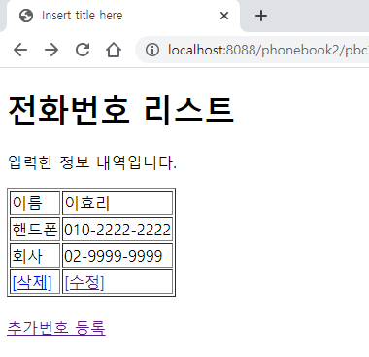
phonebook2 개요 및 분석
01
Delete
action=delete&no=<%=personList.get(i).getPersonId()
http://localhost:8088/phonebook2/pbc?action=list
Request(요청)
Tomcat
phonebook2
Request header
Request body
(파라미터)
Contoller(servlet) 객체
phoneDao 객체
request
delete일때
personDelete()
response
리스트 요청
Response(응답)
Response header
Response body (리다이렉트코드)
DB
http://localhost:8088/phonebook2/pbc?action=list

Slide 2
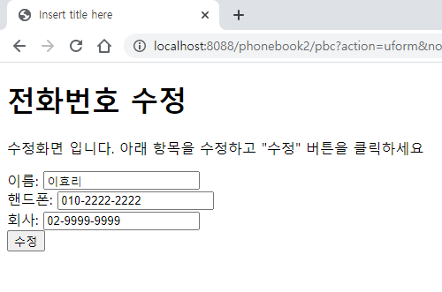
phonebook2 개요 및 분석
01
Request(요청)
UpdateForm
Request header
파라미터: action=uform&no=<%=personList.get(i).getPersonId()
Request body
http://localhost:8088/phonebook2/pbc?action=list
Tomcat
phonebook2
contoller(servlet)객체
request
Uform일때
getPerson()
Response(응답)
response
Response header
Response body (html)
request
*포워드
list.jsp
객체
response
Rqeust(요청)
Request header
파라미터: action=uform
Request body
getName();
getHp();
getCompany();
DB
Response(응답)
Response header
Response body (html)

Slide 3
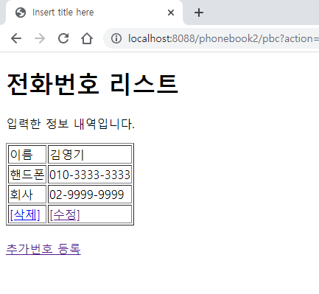
phonebook2 개요 및 분석
01
Update
action=update&no=***&name=***&hp=***&company=***
http://localhost:8088/phonebook2/pbc?action=uform
Rqeust(요청)
Tomcat
phonebook2
Request header
Request body
Action=update
Contoller(servlet) 객체
phoneDao 객체
request
update일때
personUpdate()
response
Response(응답)
Response header
Response body (리다이렉트코드)
DB
http://localhost:8088/phonebook2/pbc?action=list

