Slide 1

Crowd Raising
Ritik kumar

Slide 2
Crowd raising is Decentralized web application made on ethereum blockchain using smart contracts and Web3.0 js.
Project TECH: Solidity,Node.js,Web 3.0 js,Html,Css,Java Script,
Meta mask,Ganache,Truffle

Slide 3
Defining the Problem TAKE IT FROM YOUR INVESTORS.
WHAT INVESTORS SAY
Although stringent measures such as symmetric encryption are in place to make e-payment safe and secure, it is still vulnerable to hacking.
Enterprises with in-house e-payment systems must incur additional costs in procuring, installing and maintaining sophisticated payment-security technologies.
There is no guarantee that people who post projects on Kickstarter will deliver on their projects, use the money to implement their projects, or that the completed projects will meet backers' expectations.
WHAT WE PROPOSE
Making transaction histories more transparent and secure through the use of blockchain technology.
Because Blockchain is a type of distributed ledger, all network participants share the same documentation as opposed to individual copies.
Contributors can decide Where to invest and can Acknowledge the requests for money made by the Project Creators through their votes according to their voting power not by majority of voting.The creator can only use the money if contributors with voting power have voted and raised the request to demanding amount. It will make sure the money is used for Necessities rather than Luxuries.

Slide 4
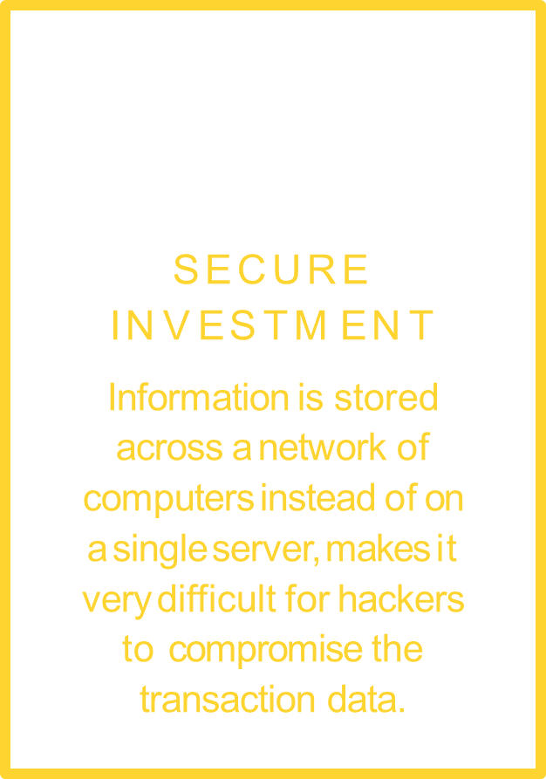
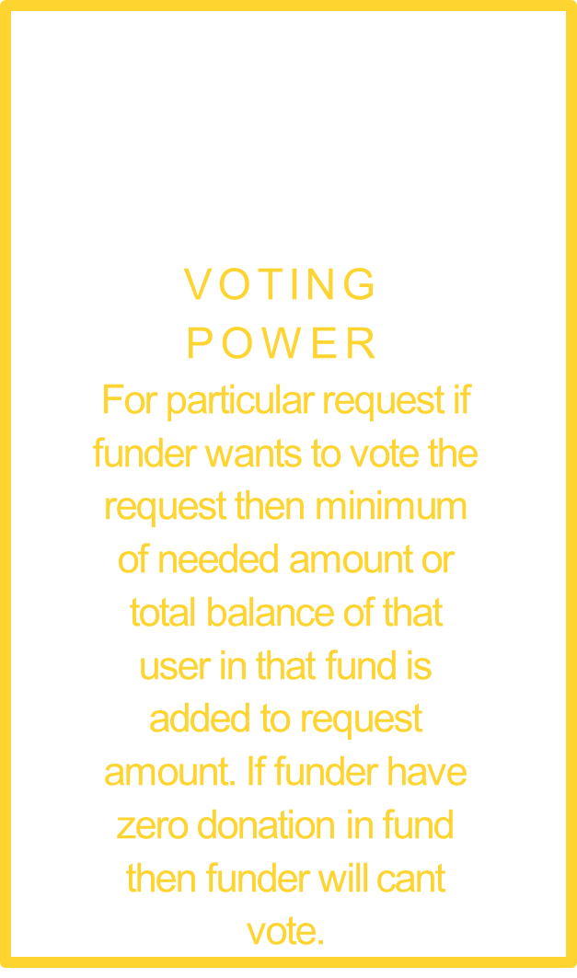
KEY FEATURES

Slide 5
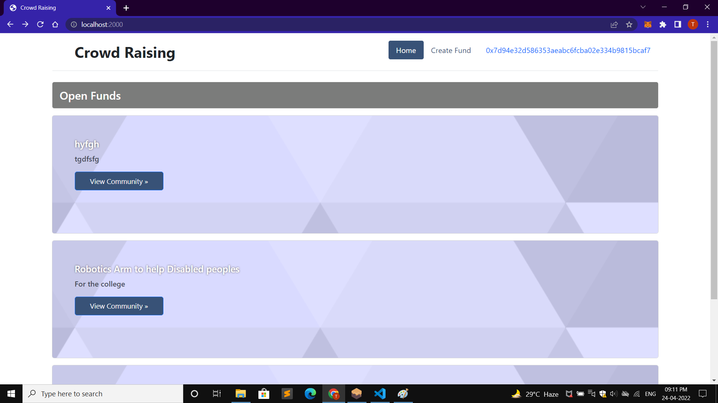

Slide 6
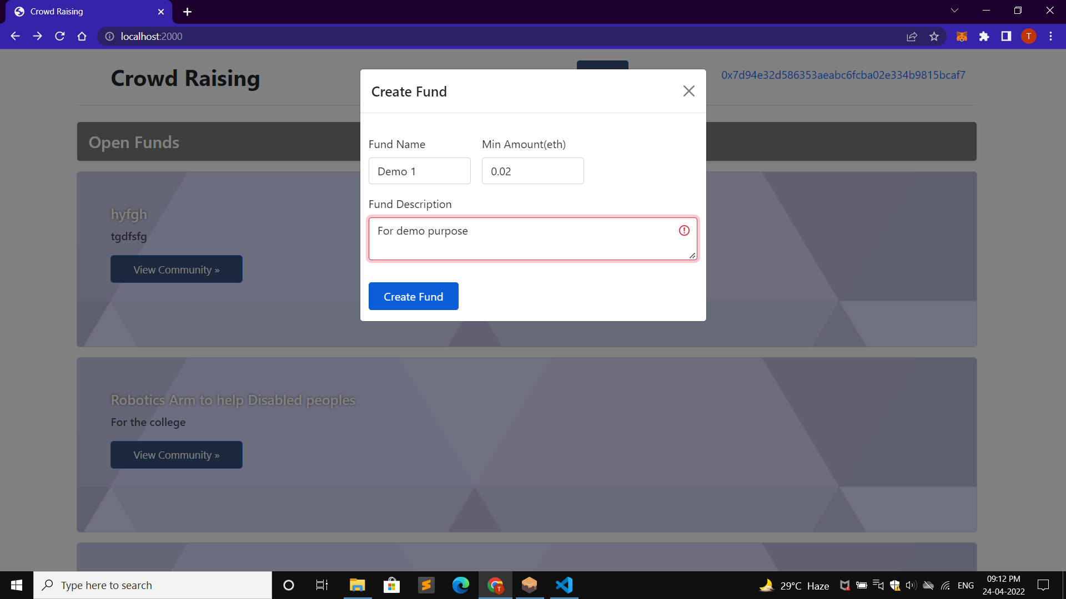

Slide 7
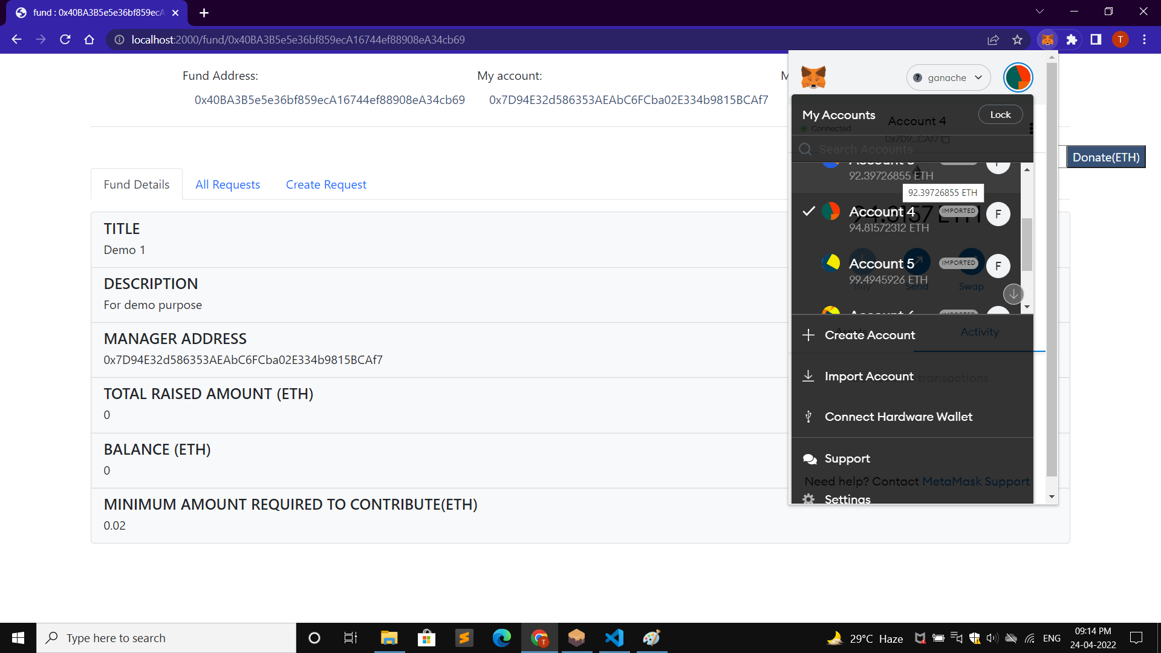

Slide 8
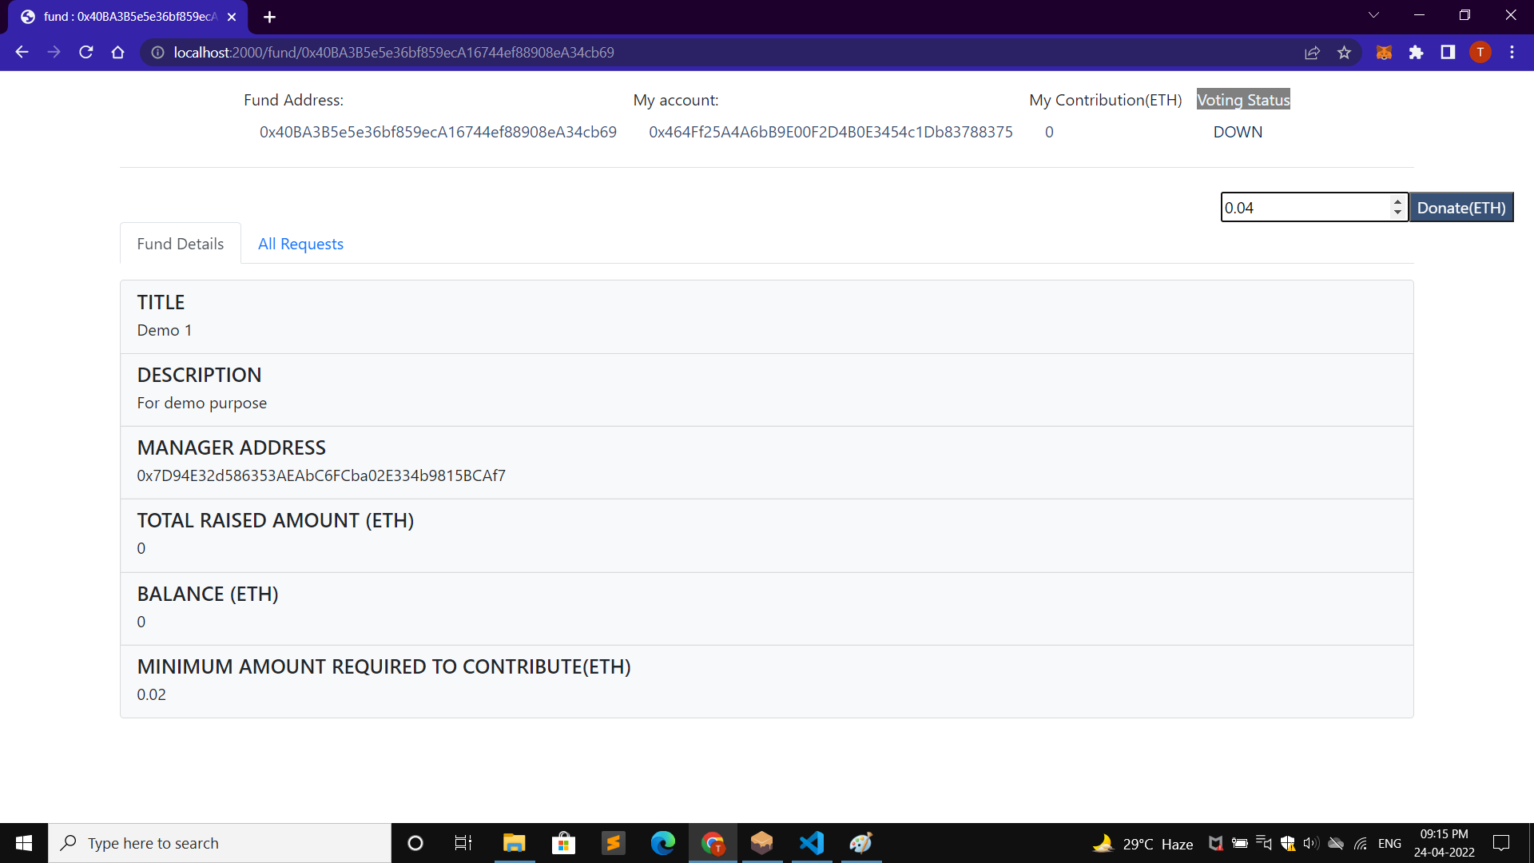

Slide 9
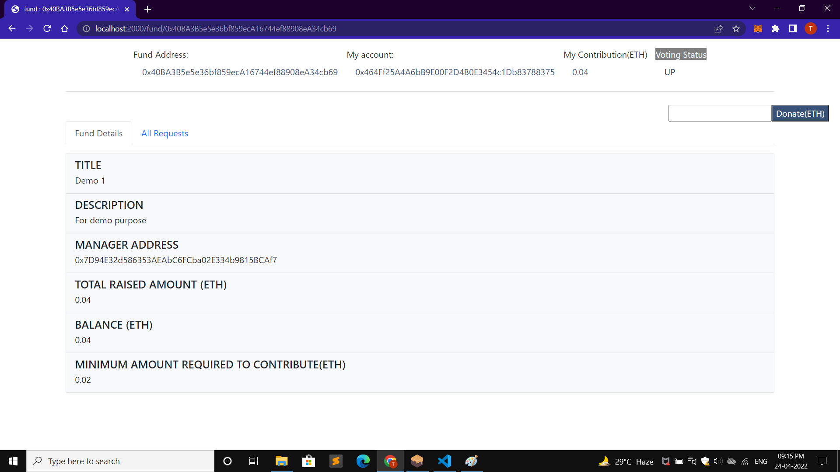

Slide 10
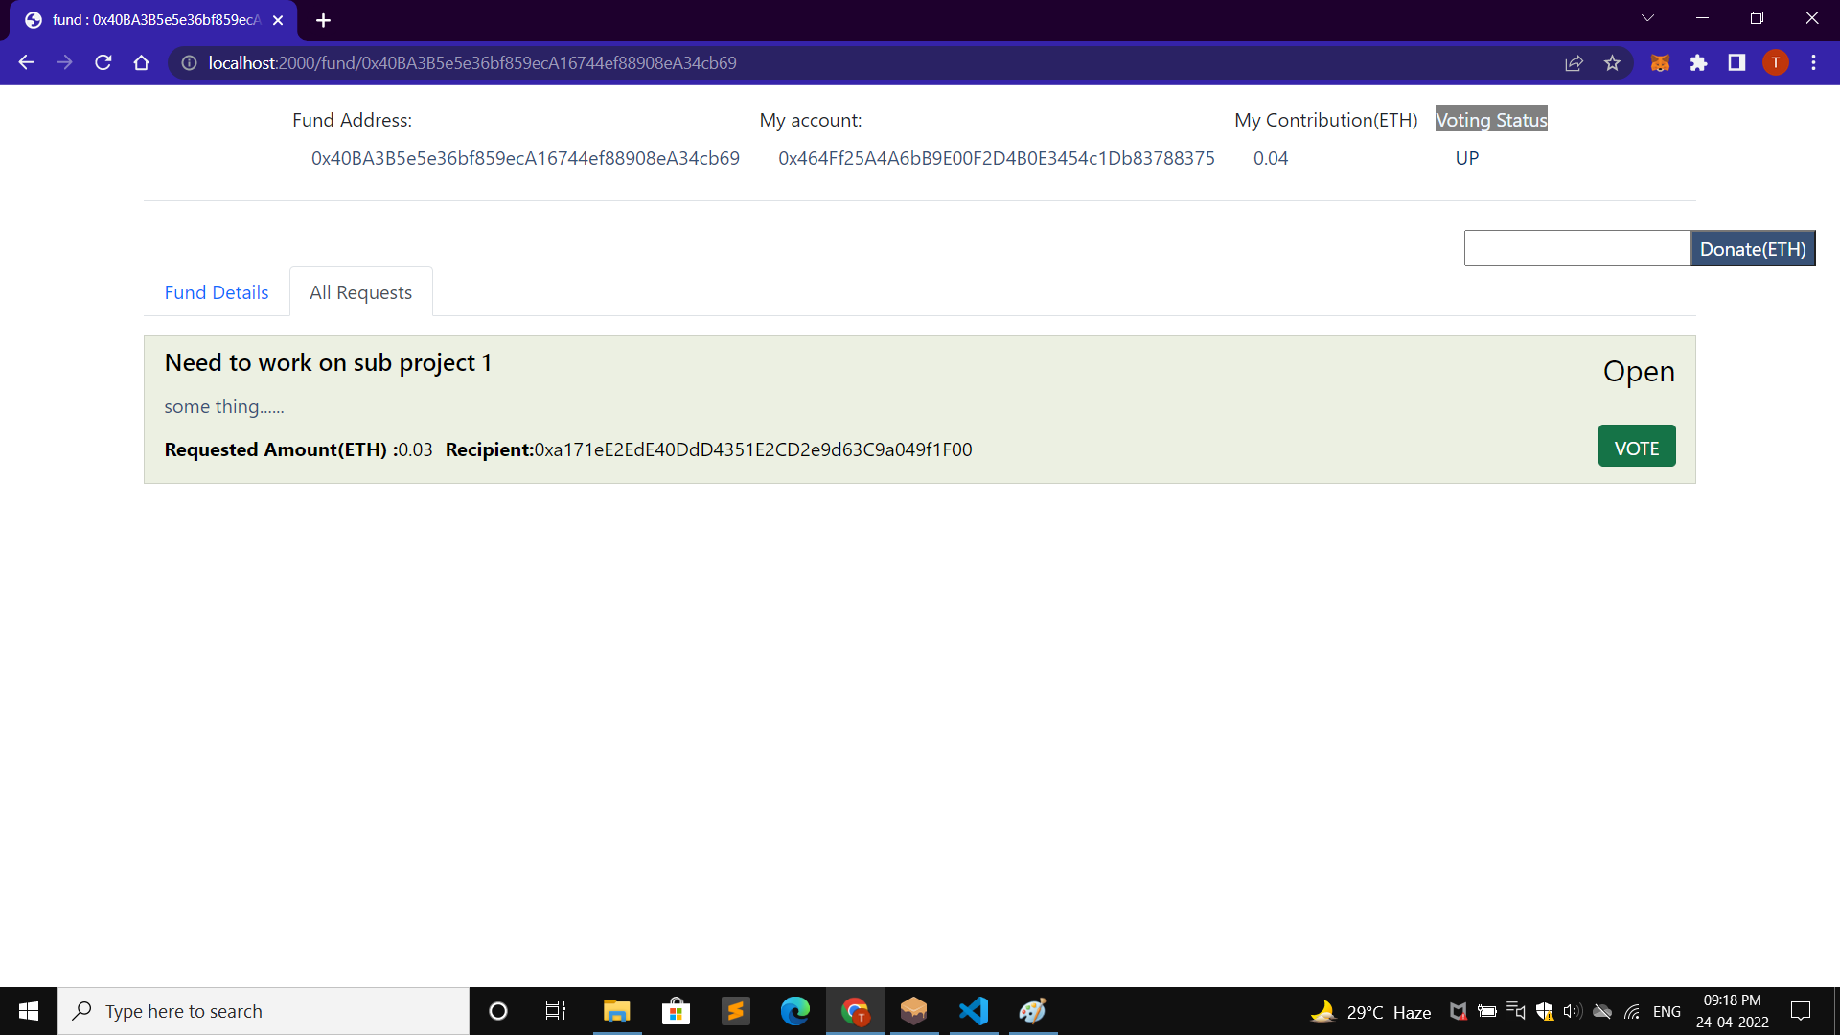

Slide 11
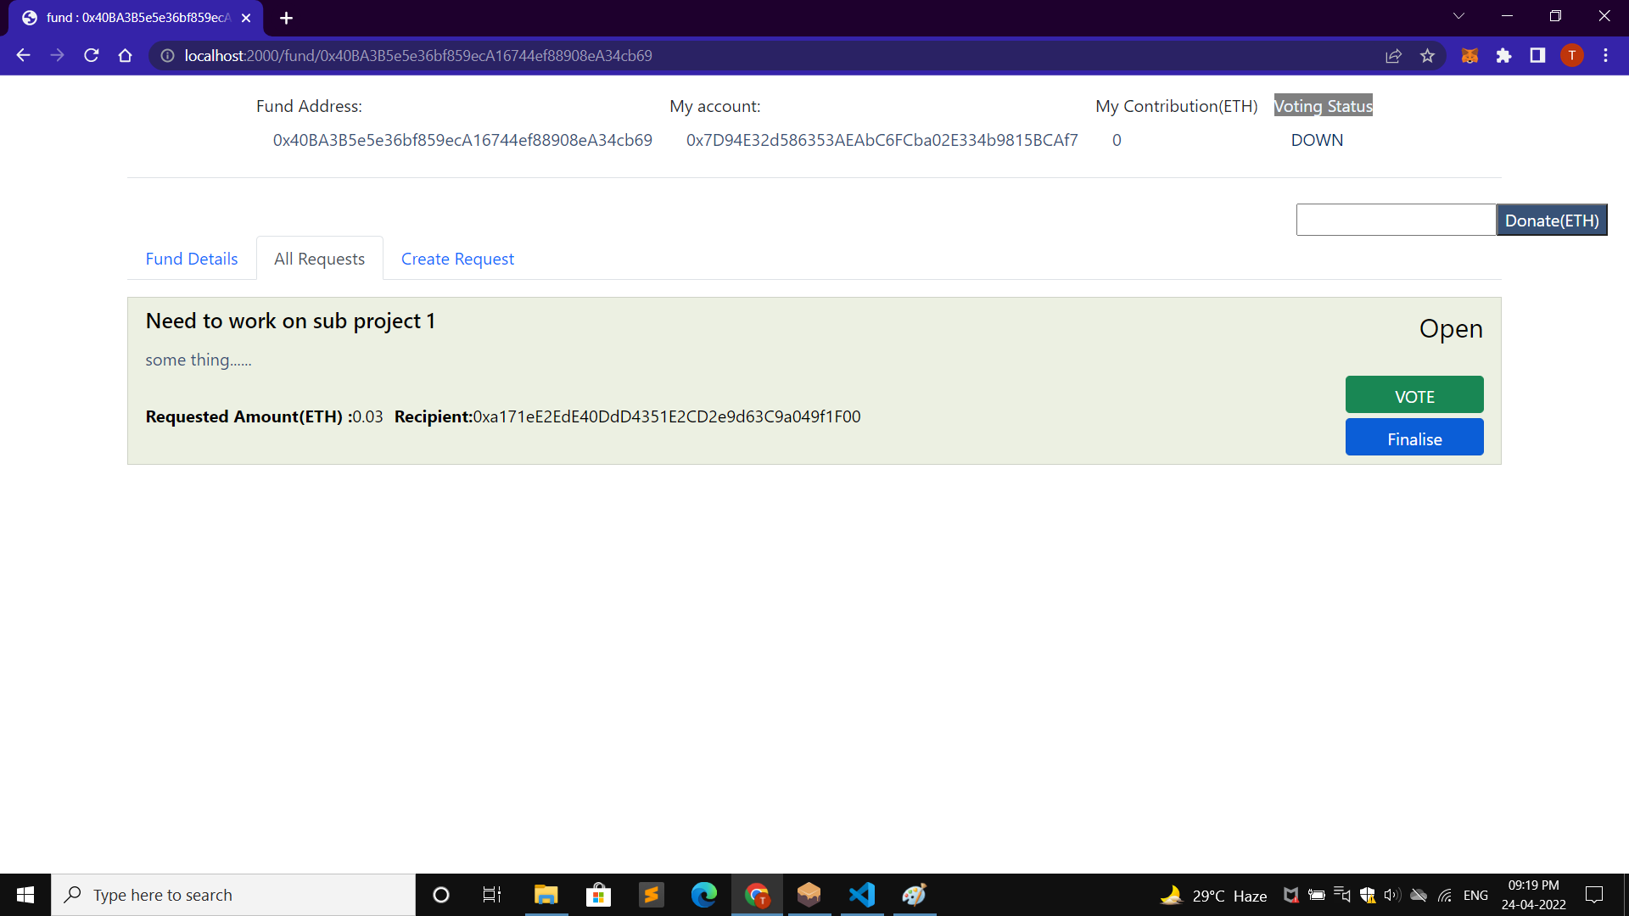

Slide 12


Slide 13
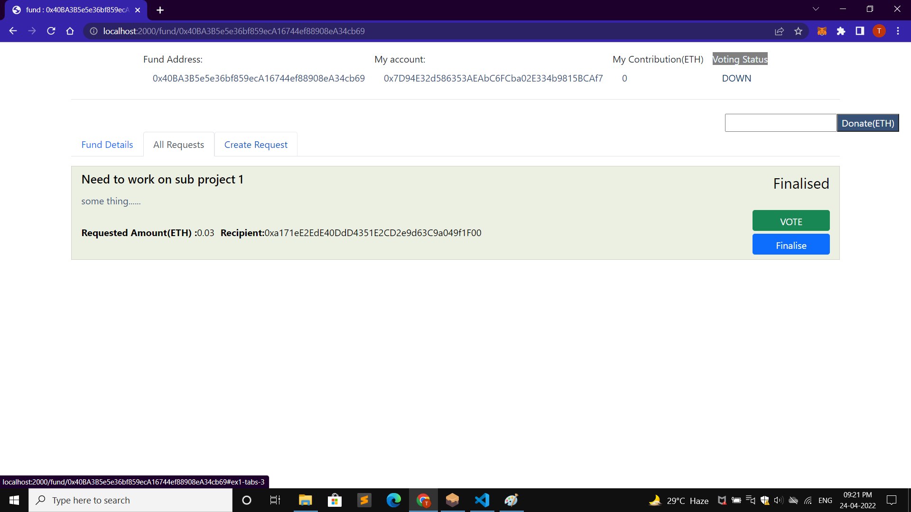

Slide 14
