Slide 1
FORENIX-OSS
OSINT and Forensics,
finally one workflow.
Open-source platform that turns public-source intelligence into court-admissible evidence — with a cryptographic chain of custody from finding to verdict.
MIT licensed
6 AI adapters
Hash-chained audit
Self-host or SaaS
Ali Murtaza Bhutto · YC Application · 2026

Slide 2
THE PROBLEM
forenix-oss · 2/17
Two tools, one investigation, zero accountability.
WORKFLOW SPLIT
CHAIN OF CUSTODY IS ARTISANAL
VENDOR LOCK + COST WALL
OSINT analysts use Maltego / SpiderFoot / Hunchly.
Forensic examiners use EnCase / AXIOM / Cellebrite.
Nothing bridges them — copy-paste is the integration.
Excel spreadsheets, emailed hash digests, screenshots
stored in shared drives. No replay. No tamper-evidence.
Court challenges land here.
EnCase + AXIOM + Maltego = 5–6 figure annual spend.
Smaller investigators, journalists, NGOs are priced out.
AI features are gated behind enterprise tiers.
The deal: "We found it on the open web, here's the screenshot, trust us."
That's not an audit trail. That's a vibe.
forenix-oss · OSINT × Forensics, one platform

Slide 3
THE SOLUTION
forenix-oss · 3/17
One platform owns the journey from lead to verdict.
01.
Run the OSINT pipeline.
7 agent groups in parallel through one swappable AI adapter.
02.
Capture findings with provenance.
Each finding carries confidence, source URLs, agent group, reasoning trace.
03.
Promote to forensic evidence.
One click bridges a finding into a Case with hash + commit on its own branch.
04.
Lock the chain.
Every write appends a SHA-256 forward-chained audit row. Replay verifies.
05.
Sign-off + export.
Merge-request review on evidence branches; markdown / PDF reports.
src/lib/audit-chain.ts · sha256(prevHash | action | entity | entityId | iso(t))

Slide 4
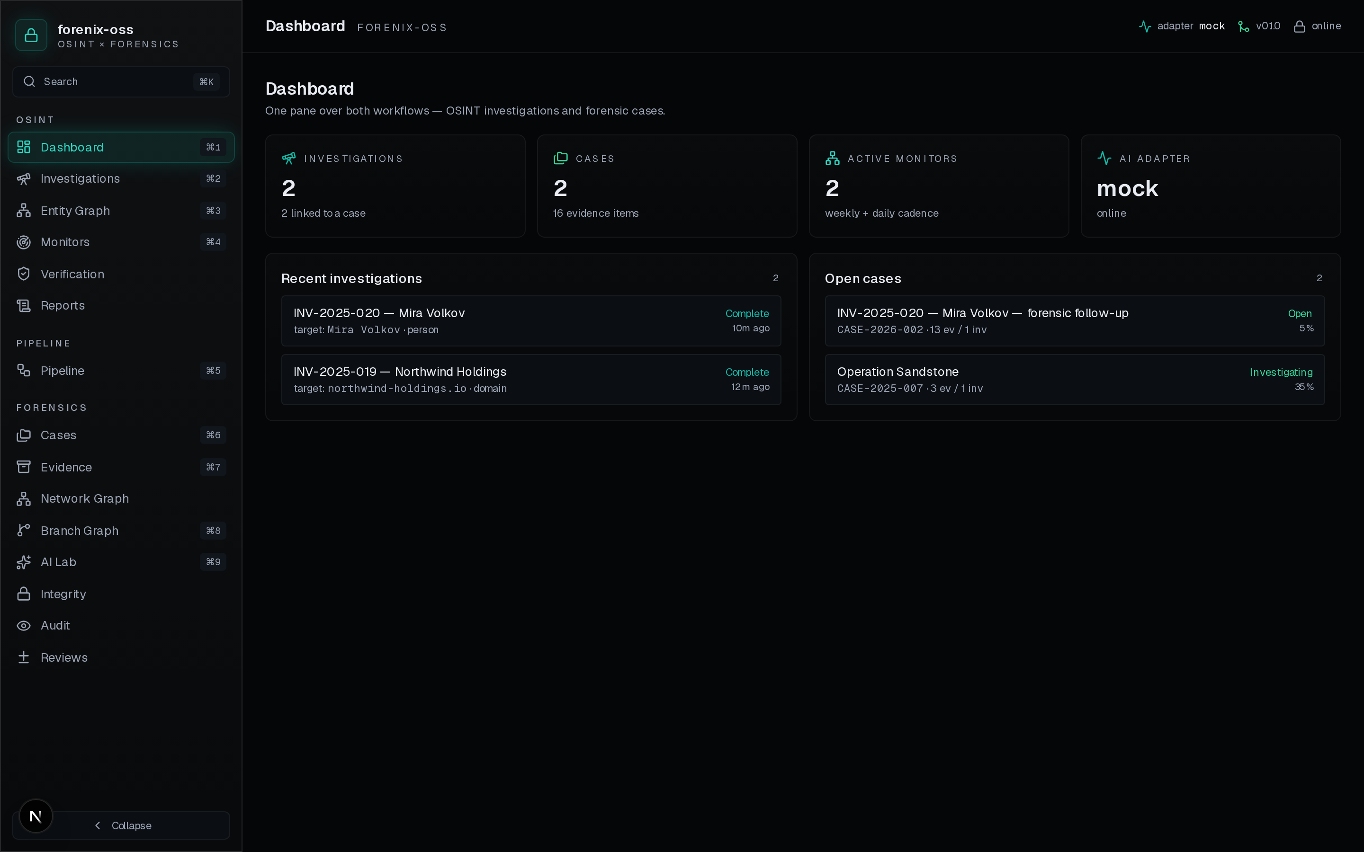
PRODUCT · VIEW 1
forenix-oss · 4/17
Dashboard.
SINGLE PANE
Both workflows on one screen.
Live counts pulled straight from the database. How many investigations are open, how many are bridged to a case, how many evidence items live across all cases, which AI adapter is active right now. Click any row to drill in.
forenix-oss · OSINT × Forensics, one platform

Slide 5
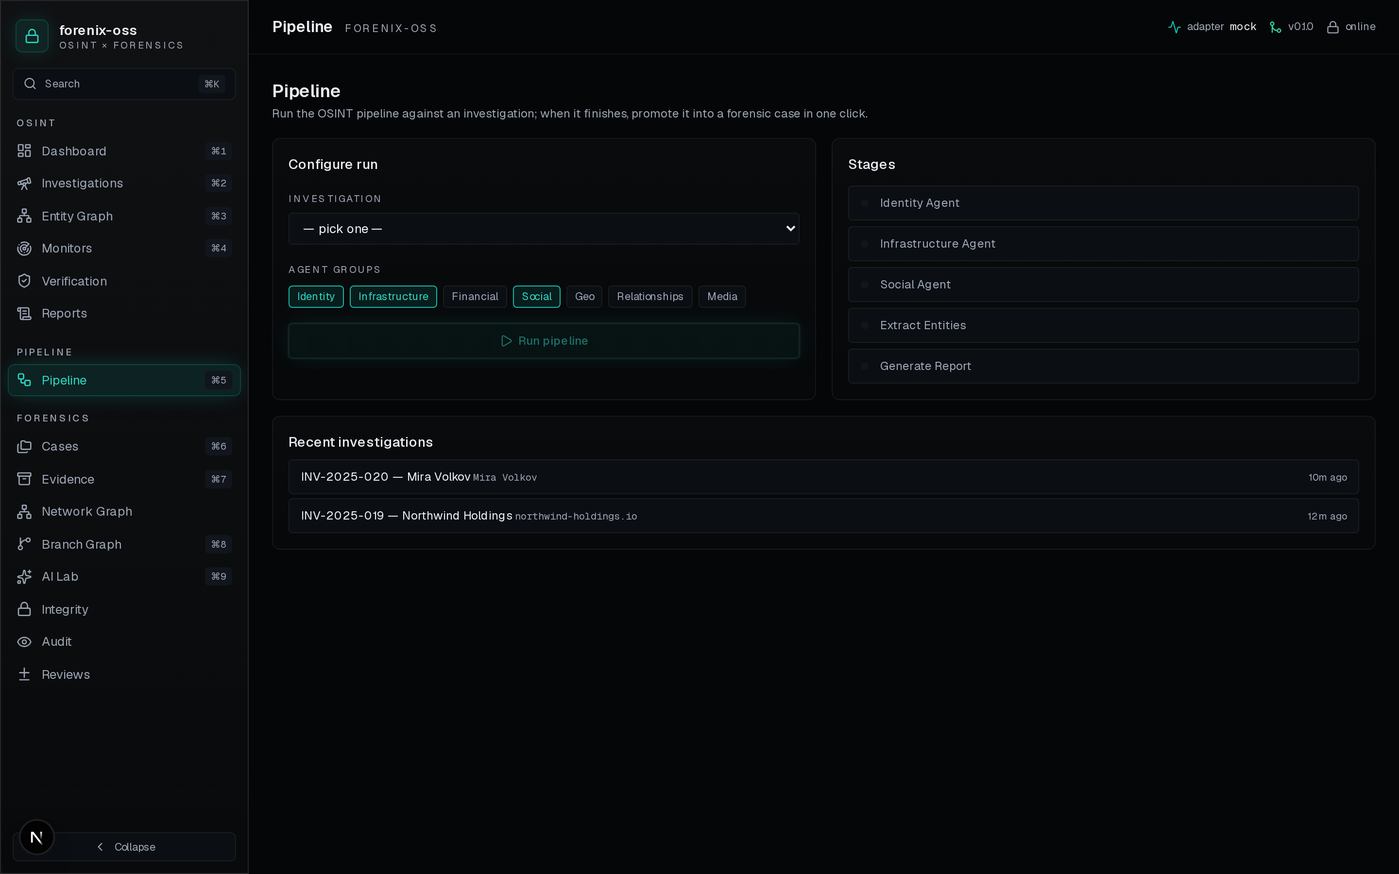
PRODUCT · VIEW 2
forenix-oss · 5/17
Pipeline runner.
OSINT IN ONE CLICK
Six adapters. One button.
Pick an investigation, toggle agent groups, hit Run. The platform drives the AI adapter end-to-end and shows stage progress. When the run completes, the 'Open forensic case' button bridges the findings into a case with hash + commit.
forenix-oss · OSINT × Forensics, one platform

Slide 6
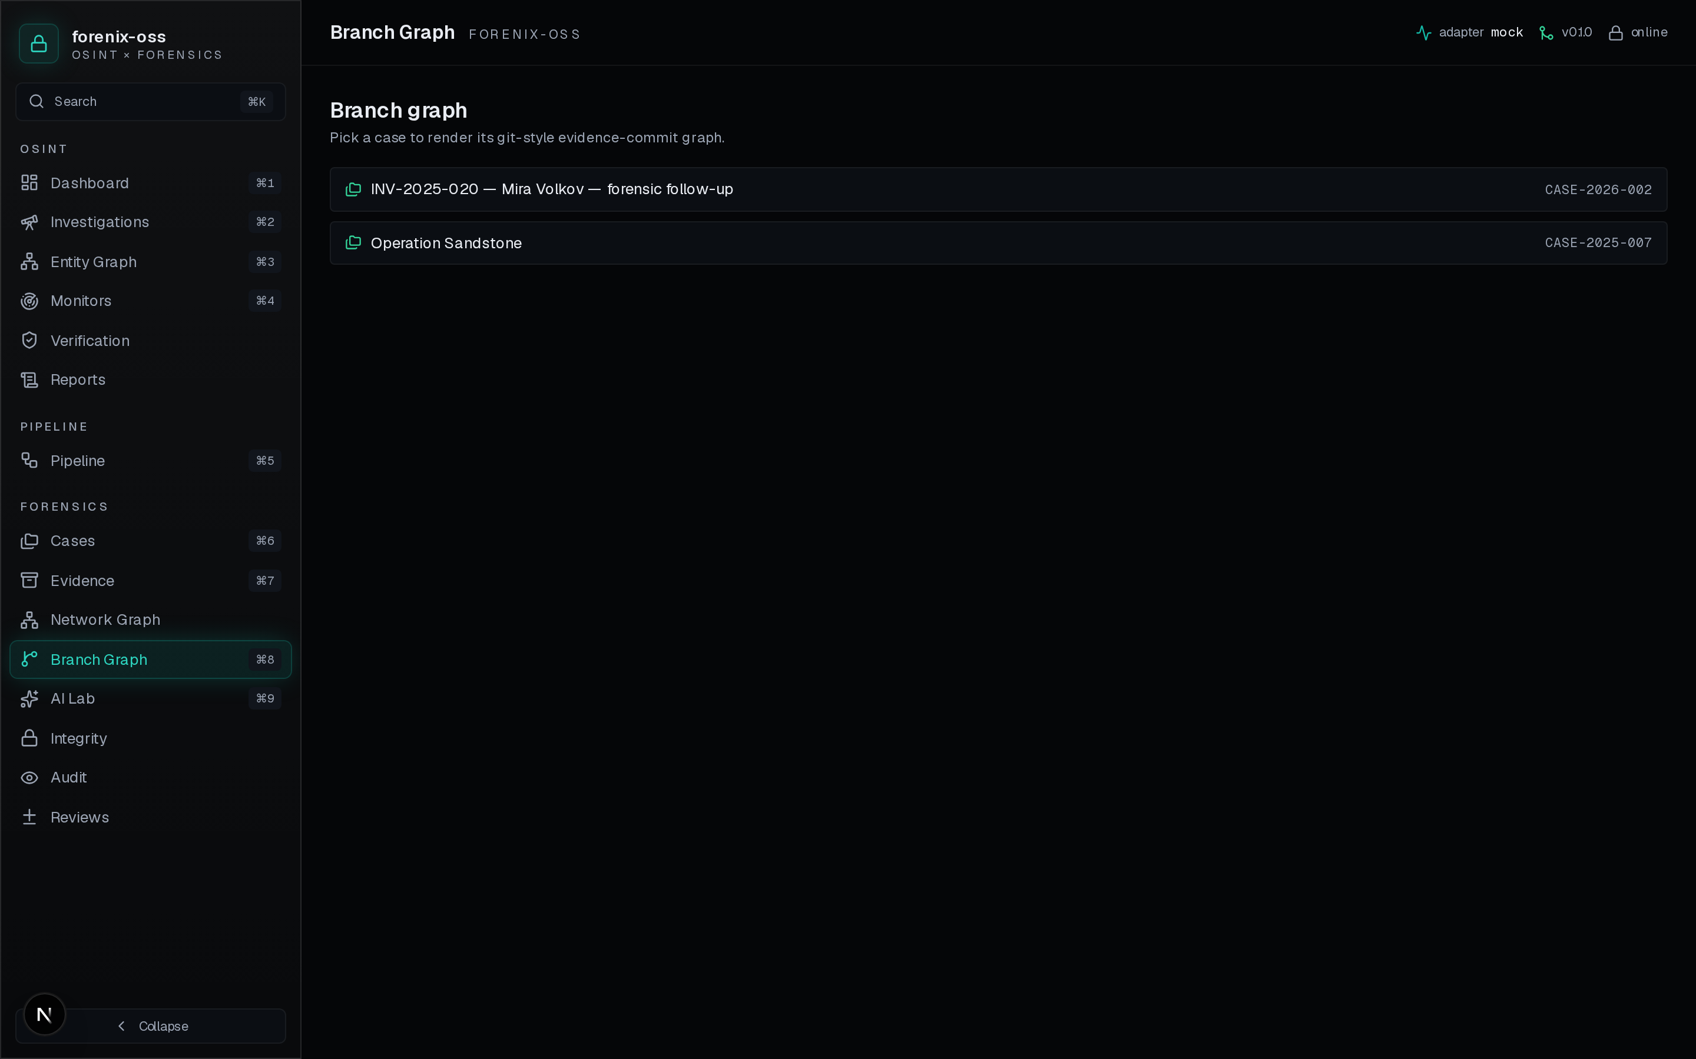
PRODUCT · VIEW 3
forenix-oss · 6/17
Git-style evidence chain.
VERIFIABLE FORENSICS
Every evidence change carries a hash + a commit.
Lane-per-branch, branch-coloured dots per commit, verified ring around verified commits. Sealed evidence is immutable. This is the structure that survives a court challenge.
forenix-oss · OSINT × Forensics, one platform

Slide 7
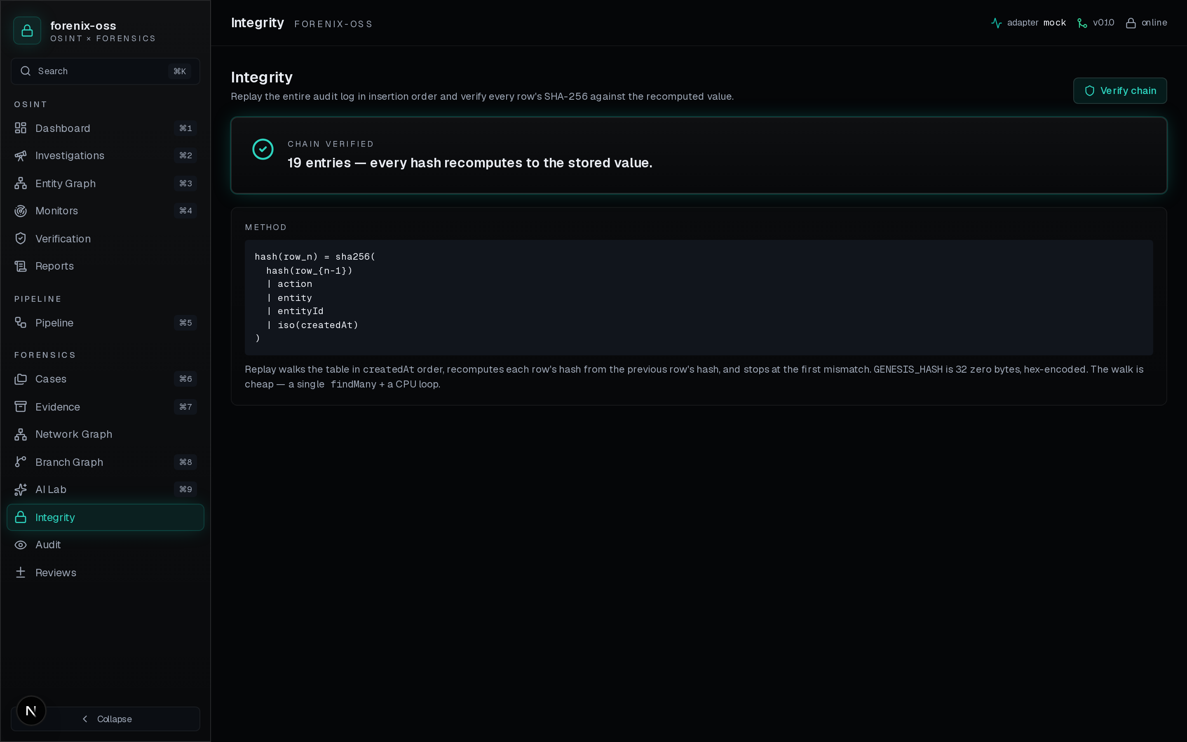
PRODUCT · VIEW 4
forenix-oss · 7/17
Cryptographic integrity.
TAMPER-EVIDENT
One button replays the chain.
SHA-256 forward chain: hash = sha256(prev | action | entity | id | iso(t)). Click 'Verify chain' and the platform replays every audit row, breaks loudly on tampering, and shows the expected vs stored hash for forensic inspection.
forenix-oss · OSINT × Forensics, one platform

Slide 8
TIMING
forenix-oss · 8/17
Why now.
LLMs make per-investigation OSINT cheap.
Hosted models (NVIDIA NIM, OpenRouter, GLM) bring 70B-class quality to $5/mo budgets. The agent-group pipeline is finally viable for single-investigator shops.
Disinformation + sanctions evasion at scale.
Russia/UA, Gaza, crypto-sanctioned-entity tracking, election interference — every analyst's caseload is up 3–5× since 2022.
Courts are starting to accept open-source evidence.
Bellingcat-style findings now appear in ICC + national-court filings. What's missing isn't the data — it's a defensible chain.
Open-source forensics is having a moment.
Velociraptor, Hayabusa, MISP, OpenCTI: the community has moved past 'cloud-only'. We're the OSINT+forensics piece that's still missing.
forenix-oss · OSINT × Forensics, one platform

Slide 9
TAM / SAM / SOM
forenix-oss · 9/17
Market.
TAM
Global cybercrime investigations + e-discovery + threat-intel.
$110B by 2027 (combined Gartner + IDC).
SAM
Mid-market + boutique investigative shops + government contractors.
$9B annual seat licenses (Maltego, EnCase, AXIOM, Cellebrite, Relativity).
SOM
Self-hosted + free OSS users converting at 4% to a $99–$499/mo SaaS tier.
$30M ARR within 3 years on a 100K-user OSS funnel.
forenix-oss · OSINT × Forensics, one platform

Slide 10
COMPETITIVE LANDSCAPE
forenix-oss · 10/17
Where we sit.
OPEN SOURCE → CLOSED SOURCE
UNIFIED OSINT + FORENSICS → SINGLE WORKFLOW
OPEN + UNIFIED
CLOSED + UNIFIED
· forenix-oss (us)
· Palantir Gotham (heavy)
· IBM i2 (legacy)
OPEN + SINGLE
CLOSED + SINGLE
· SpiderFoot (OSINT only)
· Velociraptor (forensics only)
· MISP (intel only)
· Maltego (OSINT)
· EnCase / AXIOM / Cellebrite (forensics)
· Relativity (eDiscovery)
We are the only product where the OSINT lead and the forensic chain live in one MIT-licensed schema.

Slide 11
BUSINESS MODEL
forenix-oss · 11/17
How we make money.
CORE
TEAM
SAAS PREMIUM
ENTERPRISE
MIT-licensed open source
Hosted single-tenant
Multi-tenant + ClaudeAdapter
Air-gapped + custom adapters
Every analyst feature. 5 of 6 adapters (mock, Ollama, GLM, OpenRouter, NVIDIA). Self-host forever.
Managed Postgres + backups + dashboards + Sentry + cron monitors. Email support.
Org isolation, RBAC, SSO, PDF export, advanced OSINT sources (Shodan/Censys/Hunter), priority support, usage metering.
Custom AI provider integration, custom OSINT data feeds, in-jurisdiction hosting, SOC2 attestation.
$0
$99/seat/mo
$499/seat/mo
Annual contract
OSS funnel → Team/SaaS upsell. Average $300/seat/mo blended.

Slide 12
DISTRIBUTION
forenix-oss · 12/17
Go to market.
0 → 1K self-hosted users (Q3 2026)
Launch on Hacker News, OSINT Discords (TraceLabs, Bellingcat), /r/OSINT, and the Cybersecurity OSS Slack. Bounty for the first 5 published case studies.
1K → 10K self-hosted users (2027)
Docs site + integration recipes for SpiderFoot, MISP, OpenCTI. Sponsor TraceLabs CTFs. Conference talks: DEF CON OSINT village, Black Hat Arsenal, FIRST.
10K → first 100 paid seats (2027)
Open-source funnel → hosted Team tier. 4% conversion at $99/seat = $400 / month for every 1,000 self-hosters.
Enterprise design partners (2027–2028)
Target 3 jurisdictions: EU fraud-investigation firms, US-MSSP IR teams, IGO-affiliated open-source investigators. 5-figure ACV pilots, then 6-figure expansion.
forenix-oss · OSINT × Forensics, one platform

Slide 13
MOAT
forenix-oss · 13/17
Why this is hard to copy.
Schema is the moat.
Merging an OSINT model + a Git-style forensic model into one consistent schema with cryptographic audit is a year of design decisions. Copying it requires copying the decisions, not the code.
Open core is the moat.
Closed-source competitors can't safely re-implement a hash chain without third-party audits we already publish. We benefit from their inability to copy without conceding the audit story.
Adapter pattern compounds.
Every new AI provider added by the community is a new feature for every user. Six adapters today. The seventh will land before we ship the next slide.
Audit chain is the trust anchor.
Investigators talk to other investigators. The product that survives a single court challenge is the product the field standardises on. We're playing for that single moment.
forenix-oss · OSINT × Forensics, one platform

Slide 14
TRACTION
forenix-oss · 14/17
What we've shipped.
19 view-level UI screens shipped
Dashboard, Investigations, Cases, Evidence, Branch graph, Entity graph, Network graph, Pipeline runner, Audit, Integrity, Monitors, Verification, AI Lab, Reports, Reviews.
6 AI adapters live
MockAdapter (deterministic), OllamaAdapter, GLMAdapter, ClaudeAdapter, OpenRouterAdapter, NVIDIAAdapter.
End-to-end live runs
47s NVIDIA Llama-3.3-70B pipeline against INV-2025-020 → 11 findings, 5 entities, 7 relations.
82s OpenRouter gpt-oss-120b run on same target → 10 findings, 9 entities, 8 relations + bridge → case + 13 evidence promotions.
Audit chain proven
verifyAuditChain() green at 19 entries after the full demo cycle. Method documented + reproducible offline.
Documentation pack
BRD, SRS, SDS, DFD, Deployment plan, Architecture ADRs, Threat model, API reference, Runbook + this deck.
forenix-oss · OSINT × Forensics, one platform

Slide 15
WHO WE ARE
forenix-oss · 15/17
Team.
Ali Murtaza Bhutto — Founder + technical lead
Hiring next
Two engineers + one design partner.
AI Security Engineer + OSINT specialist.
1. Senior platform engineer — Postgres + RBAC + multi-tenant.
2. ML engineer — adapter integrations + tool-use + agent supervision.
3. Design partner — boutique OSINT firm or IR/forensics team with an active caseload and willingness to give weekly feedback.
· CEH V13, CHFI, CNSP, CAP V2, ISO 27001 Associate
· Basel OSINT, Picus Purple Team
· NVIDIA DLI RAG, DeepLearning.AI (LangChain, RAG, Red Team)
· Anthropic Prompt-Engineering + Agentic Workflows
· 3 published research papers on Zenodo (ORCID 0009-0007-2787-943X)
· GitHub: thunderstornX — 15+ shipped OSS security tools
github.com/thunderstornX
alibhutto101112@gmail.com
ORCID 0009-0007-2787-943X
forenix-oss · OSINT × Forensics, one platform

Slide 16
FUNDING
forenix-oss · 16/17
The ask.
$500K SAFE @ $10M post-cap.
Risk-adjusted math
OSS funnel: 50K visitors → 10K installs → 400 paid seats
ARR at month 18: $1.4M (blended $300/seat)
Capital efficiency: $500K → $1.4M ARR = 2.8× revenue
Burn: 3 FTE × $7K/mo + infra $1K/mo = $22K/mo
Runway: $500K / $22K = 22 months
Buys us 18 months of runway. Concrete deliverables:
Q3 2026
Docker-compose deploy + on-call runbook + first 50 self-hosted users.
Q4 2026
PDF report export · multi-tenant org isolation · ClaudeAdapter live.
Q1 2027
Third-party cryptographic audit of the chain. First court-admissible export.
Q2 2027
First 10 paying Team-tier customers. $30K MRR.
Q3 2027
First 3 SaaS-premium pilots. $100K ARR.
Contact: alibhutto101112@gmail.com · github.com/thunderstornX/forenix-oss

Slide 17
WHERE THIS GOES
forenix-oss · 17/17
Vision.
Every investigation, public and private, on one chain.
Forenix-oss starts as the analyst's daily driver. It ends as the default substrate for investigative work — wherever public-source intelligence meets evidentiary standards. Investigators talk to investigators. The product that survives a single court challenge is the product the field standardises on. We're building for exactly that moment, and we're building it in the open so the next generation of investigators starts with infrastructure instead of spreadsheets.
OSINT × Forensics, one workflow, one chain.

