Slide 1
MACHINE LEARNING • PROJECT REVIEW
Multi-Task Deep Neural Network
for UAV Emergency Communication
Emergency message priority and semantic-loss tolerance prediction
Team Members
2520040030 – T. Sree Chandana
2520040119 – R. Sameera
2520040037 – K. Joshita
Software-based experiment using Python and a UAV simulation dataset

Slide 2
UAV EMERGENCY COMMUNICATION
Introduction to UAV Networks
What is a UAV?
Where is it useful?
Why communication?
UAV means Unmanned Aerial Vehicle.
A drone that can fly without a pilot inside.
Disaster response, search and rescue, and checking hard-to-reach areas.
Drones need to share updates, warnings, and other information quickly.
1
3
Drone 1
2
Drone 3
G
Drone 2
Ground team
Our focus: use network measurements to predict which links or messages may need more attention.
MT-DNN • Software-based machine learning experiment
02 / 20

Slide 3
UAV EMERGENCY COMMUNICATION
Problem Statement
In an emergency, not all information is equally important.
The problem we study
UAV links can be unstable.
Can one model use UAV network features to predict:
1. Priority: High, Medium, or Low
2. Semantic-loss tolerance: High or Low
Network capacity and bandwidth are limited.
Packets may be delayed or lost.
Treating every message the same may waste resources.
This project predicts two labels; it does not yet control a real UAV network.
MT-DNN • Software-based machine learning experiment
03 / 20

Slide 4
UAV EMERGENCY COMMUNICATION
Project Objectives
01
Predict priority
02
Predict tolerance
Classify network records as High, Medium, or Low priority.
Classify semantic-loss tolerance as High or Low.
03
Share learning
04
Measure results
Use one neural network with shared layers for both tasks.
Evaluate both predictions and compare priority results with baseline models.
MT-DNN • Software-based machine learning experiment
04 / 20

Slide 5
UAV EMERGENCY COMMUNICATION
Dataset and Simulation Source
Dataset
What the data contains
FANET Dataset NS-3.40
Selected file: Link_Stability_For_ML_Scenario1.csv
Measurements of UAV network links, movement, energy, signal quality, and data rate.
12,339
25
0
1
rows
columns
missing values
selected scenario file
Important: the dataset comes from a network simulation. The current notebook trains a machine-learning model on this existing data; it does not run a new network simulation.
MT-DNN • Software-based machine learning experiment
05 / 20

Slide 6
UAV EMERGENCY COMMUNICATION
Input Features Used by the Model
Link status
Movement
Resources
distance_m
nb_hello
symmetrical_link
new_link
vel_x
vel_y
vel_z
speed_m_s
remaining_energy
DataRate_Mbps
Total: 10 input features. The code does not use link_lifetime_s or SNR_dB as inputs because they are used to create the output labels.
MT-DNN • Software-based machine learning experiment
06 / 20

Slide 7
UAV EMERGENCY COMMUNICATION
How the Two Output Labels Are Created
1. Message priority
2. Semantic-loss tolerance
The code checks link lifetime:
• Short lifetime → High priority
• Middle range → Medium priority
• Long lifetime → Low priority
Cutoffs: 25th and 75th percentiles.
The code checks SNR (signal-to-noise ratio):
• SNR below the dataset median → Low tolerance
• SNR at or above the median → High tolerance
Median SNR: about 15.516 dB.
These are project-defined labels created by rules; they are not direct labels for real emergency-message meaning.
MT-DNN • Software-based machine learning experiment
07 / 20

Slide 8
UAV EMERGENCY COMMUNICATION
Proposed Methodology
1
2
3
4
5
Input
10 features
Prepare
data
Shared
neural layers
Two output
branches
Two predictions
A Multi-Task Deep Neural Network (MT-DNN) learns shared patterns once, then makes two predictions from separate output branches.
MT-DNN • Software-based machine learning experiment
08 / 20

Slide 9
UAV EMERGENCY COMMUNICATION
MT-DNN Model Architecture
Priority branch
16 neurons → 3 classes
10 inputs
64 neurons
Dropout 20%
32 neurons
Features
Shared layer 1
Regularisation
Shared layer 2
Tolerance branch
16 neurons → 2 classes
Model settings: ReLU hidden layers • Softmax outputs • Adam optimizer • Learning rate 0.001
MT-DNN • Software-based machine learning experiment
09 / 20

Slide 10
UAV EMERGENCY COMMUNICATION
Proposed Algorithm
1. Load the selected CSV dataset.
5. Scale the input features using StandardScaler.
2. Create priority and tolerance labels using the code rules.
6. Train the shared neural network for 30 epochs.
3. Select 10 input features and encode the labels.
7. Predict both outputs for the test records.
4. Split records into training (80%) and testing (20%).
8. Calculate metrics and compare priority accuracy with baseline models.
MT-DNN • Software-based machine learning experiment
10 / 20

Slide 11
UAV EMERGENCY COMMUNICATION
Project Workflow and Implementation
1
2
3
4
5
6
Load
Prepare
Split & scale
Build & train
Predict
Evaluate
Read CSV with Pandas
Create labels; select features
80/20 split; standardise inputs
TensorFlow / Keras MT-DNN
Generate both output classes
Metrics, confusion matrices, comparison
Tools used: Python • Jupyter Notebook • Pandas • NumPy • Scikit-learn • TensorFlow/Keras • XGBoost • Matplotlib/Seaborn
MT-DNN • Software-based machine learning experiment
11 / 20

Slide 12
UAV EMERGENCY COMMUNICATION
Model Training Setup
Train records
Test records
Epochs
9,871
2,468
30
80% of labelled data
Held out for evaluation
Full passes through training data
Batch size
Validation split
Optimizer
32
20%
Adam
Records processed per update
Taken from training data
Learning rate = 0.001
The split uses random_state = 42 and stratifies the combined output labels.
MT-DNN • Software-based machine learning experiment
12 / 20

Slide 13
UAV EMERGENCY COMMUNICATION
Simulation and Software Experiment Setup
Data source
Software experiment
Outputs
Existing NS-3.40 FANET simulation output
CSV: Scenario 1 ML-ready link data
Python notebook loads, prepares, trains, and tests the MT-DNN model.
Predicted classes, accuracy metrics, confusion matrices, and comparison chart.
No new UAV simulation is run by this notebook. The experiment is software-only and uses data produced by an existing network simulation.
MT-DNN • Software-based machine learning experiment
13 / 20

Slide 14
UAV EMERGENCY COMMUNICATION
Sample Prediction from the Notebook
Example input (10 network features)
distance_m
227.998 m
Predicted message priority
nb_hello
36
MEDIUM
symmetrical_link
1
new_link
0
velocity (x, y, z)
-2.833, -8.664, -2.340
speed_m_s
9.411 m/s
Predicted semantic-loss tolerance
remaining_energy
108.221
HIGH
DataRate_Mbps
11.0 Mbps
One example from the held-out test data.
MT-DNN • Software-based machine learning experiment
14 / 20

Slide 15
UAV EMERGENCY COMMUNICATION
Evaluation Metrics
Accuracy
How many predictions were correct overall.
Precision
When the model predicts a class, how often is it correct?
Recall
How many actual records of a class did it find?
F1-score
A balance between precision and recall.
Confusion matrix
A table of correct and incorrect predictions by class.
Precision, recall, and F1-score are reported as weighted averages in the notebook.
MT-DNN • Software-based machine learning experiment
15 / 20

Slide 16
UAV EMERGENCY COMMUNICATION
MT-DNN Experimental Results
Message priority
Semantic-loss tolerance
85.17%
96.56%
Accuracy across 3 classes
Accuracy across 2 classes
Weighted test metrics
Task
Precision
Recall
F1-score
Priority
85.28%
85.17%
85.11%
Semantic-loss tolerance
96.61%
96.56%
96.55%
MT-DNN • Software-based machine learning experiment
16 / 20

Slide 17
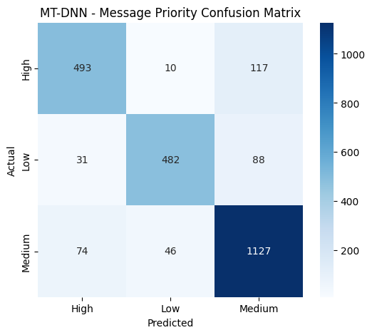
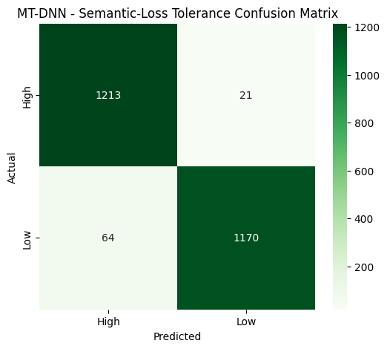
UAV EMERGENCY COMMUNICATION
Actual Confusion Matrices from the Notebook
Message Priority (High / Medium / Low)
Semantic-Loss Tolerance (High / Low)
MT-DNN • Software-based machine learning experiment
17 / 20

Slide 18
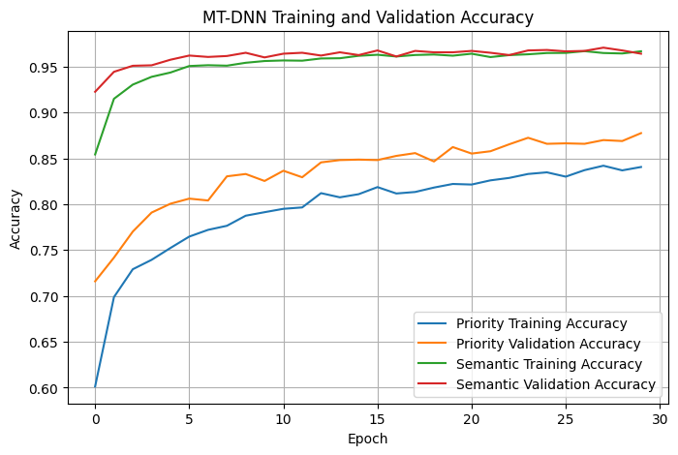
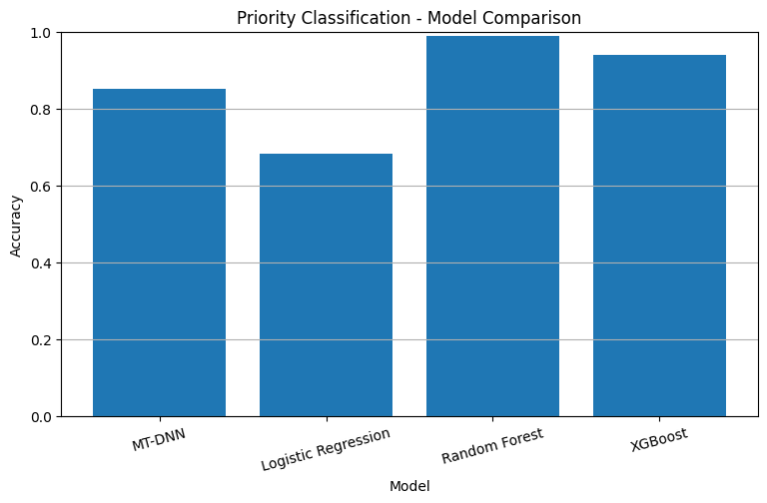
UAV EMERGENCY COMMUNICATION
Actual Training and Model Comparison Graphs
Training and Validation Accuracy
Priority Classification: Model Comparison
The graphs above are inserted directly from the saved notebook outputs.
MT-DNN • Software-based machine learning experiment
18 / 20

Slide 19
UAV EMERGENCY COMMUNICATION
Limitations and Future Work
Current limitations
Future work
• Labels are created using fixed data-based rules.
• Actual emergency-message text is not analysed.
• Predictions are not connected to a live UAV network.
• The baseline comparison shown is for priority accuracy.
• Test more dataset scenarios.
• Improve and validate label rules.
• Study performance across more models and metrics.
• Test whether predictions can support resource-allocation decisions.
Possible benefits are future goals; they are not yet measured outcomes of this experiment.
MT-DNN • Software-based machine learning experiment
19 / 20

Slide 20
Thank You
Questions?
Multi-Task Deep Neural Network for UAV Emergency Communication
Software-based machine learning experiment

