Slide 1
INSTRUCTIONS
Use Font size 22 to 28 and Font Style Times New Roman (body)
Do not change the Template: Heading / Title of the slides
Do not change font style or colours
Do not copy paste paragraphs: use only Bullet Points
Maximum slide Limit is 20 only
As per the number of supervisor allotted adopt slide-2 or slide-3
Please display the required meaningful Content or images or tables
Change the footer accordingly using insert tab then click on header & footer tab and edit it
Save the PPT with Register No, Dept and Review no, example: 23xxxxxxxxx_CSE

Slide 2

Title : Smart Resume Analysis System Tool
Student Name : Thunga Sree Chandana
Student ID: 2520040030
Cluster:2
Section:6
Under the Guidance
of
Supervisor Name : Ms. N. M. Deepika
Assistant Professor
Department of CSE

Slide 3
OUTLINE
Abstract
Existing System
Proposed System
System Architecture
Project Modules
Objectives
Co’s Attainments - FWD
Co1
Co2 …….. 5. Co5
Co’s Attainments - DSA
Co1
Co2 …….. 5. Co5
Screen Shots for FWD & DSA
Conclusion
Geo-Tagged Photos

Slide 4
Abstract
The Smart Resume Analysis System Tool is a web-based application designed to analyze resumes efficiently for recruitment purposes. The system evaluates resumes based on important factors such as education, work experience, technical skills, and certifications. Each factor is assigned a specific weight to calculate an overall score for the candidate. After the analysis, the system generates results that highlight the candidate’s strengths and areas for improvement. This helps recruiters quickly screen resumes and identify suitable candidates. The system also assists job seekers in understanding how their resume matches job requirements, providing a faster, smarter, and more effective approach to the recruitment process.

Slide 5
Existing System
Currently, most resume evaluation processes are done manually by recruiters or through basic online resume checkers. Job seekers usually rely on general resume templates or advice from websites to improve their resumes.
In many cases, users must manually compare their resumes with job requirements to understand whether they meet the expectations of employers.
Existing systems have several limitations:
Limited Resume Analysis: Many online tools provide only basic keyword checking and do not give detailed feedback.

Slide 6
Lack of Personalization: Most systems do not consider the user's skills, experience, and certifications together while analyzing resumes.
No ATS Score Insight: Many job seekers do not know how their resumes perform in Applicant Tracking Systems (ATS) used by companies.
Lack of Interview Guidance: Existing resume tools rarely provide interview preparation topics based on user skills.
Low User Interaction: Some resume evaluation tools have complex interfaces or limited features, making them less engaging for users.

Slide 7
Proposed System
The proposed system is a web-based Smart Resume Analysis System Tool that helps users evaluate their resumes and understand their job readiness. The system allows users to upload their resume and enter details such as skills, experience, and certifications.
The system analyzes the provided information and generates an ATS score, match level, and improvement suggestions. It also provides interview preparation topics based on the selected skills.
This system makes the process of resume evaluation faster, easier, and more effective, helping job seekers improve their resumes and increase their chances of getting selected for jobs.

Slide 8
Proposed System
It includes features such as:
Resume upload and analysis
ATS score calculation
Skills, experience, and certification evaluation
Resume improvement suggestions
Job readiness and match level detection
Interview preparation topic suggestions

Slide 9
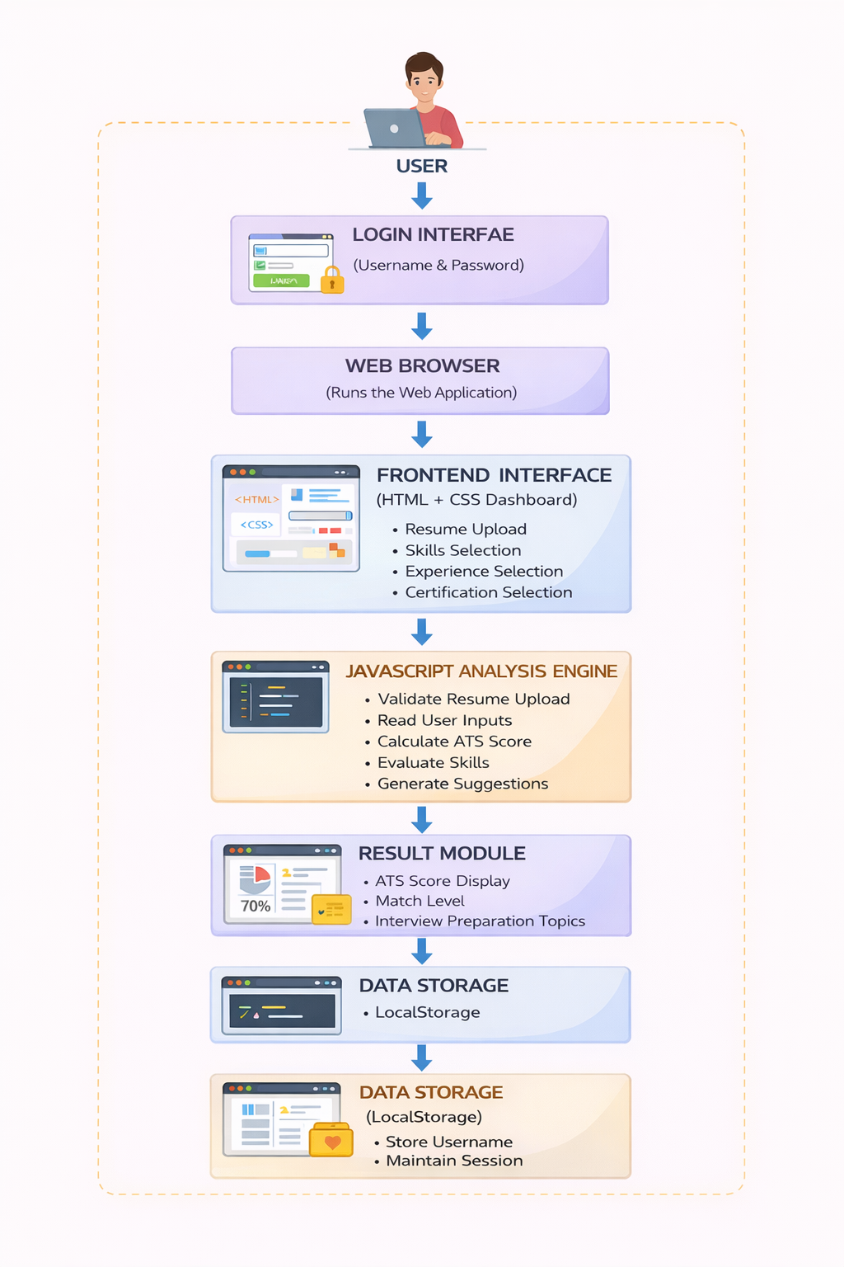
System Architecture

Slide 10
Project Modules
User Login Module Allows users to log in using username and password to access the system.
Resume Upload Module Enables users to upload their resume for analysis.
Profile Input Module Users enter skills, experience, and certifications.
Resume Analysis Module The system analyzes the resume and calculates the ATS score.
Result Module Displays ATS score, match level, and improvement suggestions.
Data Storage Module Stores user session data using LocalStorage.

Slide 11
Objectives
To develop a web-based system that helps users analyze their resumes easily.
To evaluate resumes using an ATS-based scoring system.
To identify missing skills and provide improvement suggestions.
To help users understand their job readiness level.
To provide interview preparation topics based on selected skills.
To create a simple and user-friendly interface for resume evaluation.

Slide 12
Co’s Attainments - FWD
1. CO1 – Web Fundamentals
2. CO2 – HTML Forms & Semantic Content 3. CO3 – CSS Layouts & Styling 4. CO4 – JavaScript Programming Fundamentals 5. CO5 – JavaScript Interactivity & Web Deployment

Slide 13
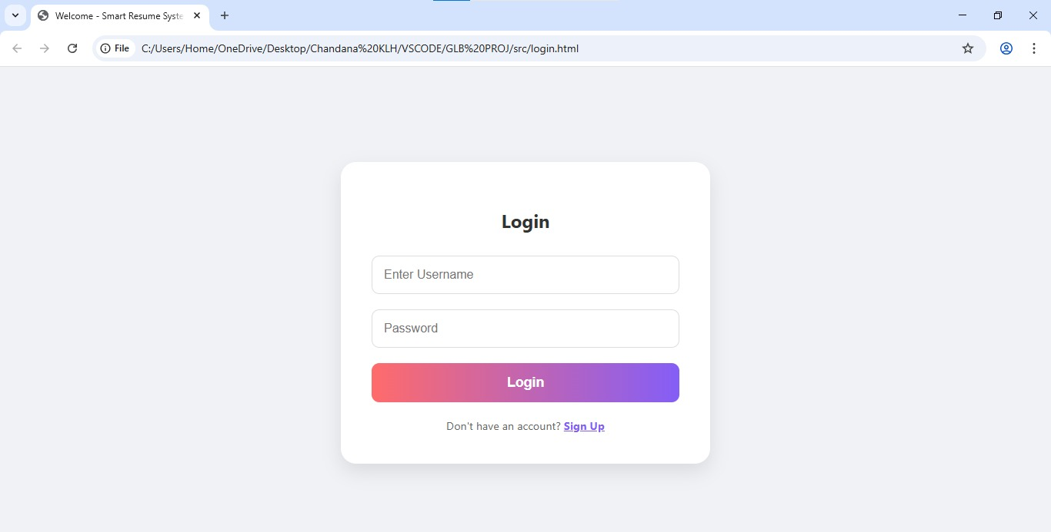
Screenshots for FWD & DSA

Slide 14
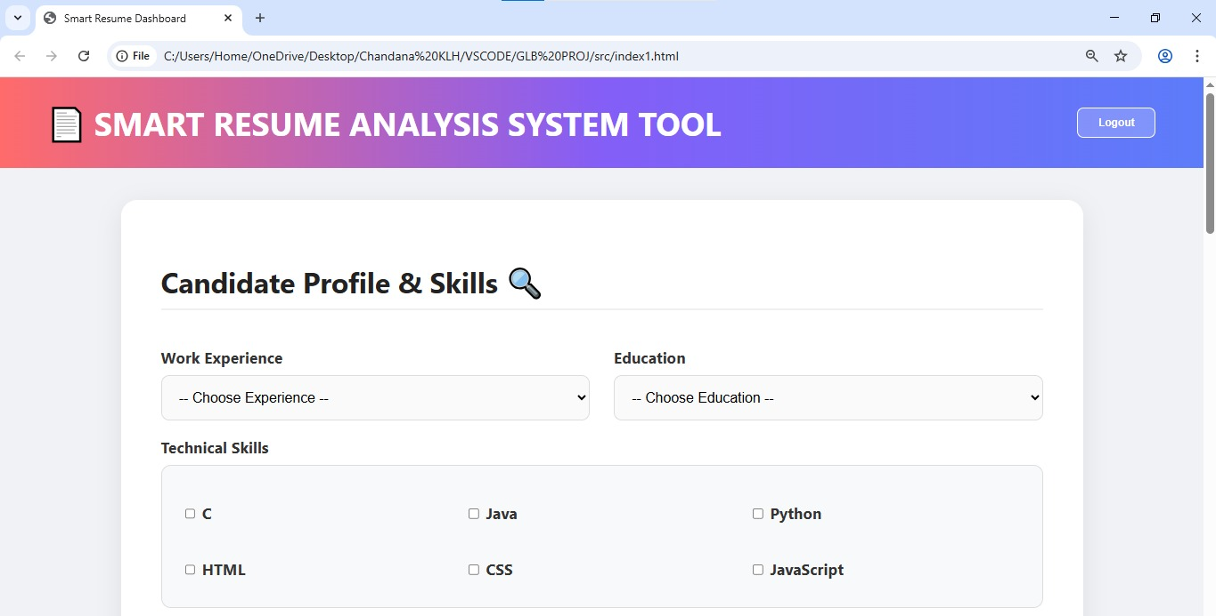
Screenshots for FWD & DSA

Slide 15
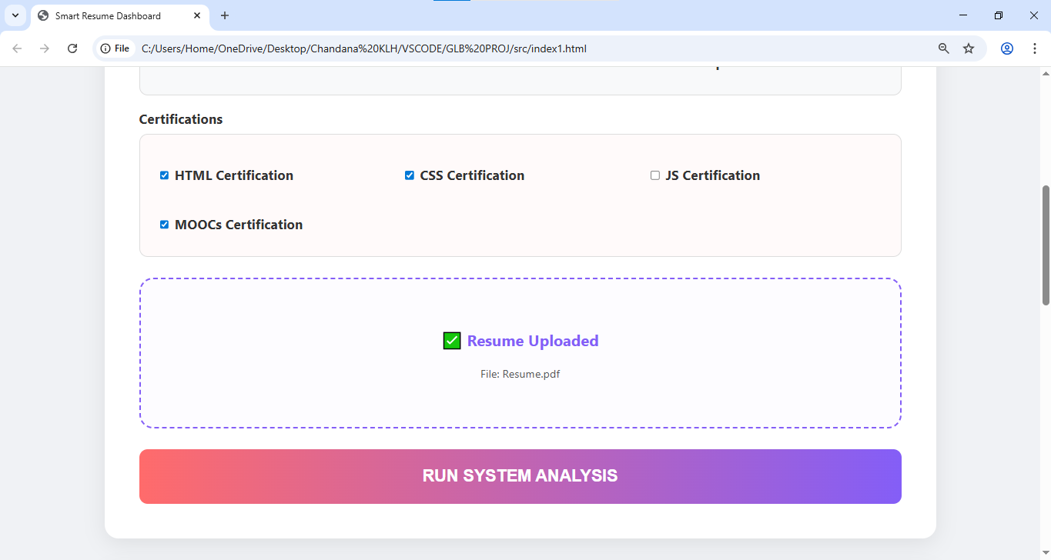
Screenshots for FWD & DSA

Slide 16
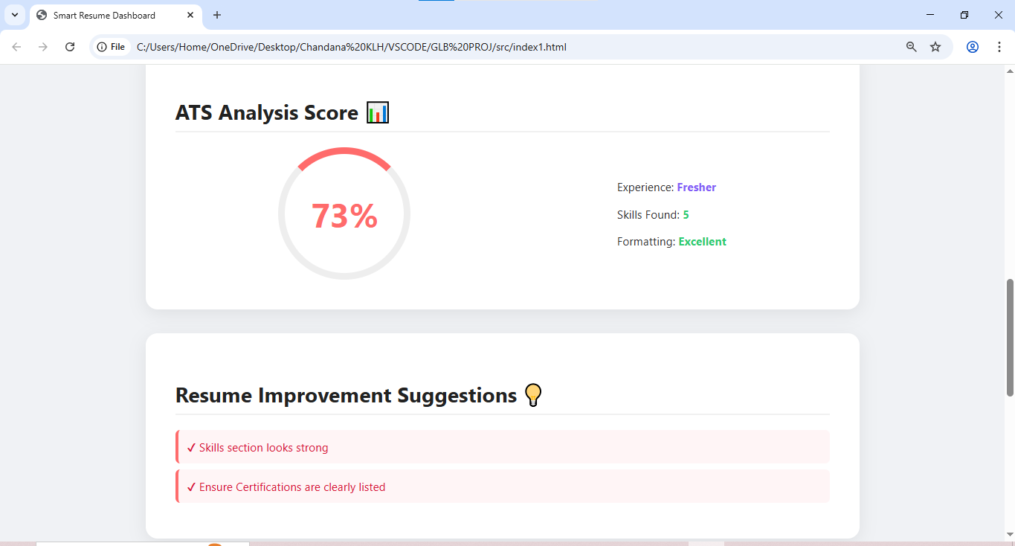
Screenshots for FWD & DSA

Slide 17
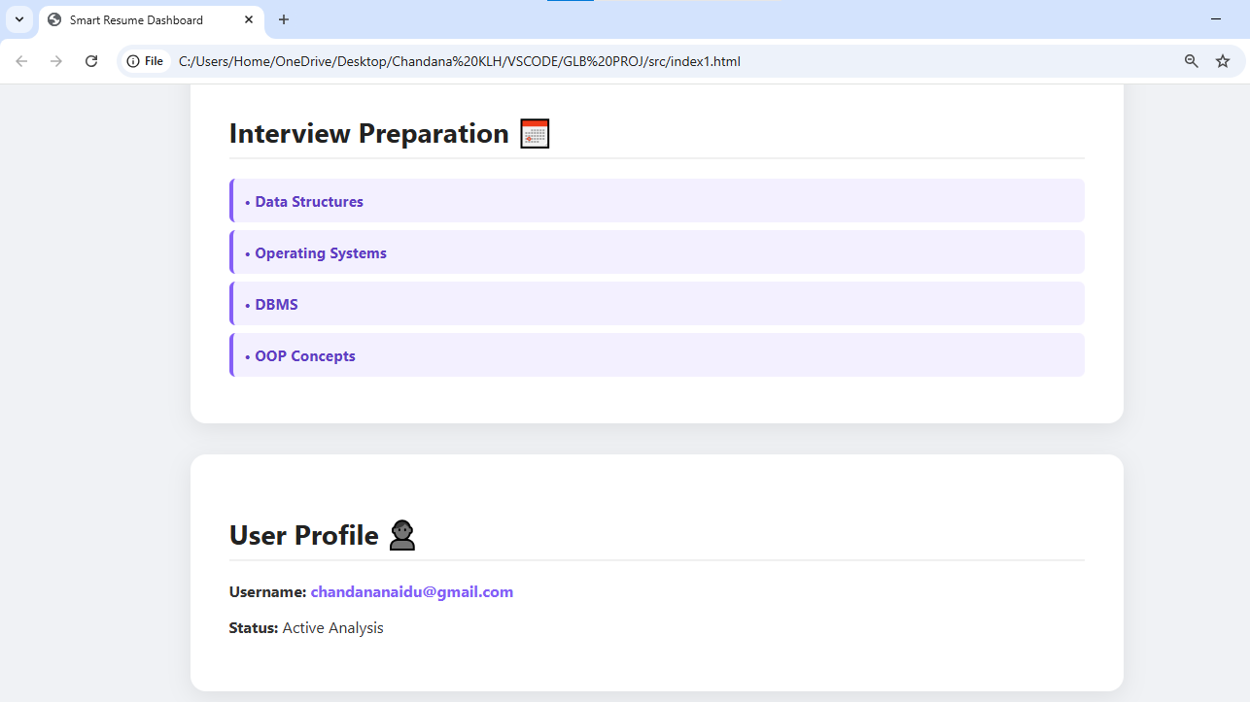
Screenshots for FWD & DSA

Slide 18
Conclusion
The Smart Resume Analysis System Tool is designed to help job seekers evaluate and improve their resumes effectively. The system analyzes user inputs such as skills, experience, and certifications to generate an ATS score and useful suggestions.
By providing resume evaluation and interview preparation topics, the system helps users understand their job readiness and improve their chances of getting selected. Overall, the tool offers a simple, fast, and user-friendly solution for resume analysis and career preparation.

Slide 19
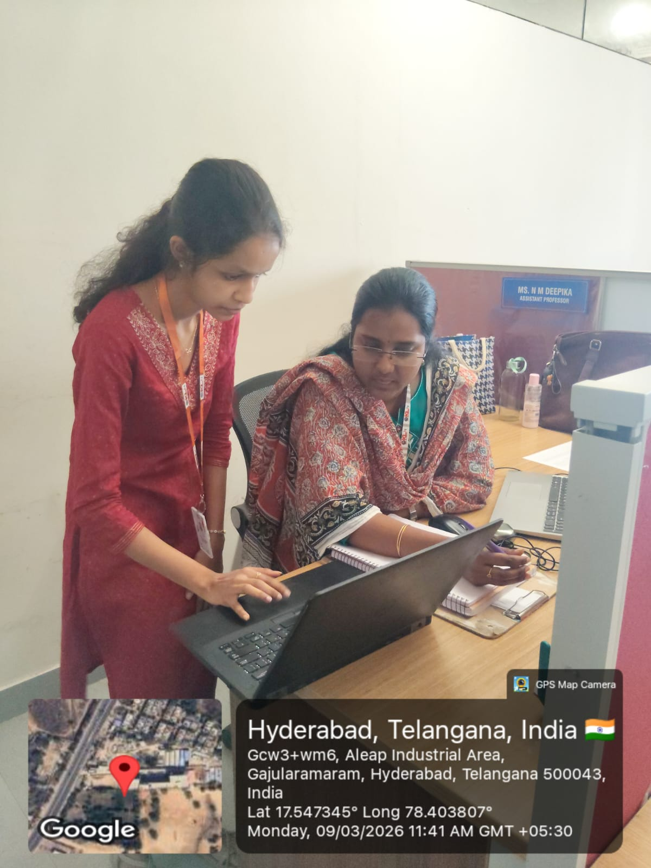
Geo- Tag Photo

Slide 20
THANK YOU

