Slide 1


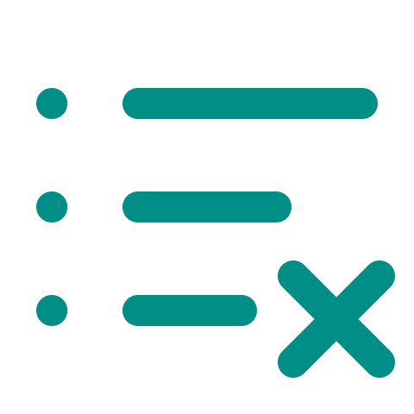
QA TEST PLANNING SKILLS
Why QA Test Planning Skills?
Three challenges when starting a new feature
Incomplete
Slow UI
Missed Test
Requirements
Exploration
Cases
OUR GOAL • Clear, reviewable test cases backed by real UI evidence
01 / 05

Slide 2
QA TEST PLANNING SKILLS
Three ways to start — one command
Start from the UI, from a document, or from both.
A
URL ONLY
qa-gather-test-requirements <app-url> <feature>
Explore the live UI and collect evidence.
B
DOCUMENT + URL
qa-gather-test-requirements <requirements-file.md> <app-url> <feature>
Compare requirements with observed UI behavior to find business rules and differences.
C
DOCUMENT ONLY
qa-gather-test-requirements <requirements-file.md> <feature>
Review requirements early; find missing tests and unclear details.
02 / 05

Slide 3


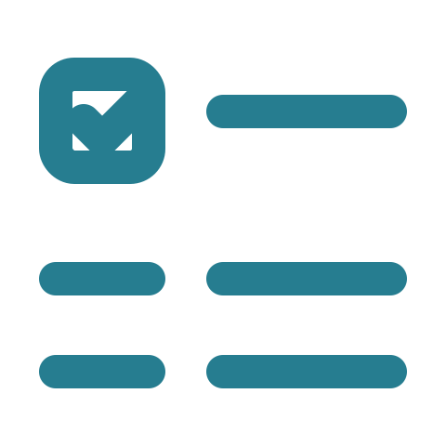


QA TEST PLANNING SKILLS
Four-Step Workflow
When a URL is provided: Explore UI → Evidence Gate → Requirements → Plan → Cases
1 STEP = 1 SKILL
1
Explore UI
2
Requirements
3
Test Plan
4
Test Cases
qa-explore-real-ui
qa-gather-test-requirements
qa-generate-test-plan
qa-generate-testcases
Check UI evidence
PASS → Save evidence and continue
Evidence Gate · automatic
Explore UI and Evidence Gate run only when a URL is provided.
FAIL → Re-explore UI
Without a URL: Start from requirements → Test plan → Proposed test cases
03 / 05

Slide 4
QA TEST PLANNING SKILLS
Three input modes — comparison of results
Three ways to prepare test cases, depending on what is available.
36 cases
41 cases
27 cases
URL ONLY
DOCUMENT + URL
DOCUMENT ONLY
Observed UI evidence
UI + documented rules
Document only · pre-UI
AREA
URL ONLY
DOCUMENT + URL
DOCUMENT ONLY
Basis
Real UI
UI + document
Provided document
Coverage
Main UI workflows
Main workflows + rules
Core cases; filter, sort and reset still missing
Verification
Observed in UI
Mixed UI & document
Not yet checked on the real UI
IN SHORT • Use a document to plan early. When the UI is ready, check the test cases on the real website.
04/ 05

Slide 5



QA TEST PLANNING SKILLS
Ready to Try It?
Start with a feature from your project.
Choose
Run
Review
Your feature
The skills
With your team
Let's improve the skills together.
Thank you! · Questions & Feedback Welcome

