Slide 1



QA TEST PLANNING SKILLS
Why does our team need QA Test Planning Skills?
How do we turn a new feature into clear, reviewable test cases?
From a URL or requirements document to test cases backed by UI evidence.
01
Missing details
02
Time-consuming exploration
03
Missed test scenarios
Requirements and expected behavior may be unclear.
Checking screens, flows, and validations takes time.
Different people may miss different cases.
OUR GOAL Clear test cases based on evidence — ready for team review.
01 / 08
Notes:
Hello everyone. Today, I'd like to introduce our QA Test Planning Skills.
When working on a new feature, we often face three challenges.
First, incomplete requirements. Sometimes, we don't have enough information about the feature.
Second, UI exploration takes time. We need to explore the UI to understand how it works.
Third, missing test cases. It's easy to miss some important scenarios.
That's why we built these skills — to help our team understand features and create test cases in a more consistent way.
Now, let's look at two ways to use them.

Slide 2
QA TEST PLANNING SKILLS
Two ways to start — one command
Choose the input you have. Both options follow the same workflow.
CASE A · URL ONLY
qa-gather-test-requirements <app-url> <feature>
Explores the real UI, checks validations, and collects evidence.
CASE B · DOCUMENT + URL
qa-gather-test-requirements <requirements-file.md> <app-url> <feature>
Compares the document with the real UI to find business rules and differences.
02 / 08
Notes:
We have two options.
Option A: URL only.
We provide a URL, a feature name, and login information if needed.
The skills explore the real UI and collect evidence.
Option B: Document and URL.
We provide the same information, plus a requirements document.
The skills use both the document and the real UI to find business rules and any differences between them.
Both options create test cases for the team to review.
Now, let's look at how the skills work.

Slide 3




QA TEST PLANNING SKILLS
Four-Step Workflow
Explore UI → Verify evidence → Analyze → Plan → Generate test cases.
1 STEP = 1 SKILL
1
Explore UI
2
Requirements
3
Test Plan
4
Test Cases
qa-explore-real-ui
qa-gather-test-requirements
qa-generate-test-plan
qa-generate-testcases
Check UI evidence
PASS → Save evidence and continue
Evidence Gate · automatic
Later steps check the saved evidence again before using it.
FAIL → Re-explore UI
Outputs: UI evidence → Requirements analysis → Test plan → Test cases
03 / 08
Notes:
Now, let's look at how the skills work.
As you can see, there are four main steps. Each step is handled by a different skill.
First, the skills explore the real UI and collect evidence, such as screenshots.
The Evidence Gate then checks the saved evidence.
If the check fails, the skills explore the UI again. If it passes, they continue to analyze the requirements, create a test plan, and generate test cases.
After each phase, we can review the results and type "next" to continue.

Slide 4

QA TEST PLANNING SKILLS
Demo A — Start with a URL only
Real command used for OrangeHRM / Recruitment → Vacancies.
qa-gather-test-requirements https://opensource-demo.orangehrmlive.com/web/index.php/auth/login Vacancies with Username : Admin, Password : admin123
Saved run — URL only
Explore UI → Review output → Type “next”
04 / 08
Notes:
Now, let's move to VS Code and look at the completed runs.
Here are the four skills we just discussed.
Each skill has its own instructions and supporting files.
And here is the Evidence Gate script.
Now, let's look at the two runs.
This is Option A, using only a URL.
And this is Option B, with a requirements document.
I've already completed both runs to save time.
Here, you can see how I typed "next" to move through the phases.
Here are the four output files.
We have UI evidence, requirements analysis, a test plan, and test cases.
Each file uses information from the previous step.
This helps us create test cases based on real UI evidence and requirements.
Let me show you one example.
Here, the document says that attachment files must be no larger than one megabyte.
And here, the skills created two test cases: one for a file over the limit, and one for a file exactly at the limit.
So, we can see how a requirement becomes test cases that the team can review.
We can also use the final test cases as input for Phase 2 to generate automation scripts, as Ngoc shared in our previous meeting.
Now, let's go back to the slides and compare the results.

Slide 5
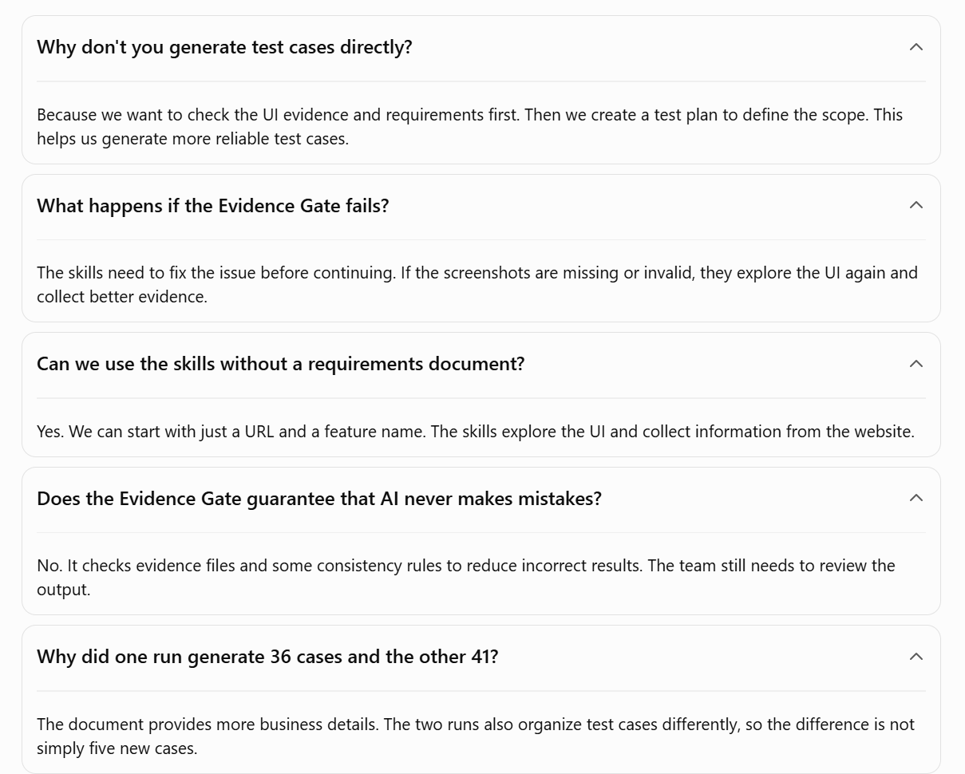

Slide 6
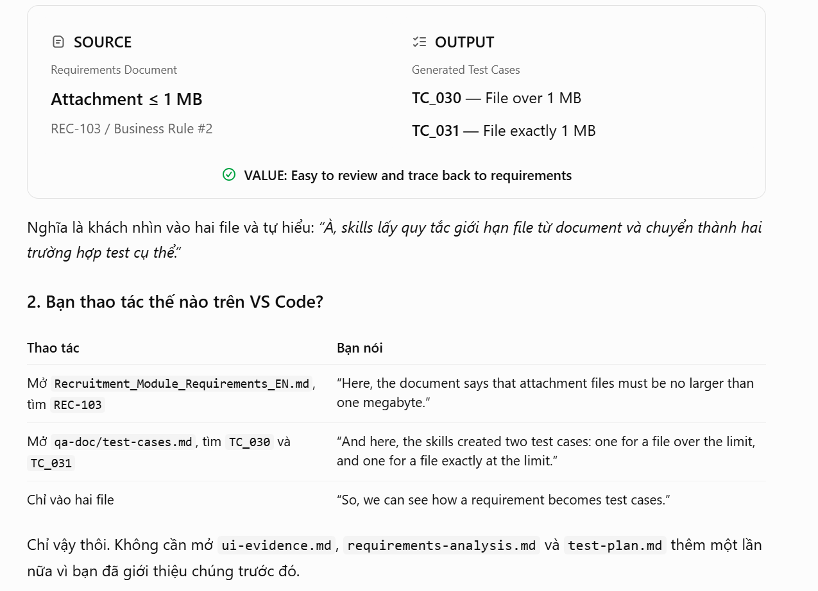

Slide 7

QA TEST PLANNING SKILLS
Demo B — Add a document for the same feature
Same URL and Vacancies feature. We only add Recruitment_Module_Requirements.md.
qa-gather-test-requirements "C:\Desktop\Recruitment_Module_Requirements.md" https://opensource-demo.orangehrmlive.com/web/index.php/auth/login Vacancies with Username : Admin, Password : admin123
What the document adds
Compare rules with the real UI
Highlight differences and open questions
05 / 08

Slide 8
QA TEST PLANNING SKILLS
Four output files — from UI evidence to test cases
Four reviewable files. The final test cases support Phase 2.
ui-evidence.md
Observed UI behavior
requirements-analysis.md
Requirements & gaps
test-plan.md
Test scope & priority
test-cases.md
Steps & expected results
Evidence: screenshots + manifest.json
PHASE 1 test-cases.md → PHASE 2 Generate automation test scripts
06 / 08

Slide 9
QA TEST PLANNING SKILLS
Two demo runs — comparison of results
Based on the generated test-cases.md files. The difference is what the cases cover, not only how many.
36 cases
URL only
41 cases
Document + URL
AREA
URL ONLY
DOCUMENT + URL
Main workflows
Covered
Covered
UI validation
Discovered from UI
Compared with document
Business rules
Based on observed behavior
More detailed rules from document
KEY TAKEAWAY • The document adds business context, not just more test cases.
07 / 08
Notes:
Now, let's compare the two runs.
With URL only, we got 36 test cases.
With Document and URL, we got 41 test cases.
Both cover the main workflows.
The URL-only run found useful UI details.
With the document, we also got more detailed test cases based on business rules.
So, the main difference is not just the number of test cases, but what they cover.

Slide 10



QA TEST PLANNING SKILLS
Ready to Try It?
Start with a feature from your project.
Choose
Run
Review
Your feature
The skills
With your team
Let's improve the skills together.
Thank you! · Questions & Feedback Welcome
Notes:
That's all for today's demo.
I hope you find these skills useful.
I'd be happy to hear your feedback so we can improve them together.
Thank you! Any questions?
Q&A — Where can we find these skills?
I'll create a separate branch and open a pull request so the team can review and try them.
After collecting feedback, we can make improvements before merging.

