Slide 1
Computer Architecture
Lab 1: MIPS Assembly 1

Slide 2
Getting Started
Open a web browser and go to https://dannyqiu.me/mips-interpreter/

Slide 3
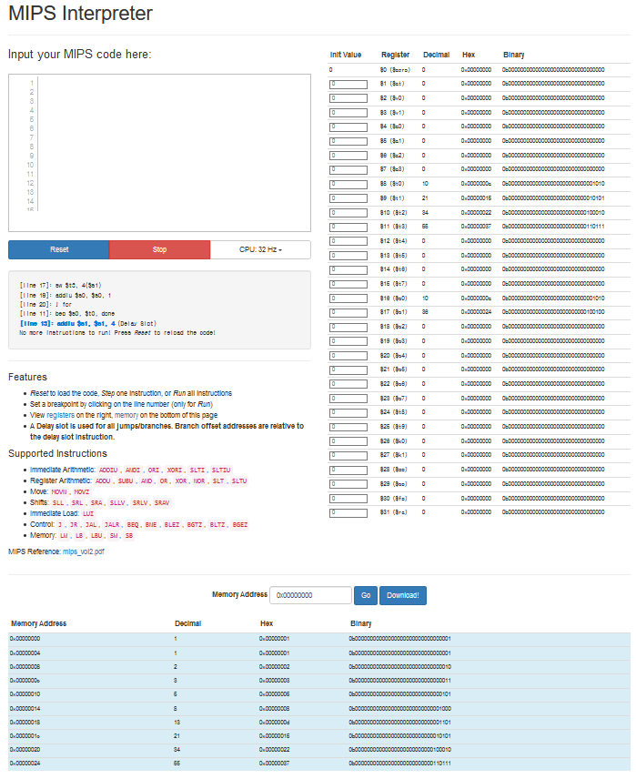

Slide 4
Lab 1-1
Copy and paste the code on the right to the code area.
Note
Add “nop” instruction after every jump/branch instruction (delay slot)
Click “Reset”
Click “Step” and observe the changes of the registers
main:
addiu $s0, $0, 0
addiu $t0, $0, 10
for:
beq $s0, $t0, done
nop
addiu $s0, $s0, 1
j for
nop
done:

Slide 5
Lab 1-2
Translate the following C code to MIPS assembly code. The base address of the array is 0x0001f000.
int array[10];
int i;
for (i=0; i < 10; i = i + 1)
array[i] = array[i] + 8;

Slide 6
Lab 1-2 (cont’d)
# $s0 = array base address, $s1 = i
# initialization code
lui $s0, 0x0001 # $s0 = 0x00010000
ori $s0, $s0, 0xF000 # $s0 = 0x0001F000
addiu $s1, $0, 0 # i = 0
addiu $t2, $0, 10 # $t2 = 10
loop:
slt $t0, $s1, $t2 # i < 10?
beq $t0, $0, done # if not then done
nop # delay slot
sll $t0, $s1, 2 # $t0 = i * 4 (byte offset)
addu $t0, $t0, $s0 # address of array[i]
lw $t1, 0($t0) # $t1 = array[i]
addiu $t1, $t1, 8 # $t1 = array[i] + 8
sw $t1, 0($t0) # array[i] = array[i] + 8
addiu $s1, $s1, 1 # i = i + 1
j loop # repeat
nop # delay slot
done:

Slide 7
Lab Assignment
Translate the following C code to MIPS assembly code. The base address of the array is 0x0001f000.
int array[10];
int i;
for (i=0; i < 10; i = i + 1)
if(i<5) array[i] = i;
else array[i] = 10 - i;

Slide 8
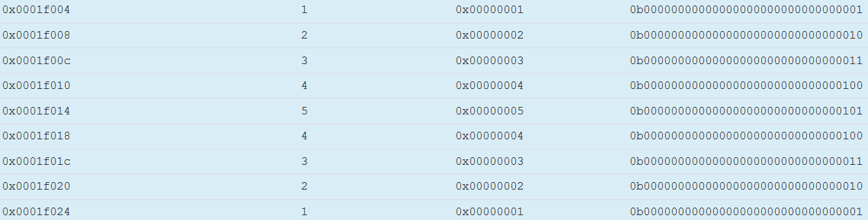
Expected Results

