Slide 1
Computer Architecture
Lab 10: Pipeline

Slide 2
Getting Started
Download alu.sv, regfile.sv, imem.sv, dmem.sv and controller.sv from Blackboard
Open a web browser and go to https://www.edaplayground.com/

Slide 3
Single-Cycle & Pipelined Datapath

Slide 4
Pipelining Sample
logic [31:0] IMEM_InstF;
logic [31:0] IMEM_InstD;
imem IMEM(
.iAddr (pc),
.oRdata (IMEM_InstF)
);
always_ff@(posedge iClk, posedge iReset)
if(iReset) begin
IMEM_InstD <= 0;
end else begin
IMEM_InstD <= IMEM_InstF;
end
assign RtD = IMEM_InstD[20:16];
assign RdD = IMEM_InstD[15:11];

Slide 5
Pipelined Processor Control
Same control unit as single-cycle processor
Control delayed to proper pipeline stage

Slide 6
Testbench
Copy the following testbench code to “testbench.sv” on the left
module testbench_mips();
logic clk;
logic reset;
mips dut(
.iClk (clk),
.iReset (reset)
);
always
begin
clk = 1; #5; clk = 0; #5;
end
initial begin
$dumpfile("dump.vcd"); $dumpvars;
reset = 0; #21;
reset = 1; #10;
reset = 0; #50;
#10; $stop;
end
endmodule

Slide 7
Datapath
Copy the following code to “design.sv” on the right
`include "alu.sv"
`include "regfile.sv"
`include "imem.sv"
`include "dmem.sv"
`include "controller.sv"
module mips(
input logic iClk,
input logic iReset
);
logic [31:0] ALU_ALUResult;
logic [31:0] REG_SrcA;
logic [31:0] REG_WriteData;
logic [31:0] IMEM_InstF;
logic [31:0] IMEM_InstD;
logic [31:0] DMEM_ReadData;
logic [31:0] pc;
logic [4:0] WriteReg;
logic [31:0] SrcB;
logic [31:0] Result;
logic [31:0] SignImm;
logic [4:0] Rt;
logic [4:0] Rd;
logic CTL_RegWrite;
logic CTL_MemWrite;
logic CTL_RegDst;
logic CTL_ALUSrc;
logic CTL_MemtoReg;
logic [2:0] CTL_ALUControl;
assign Rt = IMEM_InstD[20:16];
assign Rd = IMEM_InstD[15:11];
assign WriteReg = CTL_RegDst ? Rd : Rt;
assign SignImm = {{16{IMEM_InstD[15]}}, IMEM_InstD[15:0]};
assign SrcB = CTL_ALUSrc ? SignImm : REG_WriteData;
assign Result = CTL_MemtoReg ? DMEM_ReadData : ALU_ALUResult;
alu ALU(
.iA (REG_SrcA),
.iB (SrcB),
.iF (CTL_ALUControl),
.oY (ALU_ALUResult),
.oZero ()
);
regfile REG(
.iClk (iClk),
.iReset (iReset),
.iRaddr1(IMEM_InstD[25:21]),
.iRaddr2(IMEM_InstD[20:16]),
.iWaddr (WriteReg),
.iWe (CTL_RegWrite),
.iWdata (Result),
.oRdata1(REG_SrcA),
.oRdata2(REG_WriteData)
);
imem IMEM(
.iAddr (pc),
.oRdata (IMEM_InstF)
);
dmem DMEM(
.iClk (iClk),
.iReset (iReset),
.iWe (CTL_MemWrite),
.iAddr (ALU_ALUResult),
.iWdata (REG_WriteData),
.oRdata (DMEM_ReadData)
);
controller CTL(
.iOp (IMEM_InstD[31:26]),
.iFunc (IMEM_InstD[5:0]),
.oRegWrite (CTL_RegWrite),
.oMemWrite (CTL_MemWrite),
.oRegDst (CTL_RegDst),
.oALUSrc (CTL_ALUSrc),
.oMemtoReg (CTL_MemtoReg),
.oALUControl(CTL_ALUControl)
);
always_ff@(posedge iClk, posedge iReset)
if(iReset)
pc <= 0;
else
pc <= pc + 4;
always_ff@(posedge iClk, posedge iReset)
if(iReset) begin
IMEM_InstD <= 0;
end else begin
IMEM_InstD <= IMEM_InstF;
end
endmodule

Slide 8
Building Blocks
Click “+” right after “design.sv”
Upload “alu.sv”
Upload regfile.sv, imem.sv, dmem.sv, and controller.sv in the same way

Slide 9
Lab Assignment
Finish the implementation of the datapath module
No need to consider hazards
Save and submit the link of your design to the Blackboard.

Slide 10
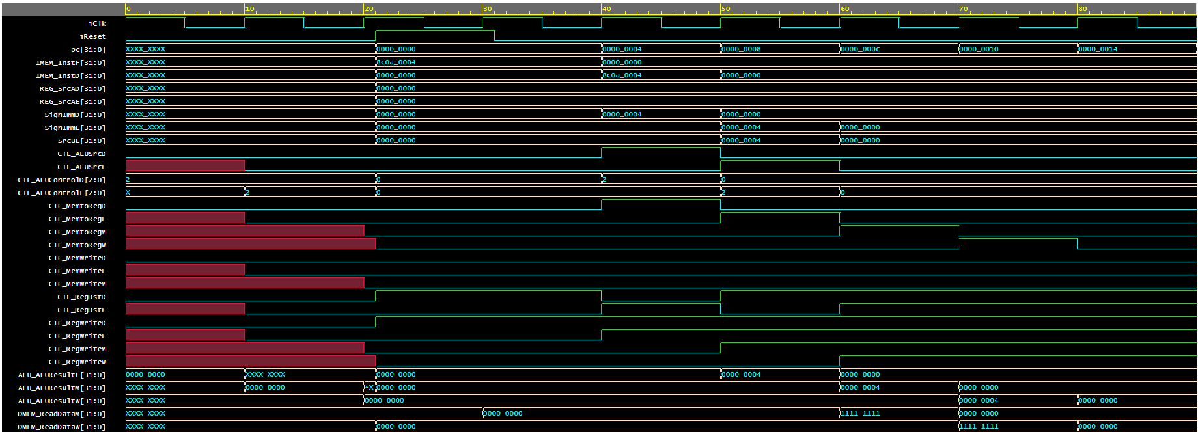
Expected Result

