Slide 1
Computer Architecture
Lab 4: Verilog Basics

Slide 2
Getting Started
Open a web browser and go to https://www.edaplayground.com/
Create an account with your university email

Slide 3
Always Statement
General Structure:
always @(sensitivity list)
statement;
Whenever the event in sensitivity list occurs, statement is executed

Slide 4
Combinational Logic using always
// combinational logic using an always statement
module gates(input logic [3:0] a, b,
output logic [3:0] y1, y2, y3, y4, y5);
always_comb // need begin/end because there is
begin // more than one statement in always
y1 = a & b; // AND
y2 = a | b; // OR
y3 = a ^ b; // XOR
y4 = ~(a & b); // NAND
y5 = ~(a | b); // NOR
end
endmodule
This hardware could be described with assign statements using fewer lines of code, so it’s better to use assign statements in this case.

Slide 5
Other Behavioral Statements
Statements that must be inside always statements:
if / else
case, casez
// combinational logic using an always statement
module mux(input logic a, b, s
output logic y);
always_comb // always @ (a, b, s) in Verilog
if(s)
y = a;
else
y = b;
endmodule

Slide 6
Combinational Logic using case
module sevenseg(input logic [3:0] data,
output logic [6:0] segments);
always_comb
case (data)
// abc_defg
0: segments = 7'b111_1110;
1: segments = 7'b011_0000;
2: segments = 7'b110_1101;
3: segments = 7'b111_1001;
4: segments = 7'b011_0011;
5: segments = 7'b101_1011;
6: segments = 7'b101_1111;
7: segments = 7'b111_0000;
8: segments = 7'b111_1111;
9: segments = 7'b111_0011;
default: segments = 7'b000_0000; // required
endcase
endmodule

Slide 7
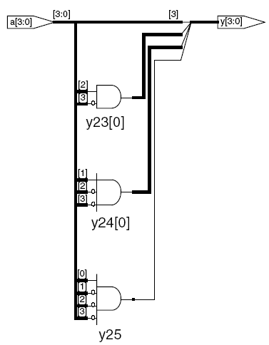
Combinational Logic using casez
module priority_casez(input logic [3:0] a,
output logic [3:0] y);
always_comb
casez(a)
4'b1???: y = 4'b1000; // ? = don’t care
4'b01??: y = 4'b0100;
4'b001?: y = 4'b0010;
4'b0001: y = 4'b0001;
default: y = 4'b0000;
endcase
endmodule

Slide 8
Resettable D Flip-Flop
module flopr(input logic clk,
input logic reset,
input logic [3:0] d,
output logic [3:0] q);
// synchronous reset
always_ff @(posedge clk)
if (reset) q <= 4'b0;
else q <= d;
endmodule

Slide 9
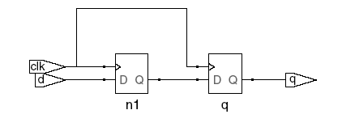

Blocking vs. Nonblocking Assignment
<= is nonblocking assignment
Occurs simultaneously with others
= is blocking assignment
Occurs in order it appears in file
// Good synchronizer using
// nonblocking assignments
module syncgood(input logic clk,
input logic d,
output logic q);
logic n1;
always_ff @(posedge clk)
begin
n1 <= d; // nonblocking
q <= n1; // nonblocking
end
endmodule
// Bad synchronizer using
// blocking assignments
module syncbad(input logic clk,
input logic d,
output logic q);
logic n1;
always_ff @(posedge clk)
begin
n1 = d; // blocking
q = n1; // blocking
end
endmodule

Slide 10
Rules for Signal Assignment
Synchronous sequential logic: use always_ff @(posedge clk) and nonblocking assignments (<=)
always_ff @ (posedge clk)
q <= d; // nonblocking
Simple combinational logic: use continuous assignments (assign…)
assign y = a & b;
More complicated combinational logic: use always_comb and blocking assignments (=)
Assign a signal in only one always statement or continuous assignment statement.

Slide 11
Finite State Machines (FSMs)
Three blocks:
next state logic
state register
output logic

Slide 12
FSM Example: Divide by 3
The double circle indicates the reset state

Slide 13
FSM in SystemVerilog
module divideby3FSM (input logic clk,
input logic reset,
output logic q);
typedef enum logic [1:0] {S0, S1, S2} statetype;
statetype [1:0] state, nextstate;
// state register
always_ff @ (posedge clk, posedge reset)
if (reset) state <= S0;
else state <= nextstate;
// next state logic
always_comb
case (state)
S0: nextstate = S1;
S1: nextstate = S2;
S2: nextstate = S0;
default: nextstate = S0;
endcase
// output logic
assign q = (state == S0);
endmodule

Slide 14
Lab 4
Copy and paste the following code to the left top window (testbench.sv)
module testbench4();
logic [3:0] in;
logic [1:0] out;
// instantiate device under test
priority_casez dut(in, out);
initial begin
$dumpfile("dump.vcd"); $dumpvars;
in = 4'b1101; #20;
in = 4'b0111; #20;
in = 4'b0010; #20;
in = 4'b0001; #20;
in = 4'b0000; #20;
end
endmodule

Slide 15
Lab 4 – cont’d
Copy and paste the following code to the right top window (design.sv)
module priority_casez(input [3:0] a,
output reg [1:0] y);
always @(a)
casez(a)
4'b1???: y = 2'b11; // ? = don’t care
4'b01??: y = 2'b10;
4'b001?: y = 2'b01;
4'b0001: y = 2'b00;
default: y = 2'b00;
endcase
endmodule

Slide 16
Lab 4 – cont’d
Select “Synopsys VCS 2021.09” in Tools & Simulators
Add “+vcs+finish+100” to Run Options
Check “Open EPWave after run”
Click “Run” on the top menu

Slide 17
Lab 4 – Expected Result

Slide 18

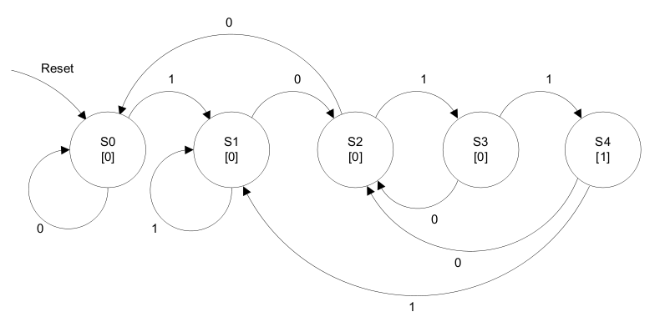
Lab Assignment
Write a SystemVerilog module that implements the following FSM, which is a 1011 pattern recognizer.
It has three inputs, clk, reset, and in and an one-bit output out.
Use the testbench given in the next slide.
Select “Synopsys VCS 2021.09” in Tools & Simulators
Check “Open EPWave after run”
Add “+vcs+finish+200” to Run Options
Run
Save and submit the link of your design to the Blackboard.
Click in the bottom window to copy the URL of your design.

Slide 19
Lab Assignment – cont’d
Copy and paste the following code to the left top window (testbench.sv)
module testbench();
logic clk, rst, in;
logic out;
// instantiate device under test
patterndet dut(clk, rst, in, out);
always // no sensitivity list, so it always executes
begin
clk = 1; #5; clk = 0; #5;
end
initial begin
$dumpfile("dump.vcd"); $dumpvars;
in = 0; rst = 1; #21; rst = 0; #10
in = 1; #30
in = 0; #40
in = 1; #10
in = 0; #10
in = 1; #40
in = 0;
end
endmodule

Slide 20
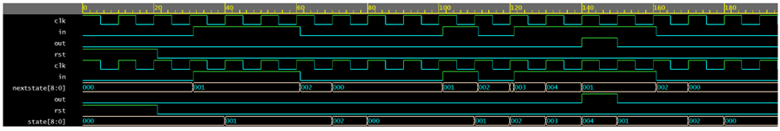
Expected Result

