Slide 1
Computer Architecture
Lab 8: sw

Slide 2
Getting Started
Download alu.sv, regfile.sv, imem.sv, dmem.sv and controller.sv from Blackboard
Open a web browser and go to https://www.edaplayground.com/

Slide 3
Single-Cycle Datapath: sw
Write data in rt to memory

Slide 4
Control Unit: Main Decoder
Instruction | Op_{5:0} | RegWrite | RegDst | AluSrc | Branch | MemWrite | MemtoReg | ALUOp_{1:0}
lw | 100011 | 1 | 0 | 1 | 0 | 0 | 1 | 00
sw | 101011 | 0 | X | 1 | 0 | 1 | X | 00

Slide 5
Testbench
Copy the following testbench code to “testbench.sv” on the left
module testbench_mips();
logic clk;
logic reset;
mips dut(
.iClk (clk),
.iReset (reset)
);
always
begin
clk = 1; #5; clk = 0; #5;
end
initial begin
$dumpfile("dump.vcd"); $dumpvars;
reset = 0; #21;
reset = 1; #10;
reset = 0; #20;
#10; $stop;
end
endmodule

Slide 6
Datapath
Copy the following code to “design.sv” on the right
`include "alu.sv"
`include "regfile.sv"
`include "imem.sv"
`include "dmem.sv"
`include "controller.sv"
module mips(
input logic iClk,
input logic iReset
);
logic [31:0] ALU_ALUResult;
logic [31:0] REG_SrcA;
logic [31:0] IMEM_Inst;
logic [31:0] DMEM_ReadData;
logic [31:0] pc;
logic CTL_RegWrite;
logic CTL_MemWrite;
logic [2:0] CTL_ALUControl;
alu ALU(
.iA (REG_SrcA),
.iB ({{16{IMEM_Inst[15]}}, IMEM_Inst[15:0]}),
.iF (CTL_ALUControl),
.oY (ALU_ALUResult),
.oZero ()
);
regfile REG(
.iClk (iClk),
.iReset (iReset),
.iRaddr1(IMEM_Inst[25:21]),
.iRaddr2(),
.iWaddr (IMEM_Inst[20:16]),
.iWe (CTL_RegWrite),
.iWdata (DMEM_ReadData),
.oRdata1(REG_SrcA),
.oRdata2()
);
imem IMEM(
.iAddr (pc),
.oRdata (IMEM_Inst)
);
dmem DMEM(
.iClk (iClk),
.iWe (CTL_MemWrite),
.iAddr (ALU_ALUResult),
.iWdata (),
.oRdata (DMEM_ReadData)
);
controller CTL(
.iOp (IMEM_Inst[31:26]),
.oRegWrite (CTL_RegWrite),
.oMemWrite (CTL_MemWrite),
.oALUControl(CTL_ALUControl)
);
always_ff@(posedge iClk, posedge iReset)
if(iReset)
pc <= 0;
else
pc <= pc + 4;
endmodule

Slide 7
Building Blocks
Click “+” right after “design.sv”
Upload “alu.sv”
Upload regfile.sv, imem.sv, dmem.sv, and controller.sv in the same way

Slide 8
Lab Assignment
Modify SystemVerilog modules to implement the sw instruction
Save and submit the link of your design to the Blackboard.

Slide 9
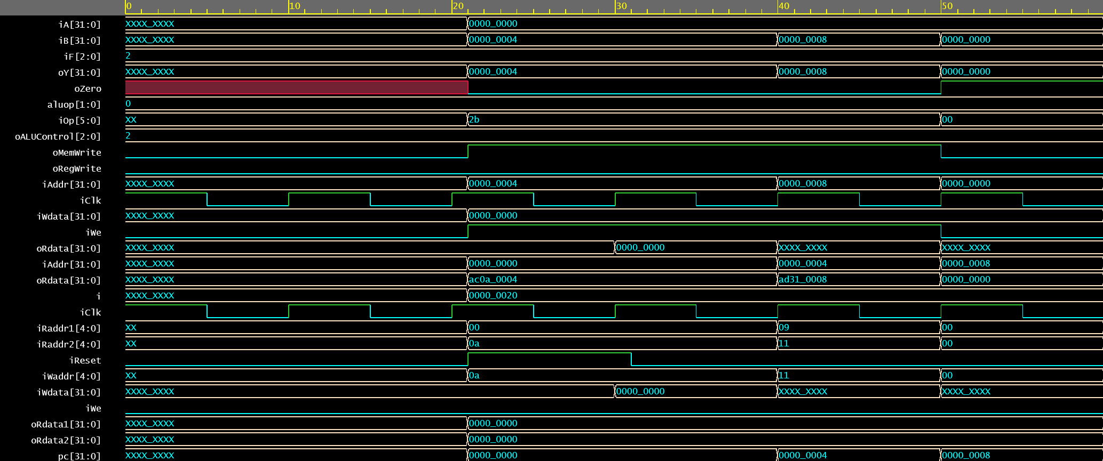
Expected Result

