Slide 1
Book Store
Web App
Web Project

Slide 2
eam Members
T
Nguyễn Trung Trực ITITIU19228 50%
Nguyễn Trung Trực ITITIU19228 50%
Lê Quốc Phong ITI1TIU19181 50%
Lê Quốc Phong ITI1TIU19181 50%

Slide 3
able of contents
01 - Introduction
02 - System Design
03 - Diagram
04 - Conclusion
T

Slide 4
0
1
Introduction
Online bookstores allow users to search for and purchase a book based on the title, author, and subject they're interested in.
Customers can create an account with name, age, address, email,... And log in to the bookstore with their username and password.

Slide 5
0
2
System Design

Slide 6
Functional Requirement
Online Book store is an online web application where the customer can purchase books online
Customers
Customers
Set up an account very quickly
Can search for a book by its title or author.
Add to the shopping cart
Purchase using credit card
Give feedback to a book by giving ratings on a score of five

Slide 7
Customers
A Home page with product catalog
Search & Advanced Search
User Feedback
Shopping Cart
Managing user accounts
Adminitrator
Add or delete a book category
Add or delete a member
Manage member orders

Slide 8
03
UML Diagram

Slide 9
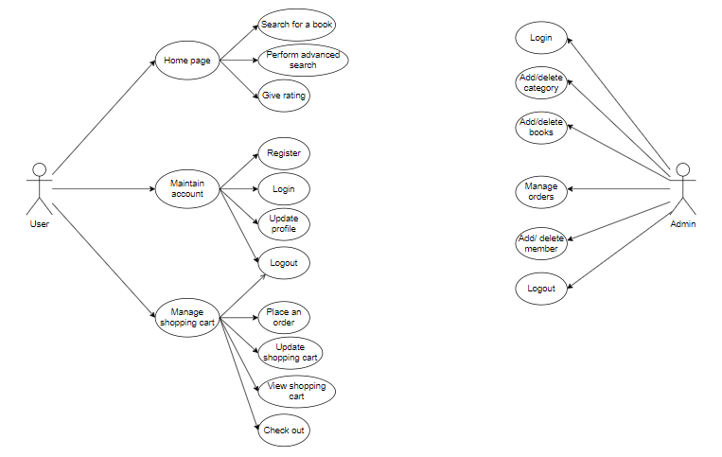
Use Case

Slide 10
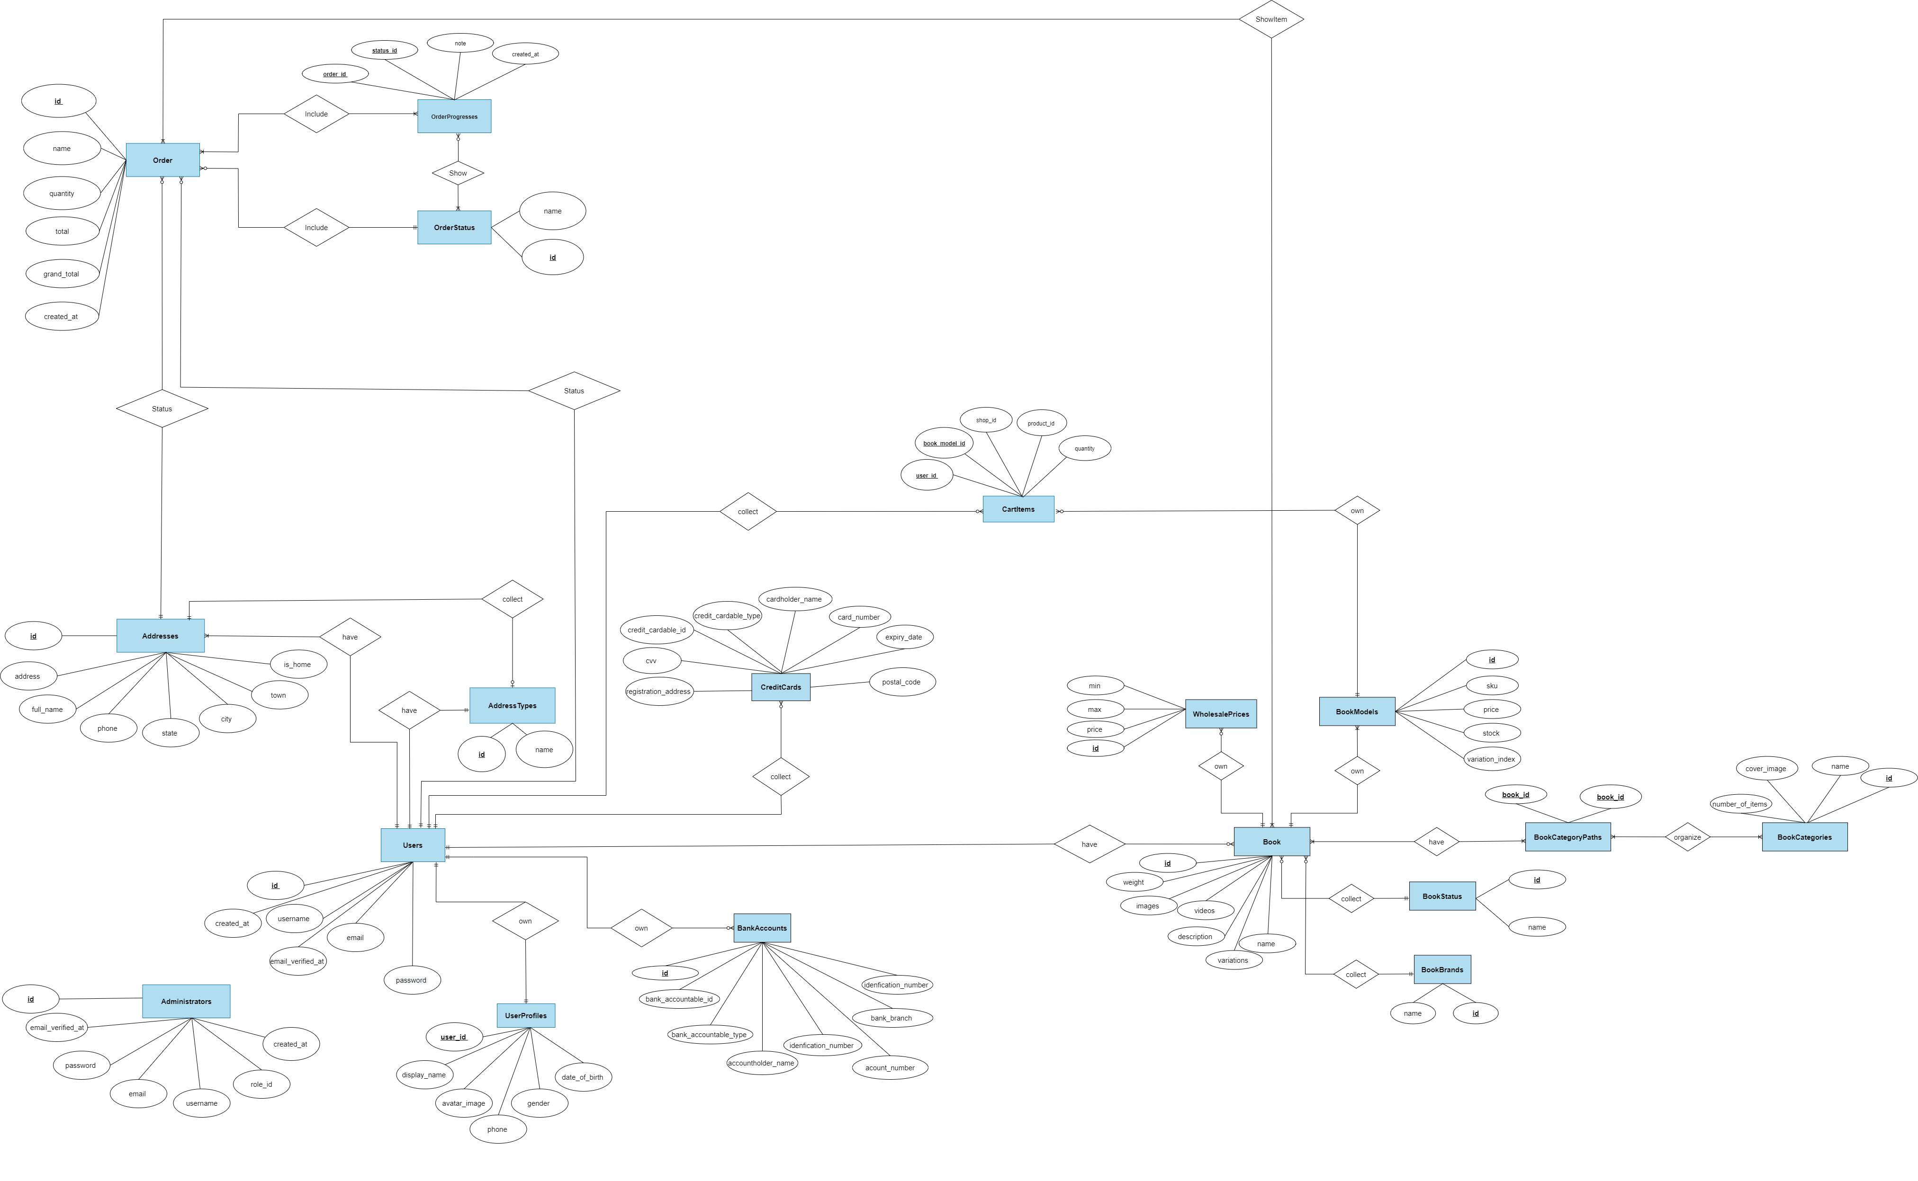
ERD

Slide 13
04
Conclusion

Slide 14
Conclusion
Some typical functions include
Log in / log out
Search product
Add/delete product
Create/Update/Delete product
Update profile for user
Create/cancel Order
Create/update/delete category

Slide 15
Thanks for your listening !!!

