Slide 1

Arrive OVS – DPDK
HQoS
Jan 2020
Arrive Preliminary and Confidential 2019 Do Not Copy or Distribute Without Permission
Notes:
1
1
1
1
1
1
1

Slide 2
OVS - Overview
Open vSwitch, sometimes abbreviated as OVS, is an open-source implementation of a distributed virtual multilayer switch. The main purpose of Open vSwitch is to provide a switching stack for hardware virtualization environments, while supporting multiple protocols and standards used in computer networks.
OvS can run as a virtual switch in virtual environments, provide switching to host-based applications, and run as the control stack of hardware switches.
Feature:
Standard 802.1Q VLAN model with trunk and access ports
NIC bonding with or without LACP on upstream switch
NetFlow, sFlow(R), and mirroring for increased visibility
QoS (Quality of Service) configuration, plus policing
Geneve, GRE, VXLAN, STT, and LISP tunneling
802.1ag connectivity fault management
OpenFlow 1.0 plus numerous extensions
Transactional configuration database with C and Python bindings
High-performance forwarding using a Linux kernel module
Arrive Preliminary and Confidential 2019 Do Not Copy or Distribute Without Permission
Slide 2
Slide 2
Notes:
2
2
2
2
2
2

Slide 3
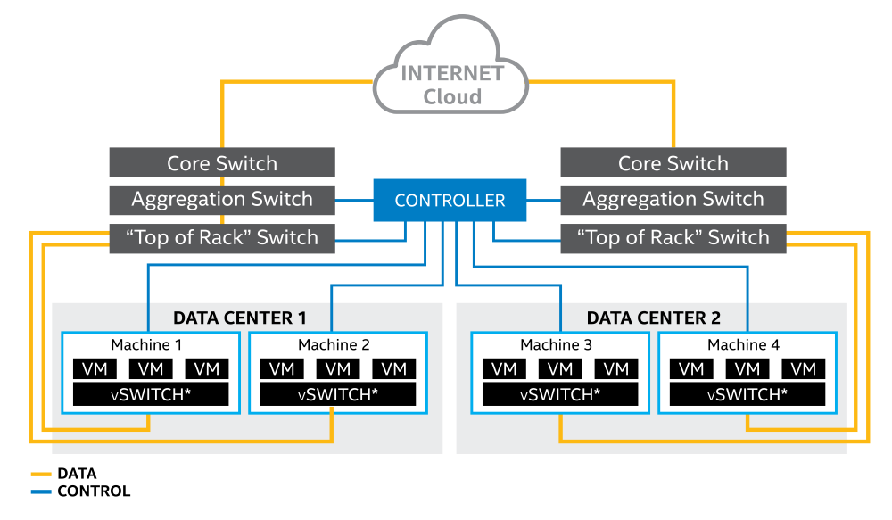
OVS - A typical service
A typical service and switching infrastructure used in a data center.
Arrive Preliminary and Confidential 2019 Do Not Copy or Distribute Without Permission
Slide 3
Slide 3
Notes:
3
3
3
3
3
3

Slide 4
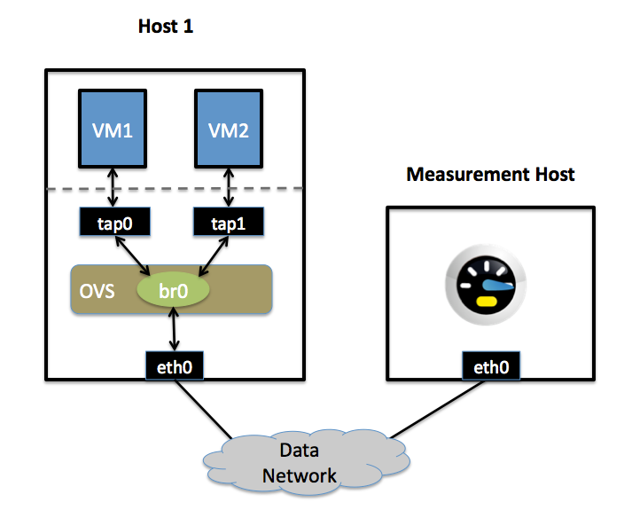
OVS – Linux Kernel: QoS Features
Open vSwitch now currently supports
Used “Linux traffic-control capability” for rate-limiting.
HFSC qdisc (Hierarchical Fair Service Curve), a hierarchical scheduling traffic control.
Add-on “Per VM interface traffic policing”
Ingress rate-limiting
Can setup rate limit for TAP0/TAP1/eth0
Can setup Hierarchy scheduling for TAP0/1/eth0
Arrive Preliminary and Confidential 2019 Do Not Copy or Distribute Without Permission
Slide 4
Slide 4
Notes:
4
4
4
4
4
4

Slide 5
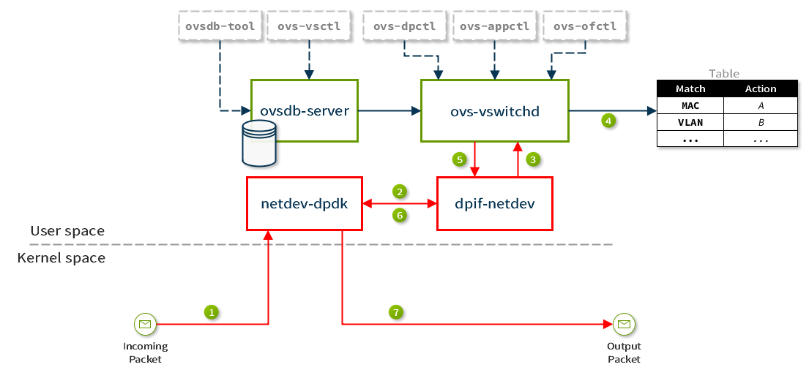
OVS – DPDK: QoS Features
Userspace implementation
Exhance the throughput performance with small packet size rate
Re-use a set of DPDK userspace libraries that are used to accelerate and optimize packet transfer and processing
Support Ingress/Egress policing rate-limit.
Used “Linux traffic-control capability” for rate-limiting.
Arrive Preliminary and Confidential 2019 Do Not Copy or Distribute Without Permission
Slide 5
Slide 5
Notes:
5
5
5
5
5
5

Slide 6
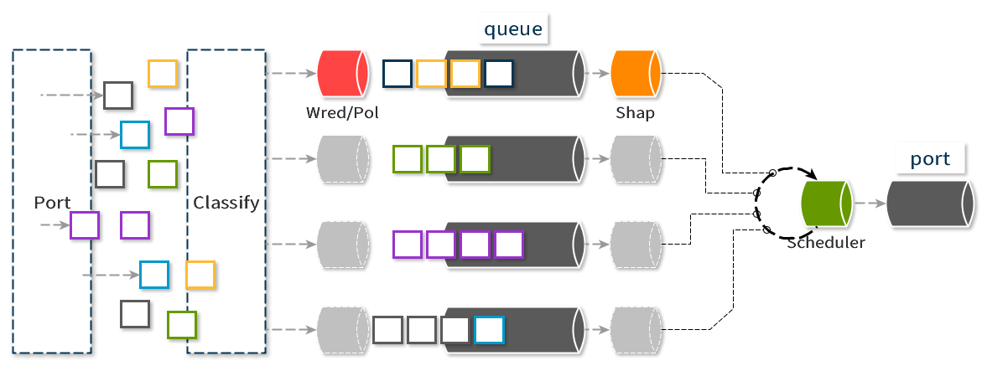
OVS – DPDK: Arrive Add-on HQoS
PMD polling interface to handle send/receive packet.
OVS-Openflow to handle packet classify
Integrate the DPDK HQoS libraries for traffic control
Arrive Preliminary and Confidential 2019 Do Not Copy or Distribute Without Permission
Slide 6
Slide 6
Notes:
6
6
6
6
6
6

Slide 7
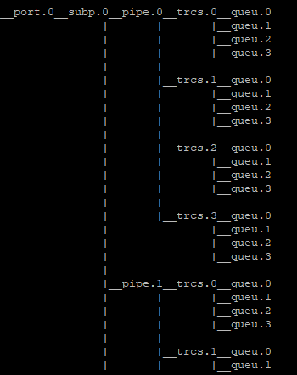
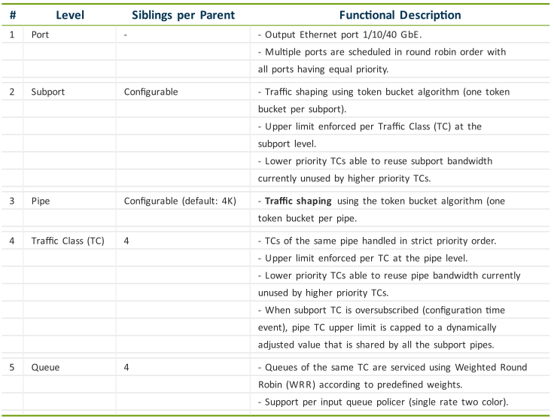
OVS – DPDK: Arrive Add-on HQoS Details
Support hierarchy scheduling
Support 64k flows (4x4x4096)
Arrive Preliminary and Confidential 2019 Do Not Copy or Distribute Without Permission
Slide 7
Slide 7
Notes:
7
7
7
7
7
7

Slide 8
OVS – DPDK: Arrive Add-on HQoS Current Status
Finish first version
Next Steps:Testing, optimize and Improvement
Build/Deploy the OVS with HQoS function for Networking NFV on OpenStack
Arrive Preliminary and Confidential 2019 Do Not Copy or Distribute Without Permission
Slide 8
Slide 8
Notes:
8
8
8
8
8
8

Slide 9
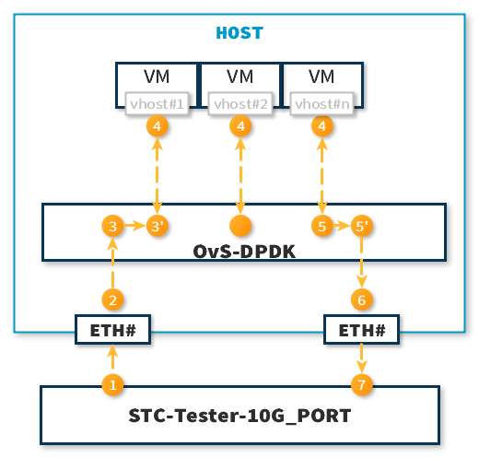
PHY-OVS-VM-OVS-PHY – 4096 Flows
(1) Generate 1flow
+ packet szie 64, 128, 256, 512, 1024, 1280, 1518
+ bw 10Gps
(2) PMD polls the ETH port to handle receiving
(3) OVS-Openflow handles classify and make an action
(4) Send packet to vhost port
(5, 5’) HQoS traffic control before transmit
(6) PMD polls the ETH port to handle transmit packet
Arrive Preliminary and Confidential 2019 Do Not Copy or Distribute Without Permission
Slide 9
Slide 9
Notes:
9
9
9
9
9
9

Slide 10
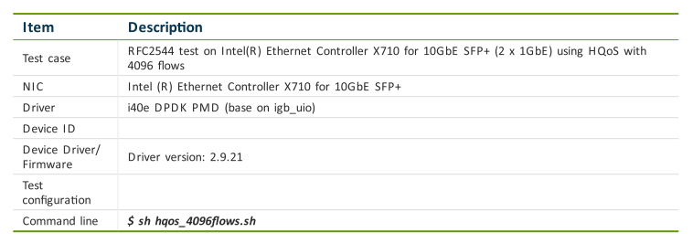
PHY-OVS-VM-OVS-PHY – 4096 Flows (cont)
Configuration
Arrive Preliminary and Confidential 2019 Do Not Copy or Distribute Without Permission
Slide 10
Slide 10
Notes:
10
10
10
10
10
10

Slide 11
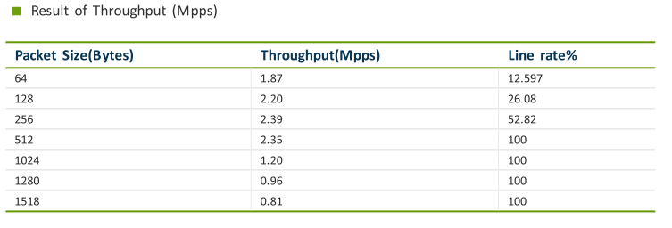
PHY-OVS-VM-OVS-PHY – 4096 Flows (cont)
Result
Arrive Preliminary and Confidential 2019 Do Not Copy or Distribute Without Permission
Slide 11
Slide 11
Notes:
11
11
11
11
11
11

Slide 12
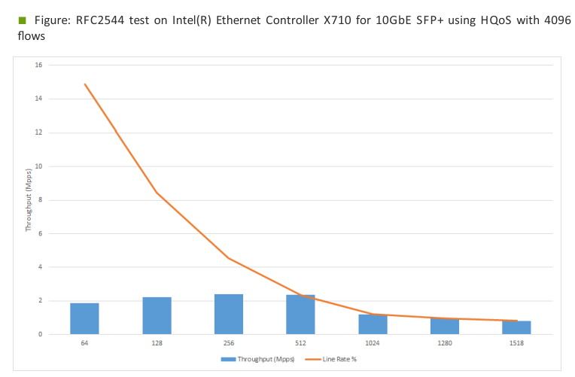
PHY-OVS-VM-OVS-PHY – 4096 Flows (cont)
Result
Arrive Preliminary and Confidential 2019 Do Not Copy or Distribute Without Permission
Slide 12
Slide 12
Notes:
12
12
12
12
12
12

Slide 13
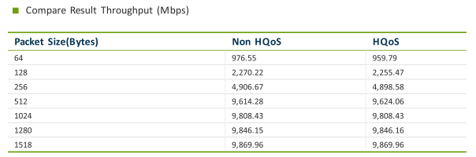
Compare result HQoS and NonHQoS – 4096 Flows
Result
Arrive Preliminary and Confidential 2019 Do Not Copy or Distribute Without Permission
Slide 13
Slide 13
Notes:
13
13
13
13
13
13

Slide 14
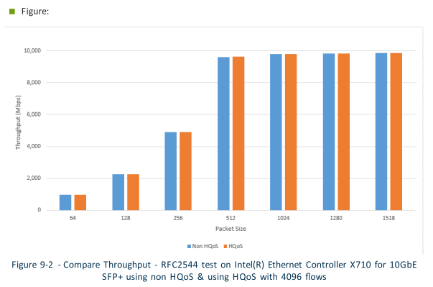
HQoS and NonHQoS Comparition – 4096 Flows
Result
Arrive Preliminary and Confidential 2019 Do Not Copy or Distribute Without Permission
Slide 14
Slide 14
Notes:
14
14
14
14
14
14

