Slide 1


Why Program?
Chapter 1
Python for Informatics: Exploring Information
www.pythonlearn.com
Notes:
Từ mới:
Note from Chuck. If you are using these materials, you can remove the UM logo and replace it with your own, but please retain the CC-BY logo on the first page as well as retain the entire last page.

Slide 2

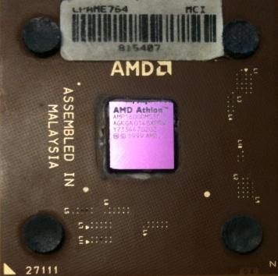
Computers want to be helpful...
What
Next?
Computers are built for one purpose - to do things for us
But we need to speak their language to describe what we want done
Users have it easy - someone already put many different programs (instructions) into the computer and users just pick the ones we want to use
What
Next?
What
Next?
What
Next?
What
Next?
What
Next?
What
Next?
Notes:
Từ mới
Instructions: hướng dẫn, dẫn
Câu:
- Máy tính được làm ra với mục đích giúp chúng ta làm một điều gì đó.
- Nhưng chúng ta cấn nói bằng ngôn ngữ của chúng để mô tả những gì mà chúng ta muốn thực hiện.
- Người sử dụng dễ dàng đặt những chương trình khác nhau (những hướng dẫn) vào trong máy tính và chỉ chọn những cái muốn sử dụng.

Slide 3
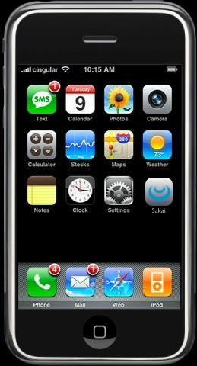
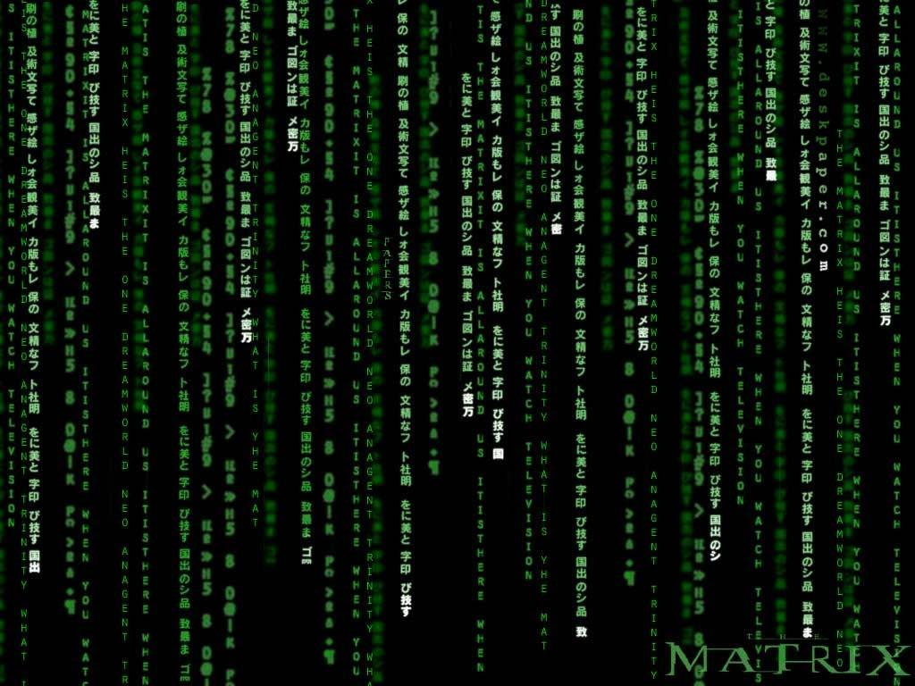
Programmers Anticipate Needs
iPhone Applications are a market
iPhone Applications have over 3 Billion downloads
Programmers have left their jobs to be full-time iPhone developers
Programmers know the ways of the program
Pick
Me!
Pick
Me!
Pick
Me!
Pick
Me!
Pick
Me!
Pay
Me!
Notes:
Từ mới:
- Anticipate: biết trước, chờ đợi

Slide 4
Users vs. Programmers
Users see computers as a set of tools - word processor, spreadsheet, map, todo list, etc.
Programmers learn the computer “ways” and the computer language
Programmers have some tools that allow them to build new tools
Programmers sometimes write tools for lots of users and sometimes programmers write little “helpers” for themselves to automate a task
Notes:
Từ mới:
- Little (danh từ, phó từ): ít, nhỏ bé, ngắn ngủi.

Slide 5
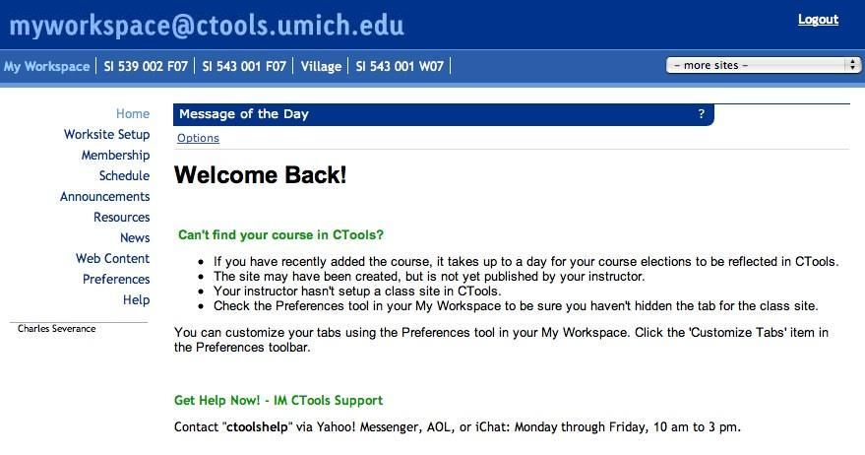

User
Computer
Hardware + Software
Programmer
Data
Information
Networks
....
From a software creator’s point of view, we build the software. The end users (stakeholders/actors) are our masters - who we want to please - often they pay us money when they are pleased. But the data, information, and networks are our problem to solve on their behalf. The hardware and software are our friends and allies in this quest.
Notes:
Từ mới:
Pleased: Hài long, vui lòng
Stakeholders: Những bên liên quan
Actor: (hiểu là) đối tác.
Master (danh từ) : chủ nhân, thầy.
Behalf: thay mặt, nhân danh.
Allies (số nhiều của Ally): liên minh, liên kết
Câu:
Từ góc nhìn việc tạo ra phần mềm, chúng là sẽ là những người xây dựng phần mềm. Người dùng (những bên liên quan/đối tác) là chủ nhân của chúng ta. Họ là những người mà chúng ta sẽ làm vừa ý – họ thường trả tiền khi chúng ta làm họ được hài lòng. Nhưng dữ liệu , thông tin và hệ thống mạng là những thứ mà chung ta cần giải quyết thay cho họ. Phần cứng và phần mềm là những người bạn của chúng ta và chúng sẽ liên kết kết các yêu cầu này.

Slide 6
Why be a programmer?
To get some task done - we are the user and programmer
Clean up survey data
To produce something for others to use - a programming job
Fix a performance problem in the Sakai software
Add guestbook to a web site

Slide 7
What is Code? Software? A Program?
A sequence of stored instructions
It is a little piece of our intelligence in the computer
It is a little piece of our intelligence we can give to others - we figure something out and then we encode it and then give it to someone else to save them the time and energy of figuring it out
A piece of creative art - particularly when we do a good job on user experience
Notes:
Sequence: dãy, chuỗi, sự nối tiếp
Intelligence: Thông tin, thông minh
Creative: sáng tạo, tạo ra
Particulary: Nhất là, đặc biệt

Slide 8
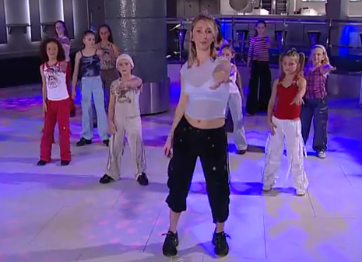
Programs for Humans...
http://www.youtube.com/watch?v=vlzwuFkn88U

Slide 9
Programs for Humans...
while music is playing:
Left hand out and up
Right hand out and up
Flip Left hand
Flip Right hand
Left hand to right shoulder
Right hand to left shoulder
Left hand to back of head
Right ham to back of head
Left hand to right hit
Right hand to left hit
Left hand on left bottom
Right hand on right bottom
Wiggle
Wiggle
Jump
http://www.youtube.com/watch?v=sN62PAKoBfE

Slide 10
Programs for Humans...
while music is playing:
Left hand out and up
Right hand out and up
Flip Left hand
Flip Right hand
Left hand to right shoulder
Right hand to left shoulder
Left hand to back of head
Right ham to back of head
Left hand to right hit
Right hand to left hit
Left hand on left bottom
Right hand on right bottom
Wiggle
Wiggle
Jump
http://www.youtube.com/watch?v=vlzwuFkn88U

Slide 11
Programs for Humans...
while music is playing:
Left hand out and up
Right hand out and up
Flip Left hand
Flip Right hand
Left hand to right shoulder
Right hand to left shoulder
Left hand to back of head
Right hand to back of head
Left hand to right hip
Right hand to left hip
Left hand on left bottom
Right hand on right bottom
Wiggle
Wiggle
Jump
http://www.youtube.com/watch?v=vlzwuFkn88U

Slide 12
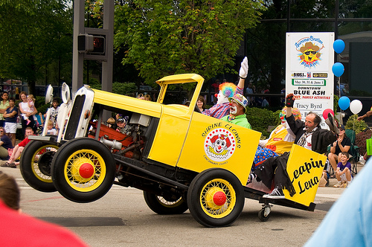
Programs for Python...
the clown ran after the car and the car ran into the tent and the tent fell down on the clown and the car
Notes:
Clown: chú hề, anh hề.
Tent: Cái lều, rạp

Slide 13
Programs for Python...

Slide 14
name = raw_input('Enter file:')
handle = open(name, 'r')
text = handle.read()
words = text.split()
counts = dict()
for word in words:
counts[word] = counts.get(word,0) + 1
bigcount = None
bigword = None
for word,count in counts.items():
if bigcount is None or count > bigcount:
bigword = word
bigcount = count
print bigword, bigcount
python words.py
Enter file: words.txt
to 16
python words.py
Enter file: clown.txt
the 7

Slide 15
Hardware Architecture

Slide 16
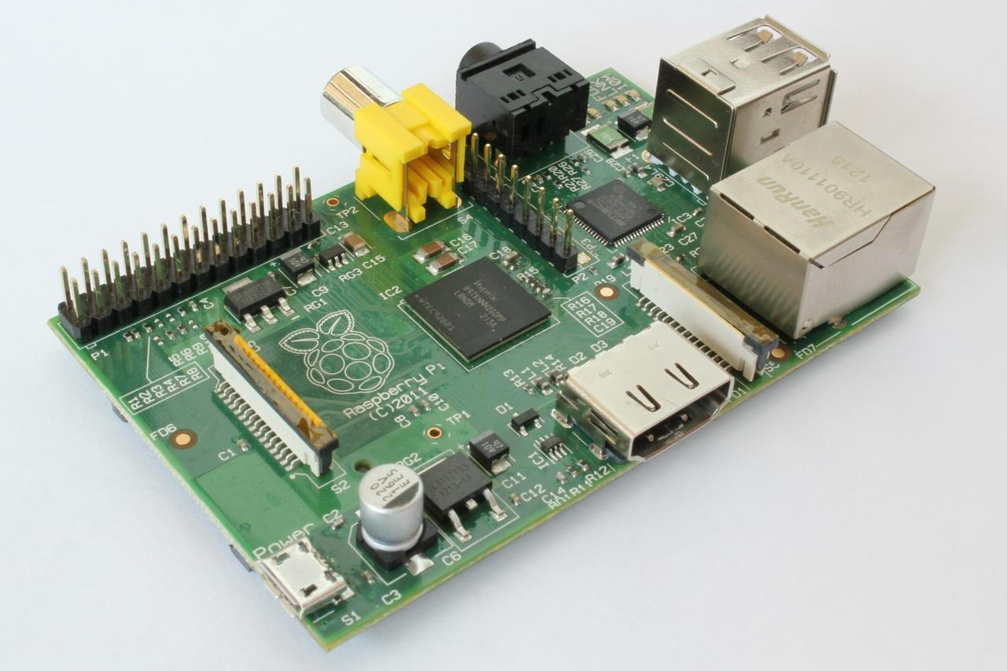
http://upload.wikimedia.org/wikipedia/commons/3/3d/RaspberryPi.jpg

Slide 17
What
Next?
Generic
Computer
Software
Input
and Output
Devices
Central
Processing
Unit
Secondary
Memory
Main
Memory

Slide 18
Definitions
What
Next?
Central Processing Unit: Runs the Program - The CPU is always wondering “what to do next”? Not the brains exactly - very dumb but very very fast
Input Devices: Keyboard, Mouse, Touch Screen
Output Devices: Screen, Speakers, Printer, DVD Burner
Main Memory: Fast small temporary storage - lost on reboot - aka RAM
Secondary Memory: Slower large permanent storage - lasts until deleted - disk drive / memory stick
Notes:
Temporary: Tạm thời
Permanent: Cố định, bất động, lâu dài, bền vững

Slide 19
What
Next?
Generic
Computer
Software
Input
and Output
Devices
Central
Processing
Unit
Secondary
Memory
if x< 3: print
Main
Memory

Slide 20
What
Next?
Software
Input
and Output
Devices
Central
Processing
Unit
Secondary
Memory
01001001
00111001
Main
Memory
Machine
Language

Slide 21
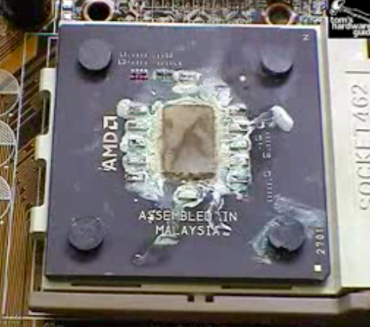
Totally Hot CPU
What
Next?
http://www.youtube.com/watch?v=y39D4529FM4

Slide 22
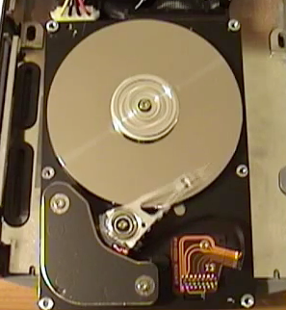
Hard Disk in Action
http://www.youtube.com/watch?v=9eMWG3fwiEU

Slide 23
Python as a Language

Slide 24
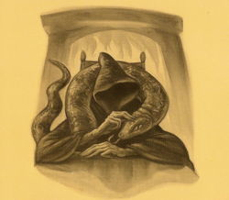
Parseltongue is the language of serpents and those who can converse with them. An individual who can speak Parseltongue is known as a Parselmouth. It is a very uncommon skill, and may be hereditary. Nearly all known Parselmouths are descended from Salazar Slytherin.
http://harrypotter.wikia.com/wiki/Parseltongue
Notes:
Serpent: Con rắn
Converse: đối thoại, nói chuyện
Hereditary: di truyền, cha truyền con nối.
Descended: Có nguồn gốc từ

Slide 25
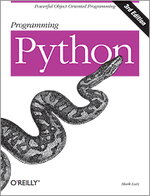
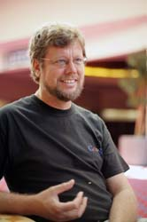

Python is the language of the Python Interpreter and those who can converse with it. An individual who can speak Python is known as a Pythonista. It is a very uncommon skill, and may be hereditary. Nearly all known Pythonistas use software initially developed by Guido van Rossum.

Slide 26
Early Learner: Syntax Errors
We need to learn the Python language so we can communicate our instructions to Python. In the beginning we will make lots of mistakes and speak gibberish like small children.
When you make a mistake, the computer does not think you are “cute”. It says “syntax error” - given that it knows the language and you are just learning it. It seems like Python is cruel and unfeeling.
You must remember that you are intelligent and can learn. The computer is simple and very fast, but cannot learn. So it is easier for you to learn Python than for the computer to learn English...
Notes:
Gibberish: lắp bắp
Cruel: độc ác, dự tợn

Slide 27
Talking to Python

Slide 28
csev$ python
Python 2.5 (r25:51918, Sep 19 2006, 08:49:13)
[GCC 4.0.1 (Apple Computer, Inc. build 5341)] on darwin
Type "help", "copyright", "credits" or "license" for more information.
>>>
What next?

Slide 29
csev$ python
Python 2.5 (r25:51918, Sep 19 2006, 08:49:13)
[GCC 4.0.1 (Apple Computer, Inc. build 5341)] on darwin
Type "help", "copyright", "credits" or "license" for more information.
>>> x = 1
>>> print x
1
>>> x = x + 1
>>> print x
2
>>> exit()
This is a good test to make sure that you have Python correctly installed. Note that quit() also works to end the interactive session.

Slide 30
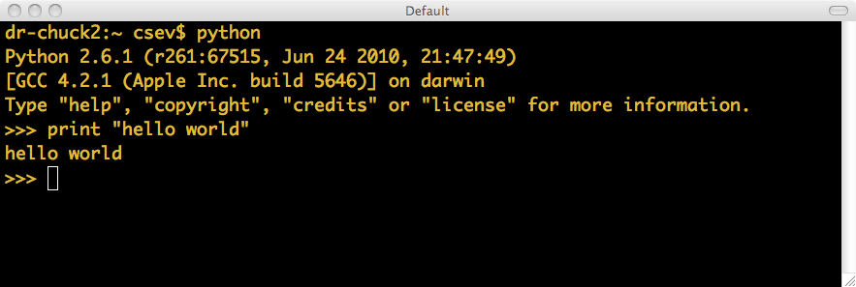
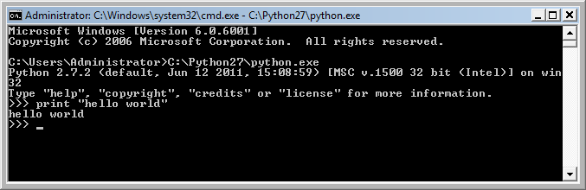
Let’s Talk to Python...

Slide 31
What Do We Say?

Slide 32
Elements of Python
Vocabulary / Words - Variables and Reserved words (Chapter 2)
Sentence structure - valid syntax patterns (Chapters 3-5)
Story structure - constructing a program for a purpose

Slide 33
name = raw_input('Enter file:')
handle = open(name, 'r')
text = handle.read()
words = text.split()
counts = dict()
for word in words:
counts[word] = counts.get(word,0) + 1
bigcount = None
bigword = None
for word,count in counts.items():
if bigcount is None or count > bigcount:
bigword = word
bigcount = count
print bigword, bigcount
A short “story” about how to count words in a file in Python
python words.py
Enter file: words.txt
to 16

Slide 34
Reserved Words
You cannot use reserved words as variable names / identifiers
and del for is raise assert elif from lambda return break else global not try class except if or while continue exec import pass yield def ﬁnally in print as with

Slide 35
Sentences or Lines
x = 2
x = x + 2
print x
Assignment statement
Assignment with expression
Print statement
Variable
Operator
Constant
Reserved Word
Notes:
Sentences: câu
Expression: Biểu thức.

Slide 36
Programming Paragraphs

Slide 37
Python Scripts
Interactive Python is good for experiments and programs of 3-4 lines long.
Most programs are much longer, so we type them into a file and tell Python to run the commands in the file.
In a sense, we are “giving Python a script”.
As a convention, we add “.py” as the suffix on the end of these files to indicate they contain Python.
Notes:
Experiment: thử nghiệm, thí nghiệm.
Convention: quy ước.
Indicate: Báo hiệu.

Slide 38
Writing a Simple Program

Slide 39
Interactive versus Script
Interactive
You type directly to Python one line at a time and it responds
Script
You enter a sequence of statements (lines) into a file using a text editor and tell Python to execute the statements in the file

Slide 40
Program Steps or Program Flow
Like a recipe or installation instructions, a program is a sequence of steps to be done in order.
Some steps are conditional - they may be skipped.
Sometimes a step or group of steps are to be repeated.
Sometimes we store a set of steps to be used over and over as needed several places throughout the program (Chapter 4).
Notes:
Recipe: Phương pháp, cách làm:

Slide 41
Sequential Steps
x = 2
Program:
x = 2
print x
x = x + 2
print x
Output:
2
4
print x
x = x + 2
print x
When a program is running, it flows from one step to the next. As programmers, we set up “paths” for the program to follow.

Slide 42
Conditional Steps
x = 5
x < 10 ?
Yes
Program:
x = 5
if x < 10:
print 'Smaller’
if x > 20:
print 'Bigger'
print 'Finis'
print 'Smaller'
Output:
Smaller
Finis
x > 20 ?
No
print 'Bigger'
print 'Finis'

Slide 43
Repeated Steps
n = 5
No
n > 0 ?
Yes
Output:
5
4
3
2
1
Blastoff!
Program:
n = 5
while n > 0 :
print n
n = n – 1
print 'Blastoff!'
print n
n = n -1
print 'Blastoff'
Loops (repeated steps) have iteration variables that change each time through a loop. Often these iteration variables go through a sequence of numbers.
Notes:
- Variable: biến số
- Interation: Lặp lại

Slide 44
name = raw_input('Enter file:')
handle = open(name, 'r')
text = handle.read()
words = text.split()
counts = dict()
for word in words:
counts[word] = counts.get(word,0) + 1
bigcount = None
bigword = None
for word,count in counts.items():
if bigcount is None or count > bigcount:
bigword = word
bigcount = count
print bigword, bigcount
Sequential
Repeated
Conditional

Slide 45
name = raw_input('Enter file:')
handle = open(name, 'r')
text = handle.read()
words = text.split()
counts = dict()
for word in words:
counts[word] = counts.get(word,0) + 1
bigcount = None
bigword = None
for word,count in counts.items():
if bigcount is None or count > bigcount:
bigword = word
bigcount = count
print bigword, bigcount
A short Python “Story” about how to count words in a file
A word used to read data from a user
A sentence about updating one of the many counts
A paragraph about how to find the largest item in a list

Slide 46
Summary
This is a quick overview of Chapter 1
We will revisit these concepts throughout the course
Focus on the big picture

Slide 47
Acknowledgements / Contributions
These slides are Copyright 2010- Charles R. Severance (www.dr-chuck.com) of the University of Michigan School of Information and open.umich.edu and made available under a Creative Commons Attribution 4.0 License. Please maintain this last slide in all copies of the document to comply with the attribution requirements of the license. If you make a change, feel free to add your name and organization to the list of contributors on this page as you republish the materials.
Initial Development: Charles Severance, University of Michigan School of Information
… Insert new Contributors and Translators here
...

