Slide 1

PATPAT.LK
Group No:- 2021SE_REG_WE_19

Slide 2
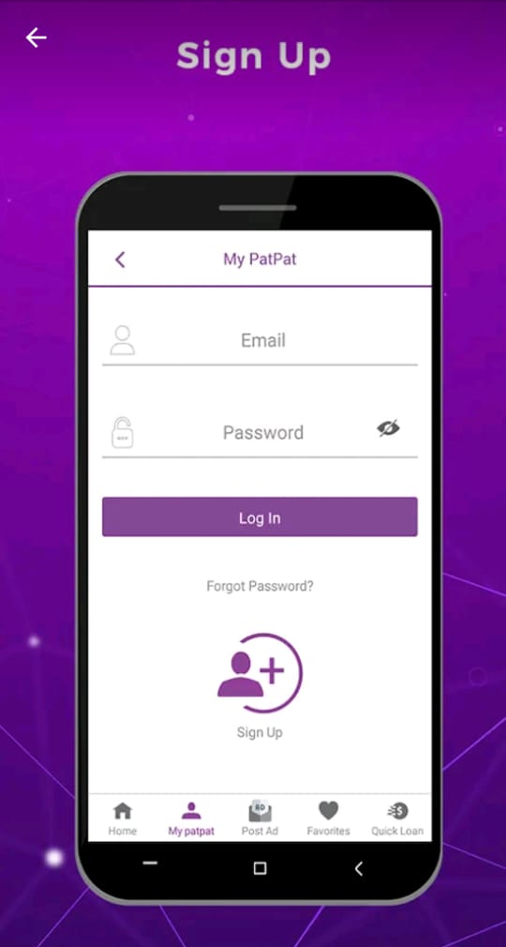
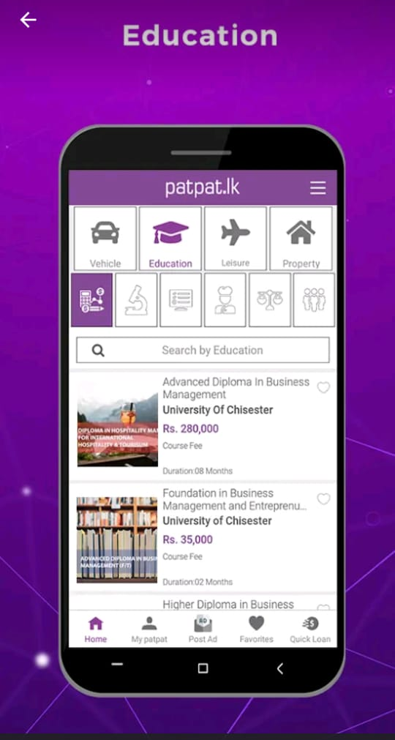
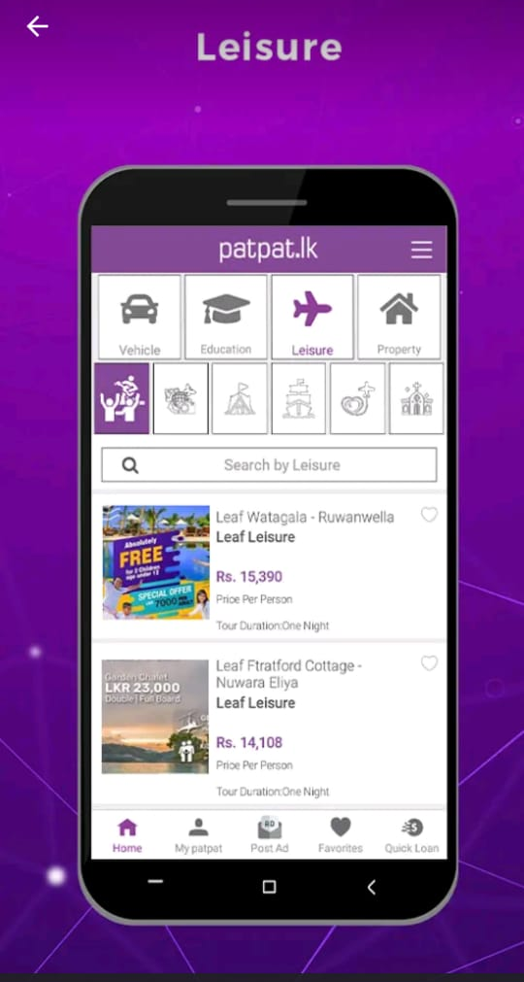
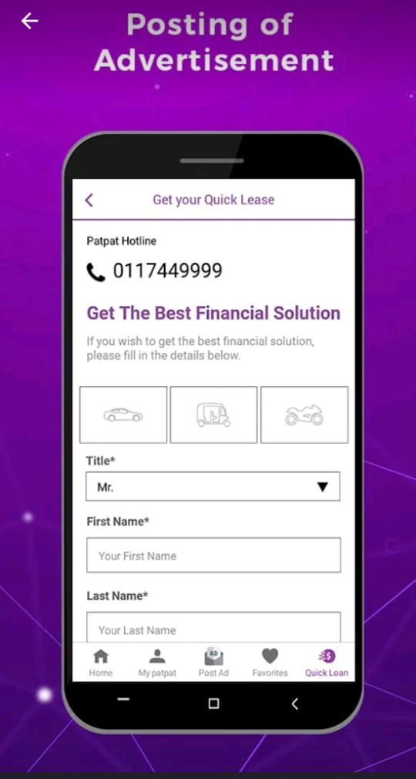
What is patpat.lk ?
Free advertising platform for selective lifestyle needs.

Slide 3
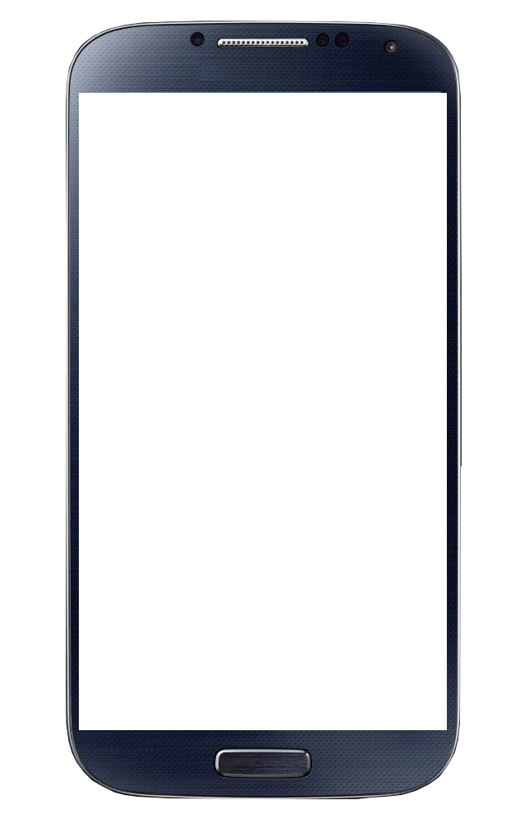
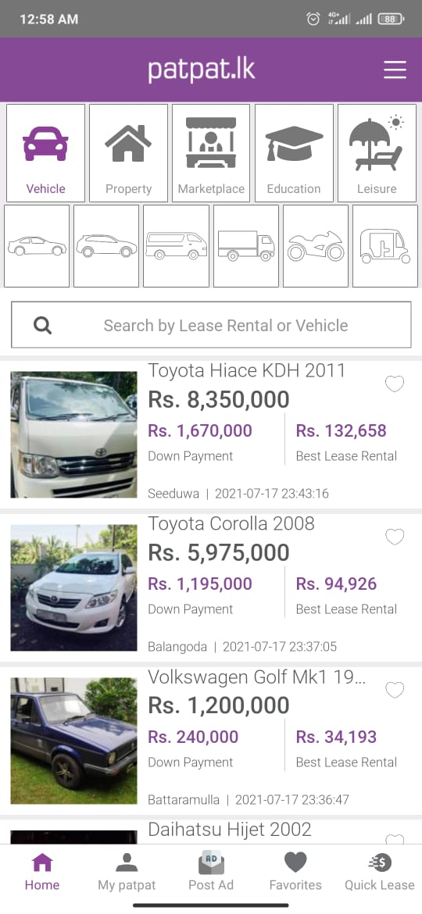
Why?
Less User-friendly.
App crashes at launch.
Searching is not user-friendly.
User cannot save adverstiment.
Too much unrelated ADs
Unable to cancel loading.
Unable to return to homepage.
FAQ section cannot be accessed.

Slide 4
functions
MEMBER 01
MEMBER 02
Handling
favourites
Delete
Advertisment
Post
Advertisment
Quick Lease
Edit
Advertisement
Order
Inquiry
About us

Slide 5
functions
MEMBER 03
MEMBER 04
Vehicle
Search
FAQ
section
Login
Contact
Us
Registration
Handle
filteration
Update
User

