Slide 1
Digital Portfolio
STUDENT NAME: THUSHETHA.B
REGISTER NO AND NMID:212404665 and 892C782303E00E8AE8B41632B610F983
DEPARTMENT: BCA
COLLEGE: COLLEGE/ UNIVERSITY:RATANKANWAR BHAWARLAL GOTHI JAIN COLLEGE FOR WOMEN/UNIVERSITY OF MADRAS

Slide 2
PROJECT TITLE:
My Digital Portfolio
Showcasing my Journey to crafting my carrier path

Slide 3
AGENDA
Problem Statement
Project Overview
End Users
Tools and Technologies
Portfolio design and Layout
Features and Functionality
Results and Screenshots
Conclusion
GitHub Link

Slide 4
PROBLEM STATEMENT:
“Many students and professionals struggle to showcase their skills and achievements in a structured and creative way. Traditional resumes often fail to reflect personality, creativity, and technical expertise. Hence, a digital portfolio is necessary to bridge this gap.”

Slide 5
PROJECT OVERVIEW:
This project is a digital portfolio website designed to showcase my academic background, technical skills, and career aspirations. It serves as a personal branding platform where I present my projects, certifications, and achievements in a structured and visually appealing format. Built using HTML, CSS, and JavaScript, the portfolio is responsive and user-friendly, making it accessible across devices.

Slide 6
WHO ARE THE END USERS:
Recruiters & Employers
Academic Faculty & Evaluators
Peers & Classmates
Clients / Internship Providers
General Audience / Visitors

Slide 7
TOOLS AND TECHNIQUES:
HTML (Hyper Text Markup Language)
Used for structuring the content of the portfolio such as headings, paragraphs, images, and links.
Provides the backbone of the website
CSS (Cascading Style Sheets)
Used for styling the portfolio (fonts, colors, layouts, responsiveness).
Ensures the design is attractive and user-friendly.
JavaScript
Adds interactivity and dynamic features (form validation, animations, interactive menus, etc.)
Enhances the user experience of the portfolio.

Slide 8
PORTFOLIO DEGIN AND LAYOUT:
Home Page – Intro with name, tagline, and quick navigation.
About Me – Brief bio, education, and goals.
Skills – Technical and soft skills shown with icons/bars.
Projects – Showcasing academic and personal works.
Contact – Form, email, and social links.
Navigation – Simple, user-friendly menu.
Design – Consistent colors, readable fonts, and visuals.
Responsive – Works on desktop, tablet, and mobile.
Footer – Copyright and quick links.

Slide 9
FEATURES AND FUNCTIONALITY:
Responsive Design – Works on all devices.
Easy Navigation – Smooth access to sections.
Projects Showcase – Displays work and achievements.
Contact Form – Direct communication option.

Slide 10
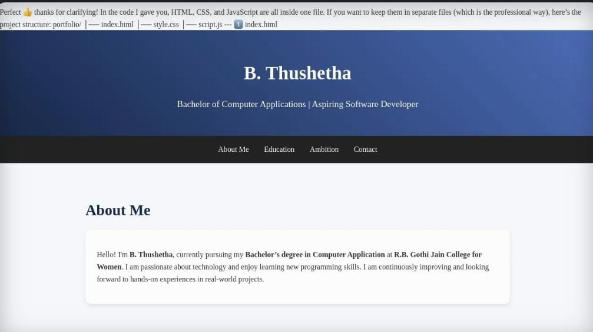
RESULTS AND SCREENSHOTS:

Slide 11
CONCLUSION:
In conclusion, this digital portfolio serves as a personalized platform to present my academic background, technical skills, and career aspirations. It not only highlights my projects and achievements but also reflects my creativity and passion for web development.
This project helped me enhance my knowledge of HTML, CSS, and JavaScript while creating a responsive and user-friendly website.

