Slide 1
Introduction to TensorFlow
Thushan Ganegedara

Slide 2
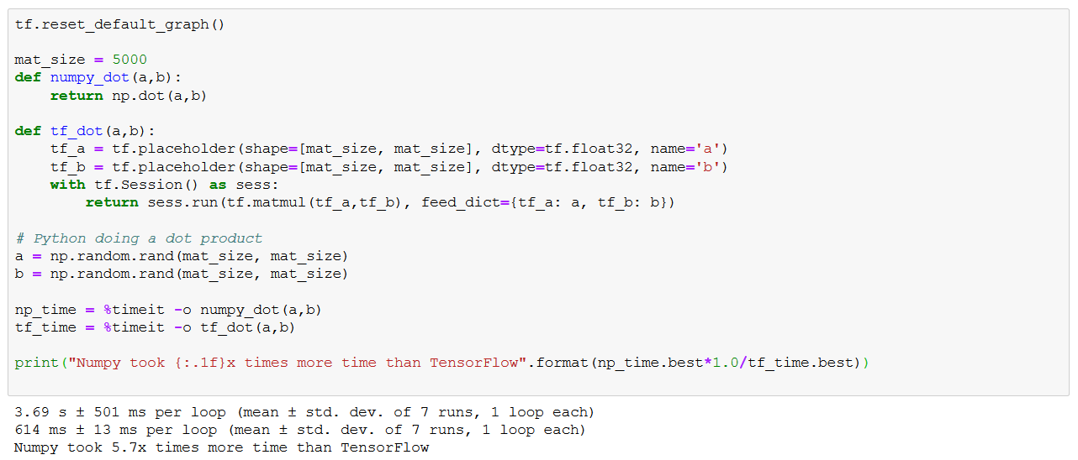
Why TensorFlow?

Slide 3

Nympy can be very slow with large tensors
Deep networks involve large number of large tensor operations
So we need a better solution

Slide 4
Why TensorFlow?
Has highly optimized GPU CUDA kernels
Matrix multiplication
Convolution
Rich and comprehensive API for deep networks
Provides an end-to-end eco system for deep learning
tf.Keras
tf.serving
tf.Mesh
tf.federated

Slide 5
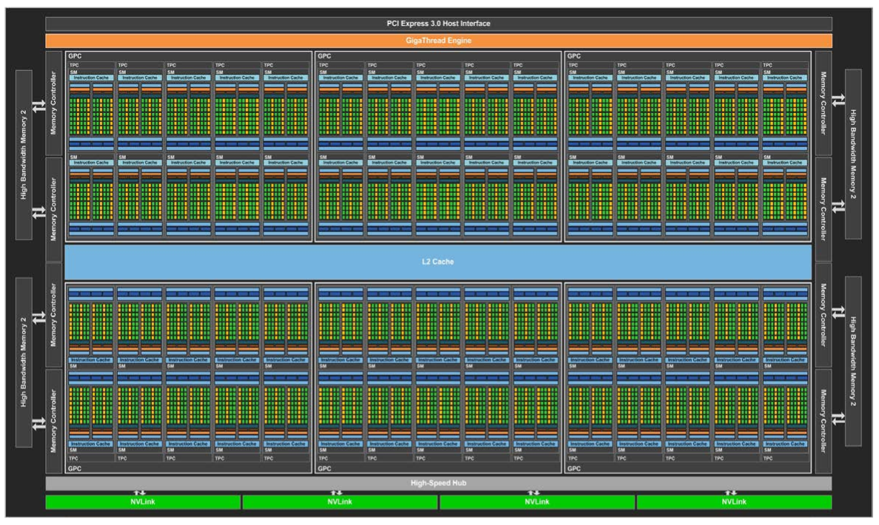
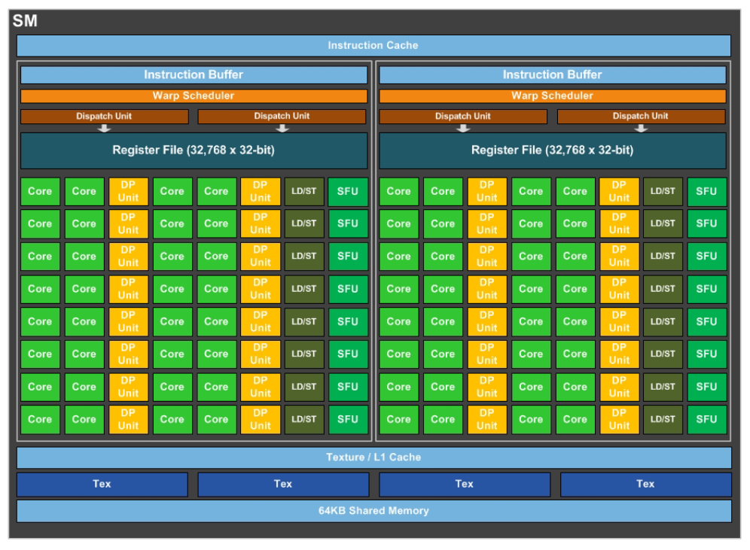
CPUs vs GPUs
Why GPUs are better than CPUs?
GPUs have many more cores (several thousands) compared to a CPU which has (few more than hundred) at maximum
NVIDIA P100 GPU: 1920 CUDA Cores
http://images.nvidia.com/content/pdf/tesla/whitepaper/pascal-architecture-whitepaper-v1.2.pdf

Slide 6
TensorFlow 101
Learning the basic building blocks of TensorFlow

Slide 7
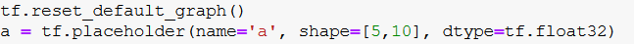
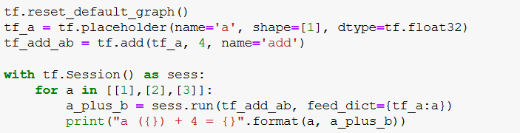
Placeholders, Variables, Tensors and Operations
Placeholder: A type of tensor where data is fed at run time
Definition
Execution
Where would you use one?
Feed in a batch of data (i.e. images) to a convolution neural network

Slide 8
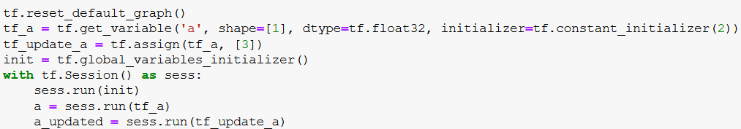
Placeholders, Variables, Tensors and Operations
Variables
A type of tensor which is mutable, of which value can be changed later
Definition
Execution
Where would you use one?
Store the weights of a neural network

Slide 9
Placeholders, Variables, Tensors and Operations
Tensors
An immutable tensor that cannot be changed ones initialized
Where would you use one?
Storing the predictions of the network
TensorFlow Trivia: What’s the difference between a Variable and a Tensor in TensorFlow?

Slide 10

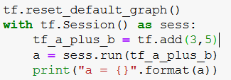
Placeholders, Variables, Tensors and Operations
Operation
An operation known by the TensorFlow graph and can be executed within a session
Definition
Execution
Where would you use one?
To compute layer outputs of a deep network

Slide 11
Exercise: 5 min
Implement a placeholder tf_c, that is of shape 2x1 and has dtype tf.float32
Implement a variable tf_d, which is a 3x2 matrix and initialized with random normal initialization and has dtype tf.float32
Write an operation to compute the dot product between tf_d and tf_c using tf.matmul

Slide 12


Python vs TensorFlow

Slide 13
Exercise: How long do I have to work?
https://gist.github.com/thushv89/c8e912fd8e90bada801d85c8f8b97df4#file-ch1_exercises-py
Python
Try printing out the variables via the following
saving_per_week = 1000
dreams = [("House", 1000000), ("Car", 50000), ("Desktop-DL", 5000)]
for ___, ____ in dreams:
num_weeks = int(___/___)
print("You have to save {} weeks in order to by a {}".format(num_weeks, ___))
print([v for v in dir() if (not v.startswith('_')) and (not v.startswith('tf')) and v!='In' and v!='Out'])

Slide 14
Let’s now try TensorFlow
tf.reset_default_graph()
saving_per_week = 1000
dreams = [("House", 1000000), ("Car", 50000), ("Desktop-DL", 5000)]
for ___, ___ in dreams:
tf_price = tf.get_variable(___, initializer=price)
tf_num_weeks = ___/___
with tf.Session() as sess:
tf.global_variables_initializer().run()
print("You have to save {:d} weeks in order to by a {}".format(
int(sess.run(___)), ___)
)
Try printing out the variables via the following
print("Variables in the graph")
print([v.name for v in tf.global_variables()])
print("\nOperations in the graph")
print([op.name for op in tf.get_default_graph().get_operations()])

Slide 15
Oh ooh!
TensorFlow has created way too many variables
Why?
TensorFlow is not define-by-run
TensoFlow is define-then-run (i.e. graph based execution)

Slide 16
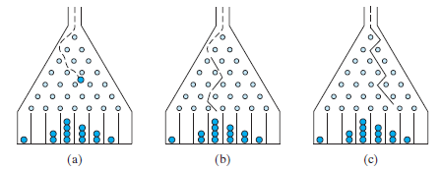
Anatomy of TF program
Defines the graph
Define all the variables placeholders tensors and operations only ones
Executes the graph
Executes the graph by feeding in data from outside (via placeholders) any number of times you want
It is like a Galton Board

Slide 17
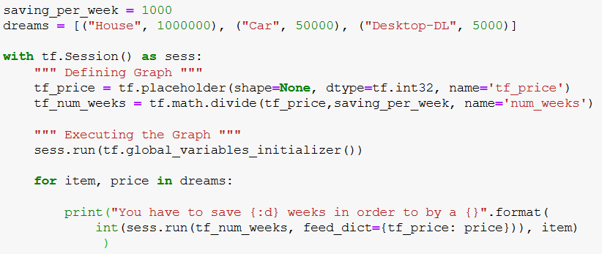
Correct way to implement a TF program

Slide 18
Context Management in TensorFlow: Variable Scoping
Protection against accidental variable creation

Slide 19
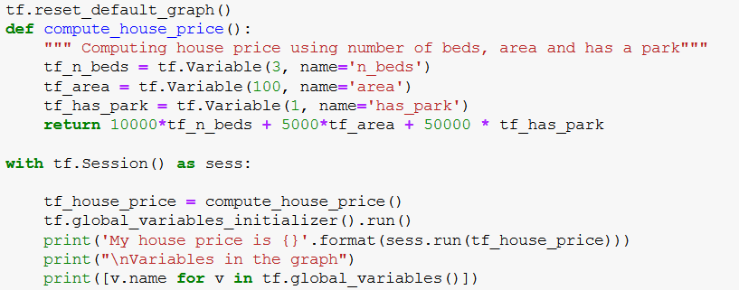

What can go wrong when not using variable scoping?

Slide 20
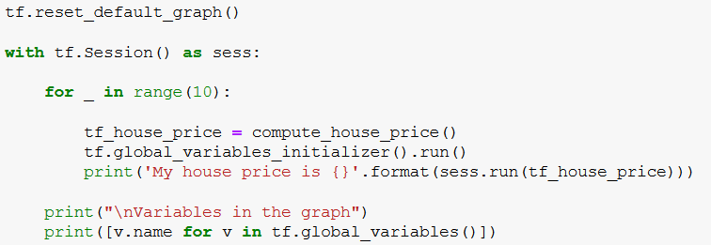
What can go wrong when not using variable scoping?
What else could have caused this issue?

Slide 21
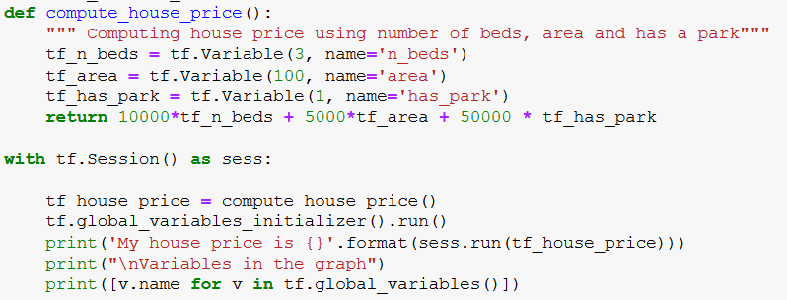
How to use variable scoping

Slide 22
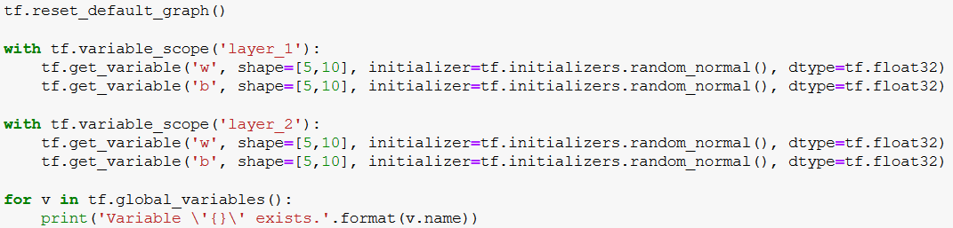

Variable Scoping for deep networks

Slide 23
What if you don’t create a session?
If you don’t create a session and execute your graph, this tensor will empty
This is like having the Galton board, but not the balls!

Slide 24


What wrong with graph-based execution?
It can get quite daunting for complex deep networks
Increases the lines of code required
Making dynamic changes to the graph
E.g. adding a new layer to the model dynamically
Define by run is a much more better approach
Define-by-Run Frameworks

Slide 25
Eager Execution
Executing TensorFlow code on-the-go

Slide 26
Eager Execution
What is eager execution?
Eager execution executes things on the definition
TensorFlow runs on a define-by-run basis
Beware!
It is not quite on par in terms of performance with PyTorch

Slide 27
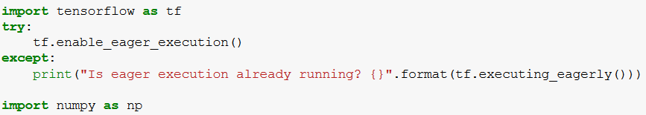
Eager execution

Slide 28
Exercise: Eager Execution
https://gist.github.com/thushv89/c8e912fd8e90bada801d85c8f8b97df4#file-ch1_exercises-py
Define two single-element TensorFlow variables tf_a and tf_b
Add the two variables together and print the result
Enable eager execution
Repeat the same process as above

Slide 29
Some best practices I’ve learnt
Use tf.reset_default_graph() at the beginning (when you need to clean up past variables)
When naming TensorFlow variables append “tf_” to the beginning
Then you can use normal name to define the value you get from sess.run
Always use get_variable() function to create variables
Always use variable scoping
A common mistake when defining TensorFlow graphs is accidental variable/op creation
Assert your variable/op count stays the same during execution

Slide 30
Takeaways
TensorFlow is much better for large tensor based operations
Compared to traditional libraries like Numpy
TensorFlow was designed with “define-then-run” approach
Define the computation graph using TF placeholders/variables/tensors/ops
Execute the graph by creating a session and executing those operations
Use scoping and get_variable() to avoid accidental variable creation
Eager execution is very helpful to debug programs

